Slide 1

Chapter 3
Boolean Algebra and Digital Logic

Slide 2
Chapter 3 Objectives
Understand the relationship between Boolean logic and digital computer circuits.
Learn how to design simple logic circuits.
Understand how digital circuits work together to form complex computer systems.

Slide 3
Introduction

Slide 4
3.1 Introduction
In the latter part of the nineteenth century, George Boole incensed philosophers and mathematicians alike when he suggested that logical thought could be represented through mathematical equations.
How dare anyone suggest that human thought could be encapsulated and manipulated like an algebraic formula?
Computers, as we know them today, are implementations of Boole’s Laws of Thought.
John Atanasoff and Claude Shannon were among the first to see this connection.

Slide 5
3.1 Introduction
In the middle of the twentieth century, computers were commonly known as “thinking machines” and “electronic brains.”
Many people were fearful of them.
Nowadays, we rarely ponder the relationship between electronic digital computers and human logic. Computers are accepted as part of our lives.
Many people, however, are still fearful of them.
In this chapter, you will learn the simplicity that constitutes the essence of the machine.

Slide 6
Boolean Algebra

Slide 7
3.2 Boolean Algebra
Boolean algebra is a mathematical system for the manipulation of variables that can have one of two values.
In formal logic, these values are “true” and “false.”
In digital systems, these values are “on” and “off,” 1 and 0, or “high” and “low.”
Boolean expressions are created by performing operations on Boolean variables.
Common Boolean operators include AND, OR, and NOT.

Slide 8
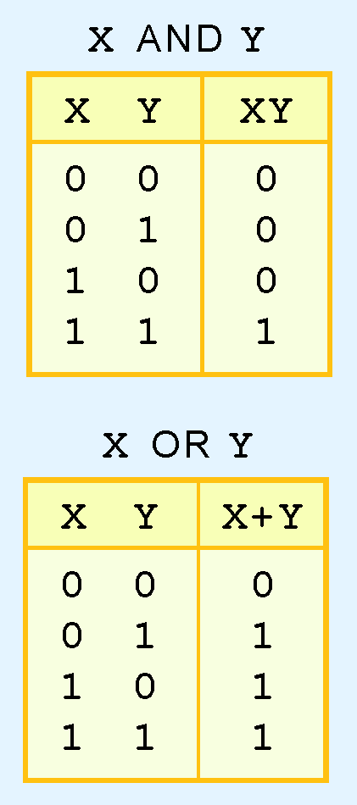
3.2 Boolean Algebra
A Boolean operator can be completely described using a truth table.
The truth table for the Boolean operators AND and OR are shown at the right.
The AND operator is also known as a Boolean product. The OR operator is the Boolean sum.

Slide 9
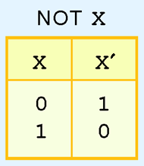
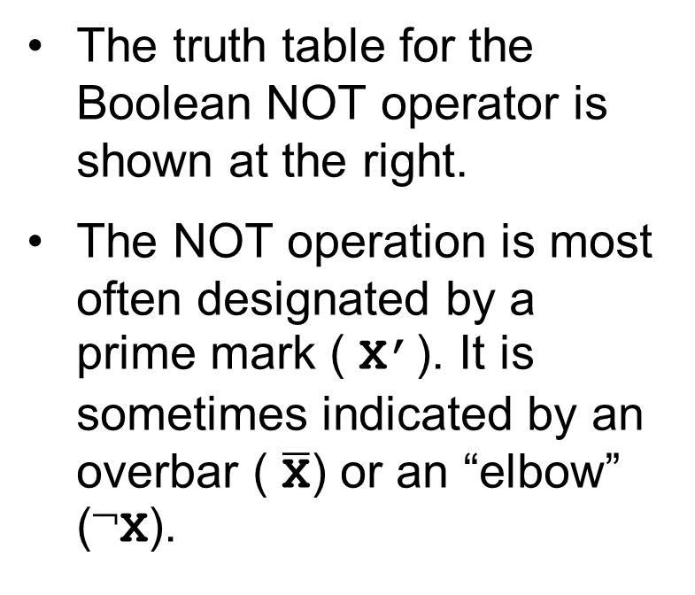
3.2 Boolean Algebra
The truth table for the Boolean NOT operator is shown at the right.
The NOT operation is most often designated by a prime mark ( X’). It is sometimes indicated by an overbar ( $\overline{\text{X}}$) or an “elbow” (¬X).

Slide 10
3.2 Boolean Algebra
A Boolean function has:
At least one Boolean variable,
At least one Boolean operator, and
At least one input from the set {0,1}.
It produces an output that is also a member of the set {0,1}.
Now you know why the binary numbering system is so handy in digital systems.

Slide 11
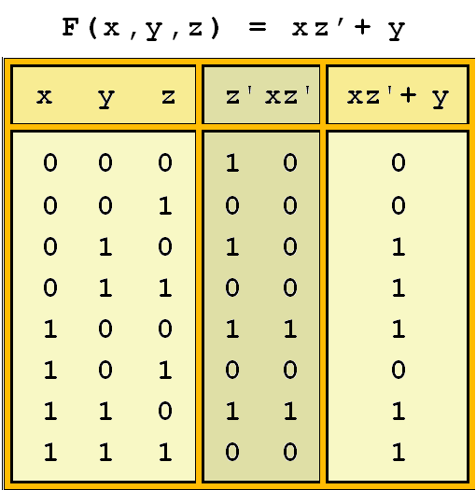

3.2 Boolean Algebra
The truth table for the Boolean function:
is shown at the right.
To make evaluation of the Boolean function easier, the truth table contains extra (shaded) columns to hold evaluations of subparts of the function.

Slide 12
3.2 Boolean Algebra
As with common arithmetic, Boolean operations have rules of precedence.
The NOT operator has highest priority, followed by AND and then OR.
This is how we chose the (shaded) function subparts in our table.

Slide 13
3.2 Boolean Algebra
Digital computers contain circuits that implement Boolean functions.
The simpler that we can make a Boolean function, the smaller the circuit that will result.
Simpler circuits are cheaper to build, consume less power, and run faster than complex circuits.
With this in mind, we always want to reduce our Boolean functions to their simplest form.
There are a number of Boolean identities that help us to do this.

Slide 14
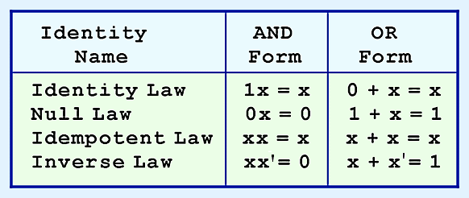
3.2 Boolean Algebra
Most Boolean identities have an AND (product) form as well as an OR (sum) form. We give our identities using both forms. Our first group is rather intuitive:

Slide 15
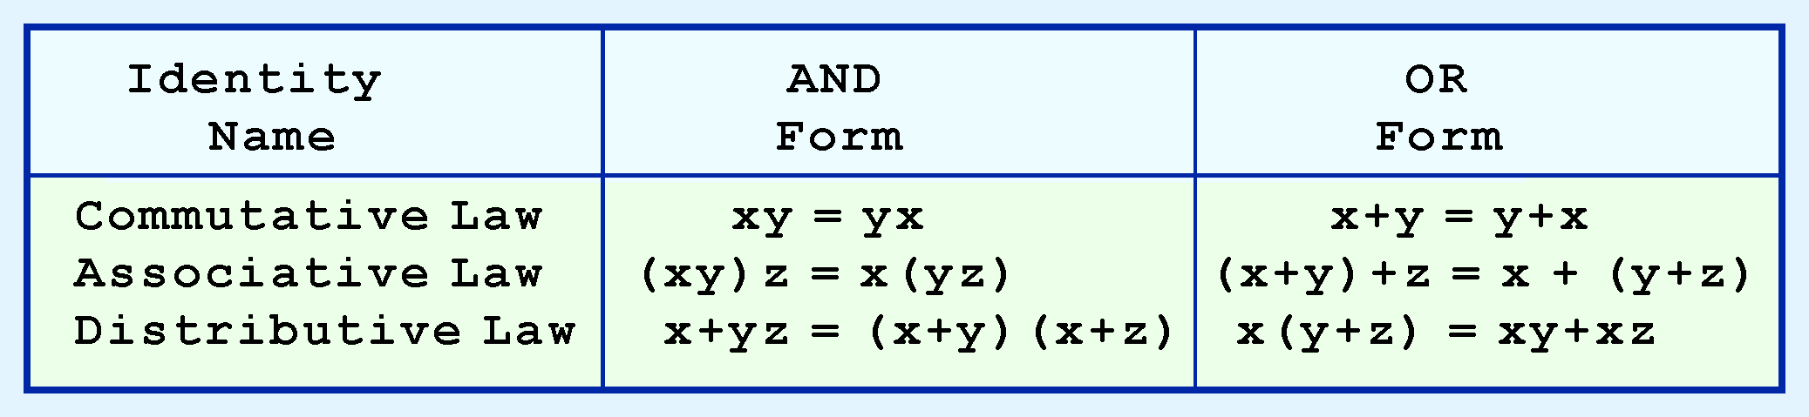
3.2 Boolean Algebra
Our second group of Boolean identities should be familiar to you from your study of algebra:

Slide 16
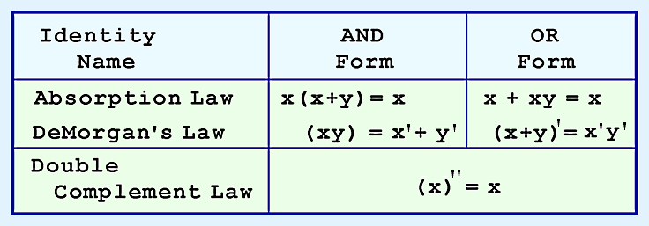
3.2 Boolean Algebra
Our last group of Boolean identities are perhaps the most useful.
If you have studied set theory or formal logic, these laws are also familiar to you.

Slide 17
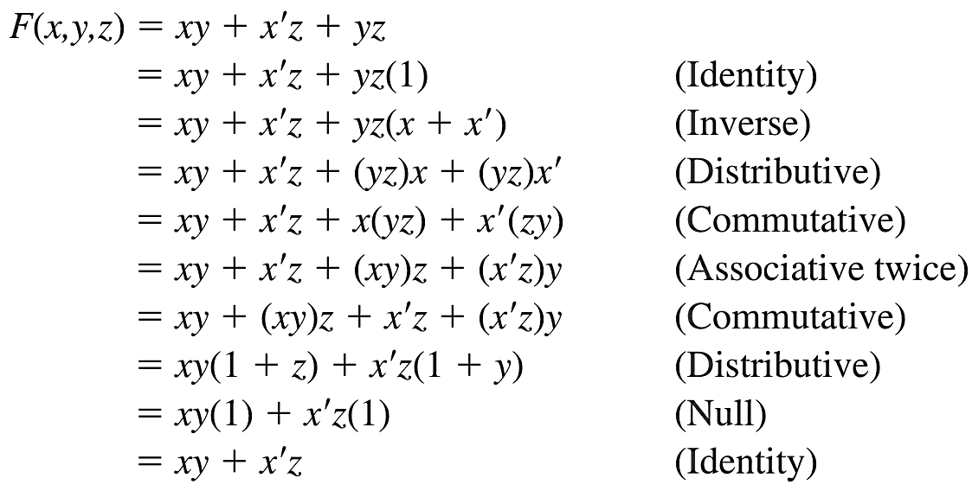
3.2 Boolean Algebra
We can use Boolean identities to simplify:
F(x,y,z) = xy + x′z + yz

Slide 18
3.2 Boolean Algebra
Sometimes it is more economical to build a circuit using the complement of a function (and complementing its result) than it is to implement the function directly.
DeMorgan’s law provides an easy way of finding the complement of a Boolean function.
Recall DeMorgan’s law states:
(xy)’ = x’+ y’ and (x + y)’= x’y’

Slide 19
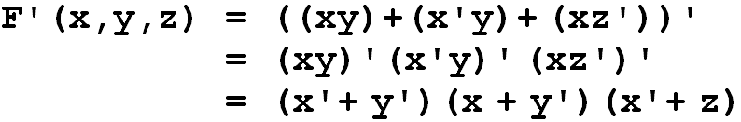
3.2 Boolean Algebra
DeMorgan’s law can be extended to any number of variables.
Replace each variable by its complement and change all ANDs to ORs and all ORs to ANDs.
Thus, we find the the complement of:
is:

Slide 20
3.2 Boolean Algebra
Through our exercises in simplifying Boolean expressions, we see that there are numerous ways of stating the same Boolean expression.
These “synonymous” forms are logically equivalent.
Logically equivalent expressions have identical truth tables.
In order to eliminate as much confusion as possible, designers express Boolean functions in standardized or canonical form.

Slide 21
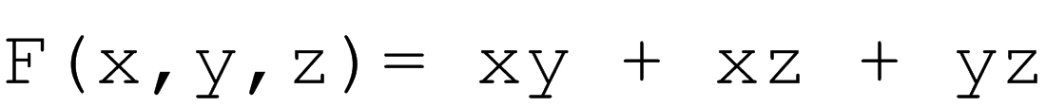
3.2 Boolean Algebra
There are two canonical forms for Boolean expressions: sum-of-products and product-of-sums.
Recall the Boolean product is the AND operation and the Boolean sum is the OR operation.
In the sum-of-products form, ANDed variables are ORed together.
For example:
In the product-of-sums form, ORed variables are ANDed together:
For example:

Slide 22
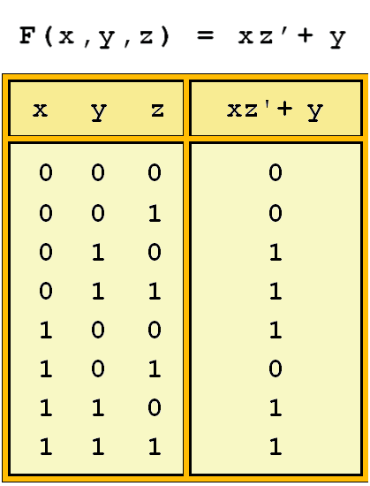
3.2 Boolean Algebra
It is easy to convert a function to sum-of-products form using its truth table.
We are interested in the values of the variables that make the function true (=1).
Using the truth table, we list the values of the variables that result in a true function value.
Each group of variables is then ORed together.

Slide 23
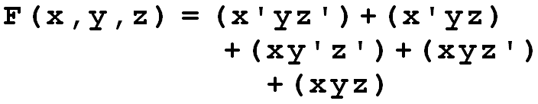
3.2 Boolean Algebra
The sum-of-products form for our function is:
We note that this function is not in simplest terms. Our aim is only to rewrite our function in canonical sum-of-products form.

Slide 24
Logic Gates

Slide 25
3.3 Logic Gates
We have looked at Boolean functions in abstract terms.
In this section, we see that Boolean functions are implemented in digital computer circuits called gates.
A gate is an electronic device that produces a result based on two or more input values.
In reality, gates consist of one to six transistors, but digital designers think of them as a single unit.
Integrated circuits contain collections of gates suited to a particular purpose.

Slide 26
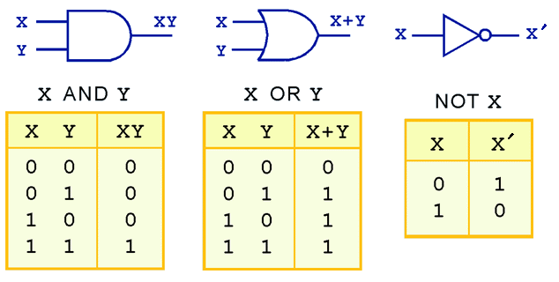
3.3 Logic Gates
The three simplest gates are the AND, OR, and NOT gates.
They correspond directly to their respective Boolean operations, as you can see by their truth tables.

Slide 27
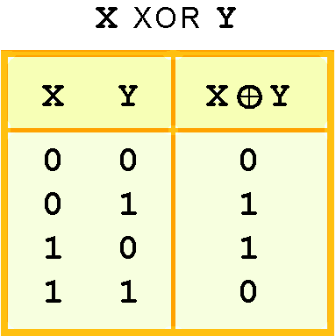
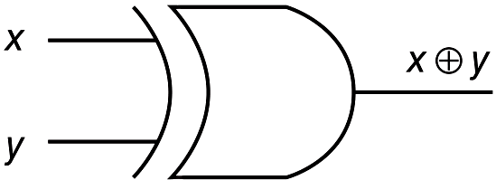
3.3 Logic Gates
Another very useful gate is the exclusive OR (XOR) gate.
The output of the XOR operation is true only when the values of the inputs differ.
Note the special symbol ⊕ for the XOR operation.

Slide 28
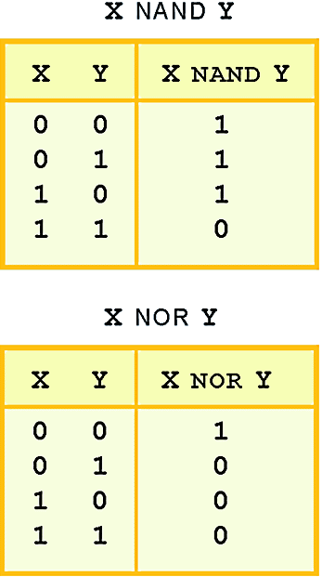
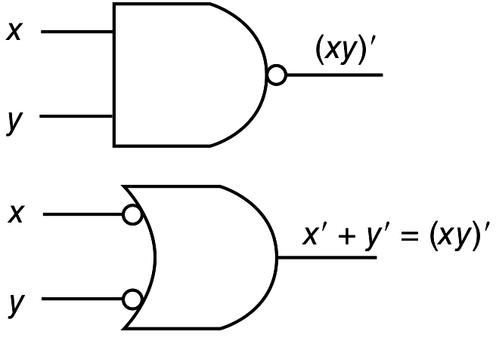
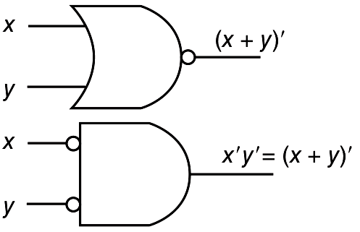
3.3 Logic Gates
NAND and NOR are two very important gates. Their symbols and truth tables are shown at the right.

Slide 29
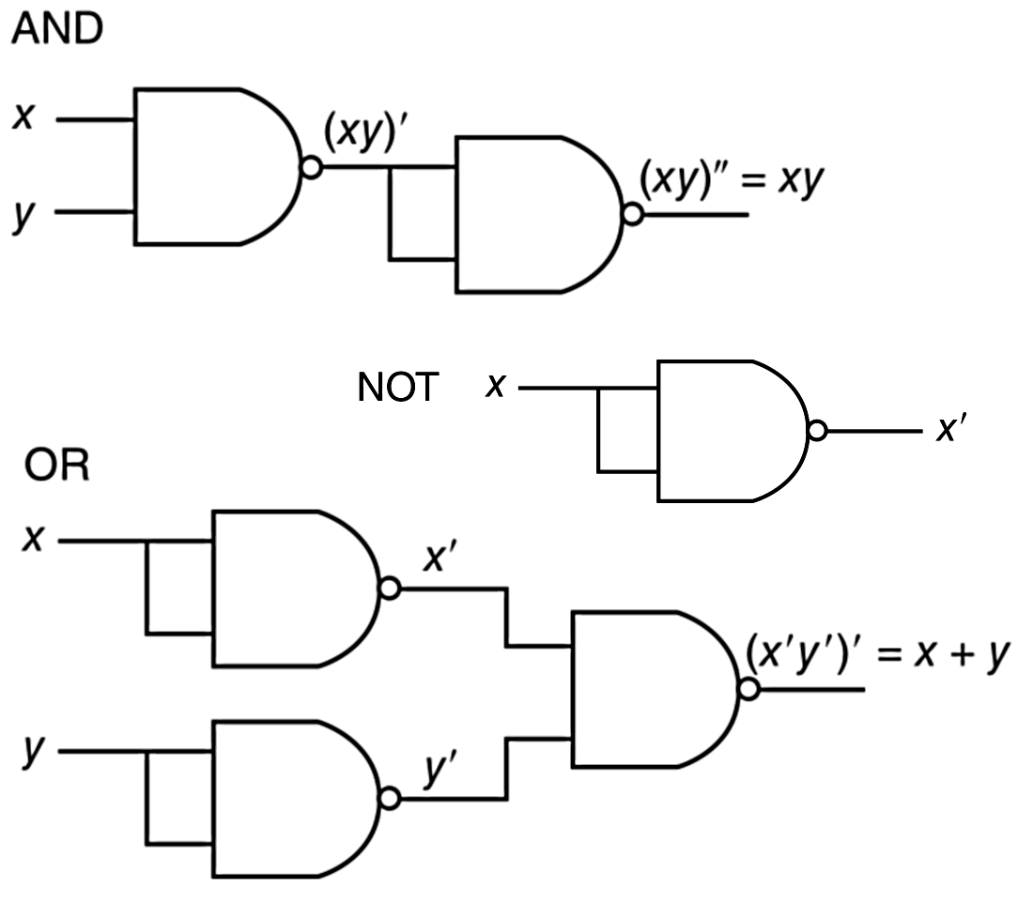
3.3 Logic Gates
NAND and NOR are known as universal gates because they are inexpensive to manufacture and any Boolean function can be constructed using only NAND or only NOR gates.

Slide 30
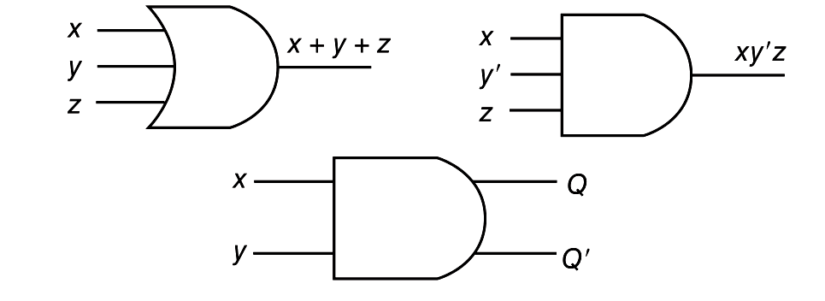
3.3 Logic Gates
Gates can have multiple inputs and more than one output.
A second output can be provided for the complement of the operation.
We’ll see more of this later.

Slide 31
Digital Components

Slide 32
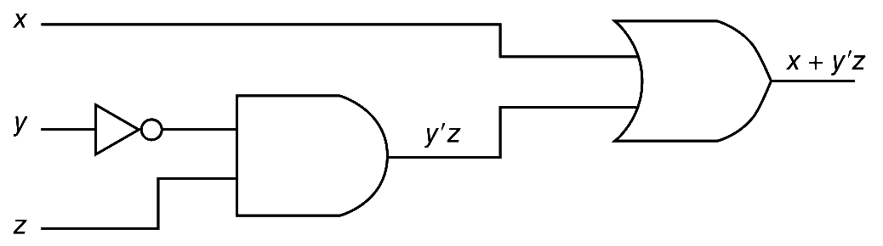
3.4 Digital Components
The main thing to remember is that combinations of gates implement Boolean functions.
The circuit below implements the Boolean function F(x,y,z) = x + y’z:
We simplify our Boolean expressions so that we can create simpler circuits.

Slide 33
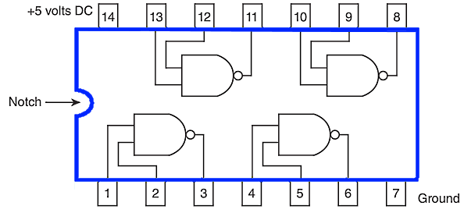
3.4 Digital Components
Standard digital components are combined into single integrated circuit packages.
Boolean logic can be used to implement the desired functions.

Slide 34
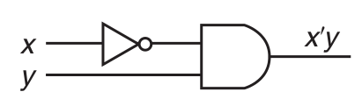
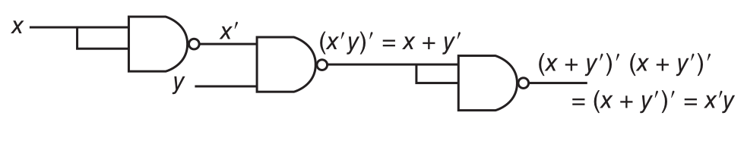
3.4 Digital Components
The Boolean circuit:
Can be rendered using only NAND gates as:

Slide 35
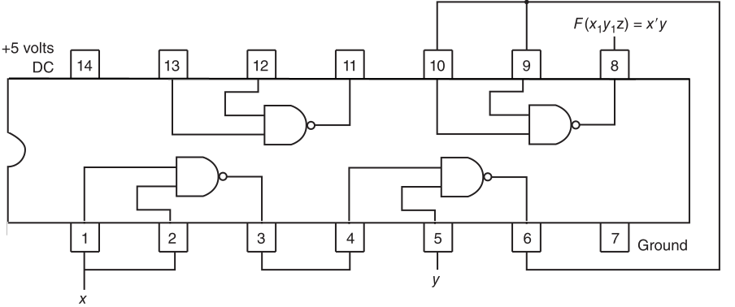
3.4 Digital Components
So we can wire the pre-packaged circuit to implement our function:

Slide 36
3.4 Digital Components
Boolean logic is used to solve practical problems.
Expressed in terms of Boolean logic practical problems can be expressed by truth tables.
Truth tables can be readily rendered into Boolean logic circuits.

Slide 37
3.4 Digital Components
Suppose we are to design a logic circuit to determine the best time to plant a garden.
We consider three factors (inputs):
(1) time, where 0 represents day and 1 represents evening;
(2) moon phase, where 0 represents not full and 1 represents full; and
(3) temperature, where 0 represents 45°F and below, and 1 represents over 45°F.
We determine that the best time to plant a garden is during the evening with a full moon.

Slide 38
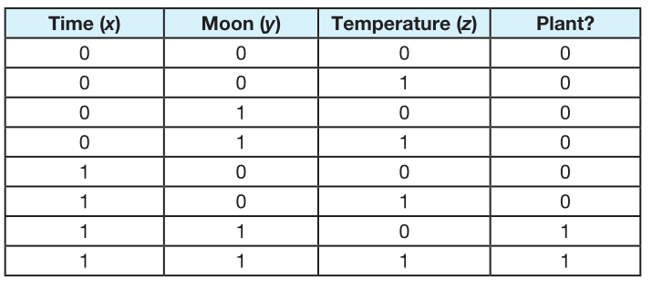
3.4 Digital Components
This results in the following truth table:

Slide 39
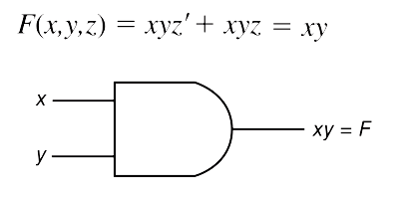
3.4 Digital Components
From the truth table, we derive the circuit:

Slide 40
Combinational Circuits

Slide 41

3.5 Combinational Circuits
We have designed a circuit that implements the Boolean function:
This circuit is an example of a combinational logic circuit.
Combinational logic circuits produce a specified output (almost) at the instant when input values are applied.
In a later section, we will explore circuits where this is not the case.

Slide 42
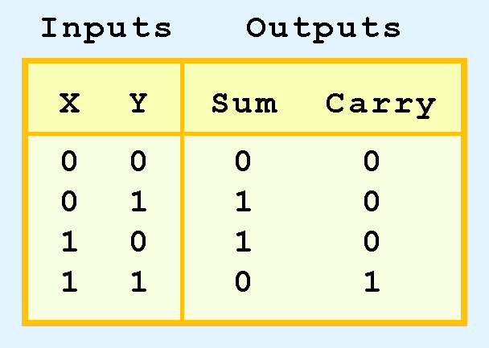
3.5 Combinational Circuits
Combinational logic circuits give us many useful devices.
One of the simplest is the half adder, which finds the sum of two bits.
We can gain some insight as to the construction of a half adder by looking at its truth table, shown at the right.

Slide 43
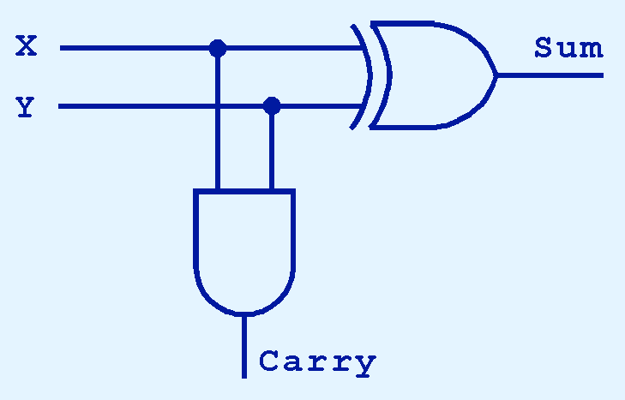
3.5 Combinational Circuits
As we see, the sum can be found using the XOR operation and the carry using the AND operation.

Slide 44
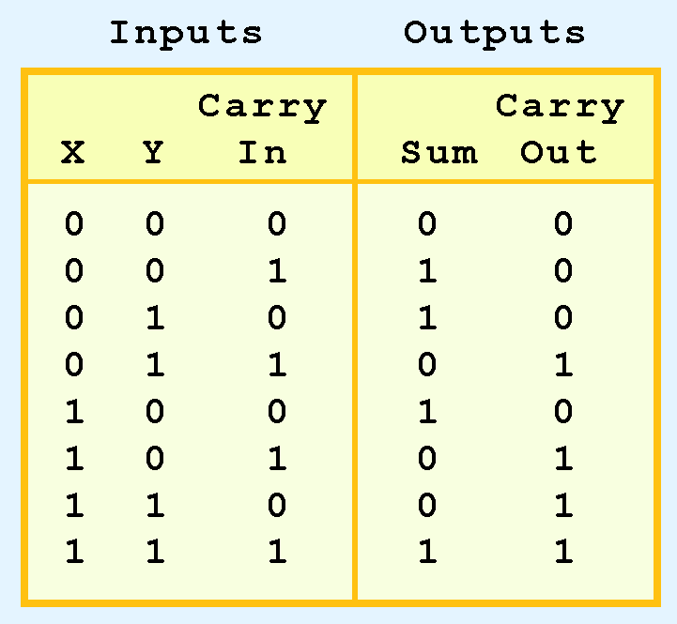
3.5 Combinational Circuits
We can change our half adder into to a full adder by including gates for processing the carry bit.
The truth table for a full adder is shown at the right.

Slide 45
3.5 Combinational Circuits
How can we change the half adder shown below to make it a full adder?

Slide 46
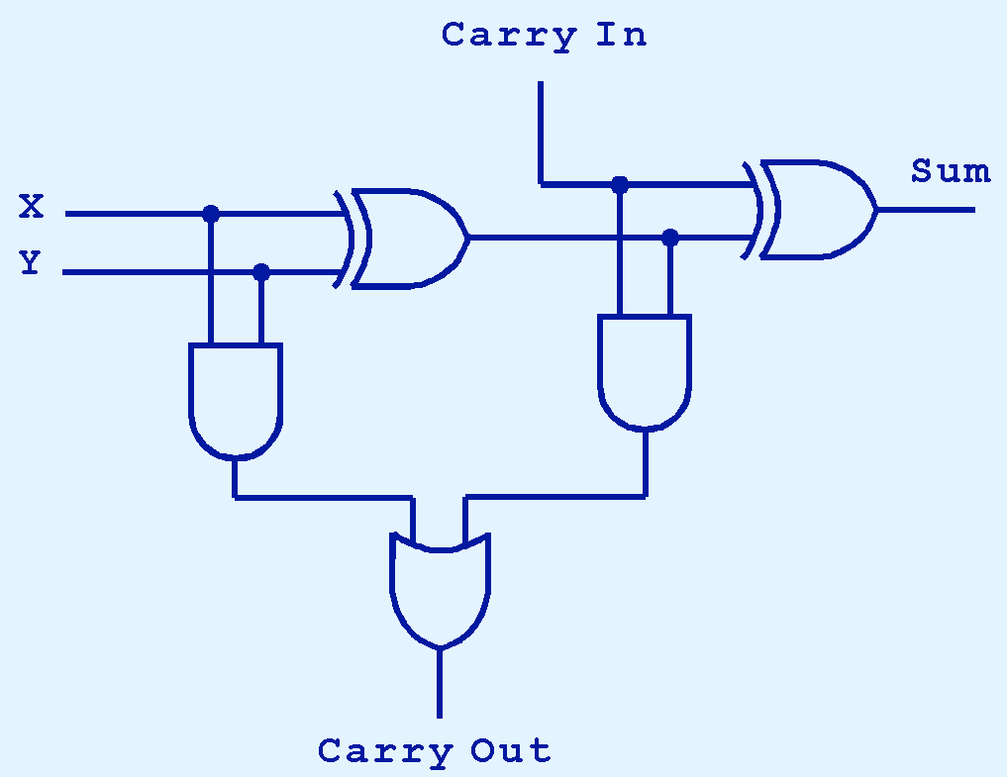
3.5 Combinational Circuits
Here’s our completed full adder.

Slide 47

3.5 Combinational Circuits
Just as we combined half adders to make a full adder, full adders can connected in series.
The carry bit “ripples” from one adder to the next; hence, this configuration is called a ripple-carry adder.
Today’s systems employ more efficient adders.

Slide 48
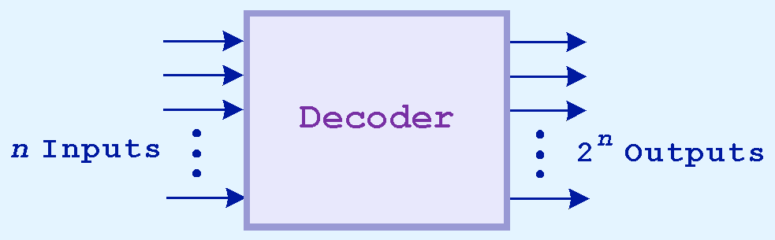
3.5 Combinational Circuits
Decoders are another important type of combinational circuit.
Among other things, they are useful in selecting a memory location according a binary value placed on the address lines of a memory bus.
Address decoders with n inputs can select any of 2^{n} locations.
This is a block diagram for a decoder.

Slide 49
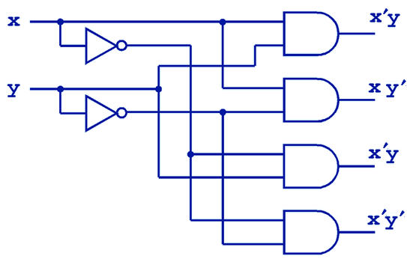
3.5 Combinational Circuits
This is what a 2-to-4 decoder looks like on the inside.
If x = 0 and y = 1, which output line is enabled?

Slide 50
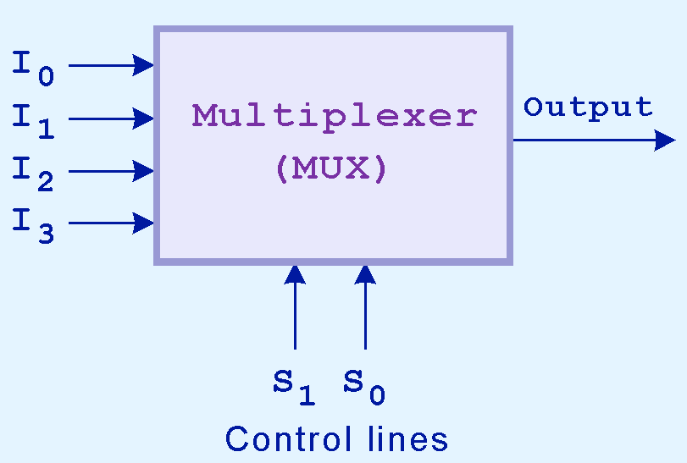
3.5 Combinational Circuits
A multiplexer does just the opposite of a decoder.
It selects a single output from several inputs.
The particular input chosen for output is determined by the value of the multiplexer’s control lines.
To be able to select among n inputs, log₂n control lines are needed.
This is a block diagram for a multiplexer.

Slide 51
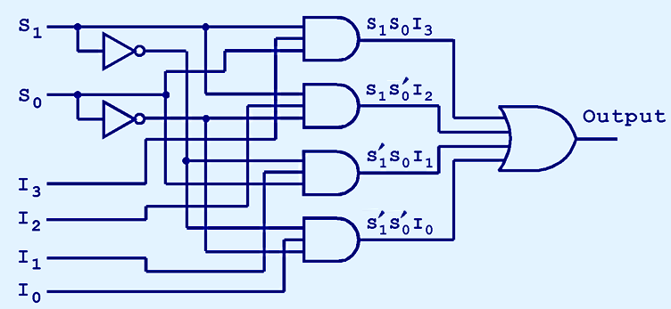
3.5 Combinational Circuits
This is what a 4-to-1 multiplexer looks like on the inside.
If S₀ = 1 and S₁ = 0, which input is transferred to the output?

Slide 52
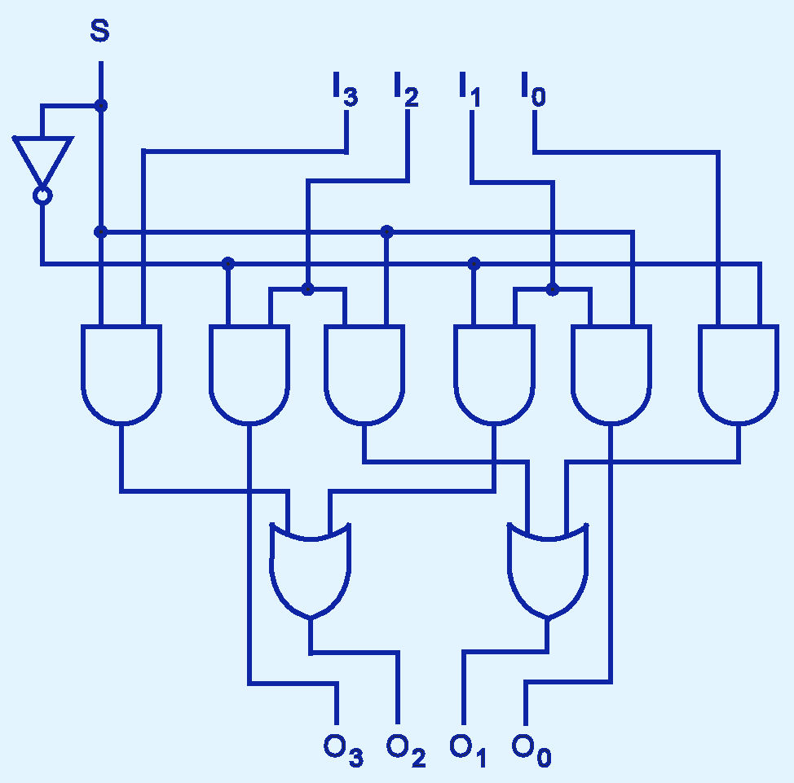
3.5 Combinational Circuits
This shifter moves the bits of a nibble one position to the left or right.
If S = 0, in which direction do the input bits shift?

Slide 53
Sequential Circuits

Slide 54
3.6 Sequential Circuits
Combinational logic circuits are perfect for situations when we require the immediate application of a Boolean function to a set of inputs.
There are other times, however, when we need a circuit to change its value with consideration to its current state as well as its inputs.
These circuits have to “remember” their current state.
Sequential logic circuits provide this functionality for us.

Slide 55

3.6 Sequential Circuits
As the name implies, sequential logic circuits require a means by which events can be sequenced.
State changes are controlled by clocks.
A “clock” is a special circuit that sends electrical pulses through a circuit.
Clocks produce electrical waveforms such as the one shown below.

Slide 56
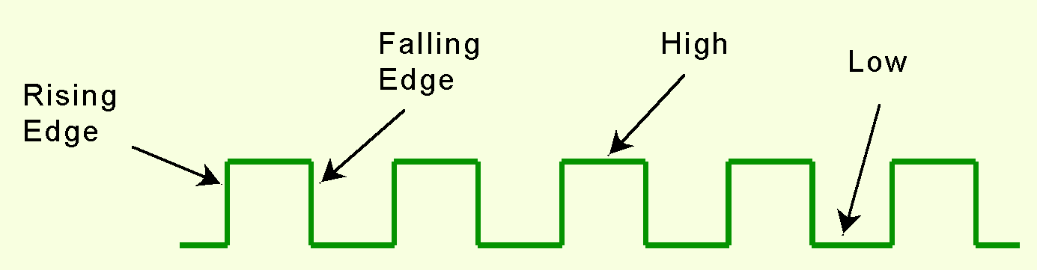
3.6 Sequential Circuits
State changes occur in sequential circuits only when the clock ticks.
Circuits can change state on the rising edge, falling edge, or when the clock pulse reaches its highest voltage.

Slide 57
3.6 Sequential Circuits
Circuits that change state on the rising edge, or falling edge of the clock pulse are called edge-triggered.
Level-triggered circuits change state when the clock voltage reaches its highest or lowest level.

Slide 58
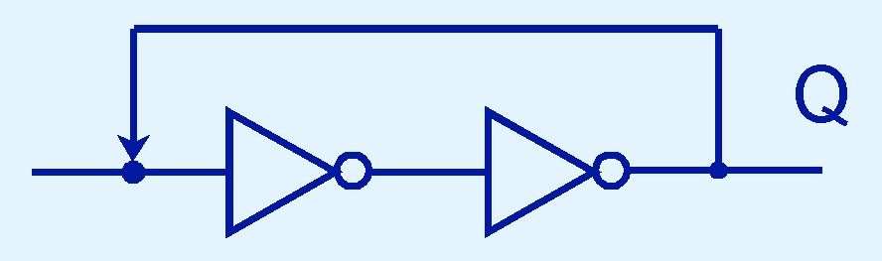
3.6 Sequential Circuits
To retain their state values, sequential circuits rely on feedback.
Feedback in digital circuits occurs when an output is looped back to the input.
A simple example of this concept is shown below.
If Q is 0 it will always be 0, if it is 1, it will always be 1. Why?

Slide 59
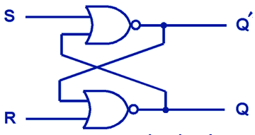
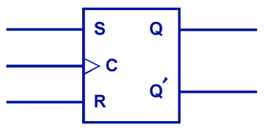
3.6 Sequential Circuits
You can see how feedback works by examining the most basic sequential logic components, the SR flip-flop.
The “SR” stands for set/reset.
The internals of an SR flip-flop are shown below, along with its block diagram.

Slide 60
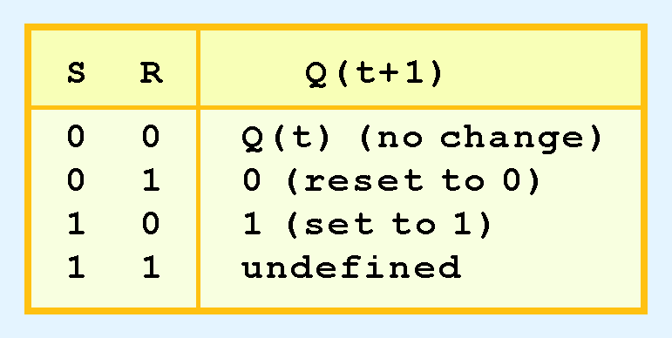
3.6 Sequential Circuits
The behavior of an SR flip-flop is described by a characteristic table.
Q(t) means the value of the output at time t. Q(t+1) is the value of Q after the next clock pulse.

Slide 61
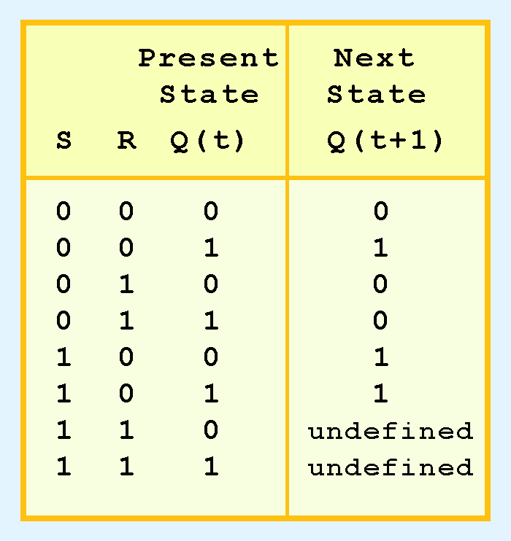
3.6 Sequential Circuits
The SR flip-flop actually has three inputs: S, R, and its current output, Q.
Thus, we can construct a truth table for this circuit, as shown at the right.
Notice the two undefined values. When both S and R are 1, the SR flip-flop is unstable.

Slide 62
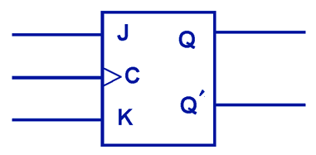
3.6 Sequential Circuits
If we can be sure that the inputs to an SR flip-flop will never both be 1, we will never have an unstable circuit. This may not always be the case.
The SR flip-flop can be modified to provide a stable state when both inputs are 1.
• This modified flip-flop is called a JK flip-flop, shown at the right.

Slide 63
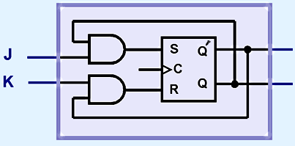
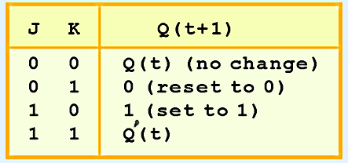
3.6 Sequential Circuits
At the right, we see how an SR flip-flop can be modified to create a JK flip-flop.
The characteristic table indicates that the flip-flop is stable for all inputs.

Slide 64
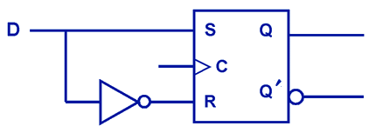
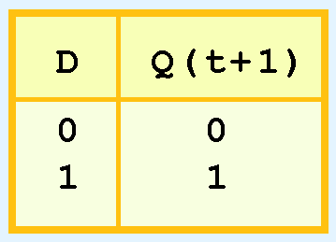
3.6 Sequential Circuits
Another modification of the SR flip-flop is the D flip-flop, shown below with its characteristic table.
You will notice that the output of the flip-flop remains the same during subsequent clock pulses. The output changes only when the value of D changes.

Slide 65
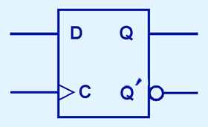
3.6 Sequential Circuits
The D flip-flop is the fundamental circuit of computer memory.
D flip-flops are usually illustrated using the block diagram shown below.
The characteristic table for the D flip-flop is shown at the right.

Slide 66
3.6 Sequential Circuits
The behavior of sequential circuits can be expressed using characteristic tables or finite state machines (FSMs).
FSMs consist of a set of nodes that hold the states of the machine and a set of arcs that connect the states.
Moore and Mealy machines are two types of FSMs that are equivalent.
They differ only in how they express the outputs of the machine.
Moore machines place outputs on each node, while Mealy machines present their outputs on the transitions.

Slide 67
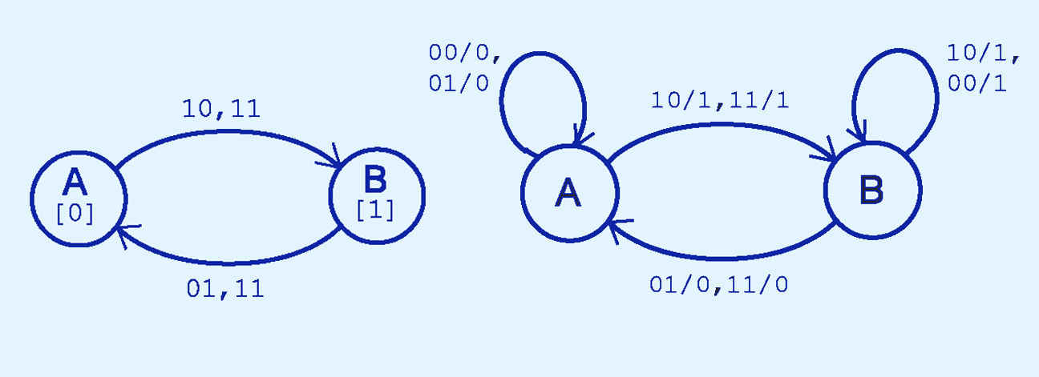
3.6 Sequential Circuits
The behavior of a JK flop-flop is depicted below by a Moore machine (left) and a Mealy machine (right).

Slide 68
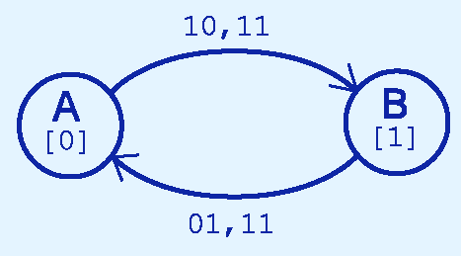

3.6 Sequential Circuits
Although the behavior of Moore and Mealy machines is identical, their implementations differ.
This is our Moore machine.

Slide 69

3.6 Sequential Circuits
Although the behavior of Moore and Mealy machines is identical, their implementations differ.
This is our Mealy machine.

Slide 70
3.6 Sequential Circuits
It is difficult to express the complexities of actual implementations using only Moore and Mealy machines.
For one thing, they do not address the intricacies of timing very well.
Secondly, it is often the case that an interaction of numerous signals is required to advance a machine from one state to the next.
For these reasons, Christopher Clare invented the algorithmic state machine (ASM).
The next slide illustrates the components of an ASM.

Slide 71

3.6 Sequential Circuits

Slide 72

3.6 Sequential Circuits
This is an ASM for a microwave oven.

Slide 73
3.6 Sequential Circuits
Sequential circuits are used anytime that we have a “stateful” application.
A stateful application is one where the next state of the machine depends on the current state of the machine and the input.
A stateful application requires both combinational and sequential logic.
The following slides provide several examples of circuits that fall into this category.
Can you think of others?

Slide 74


3.6 Sequential Circuits
This illustration shows a 4-bit register consisting of D flip-flops. You will usually see its block diagram (below) instead.
A larger memory configuration is shown on the next slide.

Slide 75

3.6 Sequential Circuits

Slide 76

3.6 Sequential Circuits
A binary counter is another example of a sequential circuit.
The low-order bit is complemented at each clock pulse.
Whenever it changes from 0 to 1, the next bit is complemented, and so on through the other flip-flops.

Slide 77
3.6 Sequential Circuits
Convolutional coding and decoding requires sequential circuits.
One important convolutional code is the (2,1) convolutional code that underlies the PRML code that is briefly described at the end of Chapter 2.
A (2, 1) convolutional code is so named because two symbols are output for every one symbol input.
A convolutional encoder for PRML with its characteristic table is shown on the next slide.

Slide 78


3.6 Sequential Circuits

Slide 79


3.6 Sequential Circuits
This is the Mealy machine for our encoder.

Slide 80
3.6 Sequential Circuits
The fact that there is a limited set of possible state transitions in the encoding process is crucial to the error correcting capabilities of PRML.
You can see by our Mealy machine for encoding that:
F(1101 0010) = 11 01 01 00 10 11 11 10.

Slide 81

3.6 Sequential Circuits
The decoding of our code is provided by inverting the inputs and outputs of the Mealy machine for the encoding process.
You can see by our Mealy machine for decoding that:
F(11 01 01 00 10 11 11 10) = 1101 0010

Slide 82

3.6 Sequential Circuits
Yet another way of looking at the decoding process is through a lattice diagram.
Here we have plotted the state transitions based on the input (top) and showing the output at the bottom for the string 00 10 11 11.
F(00 10 11 11) = 1001

Slide 83

3.6 Sequential Circuits
Suppose we receive the erroneous string: 10 10 11 11.
Here we have plotted the accumulated errors based on the allowable transitions.
The path of least error outputs 1001, thus 1001 is the string of maximum likelihood.
F(00 10 11 11) = 1001

Slide 84
Designing Circuits

Slide 85
3.7 Designing Circuits
We have seen digital circuits from two points of view: digital analysis and digital synthesis.
Digital analysis explores the relationship between a circuits inputs and its outputs.
Digital synthesis creates logic diagrams using the values specified in a truth table.
Digital systems designers must also be mindful of the physical behaviors of circuits to include minute propagation delays that occur between the time when a circuit’s inputs are energized and when the output is accurate and stable.

Slide 86
3.7 Designing Circuits
Digital designers rely on specialized software to create efficient circuits.
Thus, software is an enabler for the construction of better hardware.
Of course, software is in reality a collection of algorithms that could just as well be implemented in hardware.
Recall the Principle of Equivalence of Hardware and Software.

Slide 87
3.7 Designing Circuits
When we need to implement a simple, specialized algorithm and its execution speed must be as fast as possible, a hardware solution is often preferred.
This is the idea behind embedded systems, which are small special-purpose computers that we find in many everyday things.
Embedded systems require special programming that demands an understanding of the operation of digital circuits, the basics of which you have learned in this chapter.

Slide 88
Chapter 3 Conclusion
Computers are implementations of Boolean logic.
Boolean functions are completely described by truth tables.
Logic gates are small circuits that implement Boolean operators.
The basic gates are AND, OR, and NOT.
The XOR gate is very useful in parity checkers and adders.
The “universal gates” are NOR, and NAND.

Slide 89
Chapter 3 Conclusion
Computer circuits consist of combinational logic circuits and sequential logic circuits.
Combinational circuits produce outputs (almost) immediately when their inputs change.
Sequential circuits require clocks to control their changes of state.
The basic sequential circuit unit is the flip-flop: The behaviors of the SR, JK, and D flip-flops are the most important to know.

Slide 90
Chapter 3 Conclusion
The behavior of sequential circuits can be expressed using characteristic tables or through various finite state machines.
Moore and Mealy machines are two finite state machines that model high-level circuit behavior.
Algorithmic state machines are better than Moore and Mealy machines at expressing timing and complex signal interactions.
Examples of sequential circuits include memory, counters, and Viterbi encoders and decoders.

Slide 91
End of Chapter 3

