Slide 1
Economics 2301
Lecture 25
Risk Aversion

Slide 2
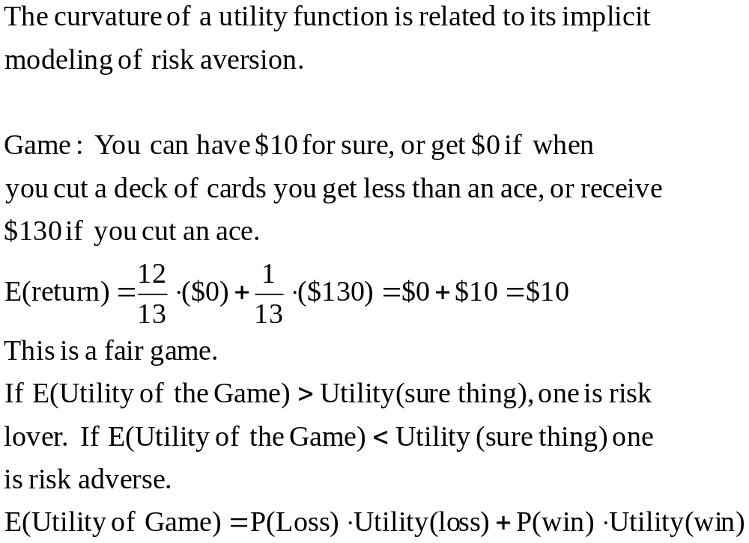
Risk Aversion

Slide 3
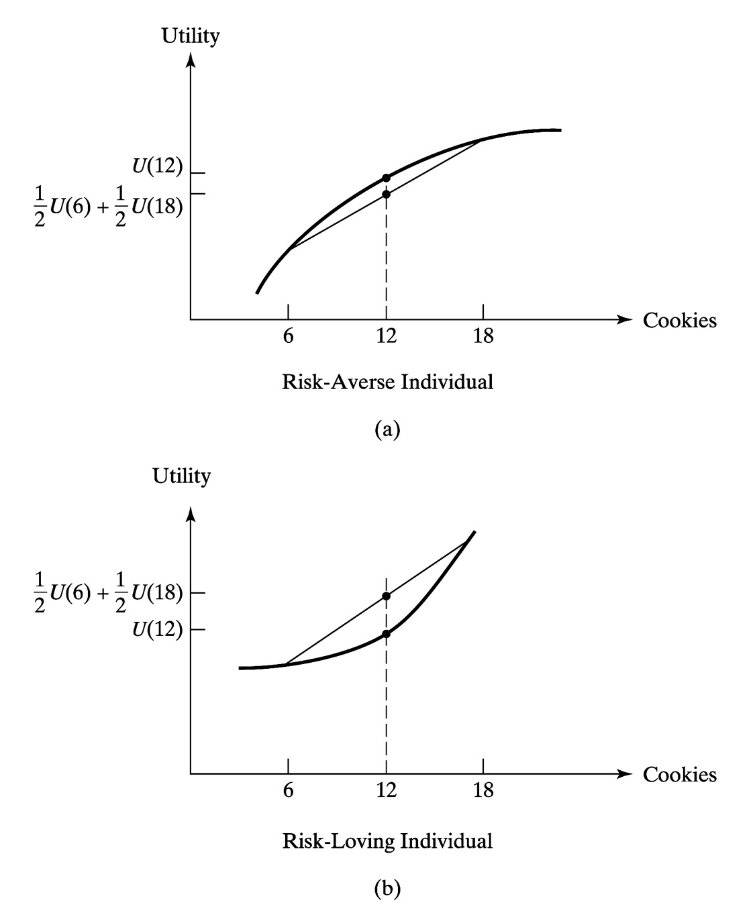
Figure 7.7 Utility Functions for Risk-Averse and Risk-Loving Individuals

Slide 4
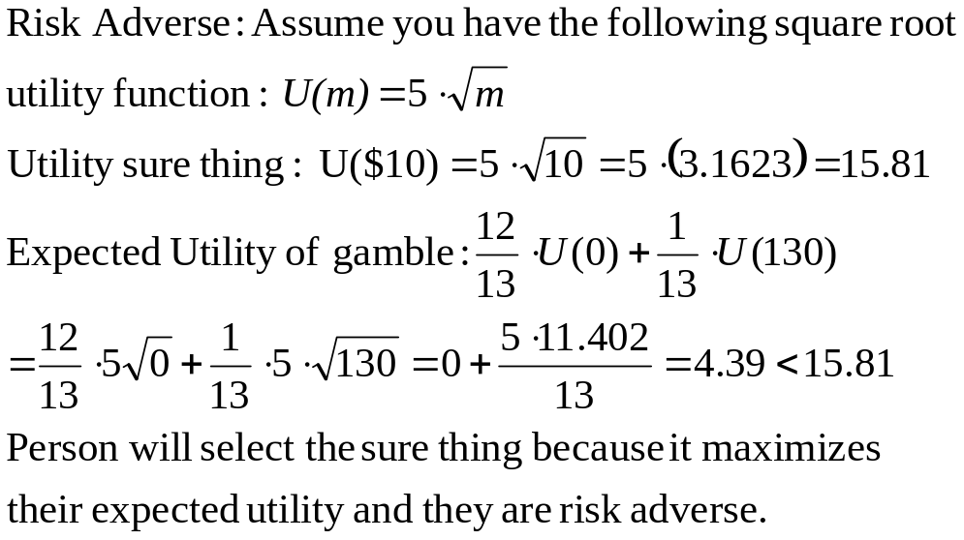
Example-Risk Adverse

Slide 5
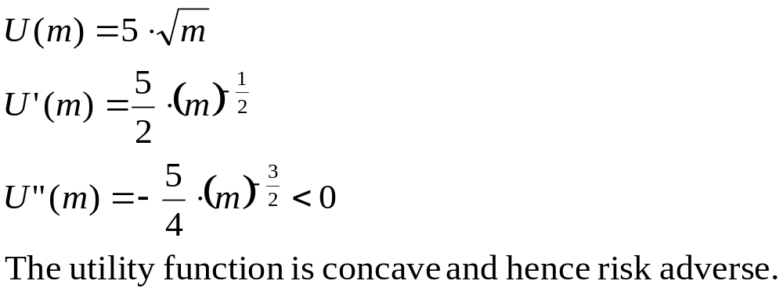
Proof of Risk Adverse

Slide 6
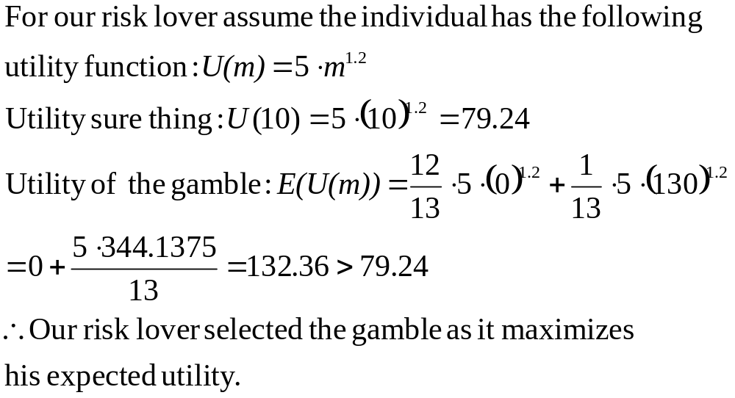
Example-Risk Lover

Slide 7
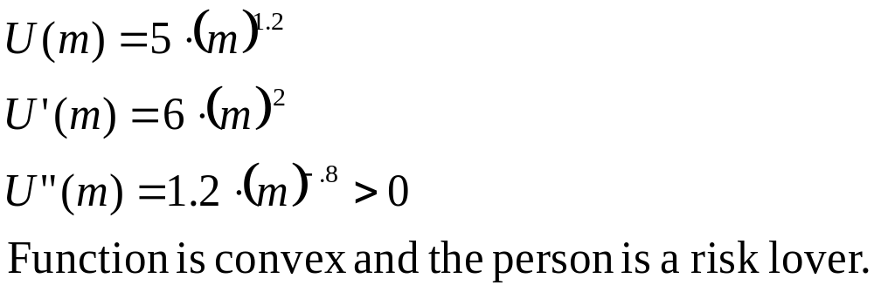
Proof Risk Lover

Slide 8
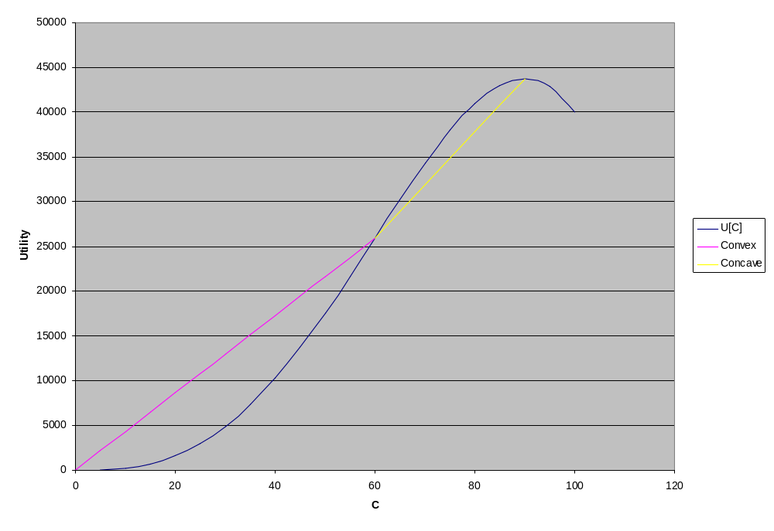
Person who is both risk-lover and risk-adverse

Slide 9
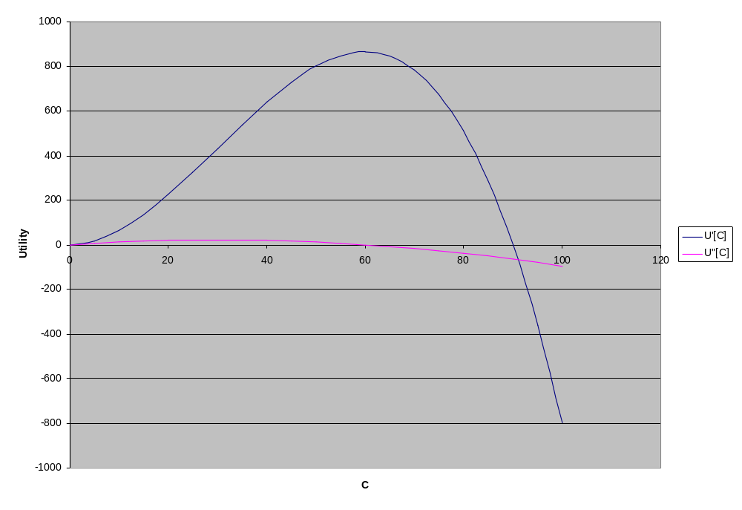
Plot of Marginal Utility and Second Derivative

Slide 10
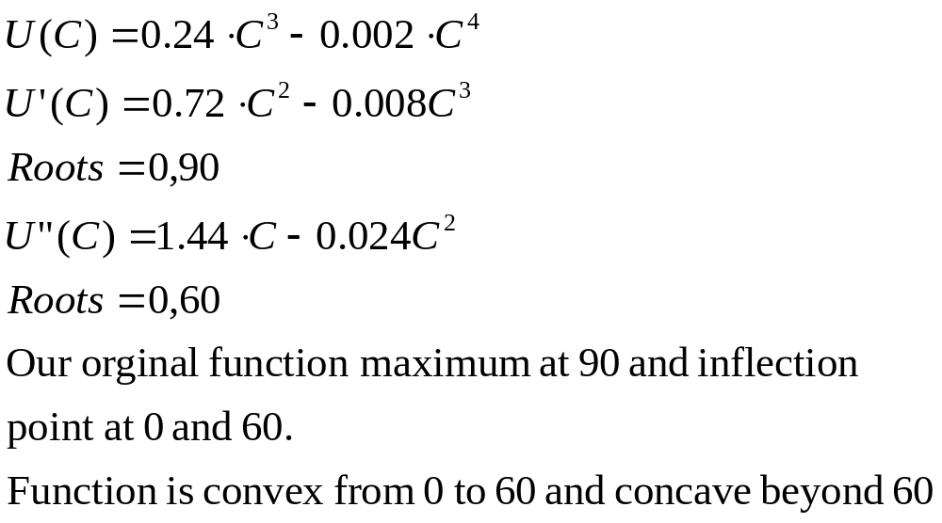
Proof of Properties of both risk-lover and risk-adverse

Slide 11
Linearization of Functions and Taylor Series
It is often useful to be able to express a function in linear form.
Helpful if we want to use matrix algebra or simple econometrics.
Calculus can give us a linear approximation to a function.

Slide 12
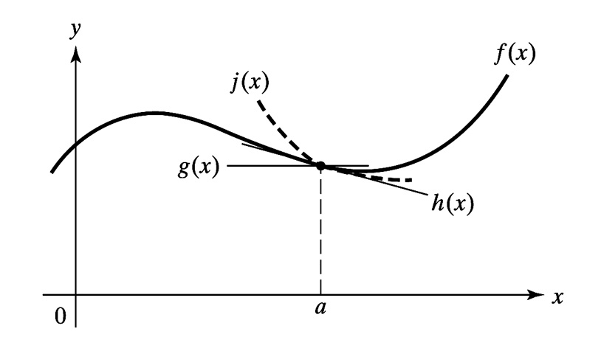
Figure 7.8 Taylor Series Approximations

Slide 13
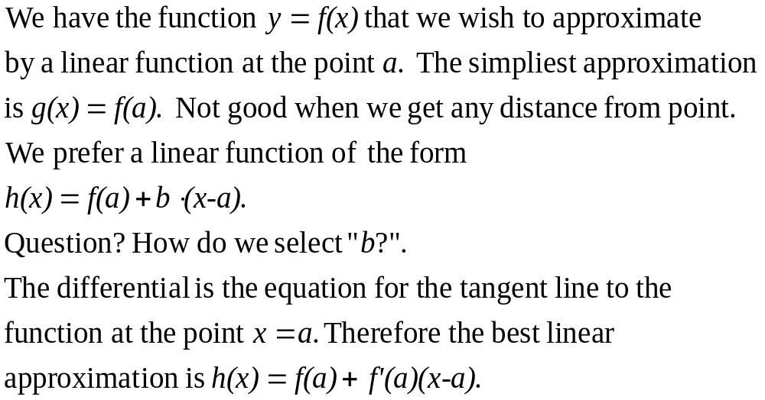
Linearization

Slide 14
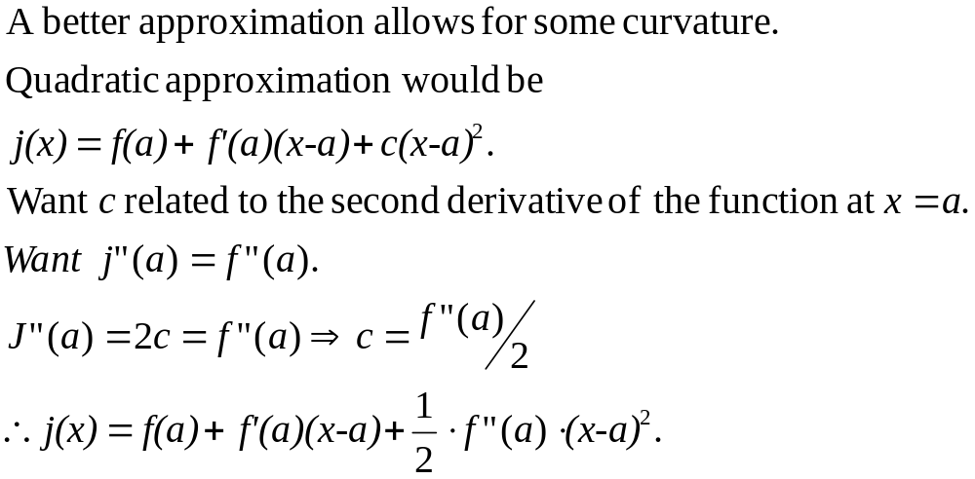
Quadratic Approximation

Slide 15
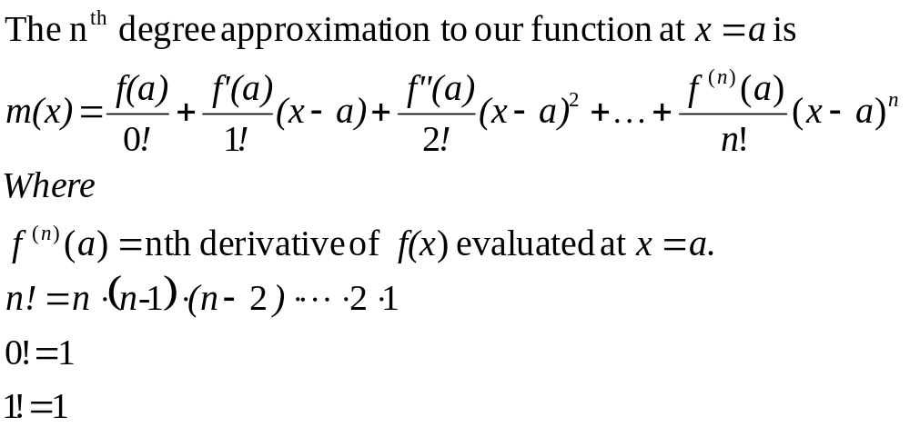
Nth Degree Taylor Expansion

Slide 16
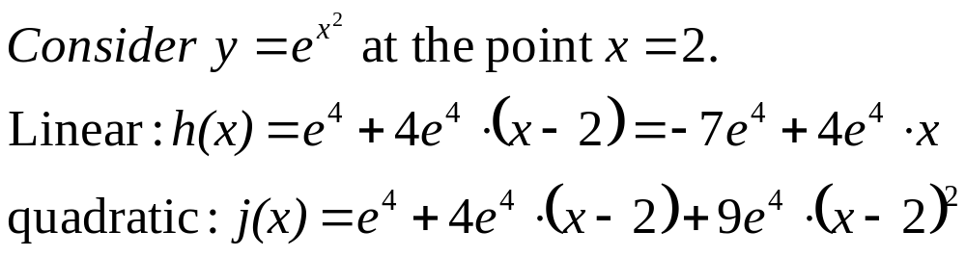
Example

Slide 17
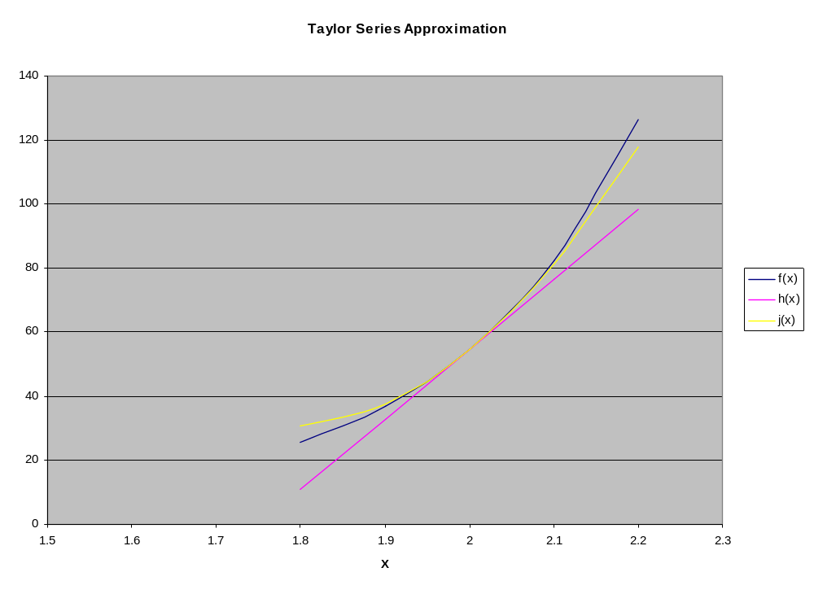
Graph of our approximations

Slide 18
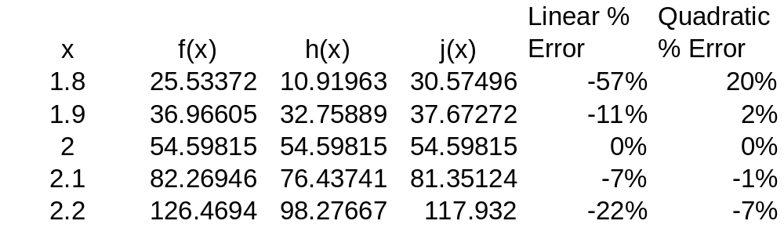
Accuracy of our approximation

