Slide 1
NaCl Potential and the Madelung Constant
Joe Pigott

Slide 2
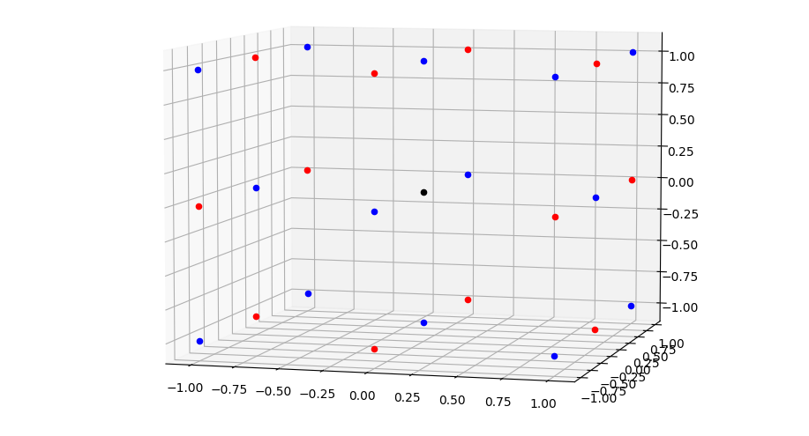
Each ion in NaCl ‘exerts’ some potential on the origin Na ion.

Slide 3




Slide 4
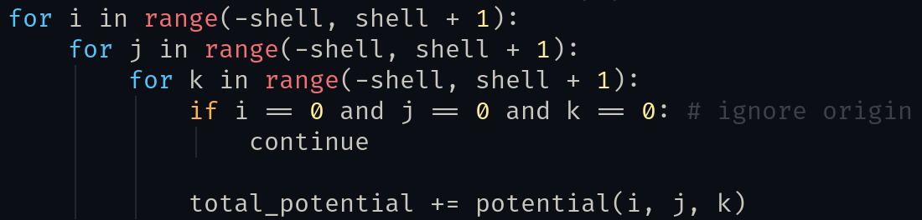
Solution: loops
Loop over the volume and add up each potential.

Slide 5
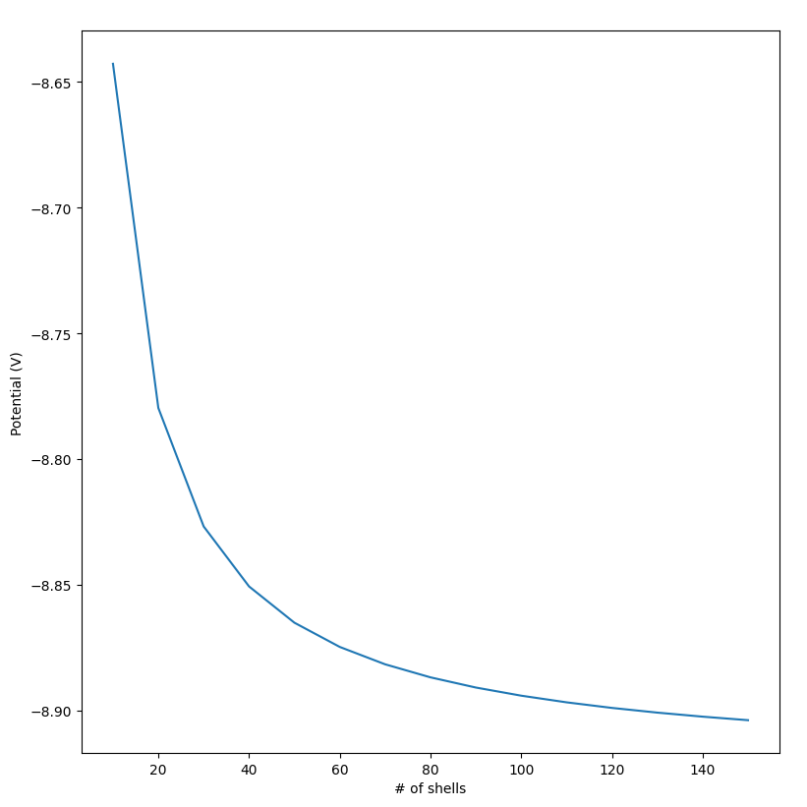
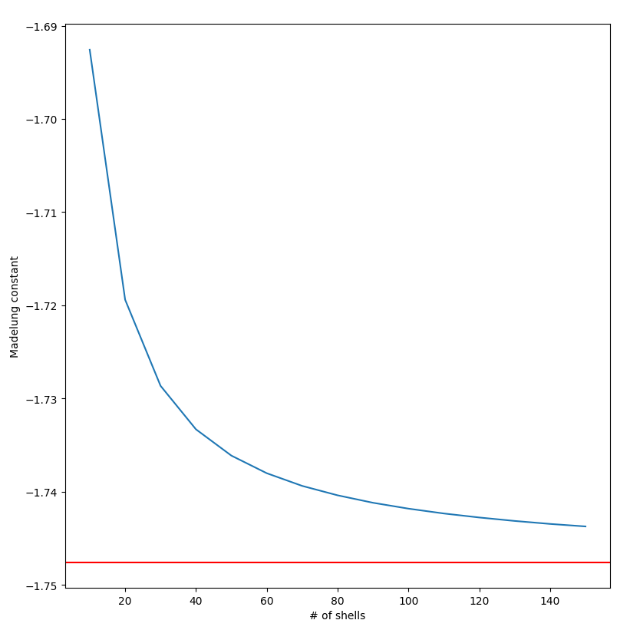
Results

