Slide 1
Seattle Traffic Incident Data Set
Unordered list of traffic incidents
List includes date/time, weather conditions, location (long./lat.), severity of incident, etc.
Objective: use this data set to determine the effect of weather on:
Frequency of incidents
Severity of incidents

Slide 2
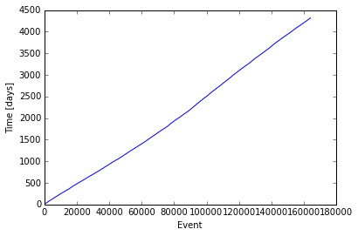
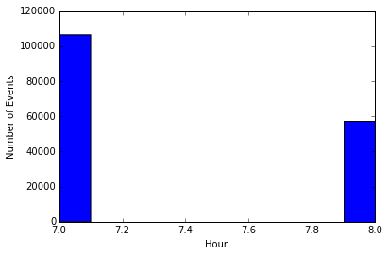
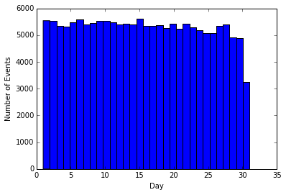
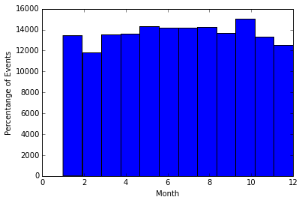
Data Set Overview
~160,000 incidents over ~10 year period
(a)
(b)
Sorted list of events, increasing time
All time stamps seem to occur at either 7 or 8 AM
Events are generally even distributed across days of month
Evenly distributed across months
(c)
(d)

Slide 3
Assumptions
All events are at either 7 or 8 AM, assume that any event in a given day gets mapped to that time stamp
All events for a given day do not have the same weather condition
Can we approximate the weather for the entire city/day by taking the most common condition?

Slide 4
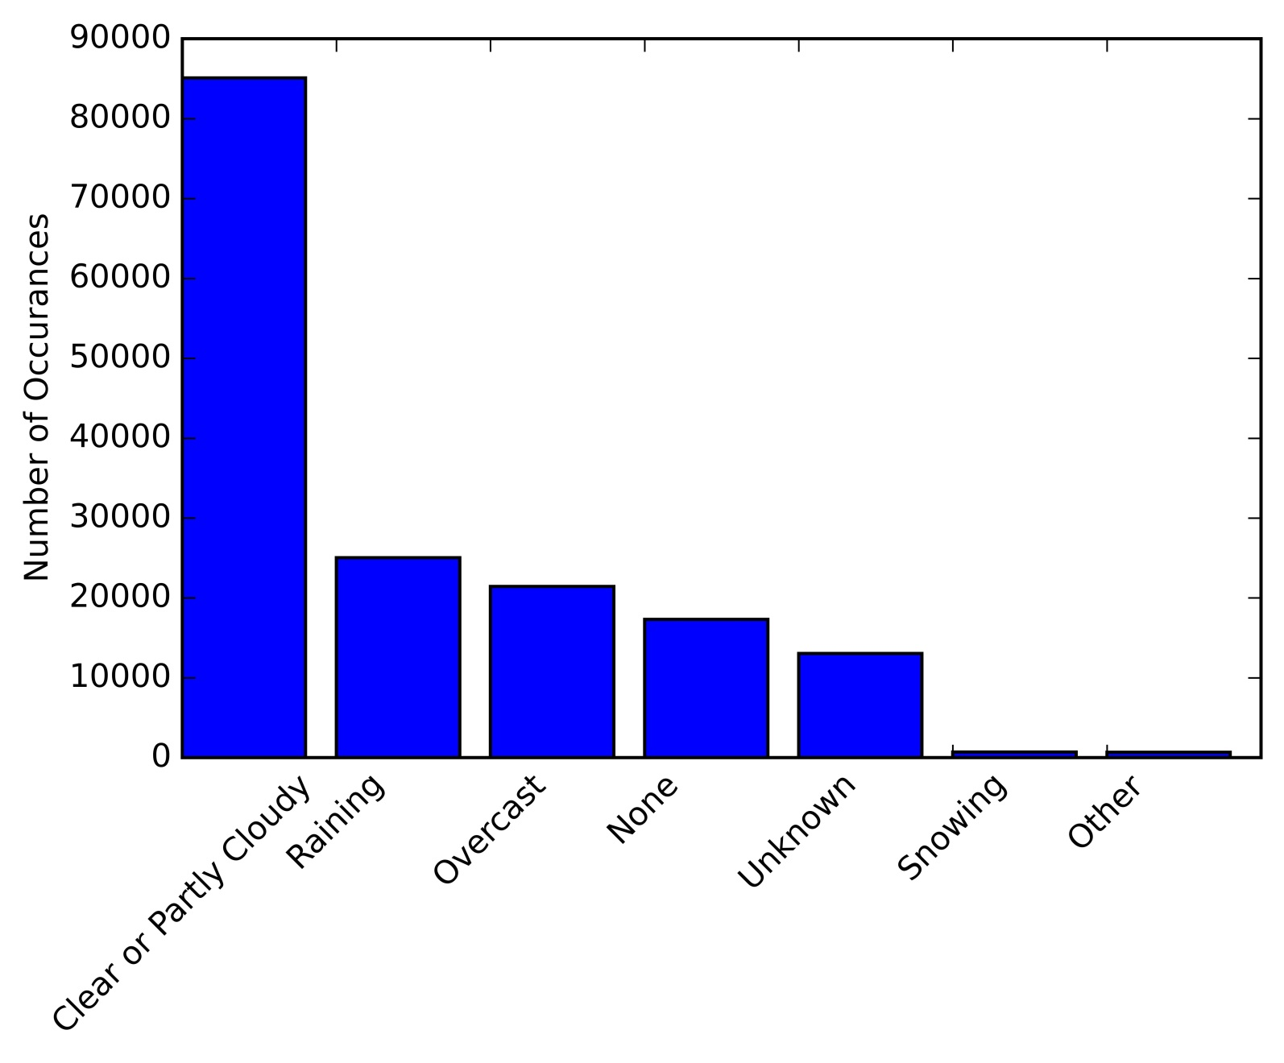
Number of accidents associated with each of the 7 most prevalent weather conditions
Disregarding ‘none’ and ‘unknown,’ nearly all incidents are associated with ‘Clear,’ ‘Raining,’ or ‘Overcast’

Slide 5
Perhaps we can gain insight by averaging over single days (since all events are recorded approx. at the same time in a given day)
E.g. number of events per day, consistency of weather conditions, etc.

Slide 6
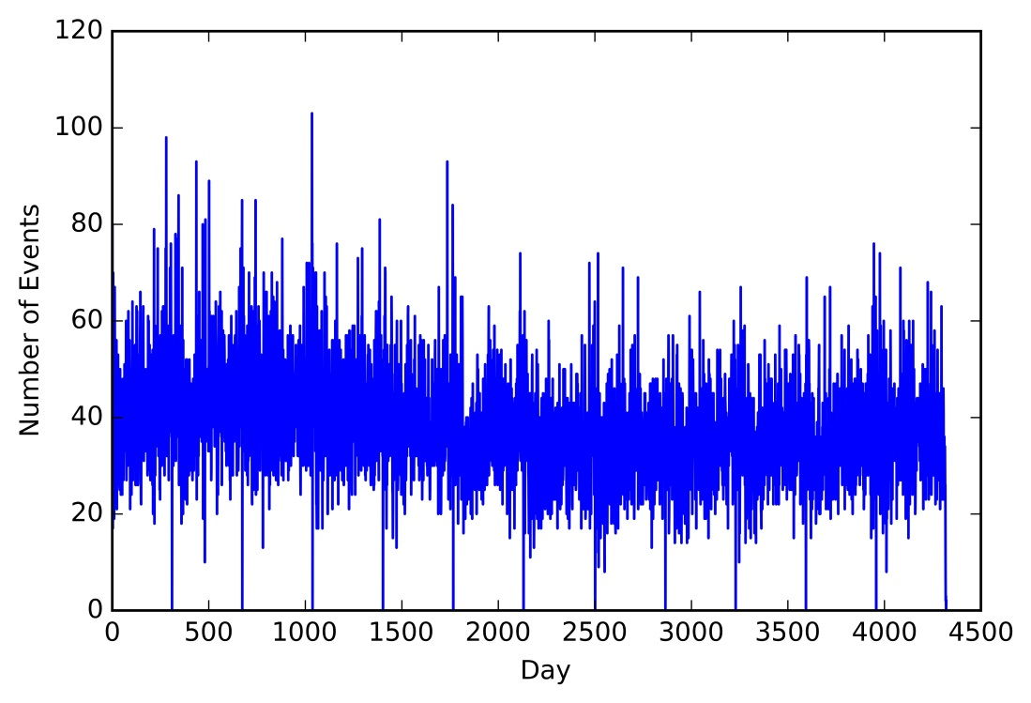
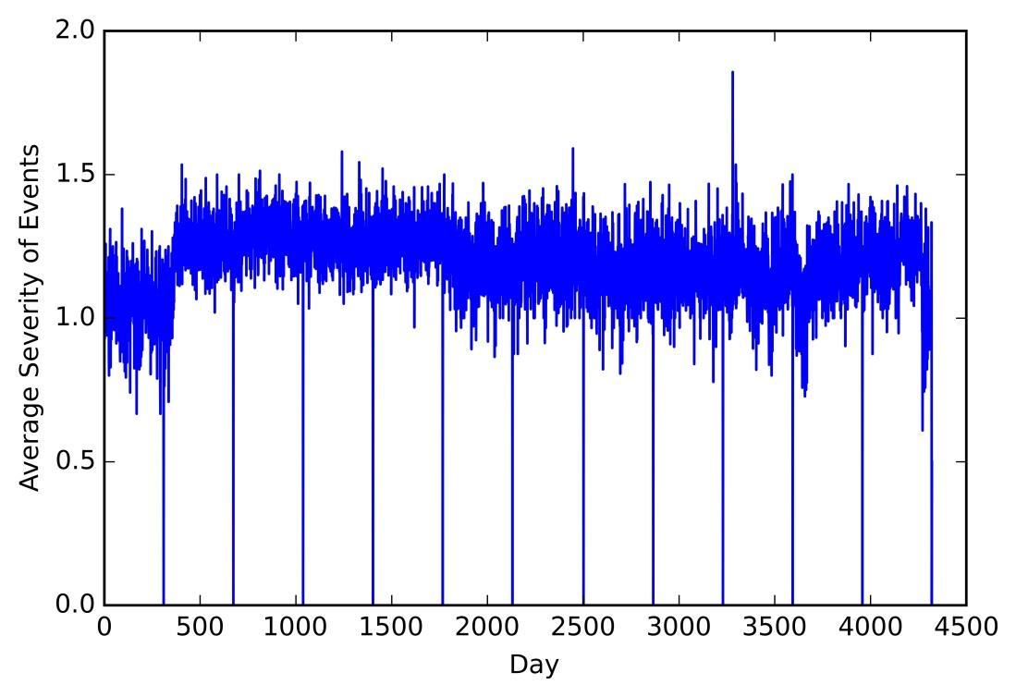
Number of incidents per day (days increasing from past to present), and average severity of events in a given day (on scale of 0 to 2)
Note that some days have no incidents reported

Slide 7

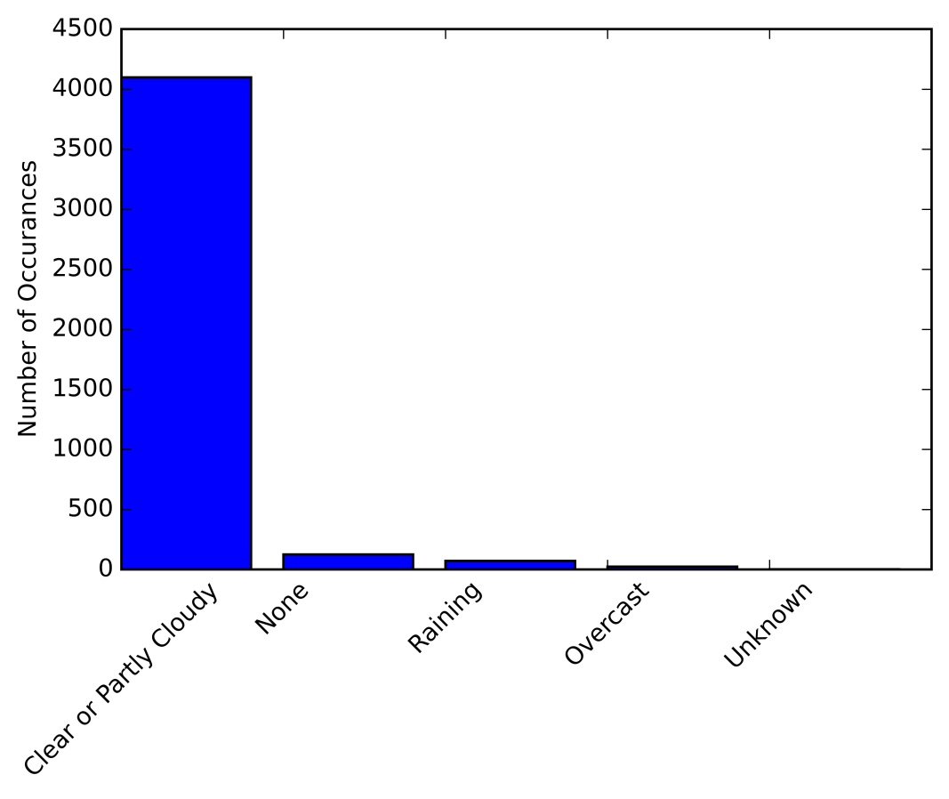
Weather condition for each incident
“Prevailing” weather for each day
Assume each say to have a single associated weather condition
i.e. Day n has m incidents, with m_{clear} during clear weather, m_{rain} during rain, etc. and m = m_{clear} + m_{rain} + …
Apparently a single day may have multiple weather conditions, but we take the prevailing condition, k, to be such that m_{k} = max{m_{i}}

Slide 8
Results
On clear days, the prevalence of the “clear” condition is on average 53%
On rainy days, the prevalence of the “rain” condition is on average 37%
There is not a statistically significant difference between the mean number of accidents (38.2 vs. 37.5) or severity (1.20 vs. 1.198) on clear and rainy days

Slide 9

What are the weather conditions of these days?
1 St. Dev.
Mean
~2.5% of “high-incident” days were predominantly rainy
~2.2% of total days were predominantly rainy

Slide 10
Future Work
More/different data
Capture variation in weather throughout the day
More data with “bad” conditions (rain, snow, etc.)
Traffic slowdowns rather than incidents
Drive-time between two points under different weather)
Different cities
Spatial variation in weather and traffic
Would require coordinates of traffic and weather from other sources

