Slide 1
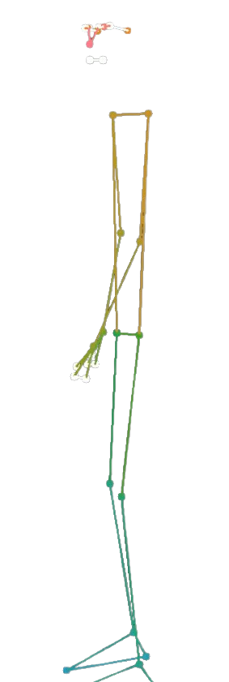
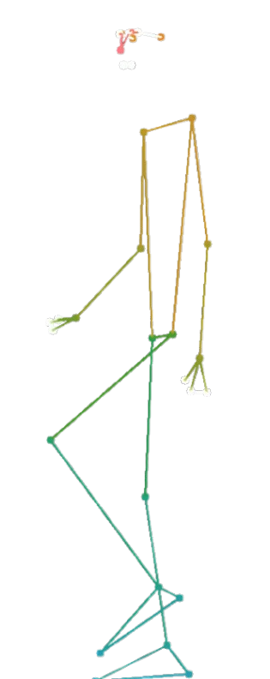
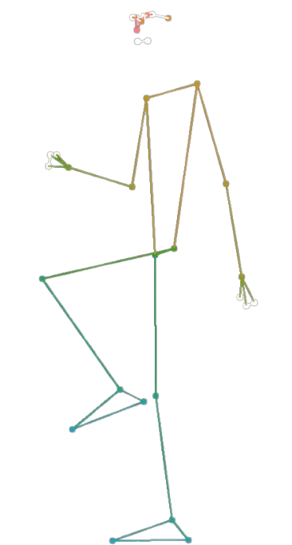
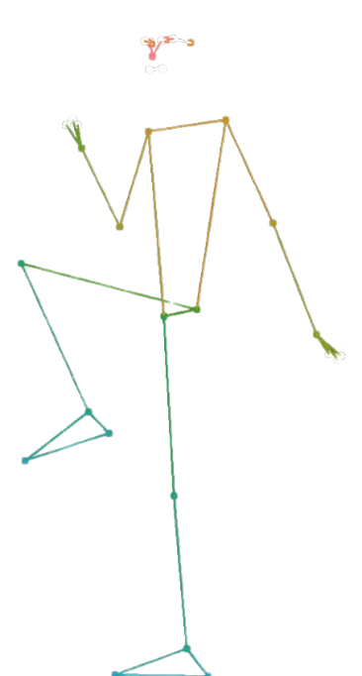
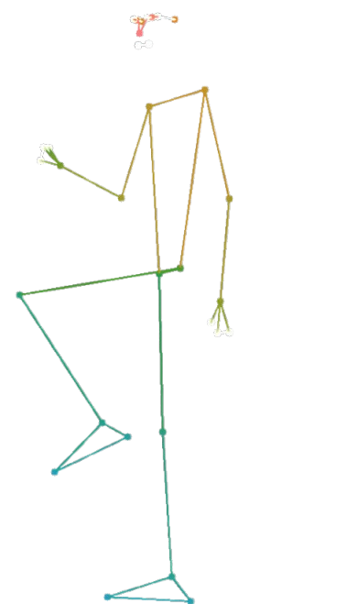
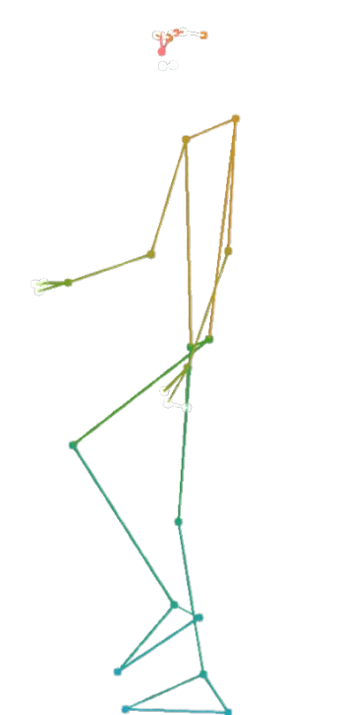
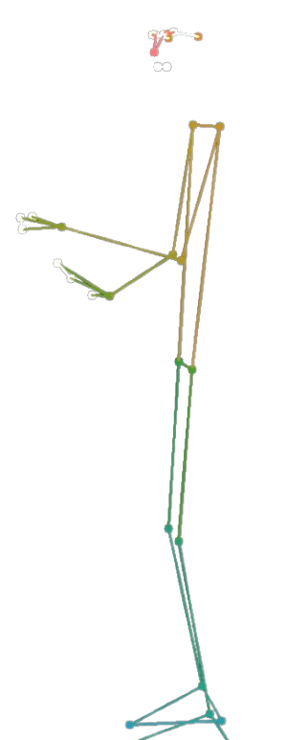
Statistics In Motion
A Python based Analysis of the 2 Minute Step Test - M.Sc. SEDS – Data Science Project
Jördis Luisa Strack
joerdis.strack@uni-Konstanz.de

Slide 2
Contents
Introduction & Motivation
Task & Relevance
Timeline of Development
Algorithm
Coordinate Generation
Preprocessing
Tracking Steps
Step Analysis
Personal Feedback
Results & Discussion
Quantitative Evaluation
Qualitative Evaluation
Conclusion

Slide 3
Introduction & Motivation
Task & Relevance
Rise in popularity of at-home workouts during COVID-19, supported by digital tools (e.g., YouTube, fitness apps).
Older adults face challenges with access to real-time feedback and fitness specialists, making home fitness support crucial for maintaining physical independence.
2-Minute Step Test (2MST): Functional fitness test to assess aerobic endurance and lower-body strength, especially for older adults.
Test involves raising each knee to a point midway between the kneecap and hip within two minutes.
Project goal: Provide personalized feedback on 2MST performance using a Python-based heuristic

Slide 4
Introduction & Motivation
Task Description
Analyze 2MST performance using smartphone video data transformed into coordinate form.
Preprocessing:
Apply Gaussian smoothing (sigma 2) to reduce positional fluctuations.
Data Analysis
Calculate velocity from timestamp differences and define valid steps based on knee thresholds and ground intervals.
Check for cross-body coordination (right leg-left arm and vice versa movement).
Segment performance into four 30-second intervals to track consistency over time.
Output: Provide individualized feedback to help improve form and endurance.

Slide 5
Introduction & Motivation
April
29.04.2024: kick-off meeting
description of task
Mai
initial 4 second data example
data exploration
June
first step tracking mechanism
July
August
September
October
improvements in step tracking
break due to exams/final projects
ground detection using velocity
Final presentation
coordinate estimation with MediaPipe & OpenCV
tracking edge cases in step tracking
deriving test takers‘ personal feedback and benchmark comparison
first 2MST example data
addition of 6 more datasets
first segmentation analysis
interview with sports scientist
midway presentation
Final report
Qualitative assessment of performance by sports scientist
Quantitave performance assessment
Timeline of Development

Slide 6
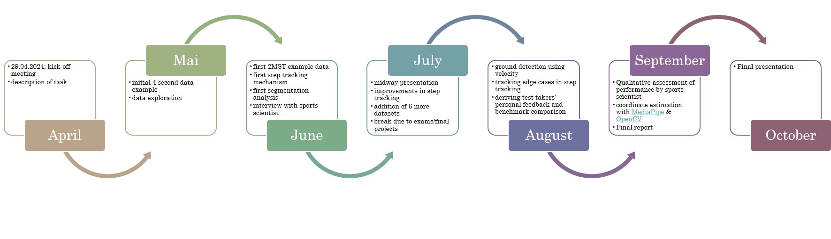
Introduction & Motivation
Timeline of Development

Slide 7
Introduction & Motivation
Timeline of Development

Slide 8
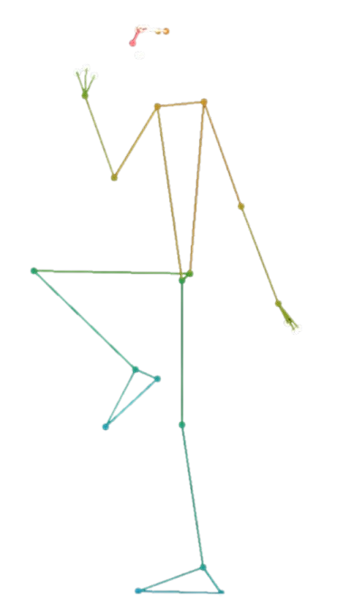
Algorithm – Coordinate Generation
Generate Coordinates from any mp4 file using Python‘s OpenCV and MediaPipe
processes video frame-by-frame to extract 32 body landmarks offered by MediaPipe
ensures valid FPS, compute timestamp and convert frames from BGR to RGB
Extracts x, y, z coordinates for each landmark per frame
standardize coordinates to [0, 1] for comparability across test takers

Slide 9
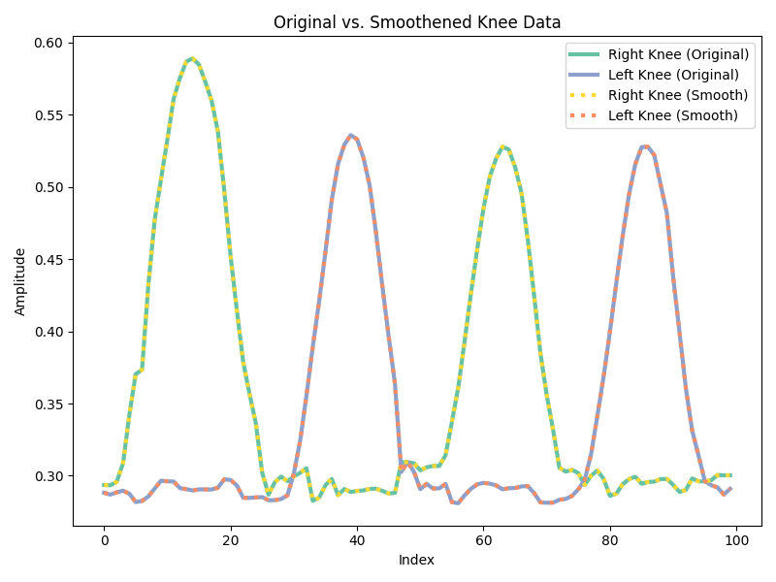
Algorithm - Preprocessing
Handling Noise
original data was distorted by noise
caused by oversensitive coordinate generation
under MediaPose approach no longer present
to smooth out any remaining noise, SciPy‘s Gaussian filter was applied
sd. of Gaussian Kernel Sigma = 2 to smooth out coordinates moderately
avoid over-smooth data and loss of information!
SciPy v1.10.1. (2024). scipy.ndimage.gaussian_filter. SciPy Documentation

Slide 10
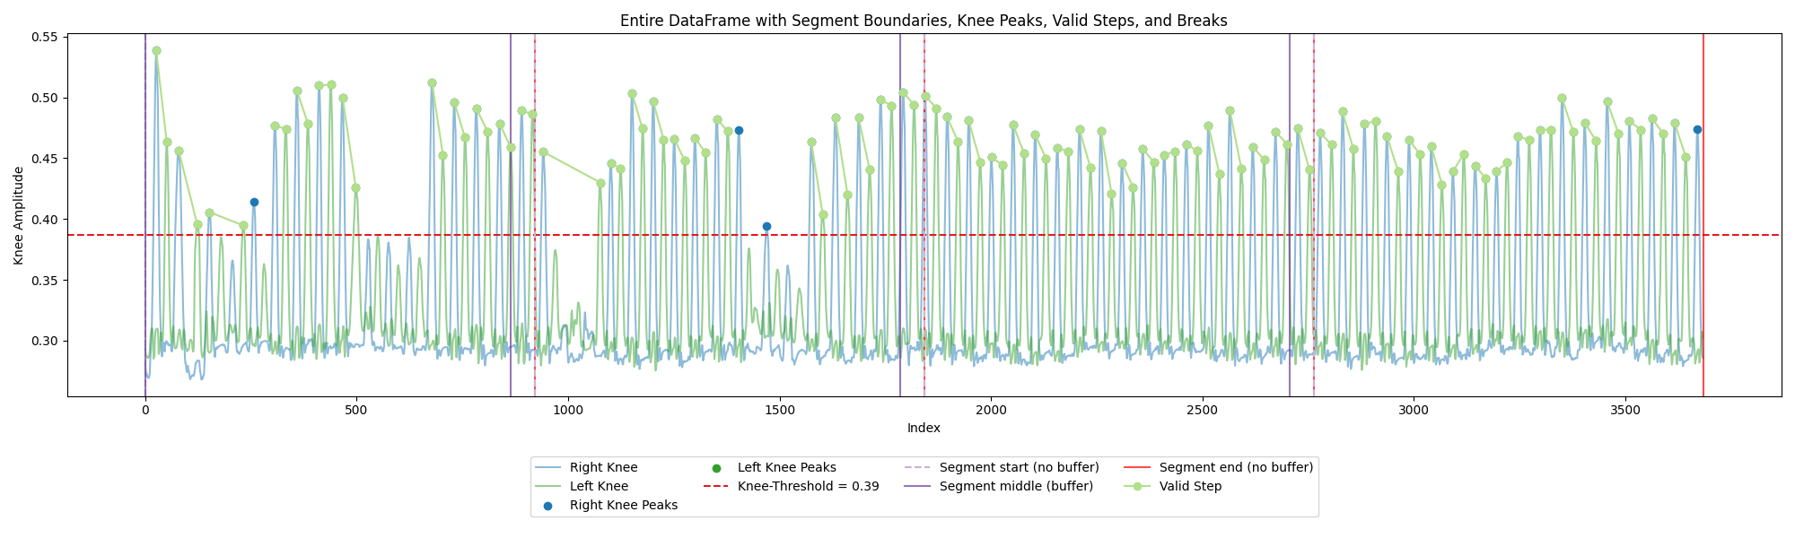
Algorithm – Tracking Steps
What is a Step?
A step is a sequence of the following events:
right knee is lifted above knee threshold while left foot is on the ground
left knee is lifted above knee threshold while right foot is on the ground
How to track Steps?
define height threshold for knees
use velocity and marker information to detect ground contact for feet
use both requirements to identify valid step sequences

Slide 11
Algorithm – Tracking Steps
Finding the Knee-threshold
knee threshold reflects height threshold between right hip and knee used in 2MST → identify global minimum of right foot marker → obtain index at which right leg is most extended
function find_knee_threshold computes Euclidian distance between right hip and knee → identify point exactly in between both markers
Threshold Significance
The knee threshold differentiates valid steps from non-valid attempts as the most important requirement
An illustrative sketch of the knee threshold based on the test taker‘s right leg markers

Slide 12
Algorithm – Tracking Steps
Autonomous detection of Ground Contact
invert data to identify local minima in the Y-coordinates of both feet
calculate ground contact intervals based on positions of foot and ankle markers → ankle marker as threshold to avoid overestimation
assess initial stance during first three seconds before first knee peak → account for potential offsets in foot positions due to bending or relaxed stances
ground contact interval is established using identified minima and initial stance data → lower bound is fixed at zero and upper bound dynamically determined
combine foot marker positions with velocity to detect moments of ground contact → utilize finite differences to compute instantaneous velocity → threshold based on 95th percentile to define inactivity within the ground contact interval

Slide 13
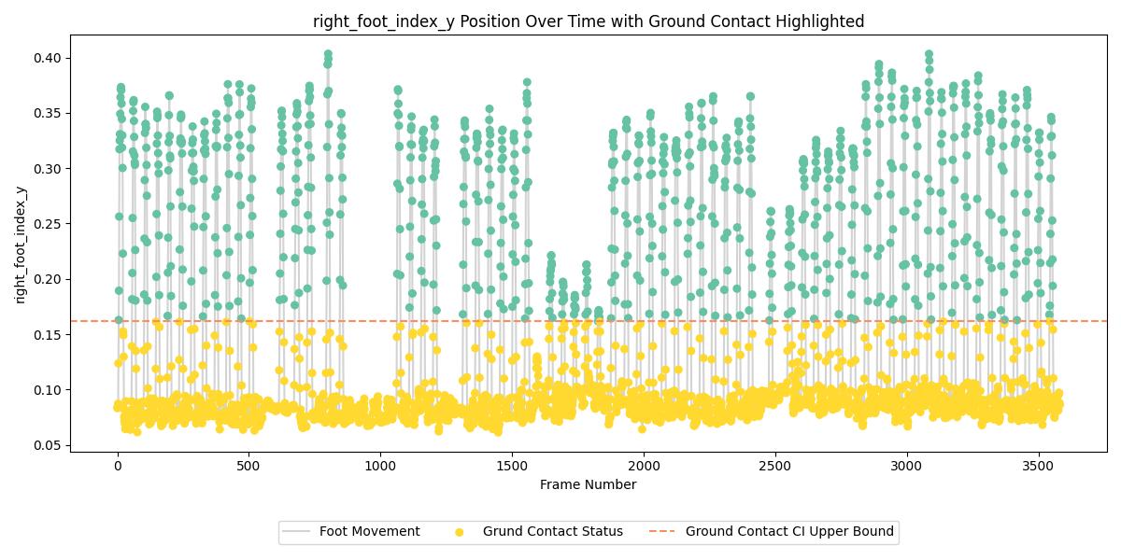
Algorithm – Tracking Steps
Autonomous detection of Ground Contact
A slight overestimation in ground contact is present, due to oversensitivity of y-coordinates in both feet of the initial data used during the first stages of development

Slide 14
Algorithm – Tracking Steps
Valid Step Sequence Identification
Step Validation:
The validate step sequence function analyzes right and left knee peaks that exceed the minimum height requirement and checks for ground contact information.
Flags the last right knee peak to ensure the final step is included in the analysis.
Sequence Identification:
Iterates through right knee peaks to find corresponding valid left knee peaks
Valid steps consist of a right knee peak followed by a left knee peak; sequences with consecutive raised peaks are deemed invalid.
Assesses ground contact for both feet between the identified knee peaks, ensuring valid steps meet both height and ground contact conditions.
Output: Returns a list of valid step sequences along with the total count of valid steps detected.

Slide 15
Algorithm – Tracking Steps
Posture and Coordination
The revised step sequence analysis function evaluates cross-body arm coordination during valid steps
Checks for the lifting of the opposite arm corresponding to knee lifts, using a time window of 200 milliseconds to account for minor delays
Reports the number of coordinated sequences, including total step count and count of steps showing correct arm-leg coordination, allowing for an analysis of posture during movement
NOTE: Not requirement for 2MST but of interest to evaluate balance and posture over time

Slide 16
Algorithm – Step Analysis
Test Takers‘ Personal Performance Metrics:
main focus is number of valid steps taken during 2MST
segmentation analysis of performance data can reveal additional feedback

Slide 17
Algorithm – Step Analysis
Buffer Calculation for Steps that are carried over Segments
in some cases, steps are started in one segment and completed in the following segment → this can cause steps to be counted twice!
a buffer between segments
captures steps that start in one segment and end in the next
searches for unpaired right knee peaks at the end of one segment if the subsequent segment begins with an unpaired left peak
buffer is computed dynamically based on all knee peak attempts (valid and invalid) → buffer is average time between peaks to create small buffer window in which a right knee peak can be expected
This is the buffer between segments 1 and 2:

Slide 18
Algorithm – Step Analysis
Segmentation and Consistency Analysis
split data into four segments of equal length, using dataset specific buffer
analyzed each segment and aggregate results:
number of valid steps and steps under good posture
variation in knee peak amplitudes overall and for left and right knee
time between knee peaks and overall number of breaks that lasted at least three seconds

Slide 19
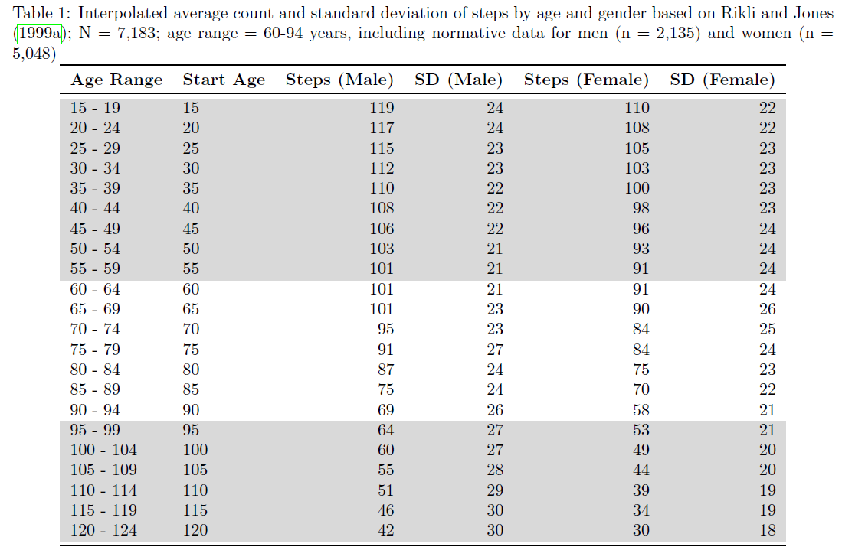
Personal Feedback
Benchmark Comparison
normative data from Rikli and Jones (1999a), N = 7,183 (2,135 men and 5,048 women) aged 60-94 years.
original benchmarks for ages 60-94 in white
interpolated age ranges for participants above 94 based on observed trends in grey
notably high standard deviations in the data due to smaller demographic subgroups.

Slide 20
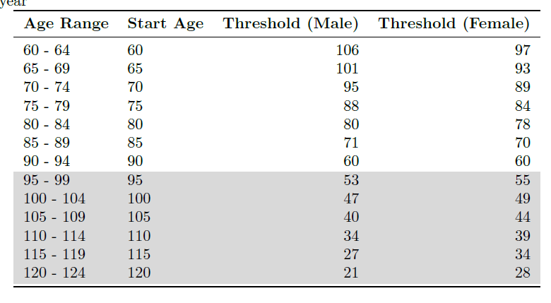
Personal Feedback
Interpolation
linear interpolation used to extend step count benchmarks for participants aged 95 to 120 based on natural physical performance rate of decline
additional benchmarks derived for younger test-takers, aged 18-59 using rate of increase → check of plausibility using data from Nogueira et al., 2021
Physical Independence
for test takers who are at least 60 years old, the number of valid steps will be used to determine their status of physical independence
→ if number of valid steps is greater than threshold, test taker is classified as independent
Table 2: Interpolated cutoff threshold values by age and gender based on Rikli and Jones (2013); N = 2,140; age range = 60-94 year

Slide 21
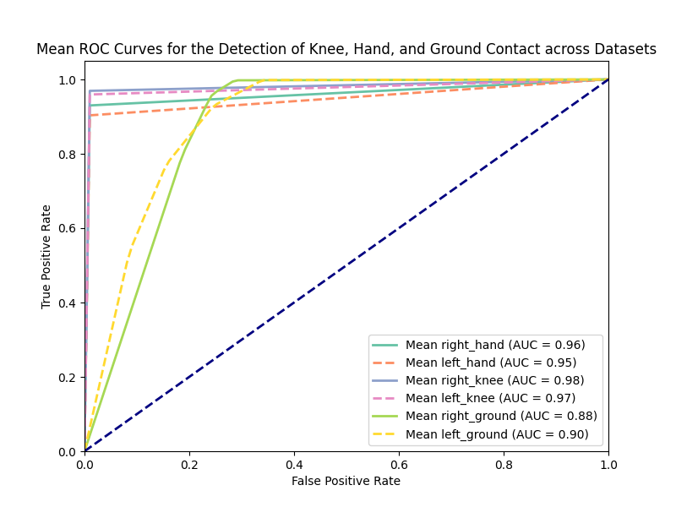
Results & Discussion
Performance Metrics
knee and hand detection show high precision, recall, and accuracy across datasets → AUC values are above 0.95 indicate robustness
ground contact detection shows lower precision but retains high recall → ground detection is overestimated due to changes in data after early development
imprecise human-annotated labels likely effect performance metrics of hand and knee peak detection → algorithm relies on SciPy‘s find_peaks, which is more precise than any human annotation → even one typo in labels distorts true performance metrics

Slide 22
Conclusion
The algorithm…
is innovative as the first of its kind and enables automatic scoring of the 2MST
is built entirely using open-source programming making it accessible for interdisciplinary research and at-home use
effectively detects peaks in hand and foot coordinates with perfect precision and high recall → due to inconsistencies in human-annotated both precision and recall are likely perfect
performs effectively even with partial occlusion or low video quality → verified by ROC and AUC metrics
Based on an interview with a sports scientist, the project fully meets the current requirements of sports science for an analysis program for the 2MST.

Slide 23
Thank you for your Attention!
Do you have any Questions?

Slide 24
Literature

