Slide 1
# TechUp The Naked Objects Pattern for Java Introduction to Apache Isis
Jörg Rade
2018-10-25

Slide 2
About Me
1983 MS Basic (Comodore 8032)
1988 Smalltalk V (i286)
~1991 Linux 0.99.6
1999 Java
2004/5 @KN
2008/11 SALOG
2013 DDD
2014 Apache Isis

Slide 3
Agenda
1 The Naked Objects Pattern
2 Apache Isis
- KN Interface Explorer – Demo

Slide 4
The Naked Objects Pattern
1
Structure - Example - Intent - Motivation - Applicability - Related - Known Uses

Slide 5
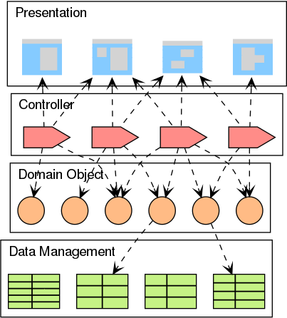
Classical 4 Layer Architecture (MVC)
View
Procedural Knowledge / Business Logic in Presentation/Controller leads to:
Anemic Domain Model (Fowler)
Behaviorally Incomplete Domain Objects (Pawson)
Smart UI Anti-Pattern (Evans)
Model

Slide 6
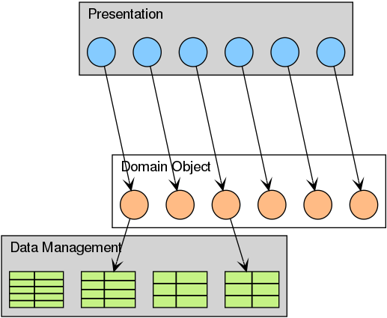
The Naked Objects Pattern
Aka: NoMVC
User Interface is generated from Domain Model
Data Definition is generated from Domain Model

Slide 7
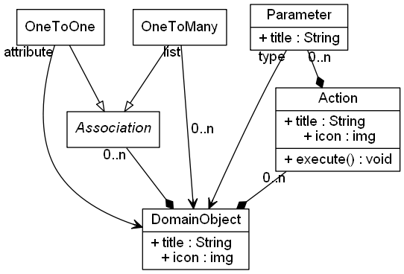
The Metamodel (simplyfied)
objects can be grouped in lists
operations appear as (menu-)actions
objects, lists, actions get decorated with
title
icon

Slide 8
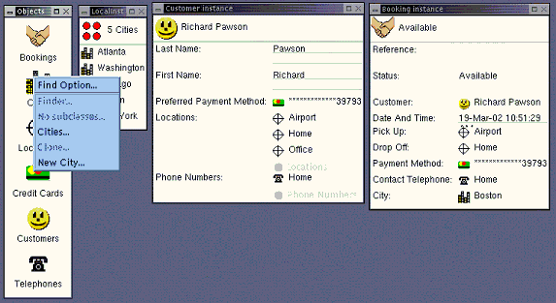
Object Oriented User Interface
UI Elements Correspond to Domain Object Model
repositories/domain services -> desktop icons
object properties / collections -> in forms
object instances -> icons
object methods
-> menu items

Slide 9
Naked Objects - An Architectural Pattern
Mission Statement / Benefits
All business logic should be encapsulated in domain objects.
The user interface should be a direct representation of the domain objects, with all user actions consisting of creating, retrieving, or invoking methods on domain objects.
The user interface shall be automatically created from the domain objects.
Benefits:
A faster development cycle, fewer layers to develop, means less code to be tested.
Greater agility, application is easy to be altered to accommodate future changes in business requirements.
A more empowering style of user interface. OOUI’s are simple and powerful at the same time.
Easier requirements analysis. Domain objects form a common language between users and developers. Combined with the faster development cycle, it becomes possible to prototype functional applications in real time.

Slide 10
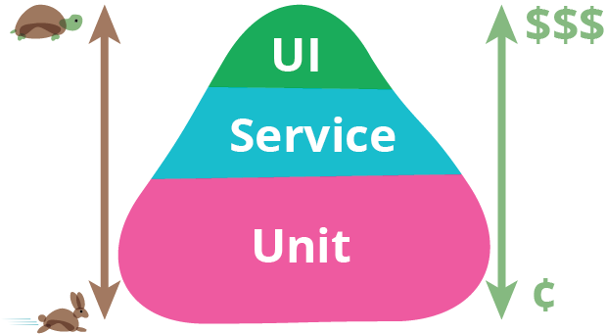
Testing (Like it should be)
The Test Pyramid (https://martinfowler.com/bliki/TestPyramid.html)
3 Testing the User Interface
is costly
2 Testing Services
is more expensive
1 Unit Testing Domain Objects
is easy & cheap

Slide 11
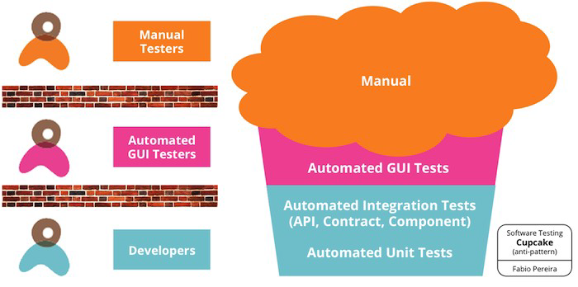
Testing (Nightmare Variant)
The Cupcake Anti-Pattern

Slide 12
The Traditional Programming Model
Business is waiting for the UI
1 2 3 4
Analysis
Design
Implementation
Iterate
Identify:
Domain Objects
Actions
Collaborations
Create (UML) Model:
Class Diagrams
Use Cases
etc.
Translate Design Model into Code
Persistence
Presentation
Get Feedback from Business Users

Slide 13
Rapid Application Development
Tightening the Feedback Loop
1
UI
handcrafted
2
UI
generated
Analysis
Design
Analysis
Design
Implementation
Implementation

Slide 14
When to use the Pattern?
Project types that will benefit most
Users
rather problem-solvers than process-followers
optional
Requirements
likely to change
optional
Requirements
uncertain
optional
Hand-crafted UI
is not a “must”
mandatory
Users
use the application frequently
mandatory
Batch Processing
simple / decoupled
mandatory

Slide 15
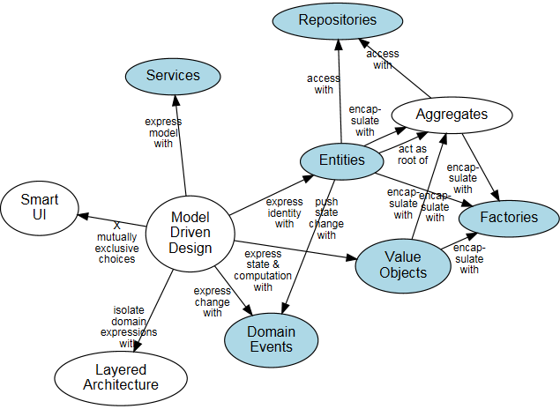
Domain Driven Design
Parallels the Naked Objects Approach
Entities play the central role
Smart UI (Anti Pattern)

Slide 16
Reference Implementations
Known Uses
DSFA
Benefits Application of the Irish Government
Naked Objects .Net
Estatio
Shopping Center Management
Apache Isis
Ges Consultor
Process Certification
Apache Isis
Poco NL
Mobil Network Reseller
Apache Isis

Slide 17

Apache
2
KN Interface Explorer - Demo

Slide 18
About
Apache Isis
2002: DSFA project went live
Java version (fork) of Naked Objects
DSFA decided to go the .Net way
Apache Project
2010: entered incubator
2012: graduated
Releases:
1.16.2 (Current)
1.16.3 (Next)
Next Major:
2.0.0-M2 (JPA, JEE)

Slide 19
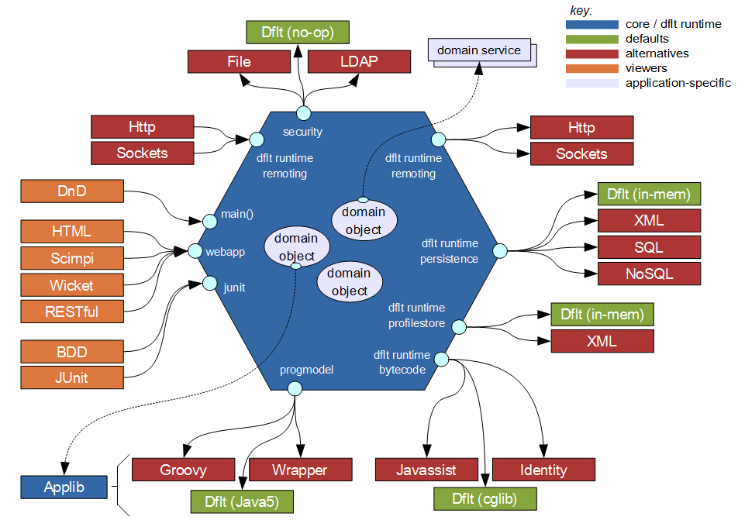
Architecture Overview
The Hexagonal Architecture
Authentication
UI
hsqldb cf.
persistor.properties

Slide 20
Requirements
Support SALOG Configuration- / Interface-Management
~ 600 configuration parameters
Possibly different for each of it‘s ~ 30 environments
Which have changed between versions?
~ 100 different interfaces provided by
~ 30 different systems
Which interfaces have changed?
Who needs to be informed?
Features:
Compare Configurations
Compare Configured Services
Identify partner systems, affected by changes
check availability of services (endpoints)

Slide 21
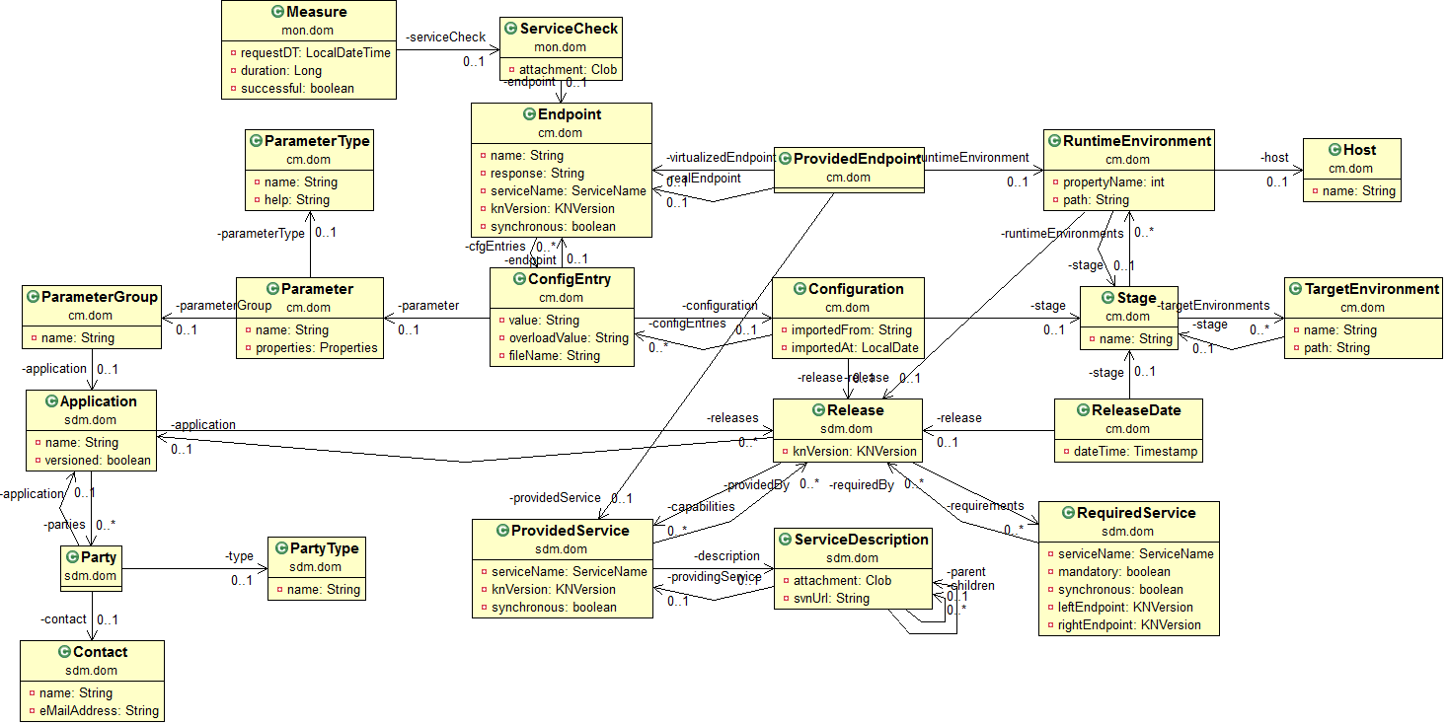
KN Interface Explorer
Domain Model

Slide 22
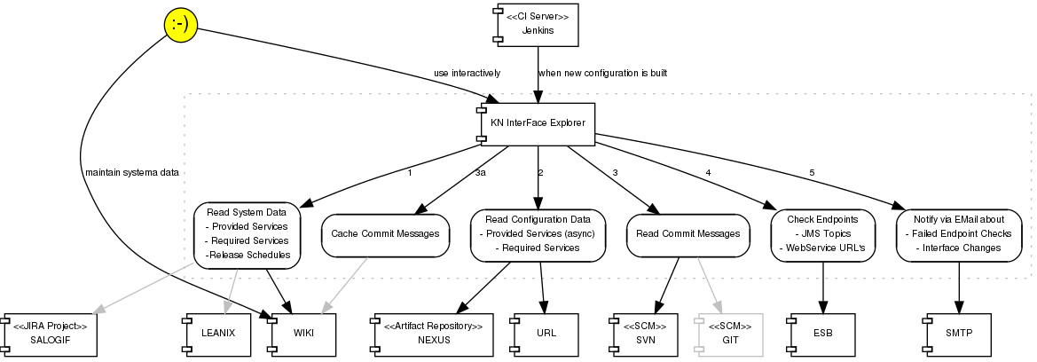
KN Interface Explorer
Dataflow

Slide 23
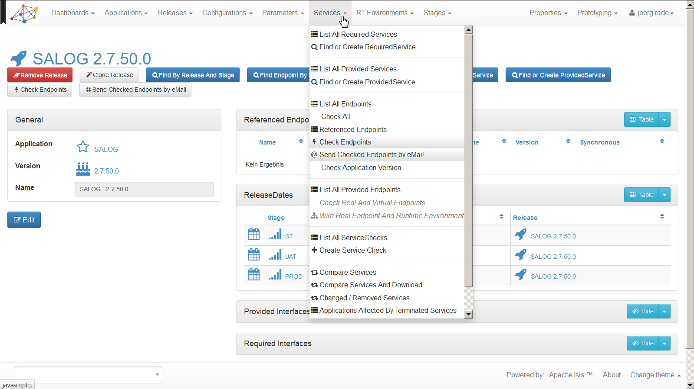
KN Interface Explorer
User Interface
repositories/domain services -> menubar items
repository / factory -> drop down menu
object properties / collections -> in forms
object instances -> icons
object methods
-> action buttons

Slide 24
FileSytem Layout
https://isis.apache.org/versions/2.0.0-M1/guides/ugfun/ugfun.pdf
domainapp/
├── application/
│ ├── HelloWorldAppManifest.java
│ └── isis.properties
├── dom/
│ ├── HelloWorldModule.java
│ └── impl/
│ ├── HelloWorldObject.java
│ ├── HelloWorldObject.layout.xml
│ ├── HelloWorldObject.png
│ └── HelloWorldObjects.java
└── app/
├── HelloWorldApplication.java
└── welcome.html
META-INF/
└── persistence.xml

Slide 25
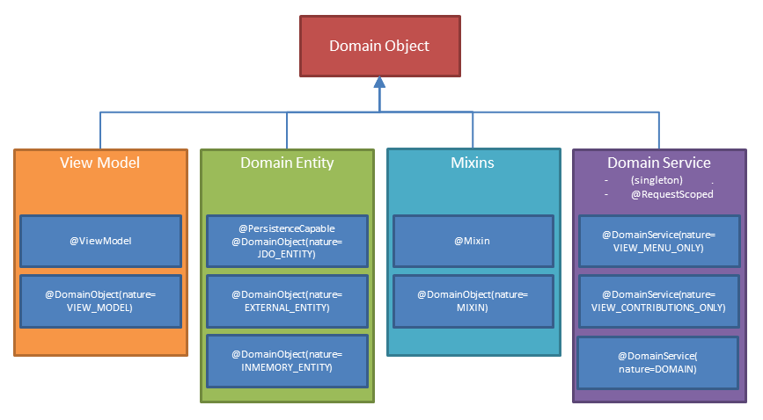
Annotations
Demo
Icons
Help
Apache Isis / KN Interface Explorer

Slide 26
Supporting Methods
Demo
need to follow strict naming rules
i.e. need to have e certain prefix (disable, hide, validate)
followed by a camelcased property or action name.
title() is somewhat special insofar as it refers to a class / DomainObject only
Apache Isis / KN Interface Explorer

Slide 27
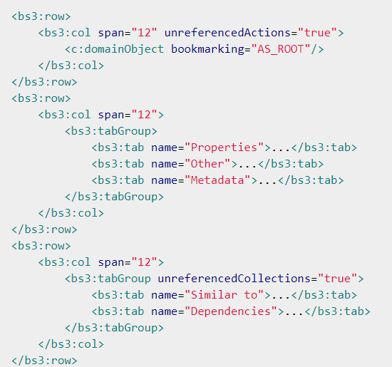
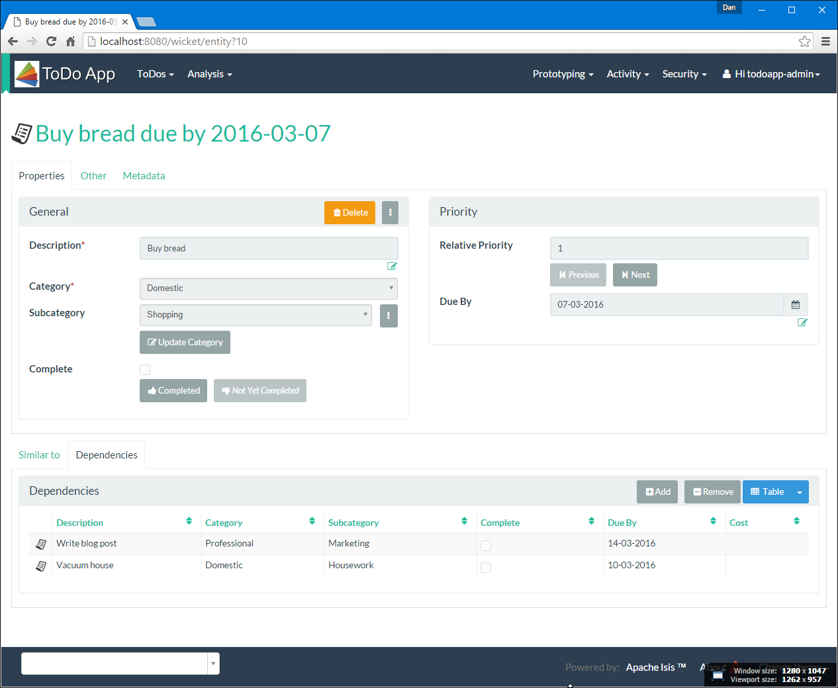
*.layout.xml (A Fig Leaf)
Demo
Apache Isis / KN Interface Explorer

Slide 28
View Model Classes
Demo
Derived from Domain Entity
cf. DB Views
No persistent attributes
Apache Isis / KN Interface Explorer

Slide 29
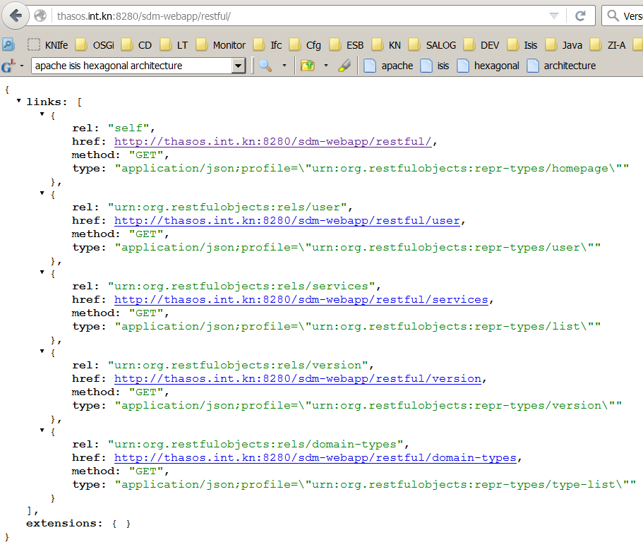
RESTful Interface
Demo
Content Negotiation Service

Slide 30
Domain Events
Demo
Internal Event Bus
@Publish
@Subscribe
coordinate/veto interactions between different modules within the system

Slide 31
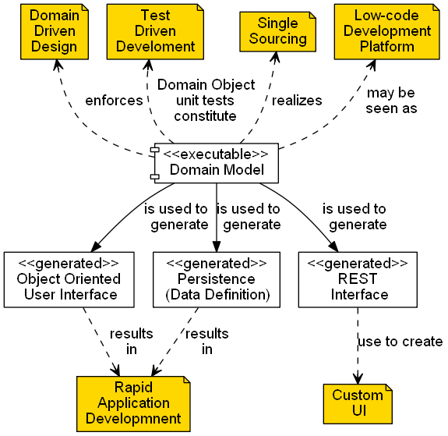
Benefits of the Framework

Slide 32
Vendor / Technology Lock In?
How much of the Framework do you need?
4 Use Apache Isis as modelling tool only and take the domain model as input for implementation in a different stack
3 Use the metamodel features (internal event bus etc.) in a .JAR
2 Handcraft the UI, use the provided REST API
1 Take the full benefit
 | Pure Pojo | Embedded Metamodel | Custom Presentation | Full Runtime
Presentation | Custom | Custom | Custom | Framework
Application | Custom | Custom / Framework | Framework | Framework
Persistence | Custom | Framework | Framework | Framework

Slide 33
Jörg Rade
SALOG Interface Responsible
Telephone +49 40 30 333 3442
joerg.rade@kuehne-nagel.com

Slide 34
References
Naked Objects http://www.nakedobjects.org/
Apache Isis http://isis.apache.org/
Restful Objects http://www.restfulobjects.org/
Richard Pawson: Naked Objects http://www.nakedobjects.org/book/
The Department of Social Protection www.welfare.ie
http://qconlondon.com/london-2011/qconlondon.com/dl/qcon-london-2011/slides/RichardPawson_LargeScalePureOOAtTheIrishGovernment.pdf
Generic Requirements/Capability Model http://njbartlett.name/2011/09/12/why-obr.html
Single Sourcing http://agilemodeling.com/essays/singleSourceInformation.htm

Slide 35

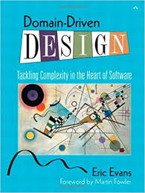
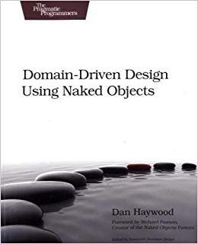
References
Books
Richard Pawson, Robert Matthews: Naked Objects (ISBN: 978-0470844205)
Eric Evans: Domain Driven Design (ISBN: 978-0321125217)
Dan Haywood: Domain Driven Design Using Naked Objects (ISBN: 978-1934356449)

Slide 36
References
Wikipedia
Naked Objects https://en.wikipedia.org/wiki/Naked_objects
Restful Objects https://en.wikipedia.org/wiki/Restful_Objects
Object-oriented user interface https://en.wikipedia.org/wiki/Object-oriented_user_interface
Low-code development platforms https://en.wikipedia.org/wiki/Low-code_development_platforms

Slide 37
ackup
B
User Interface

Slide 38
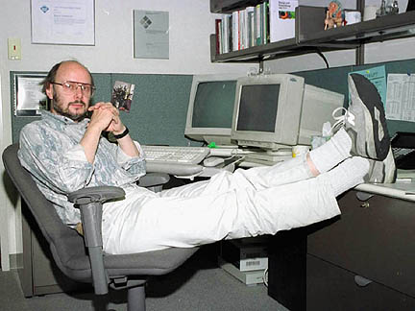
Role of the User Interface
Bjarne Stroustrup (Inventor of C++)
I have always wished for my computer to be as easy to use as my telephone; my wish has come true because I can no longer figure out how to use my telephone.

Slide 39
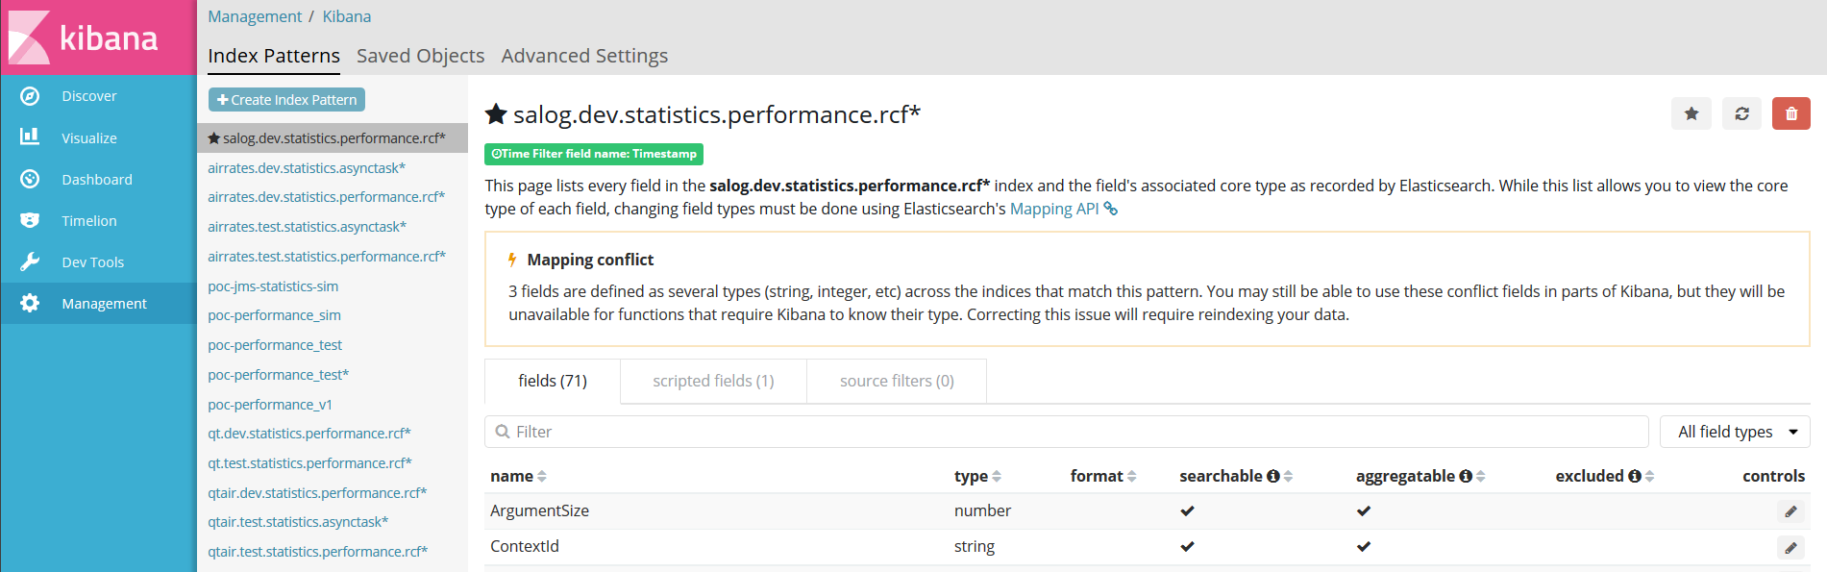
When Starting With the UI …
… you may end up in something that is hard to undestand and use

Slide 40

Role of the User Interface
Eric Evans - The Smart UI Anti-Pattern
Put all the business logic into the user interface. Chop the application into small functions and implement them as separate user interfaces, embedding the business rules into them. Use a relational database as a shared repository of the data. Use the most automated UI building and visual programming tools available [Evans p.77].”

Slide 41

Role of the User Interface
Trygve Reenskaug – Inventor of MVC
There are two traditions in the applications of computers: one is to employ the computer to empower its users, and the other is to apply the computer to control its users. I am sorry to say that the latter seems to be prevalent in mainstream computing today. I have been told that in many implementations of the “well kown MVC paradigm”, the “C” is implemented as a script controlling the user’s actions. [Pawson p.3]

Slide 42
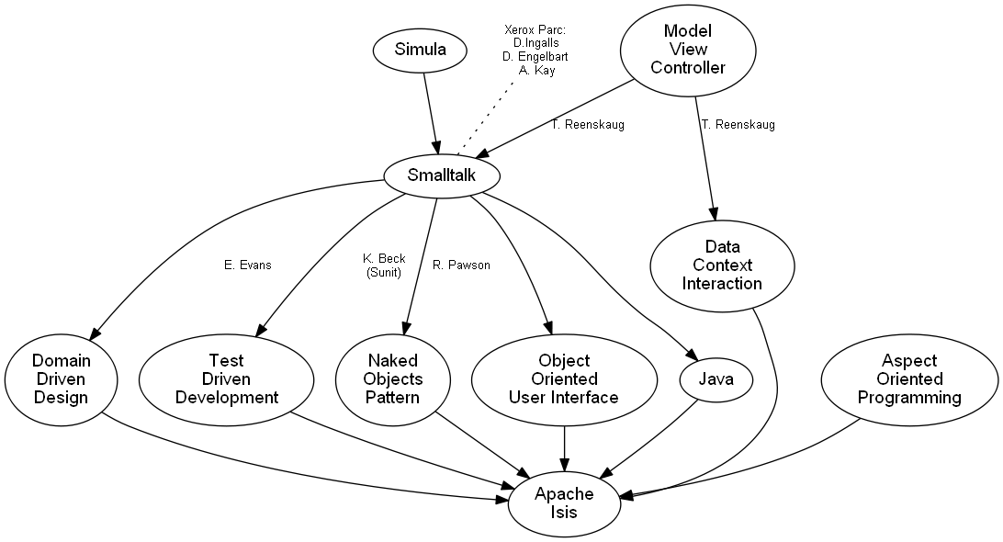
Bits of History

Slide 43
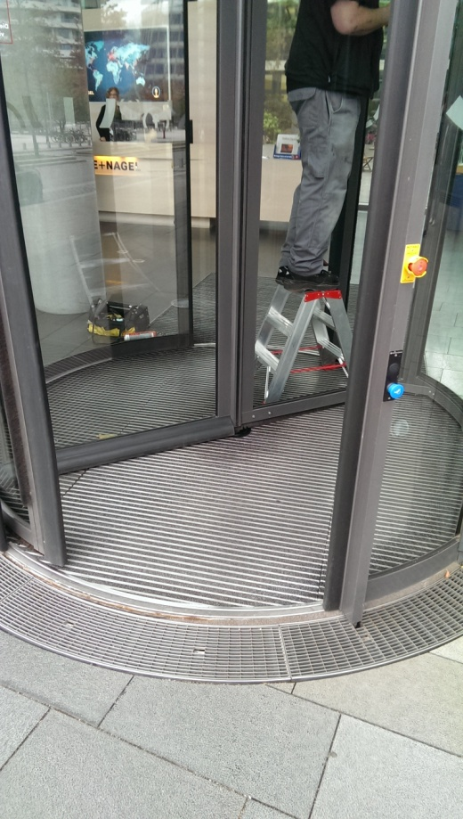
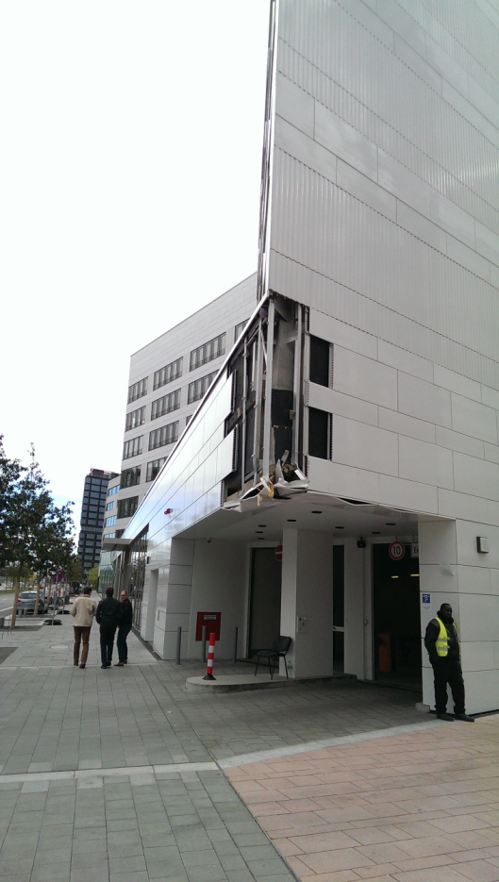
Engineering Principles for Dummies
What you don‘t build in – can‘t break

