Slide 1
test

Slide 2
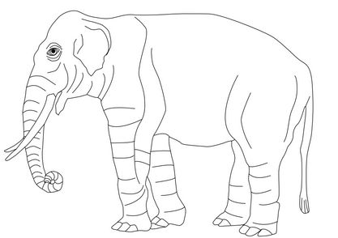
Abc
accepts html code
addf
$$x=f\left(N,K\right)$$
in this case the shourt run prouction function is $x=f\left(N\right)$
text goes here….
Exercise 1
a
b
c
Exercise 2
Exercise 3
a
Caption

Slide 3
Right | Left | Default | Center
12 | 12 | 12 | 12
123 | 123 | 123 | 123
1 | 1 | 1 | 1

