Slide 1

Teaching StatPREP in the Classroom
Joe Roith, St. Catherine University

Slide 2
Overview of StatPREP
StatPREP (NSF Grant DUE-1626337) is designed to help college instructors develop the understanding + skills to teach introductory statistics with large data sets, modern pedagogy and emphasis on data wrangling and data visualization techniques.
StatPREP is an extended professional development program (in-person workshops + online community) for math faculty, particularly at two-year institutions, featuring data- and computationally-based curricular materials that can be used in your existing course.
StatPREP is a collaboration between the MAA, AMATYC and ASA.

Slide 3
Statistics trends
In Arizona 6 out of 47 degrees require statistics
California CAP program
Washington 40% increase in statistics enrollment
Data Science degrees – ASU, NAU, U of A
AMATYC Statistics committee and Data Science subcommittee
ASA/AMATYC Joint Committee
ASA Two-year College membership rate

Slide 4
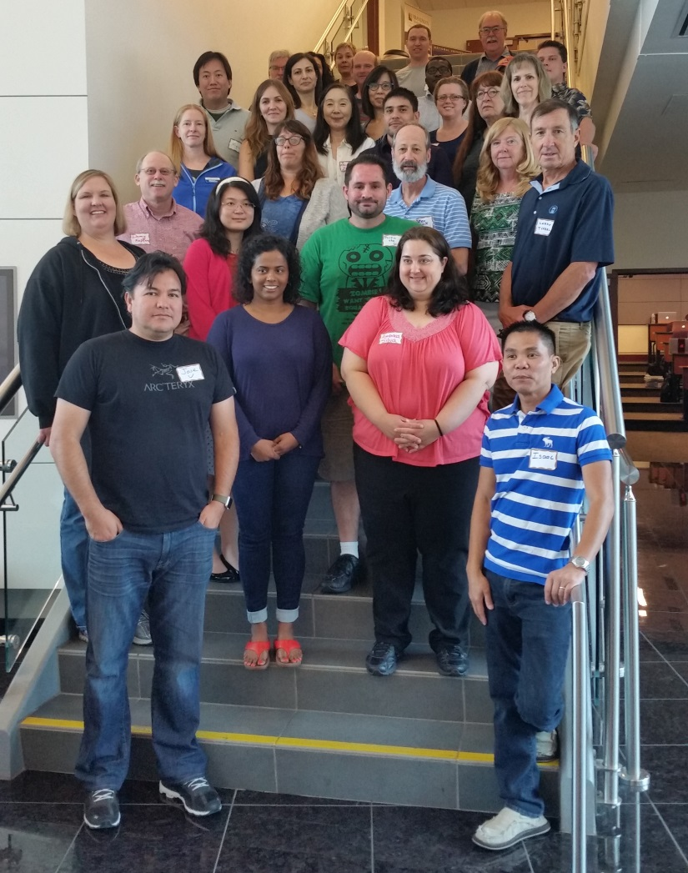
StatPREP Workshops
8 Hubs around the US, consecutive summers + academic year online webinars, e-newsletters, discussion board, etc.
Outstanding Statistics Education Workshop Leaders
Summer 2019 Workshops:
Hartford, CT
Seattle WA
Fort Worth, TX
Washington, DC
Applications Due in April 17, 2019, some travel support
Participants-to-date:
158 College Faculty
83 Institutions

Slide 5
StatPREP Website + Resources
http://statprep.org
Recorded + live webinars (ANOVA, resampling, descriptive stats...)
Class lessons (What’s Normal? Sampling Data Points on Earth...)
Tutorials (data science graphics, intro to data tables...)
Data sets (Our World in Data, The Data and Story Library, CAUSE...)
Little Apps (Two-Sample t, Regression and Smoothers, Center and Spread, Proportions, Resampling and Inference...)

Slide 6
Resources
Little Apps
Two-sample t, https://dtkaplan.shinyapps.io/LittleApp-t2/
Class Lessons
What’s Normal? https://dtkaplan.shinyapps.io/Whats_normal/

Slide 7
Questions?
Contact:
kathryn.kozak@coconino.edu

Slide 8
Acknowledgement
Support for this MAA program is provided by the National Science Foundation (grant DUE-1626337), in partnership with the ASA and AMATYC.

