Slide 1

Federated Identity & Federated Service Provider Support for OpenStack Clouds
Joe Savak - Rackspace Identity Product Manager
Brad Topol - IBM Distinguished Engineer
Jorge Williams - Rackspace Integration Architect
Steve Martinelli - IBM Software Developer (Keystone Core)
Notes:
The Openstack Foundation launched in September 2012 is one of the fastest growing open source communities IBM has seen, surpassed only by none other than the highly successful Linux Foundation. In this overview of the OpenStack foundation, we will provide an overview of the OpenStack foundation itself, IBM’s key contributions to OpenStack’s success and finally important information about IBM’s support of OpenStack in our SmartCloud offerings.

Slide 2
What was delivered in Icehouse?
Officially, from the Icehouse release notes:
  “The OS-FEDERATION extension allows Keystone to consume federated authentication via an Apache module for multiple Identity Providers, and mapping federated attributes into OpenStack group-based role assignments” – Dolph Mathews (Keystone PTL)
Outline:
  New Keystone OS-FEDERATION APIs
    Identity Providers
    Protocols
    Mappings
  Mappings
    Motivation for Mappings
    Setting up OpenStack Groups
    SAML Assertions
    Creating a Mapping
  Authenticating
    Motivation for Authenticating
    Authenticating with Keystone – Part 1
    Authenticating with Keystone – Part 2
    Authenticating with Keystone – Part 3

Slide 3
New Keystone OS-FEDERATION APIs
Identity Providers: /OS-FEDERATION/identity_providers/{idp_id}
  An Identity Provider is a third party service that is trusted by the Identity API to authenticate identities.
  Register SAML Identity Providers such as ADFS or Tivoli Federated Identity Manager.
  {
  "identity_provider": {
  "description": "Stores ACME identities",
  "enabled": true,
  "id": "ACME",
  }
  }
  description (string) - Describes the identity provider.
  enabled (boolean) - Indicates whether this identity provider should accept federated authentication requests.
  id (string) - User-defined unique id to identify the identity provider.

Slide 4
New Keystone OS-FEDERATION APIs
Protocols:
/OS-FEDERATION/identity_providers/{idp_id}/protocols/{protocol_id}
  A Protocol entry contains information that dictates which mapping rules to use for a given incoming request. An IdP may have multiple supported protocols.
  Currently, only the SAML 2.0 federation protocol is supported. However, the framework is extensible to support other federation protocols, i.e.: OpenID, WS-Federation, SAML 1.0.
  Identity Providers can communicate in many protocols, so associate an Identity Provider with a Mapping, based on a protocol.
  {
  "protocol": {
  "id": "saml2",
  "mapping_id": "xyz234",
  }
  }
  mapping_id (string) - Indicates which mapping should be used to process federated authentication requests.
  id (string) - User-defined unique id to identify the protocol.

Slide 5
New Keystone OS-FEDERATION APIs
Mappings: /OS-FEDERATION/mappings/{mapping_id}
    A mapping is a set of rules to map federation protocol attributes to Identity API objects. An Identity Provider can have a single mapping specified per Protocol. A Mapping is simply a list of rules.
    A mapping is a method to translate remote attributes (from an Identity Provider) to local attributes (Keystone entities).
    Mappings are created as a top level resource so as to enable re-use between Identity Providers.
{
"mapping": {
"id": "ACME_MAP",
"rules": [...],
}
}
    rules (list) - Each object contains a rule for mapping attributes to Identity API concepts. A rule contains a remote attribute description and the destination local attribute.
    id (string) - User-defined unique id to identify the mapping.
More on this soon!

Slide 6
Motivation for Mapping
Setting the scene:
  In Keystone, authentication is performed with password or token.
  Authorization is performed by ensuring a user or group, has a role, on a project or domain.
    i.e., does requesting user btopol, have role developer, on project services?
    or does requesting user belong to group that has role developer, on project services?
Identifying the problem:
  Users exist on an Identity Provider, not in Keystone.
  Thus, authenticating nor authorizing a user can be performed locally.
  An Identity Provider will only return Identity attributes (such as user and group information), not authorization attributes.
  Assuming an Apache module can handle the authentication between Keystone and the IdP, we still don't have a solution for authorization.
Finding a solution:
  Create a mapping to handle authorization, it can establish relationships between Keystone entities and Identity Provider attributes.
  Create a 1:1 relationship between Identity Provider groups and Keystone groups
    Only create groups that will be authorized to perform federated authentication.
  Have a user authenticate with an Identity Provider, and be mapped to a Keystone group, once mapped, the user will inherit the roles from the group.

Slide 7
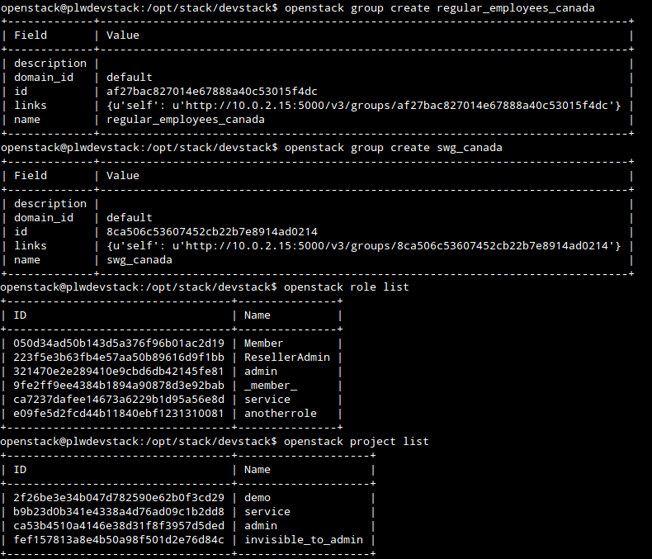

Setting up OpenStack for Groups
  Create groups, that have a role(s) on a project or domain.
  Can be done via CLI for convenience.
Keystone Group IDs:
regular_employees_canada
  (af27ba … 15f4dc)
swg_canada
  (8ca506 … ad0214)
Keystone groups have a globally unique id
Associate groups with a role on a project.
(Roles and projects listed on left side)

Slide 8
SAML Assertions
  A snippet from a SAML assertion is seen below, and has the necessary user and group information (from an IdP perspective).
  The 'roles' in the SAML attributes are the IdPs method of assigning groups, these need to be mapped back to the groups that were created in the previous step.
<saml:AttributeStatement>
<saml:Attribute Name="Role">
<saml:AttributeValue xmlns:xs="http://www.w3.org/2001/XMLSchema"
xmlns:xsi="http://www.w3.org/2001/XMLSchema-instance"
xsi:type="xs:string"
>IBM Regular Employees Canada</saml:AttributeValue>
</saml:Attribute>
<saml:Attribute Name="Role">
<saml:AttributeValue xmlns:xs="http://www.w3.org/2001/XMLSchema"
xmlns:xsi="http://www.w3.org/2001/XMLSchema-instance"
xsi:type="xs:string"
>SWG Canada</saml:AttributeValue>
</saml:Attribute>
</saml:AttributeStatement>
Keystone Group IDs:
regular_employees_canada
  (af27ba … 15f4dc)
swg_canada
  (8ca506 … ad0214)
IdP Group attributes:
IBM Regular Employees Canada
SWG Canada

Slide 9
Adding the Mapping
  Create a mapping to map the IdP attributes to Keystone entities.
  Example request body sent to OS-FEDERATION/mappings/BP_MAP
{
"mapping": {
"rules": [
{
"local": [
{
"group": {
"id": "af27bac827014e67888a40c53015f4dc"
}
}
],
"remote": [
{
"type": "Role",
"any_one_of": [
"IBM Regular Employees Canada"
]
}
]
}
]
}
}
"rules": [
{
"local": [{
"user": {
"name": "{0}"
}}],
"remote": [{
"type": "sub"
}]
},
{
"local": [{
"group": {
"id": "8ca506c53607452cb22b7e8914ad0214"
}}],
"remote": [{
"type": "Role",
"any_one_of": [
"SWG Canada"
]}]
}
]
A mapping can have many rules!
In this case 'IBM Regular Employees Canada' maps to ID 'af27ba … 15f4dc'
Keystone Group IDs:
regular_employees_canada
  (af27ba … 15f4dc)
swg_canada
  (8ca506 … ad0214)
Mapped!
IdP Group attributes:
IBM Regular Employees Canada
SWG Canada

Slide 10
Motivation for Authenticating
Setting the scene:
  Scope is defined as a resource the user wishes to access.
  In Keystone, authentication may result in a scoped or unscoped token.
    Depends on the request body, if a scope is provided.
  Authorization depends on, if the authenticated user is authorized to access the resource (based on his/her roles) defined in the scope.
    Just because a user has authenticated, does not mean he is authorized!
Identifying the problem:
  The new user doesn't know what resources (projects/domains) he/she has access to.
Finding a solution:
  Create new APIs to allow a look-up, based on group Ids.
  Perform authentication and authorization in a few steps.
    Initially retrieve an unscoped token.
    Look up which resources the group has access to.
    Retrieve a scoped token.
  Success!

Slide 11
Authenticating with Keystone - Part 1
Request an unscoped token:
/OS-FEDERATION/identity_providers/{idp_id}/protocols/{protocol}/auth
  A federated user may request an unscoped token, which can be used to get a scoped token.
  Supports both Web Single Sign-On (WebSSO) and Enhanced Client Proxy (ECP) workflows.
  The returned Token ID is contained in the response header and the Token Data will contain information about the groups to which the federated user belongs.
Response Header: `X-Auth-Token: wJalrXUtnFEMI/K7MDENG/bPxRfiCYEXAMPLEKEY`
Response Body:
{
"token": {
"methods": [
"saml2"
],
"user": {
"id": "joeuser%40ca.ibm.com",
"name": "joeuser@ca.ibm.com",
"OS-FEDERATION": {
"identity_provider": "BP",
"protocol": "SAML",
"groups": [
{"id": "af27ba … 15f4dc"},
{"id": "8ca506 … ad0214"}
]
}
}
}
}
Standard Keystone token ID (PKI, UUID … )
Data from the SAML assertion
Data from the IdP and protocol associated with the Mapping
Data from the mapping

Slide 12
Authenticating with Keystone - Part 2
Look up authorized resources:
  A user may be authorized to access either a project or domain.
List projects a federated user can access:
  GET /OS-FEDERATION/projects
  Returns a collection of projects to which the federated user has authorization to access.
  To access this resource, an unscoped token is used, the user can then select a project and request a scoped token.
  Only enabled projects will be returned.
List domains a federated user can access:
  GET /OS-FEDERATION/domains
  Returns a collection of domains to which the federated user has authorization to access.
  To access this resource, an unscoped token is used, the user can then select a domain and request a scoped token.
  Only enabled domains will be returned.

Slide 13
Authenticating with Keystone - Part 3
Request a scoped token: /auth/tokens
Once a user knows the project or domain id, a request can be made to retrieve a token that has access to that project or domain.
The returned token shows the roles the user has inherited, as well as the project or domain that was requested.
Our roles on the project!
SUCCESS!
Response Body:
{
"token": {
"methods": ["oidc"],
"roles": [
{ "id": "050d34ad50b143d5a376f96b01ac2d19",
"name": "Member" },
{ "id": "ca7237dafee14673a6229b1d95a56e8d",
"name": "service" }
],
"expires_at": "2014-03-28T03:07:42.027427Z",
"project": {
"domain": {
"id": "default",
"name": "Default"
},
"id": "b9b23d0b341e4338a4d76ad09c1b2dd8",
"name": "service"
},
"user": {
"id": "joeuser%40ca.ibm.com",
"name": "joeuser@ca.ibm.com"
},
"issued_at": "2014-03-28T02:07:42.027492Z"
}
}
Request Body:
{
"auth": {
"identity": {
"methods": [
"saml2"
],
"saml2": {
"id": "wJalrXUtnFEMI/K7MDENG/bPxRfiCYEXAMPLEKEY"
}
}
},
"scope": {
"project": {
"id": "263fd9"
}
}
}
Taken from the response header in Step 1

Slide 14



Questions?

