Slide 1
Use Cases
Plot two series from a dataset.
Change the domain/range series in a dataset.
Remove points from a series in a dataset.

Slide 2
Chart View
Chart
Data
Properties
Datasets
Dataset 1
Series 1
Series 2
…
Series n
Dataset 2
Series 1
Series 2
…
Series n
…
Dataset n
Plots
Plot 1
Plot 2
…
Plot n
Chart/Data/Properties

Slide 3
Chart View
Chart
Chart Info:
Cursor primary and secondary (x,y).
Range primary and secondary [d,r]
Plots visible of total.
Size in pixels.
(3.4, 5.677), (5643.3, 2.4); [(0,5),(1,7)], [(),(5,55)]; 2 of 2; 400 x 375

Slide 4

Data View
Series 1 | Series 2 | … | Series n
Showing n of m points

Slide 5
Datasets Properties View
Datasets Points
Dataset 1 1236/5044
Dataset 2
…
Dataset n
Plots 2 of 2; Size: 400 x 375

Slide 6
Dataset Properties View
Name:
Resource:
Series Min Max Ordered
Series 1
Series 2
…
Series n

Slide 7
Series Properties View
Name:
Min:
Max:
Visible:
Mean:
Stddev:

Slide 8
Chart Properties View
Chart
Plots
Axes
Chart/Data/Properties

Slide 9
Chart Config Properties View
Title:
Subtitle:
Top/Bottom:
Spacing:
top
bottom
left
right
Background:
000000:FF
Fill:
Dimension:
Width:
Height:
Anti-aliasing:
Object
Text
Gridlines:
Horizontal
Vertical
Minor Ticks:
Horizontal
Vertical
Crosshairs:

Slide 10
Legend Properties View
Visible:
Side:
Background:
000000:FF
Border
Visible:
Color:
000000:FF
Thickness:

Slide 11
Axes Properties View
Domain
Sec Domain
Range
Sec Range
Axis Properties

Slide 12
Axis Properties View
Title:
Subtitle:
Auto Ticks:
Tick Start:
Tick End:
Tick Width:
Dock Zero:

Slide 13
Plots Properties View
Name Visible Dataset Domain Range
Plot 1 □ DS1 S2 S3
Plot 2 □ DS2 S2 S4
… □ DS3 S1 S2
Plot n □ DS4 S1 S4

Slide 14
Plot Properties View
Name:
Dataset:
Domain:
Primary ?
Range:
Primary ?
Visible:
Domain Axis:
Range Axis:
Marker
Line
Visible:
Visible:
Shape:
Shape:
Size:
Weight:
Color:
000000:FF
Color:
000000:FF

Slide 15
Chart Layout
Chart Title
Top/Bottom
Subtitle
Secondary Domain Title
min SD tick
max SD tick
max R tick
Plots
max SR tick
Range Title
Secondary Range Title
min R tick
min SR tick
min D tick
max D tick
Domain Title
Top/Bottom

Slide 16
Class Model

Slide 17
Lines and Backgrounds
LineStyle
type:LineType - A line can be solid, dots, or dashes.
weight:int – the weight of the line in pixels.
color:Color.
end:Consider adding a line connection method.
Background – A background can be either transparent, a solid color, a pattern, an image, or a color gradient. A background can be applied to both the chart and the plot area. The background for the plot area will always be drawn on top of the chart background.

Slide 18
Text
TextLabel
visible:boolean
text:String
style:TextStyle
TextStyle
font:Font
color:Color
halign:HorizAlignment – Left, Right, Center
valign:VertAlignment – Top, Middle, Bottom

Slide 19
Axes Definition
There are primary (left vs bottom), secondary (right vs. top), off-area axes (those that sit to the top, left, bottom, or right of the plot area but do not touch it).
Axis – each axis has the following properties:
bounds (min/max)
drawBaseLine:boolean
drawTickLines:boolean
ticks:List<Tick>
value:double – the value must be between min and max and defines where the tick is drawn.
text:String – defines the text to be drawn at that tick.
minorTickCount:int – the number of minor ticks (not tick sections) between major ticks (e.g. a minor tick at each number with major ticks at 0 and 10 would result in 9 ticks and 10 tick sections).
Direction (inner/outer) – defines the direction that the tick points from the axis line. The tick text is always placed outside the axis line.
line:LineStyle
title:TextLabel
tickTextStyle:TextStyle

Slide 20
PlotArea
gridlines:boolean
gridStyle:LineStyle
minorLines:boolean
minorLineStyle:LineStyle
frameAxes:boolean – draws axes as a square frame regardless of the presence of secondary series.
domain:Axis
range:Axis
secDomain:Axis
secRange:Axis
topAxes:List<Axis>
leftAxes:List<Axis>
bottomAxes:List<Axis>
rightAxes:List<Axis>
background:Background

Slide 21
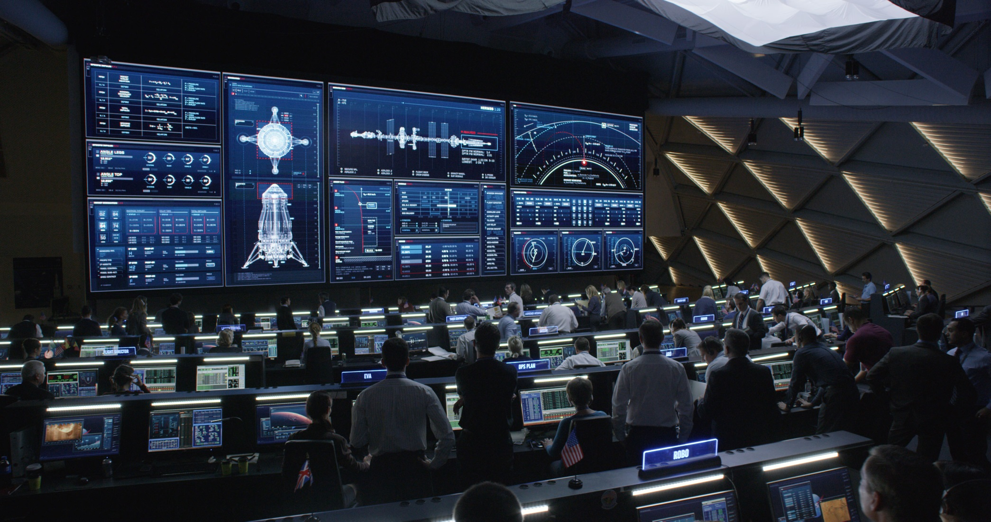
Control Room (The Martian)
http://cdn.collider.com/wp-content/uploads/2015/06/the-martian-movie-image-control-room.jpg

Slide 22

Control Room (The Martian)
http://3.bp.blogspot.com/-IOg7gg3VWsw/Vg4ZgZK3WNI/AAAAAAAABH8/MImWkRXLpsE/s1600/The_Martian_Mission_Control.jpg

Slide 23

Control Room (The Martian)
http://s3.foxmovies.com/foxmovies/production/films/104/images/gallery/martian-gallery18-gallery-image.jpg

Slide 24
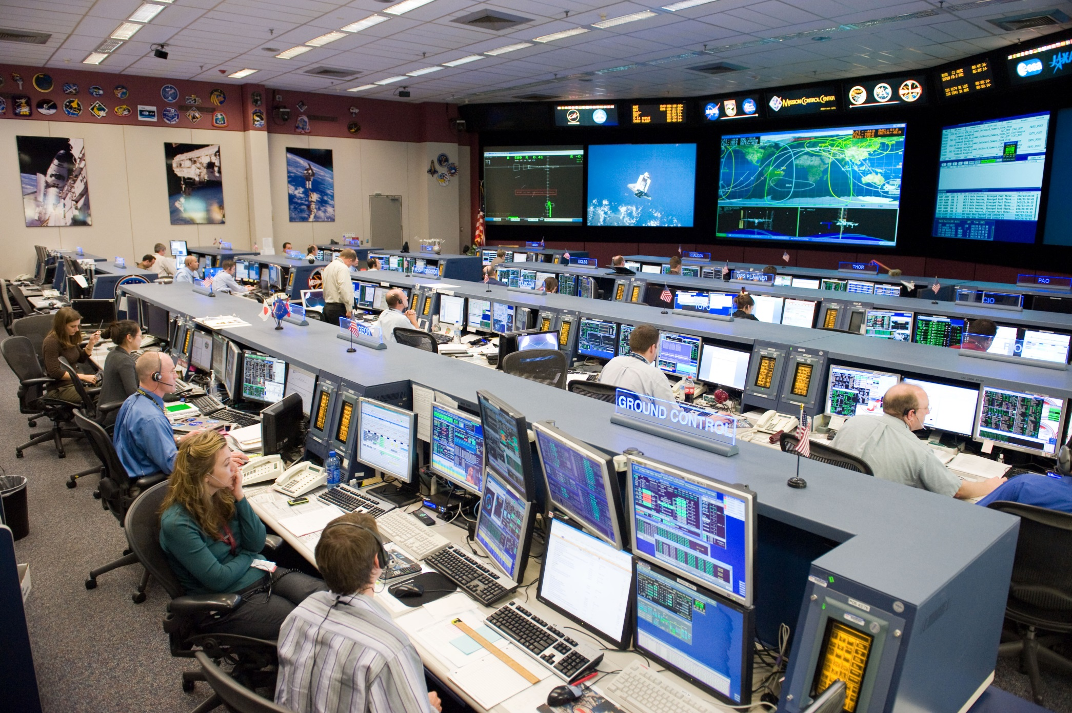
NASA Control Room
https://upload.wikimedia.org/wikipedia/commons/f/fd/STS-128_MCC_space_station_flight_control_room.jpg

Slide 25
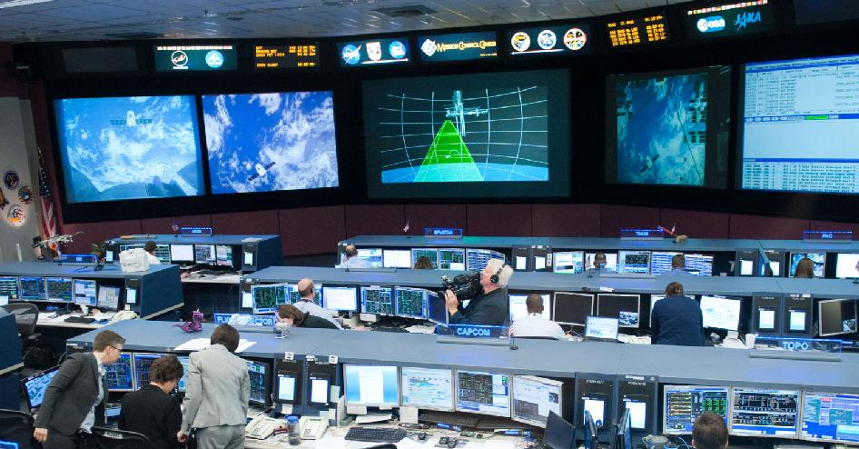
NASA Control Room
http://www.nasa.gov/images/content/652997main_jsc2012e054285_1600_946-710.jpg

Slide 26
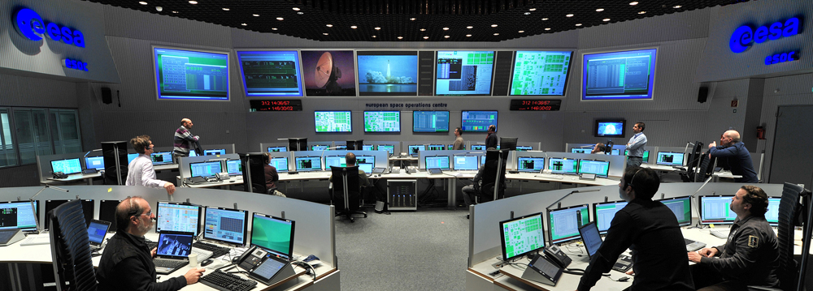
http://spacefellowship.com/wp-content/uploads/2012/08/ESOC-MainControlRoom-13x19cm-08112011-JMai-4822.jpg

Slide 27
