Slide 1
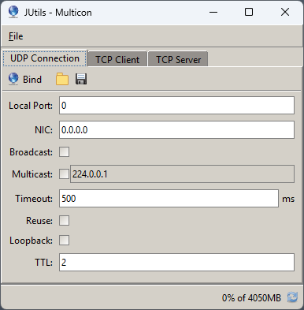
UDP( 0, "UDP" ),
/** */
TCP_SERVER( 1, "TCP Listen" ),
/** */
TCP_CONNECT( 2, "TCP Connect" ),
/** */
SERIAL( 3, "Serial" ),
/** */
BRIDGE( 4, "Bridge" ),
/** */
TRANSFER( 5, "Transfer" ),
/** */
NTP( 6, "NTP" );

