Slide 1
Direct Marketing Campaign Response Prediction
A Python modeling project using the data of KDD Cup 1998
Joe Shan
Sep 2017

Slide 2
Objective
The objective of KDD Cup 98 was to optimize the profit of direct marketing.
Profit prediction is a combination of response prediction and individual profit prediction.
This project only focus on response prediction. Meanwhile, this project is also to show the capability of Python on statistical modeling.

Slide 3
The Campaign of PVA
Paralyzed Veterans of America (PVA) is a not-for-profit organization that provides programs and services for US veterans with spinal cord injuries or disease.
One of PVA's fund raising appeals was dropped in June 1997 to a total of 3.5 million PVA donors. It included a gift "premium" of personalized name & address labels plus an assortment of 10 note cards and envelopes. All of the donors who received this mailing were acquired by PVA through premium-oriented appeals like this.

Slide 4
The Data Set
The analysis data set includes:
A subset of the 3.5 million donors sent this appeal
A flag to indicate respondents to the appeal and the dollar amount of their donation
PVA promotion and giving history
Overlay demographics, including a mix of household and area level data.
Train set (from cup98LRN.txt)
76329 rows, 481 columns (80%)
Test set (from cup98LRN.txt)
19083 rows, 481 columns (20%)
Column TARGET_B
Target Variable: Binary Indicator for Response to the 97NK Mailing

Slide 5
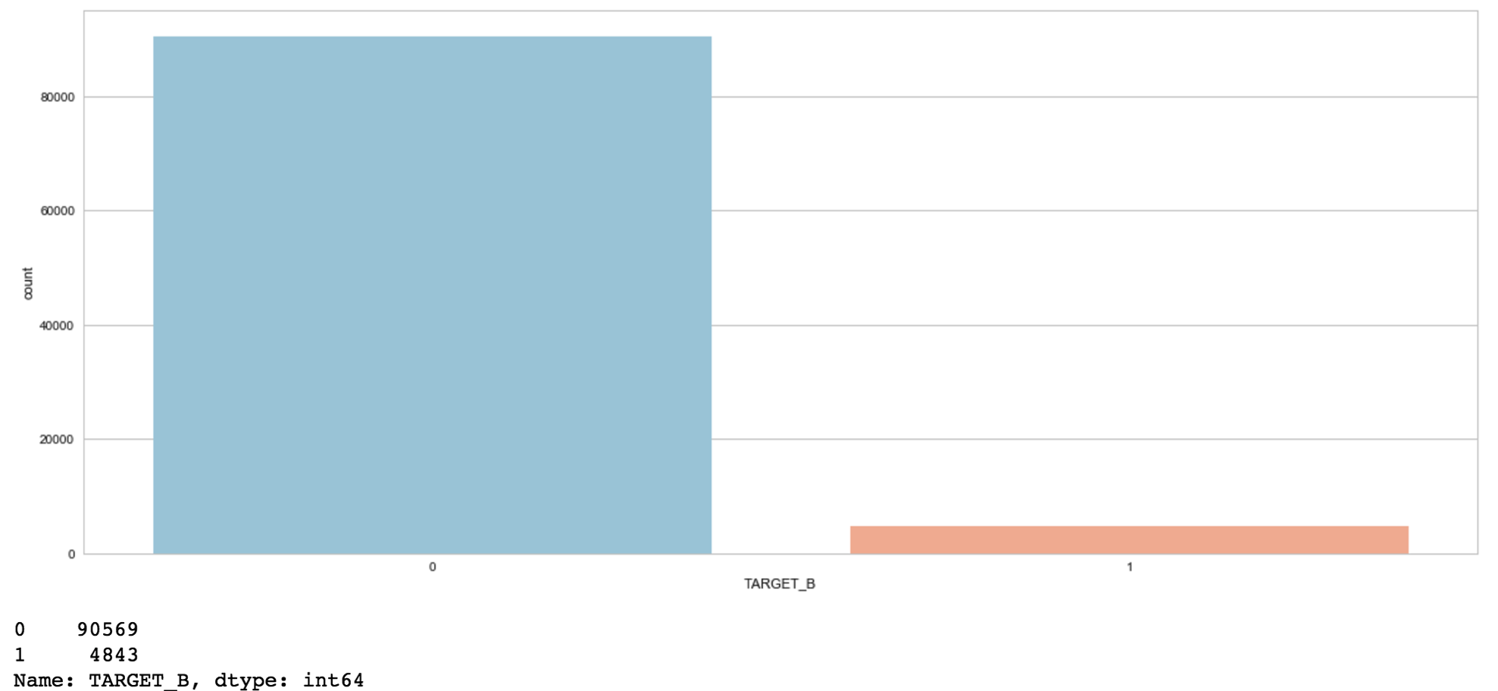
Dependent Variable on Whole Set - 1

Slide 6
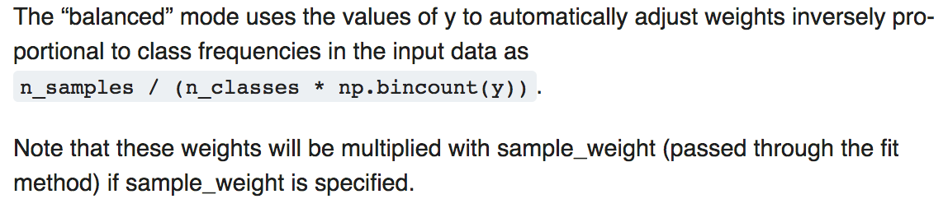
Dependent Variable on Whole Set - 2
TARGET_B is binary.
Logistic Model is valid.
Given hundreds of variables, Logistic Model is easier to interpret and more intuitive than decision tree.
The response rate is about 5%.
Unbalanced
Traditional: Resampling
In this project: balanced class weight

Slide 7
Logistic Model and Python
Python – Why
Easy to develop and more transferable
Will be more and more powerful and popular
Able to realize some amazing functions easily
(e.g. Class_Weight = ‘balanced’, REFCV, RFE)
Python – How
Tool: Jupyter Notebook (Anaconda)
Library: scikit-learn
Some self-created functions (e.g. partial correlation matrix)
Code: My github repositories

Slide 8
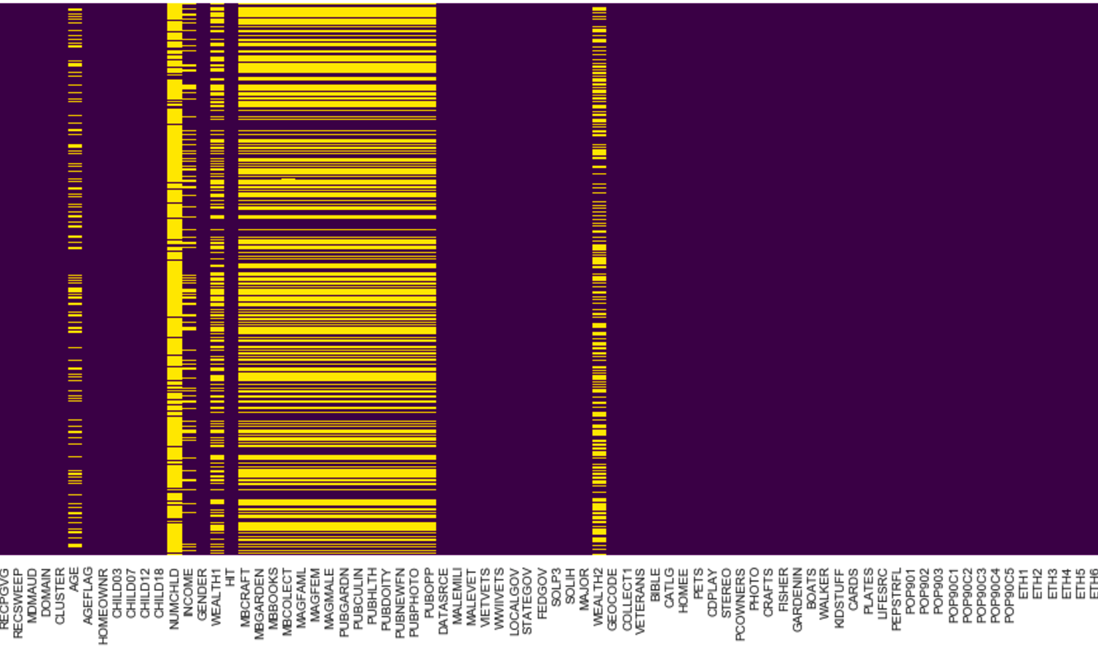
Missing Values - 1

Slide 9
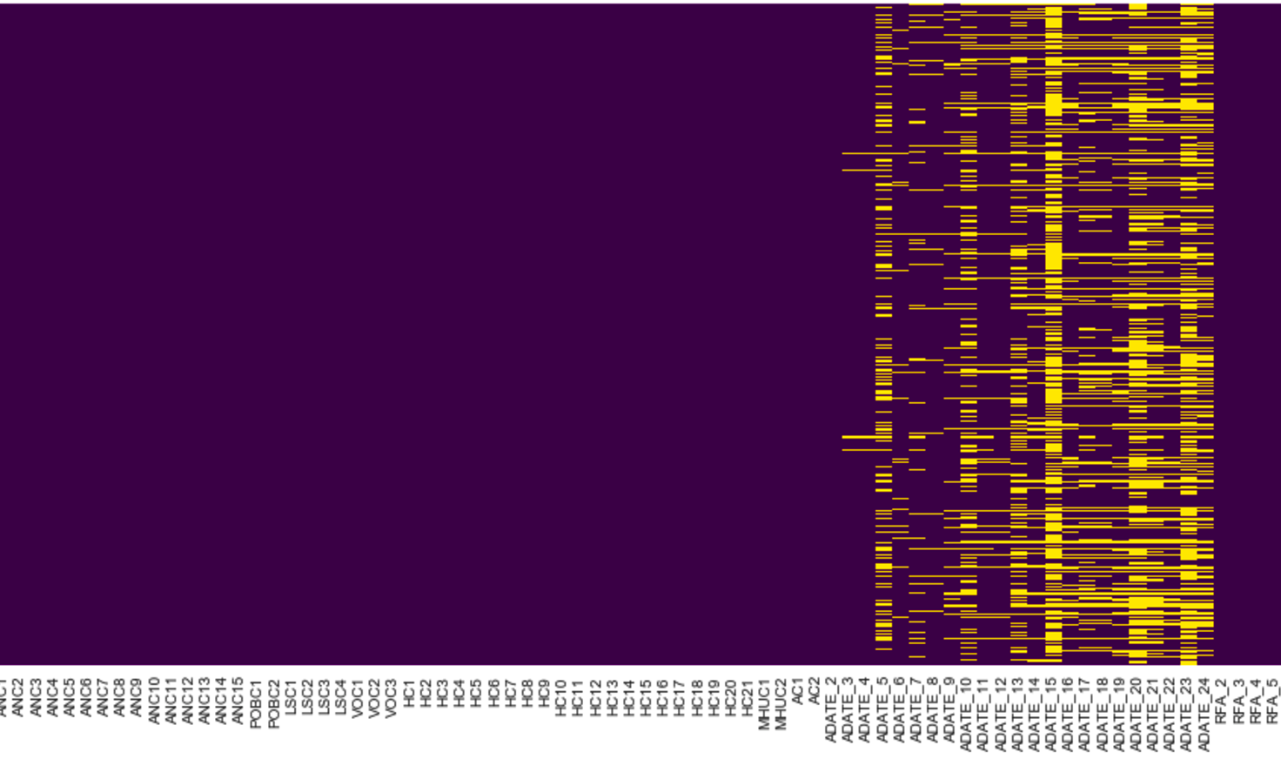
Missing Values - 2

Slide 10
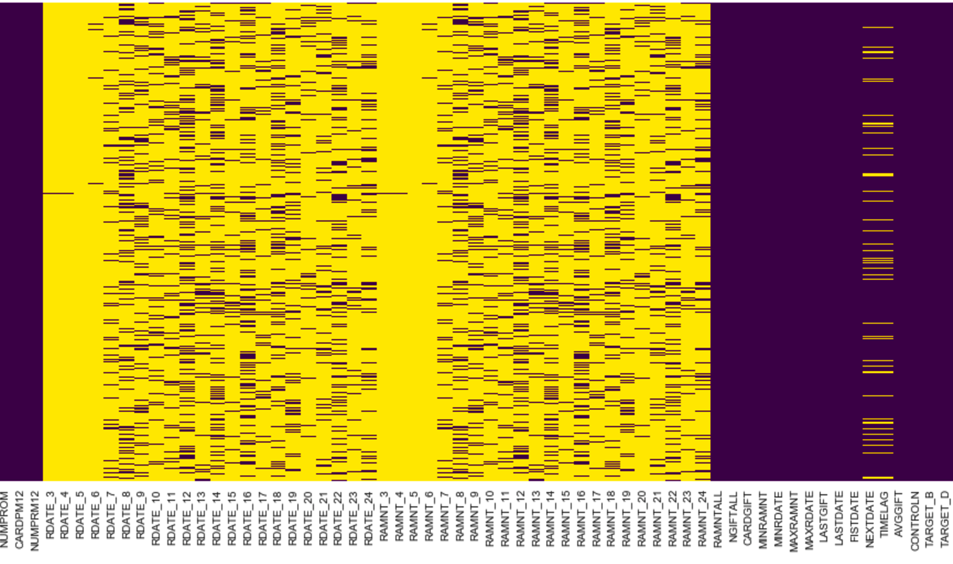
Missing Values - 3

Slide 11
Recode - 1
Philosophy
Minimize the manipulation
Let the algorithm handle the most painful part
Steps
Convert flags to 0,1
Recode some blank values
Recode the date (YYMM to difference in month)
Define ordered variables
Imputation of missing values
The most frequent for nominal, median for numeric
Create dummy variables (see the details in the next slide)
Create standardized data set for variable reduction (StandardScaler)

Slide 12
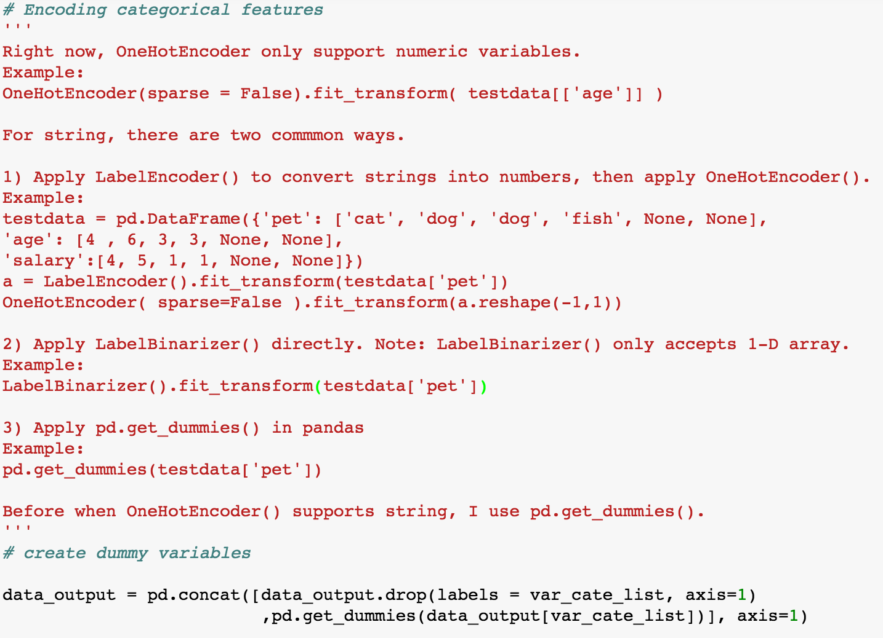
Recode - 2
Create dummy variables (0-1 binary) for each level of categorical variables

Slide 13
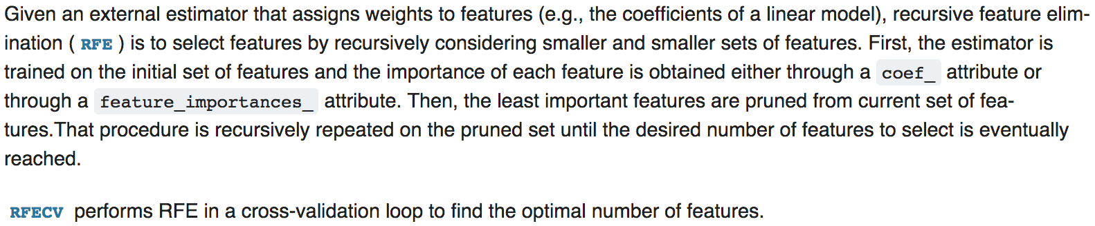
Variable Reduction - 1
Recursive Feature Elimination with Cross-Validation (RFECV)
Logic
Split data (standardized) into N folds
Fit the model using one of the fold
Calculate the average model score on all folds
Eliminate the variables with the least importance
Repeat until only one variable left
Identify the optimal number of variables using model score

Slide 14
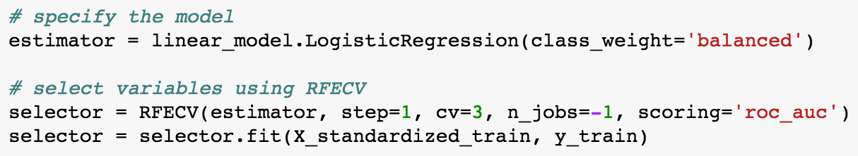
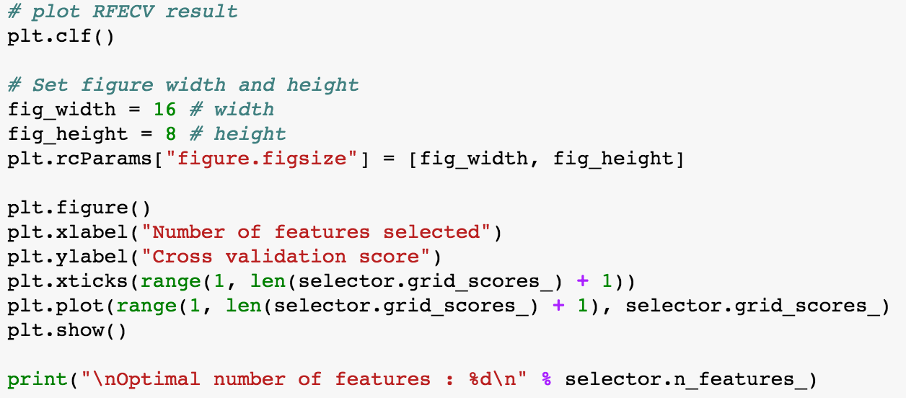
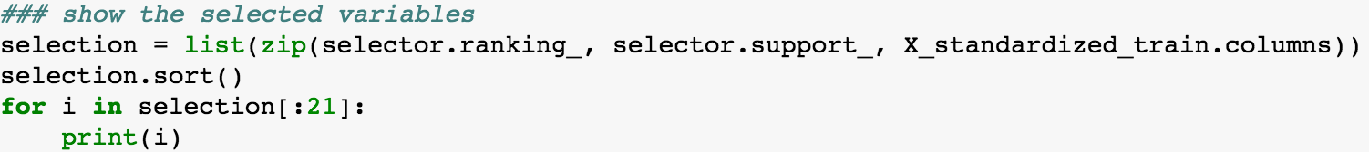
Variable Reduction - 2
REFCV can be done using Python easily. (roc_auc as model score)
The output is clear and straightforward

Slide 15
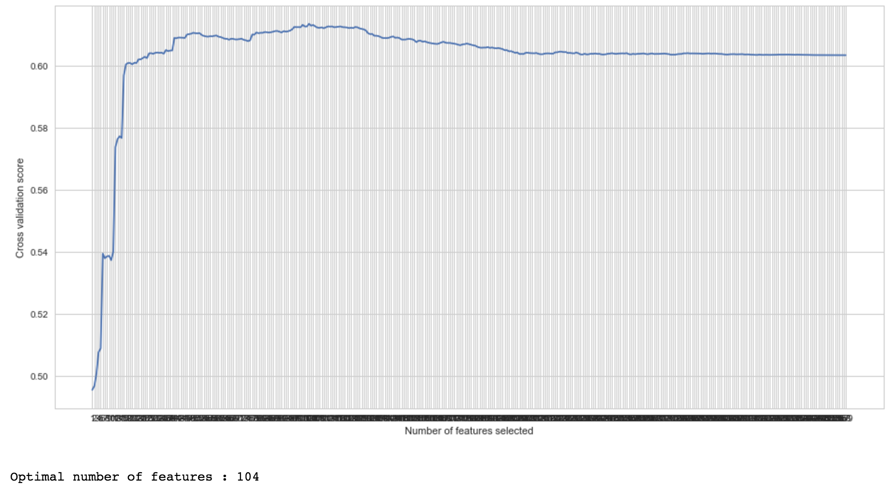
Variable Reduction - 3

Slide 16
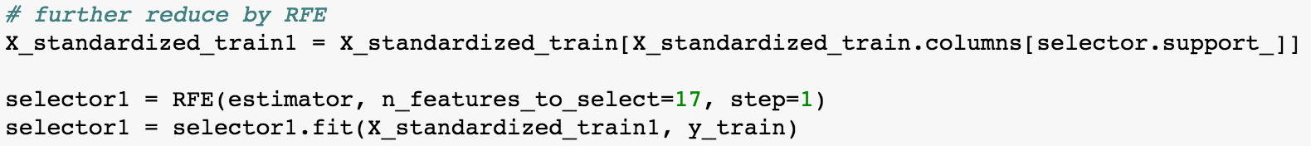
Variable Reduction - 4
Further reduce the variables using RFE
Tune the model by manual model selection based on RFE output
Eliminate highly correlated variables (consider VIF and relative importance)
Test some other variables may have the potential

Slide 17
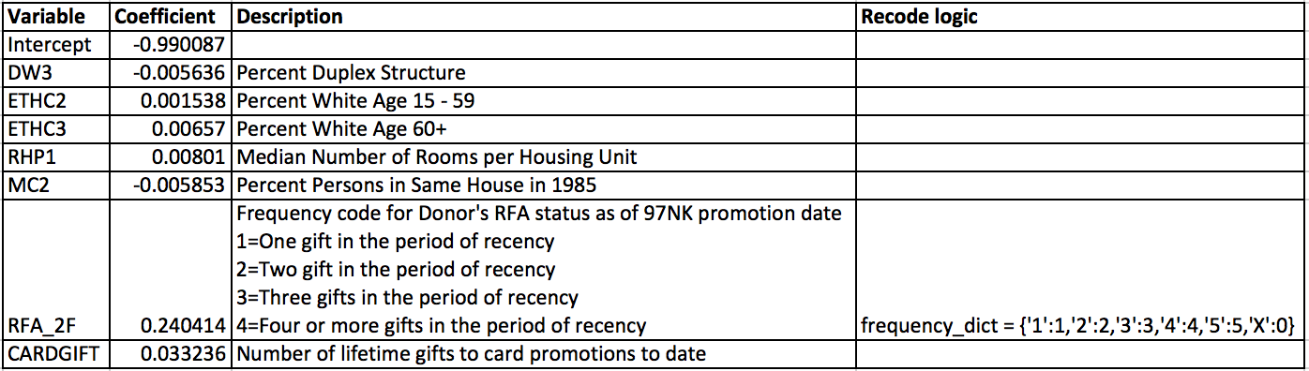
Final Model
scikit-learn doesn’t have a built-in option for parameter t-test
But scikit-learn provides REFCV, class_weight

Slide 18
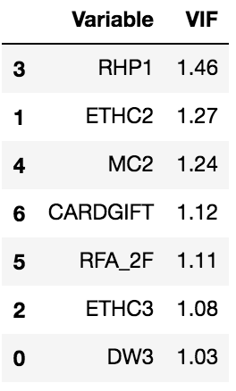
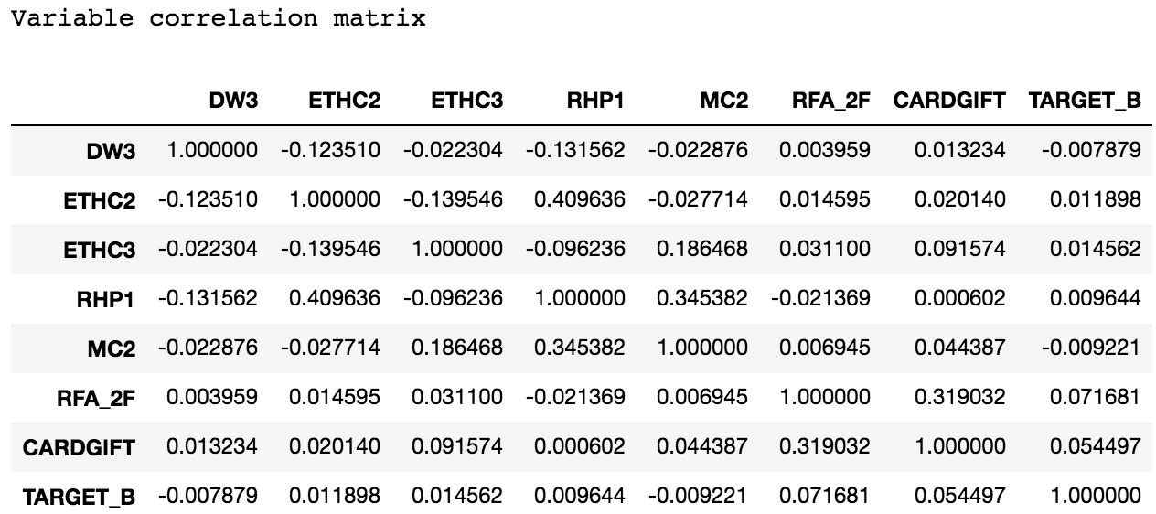
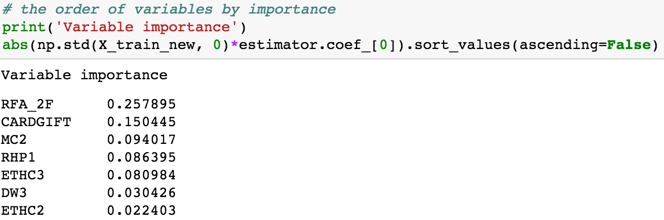
VIF, Correlation and Importance

Slide 19
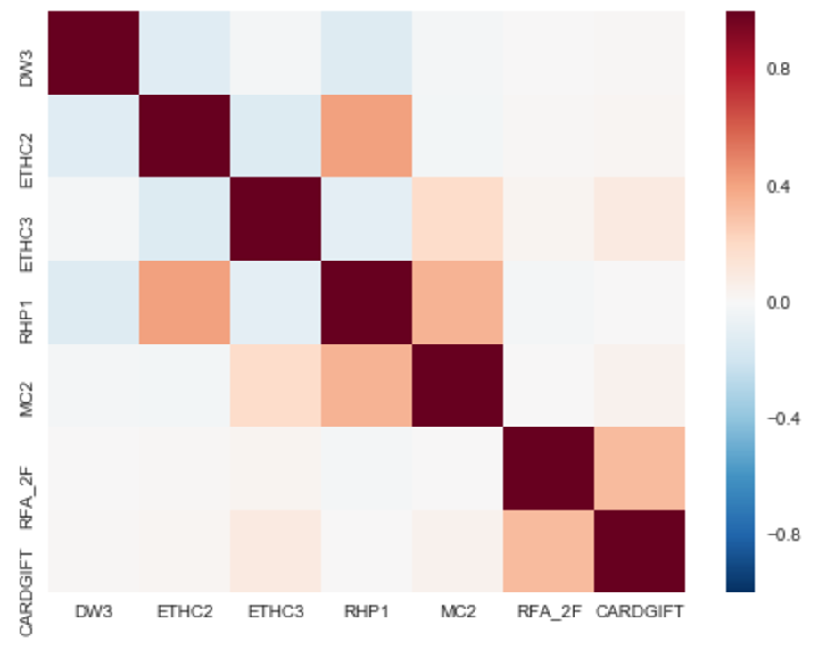
Variable Correlation Plot
Correlation matrix

Slide 20
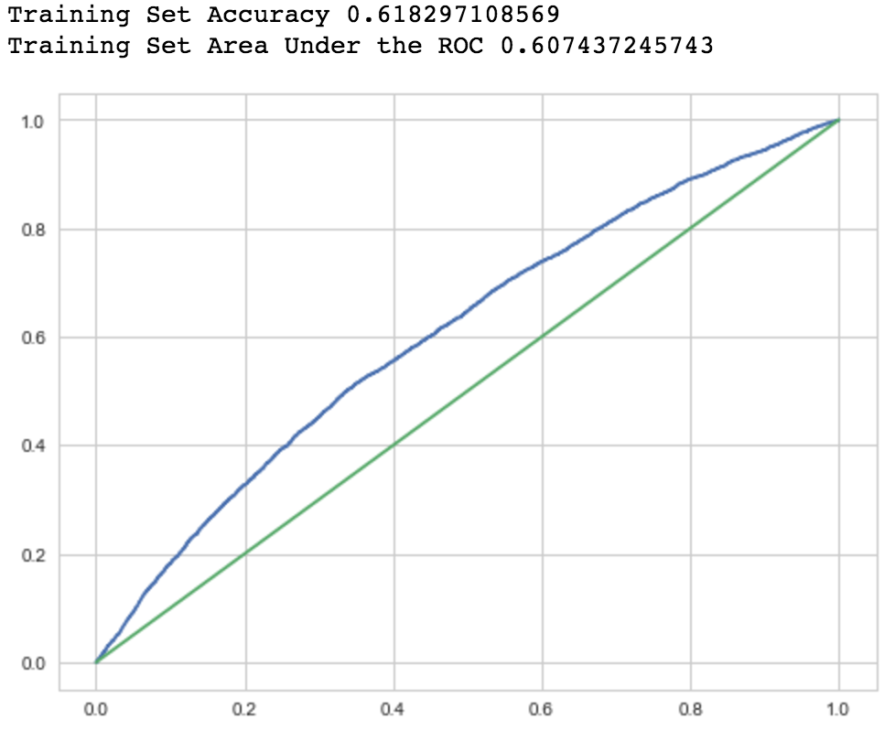
Model Performance on Train Set - 1
Accuracy and ROC curve

Slide 21
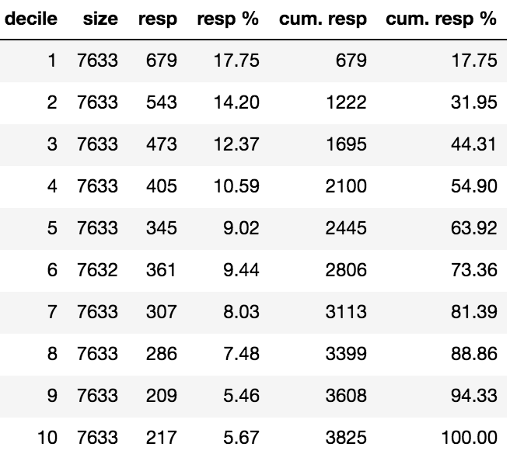
Model Performance on Train Set - 2
Performance by decile

Slide 22
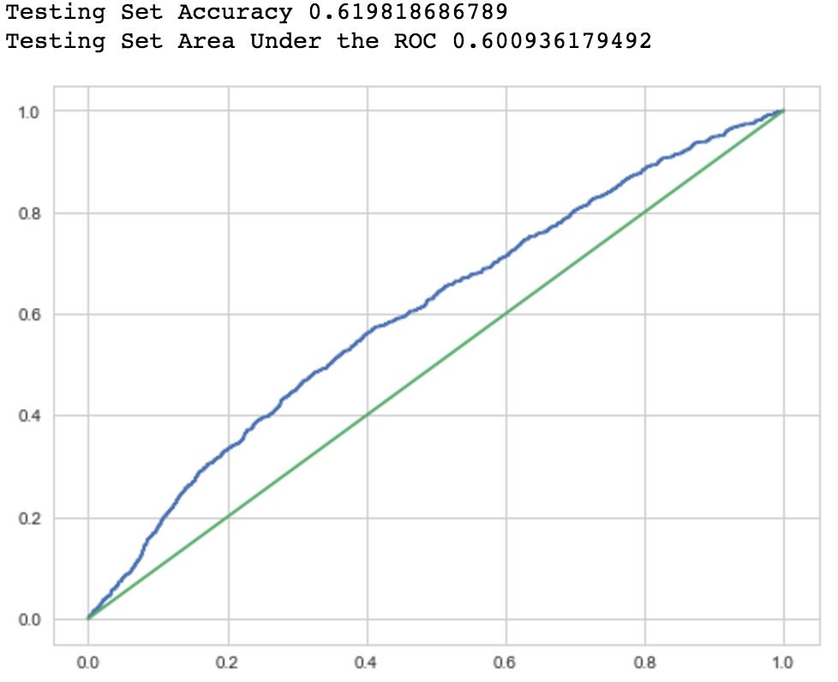
Model Performance on Test Set - 1
Accuracy and ROC curve

Slide 23
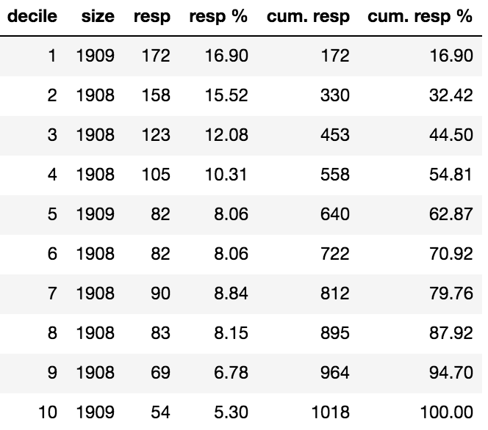
Model Performance on Test Set - 2
Performance by decile

Slide 24
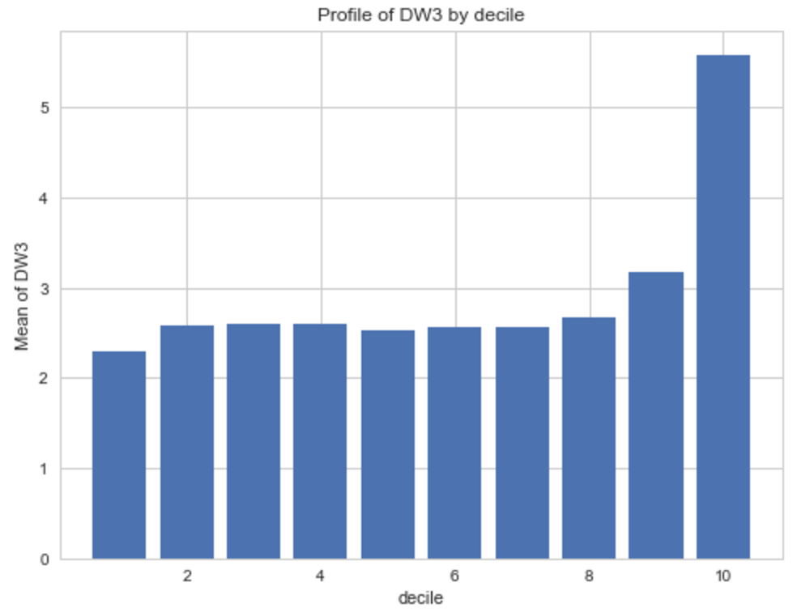
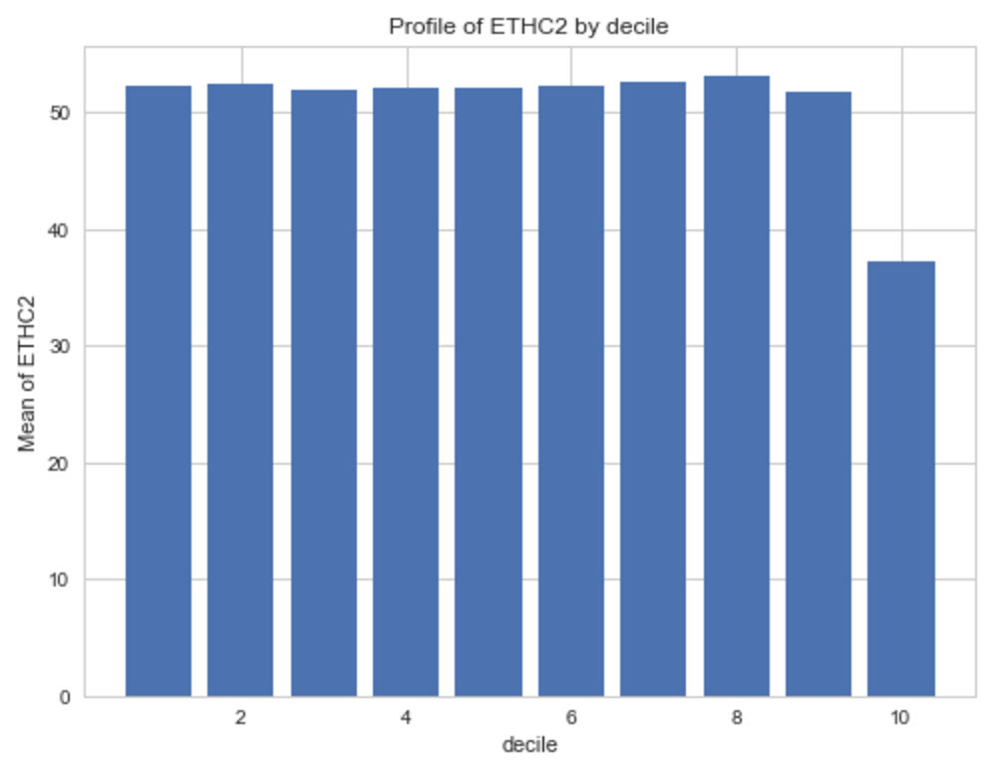
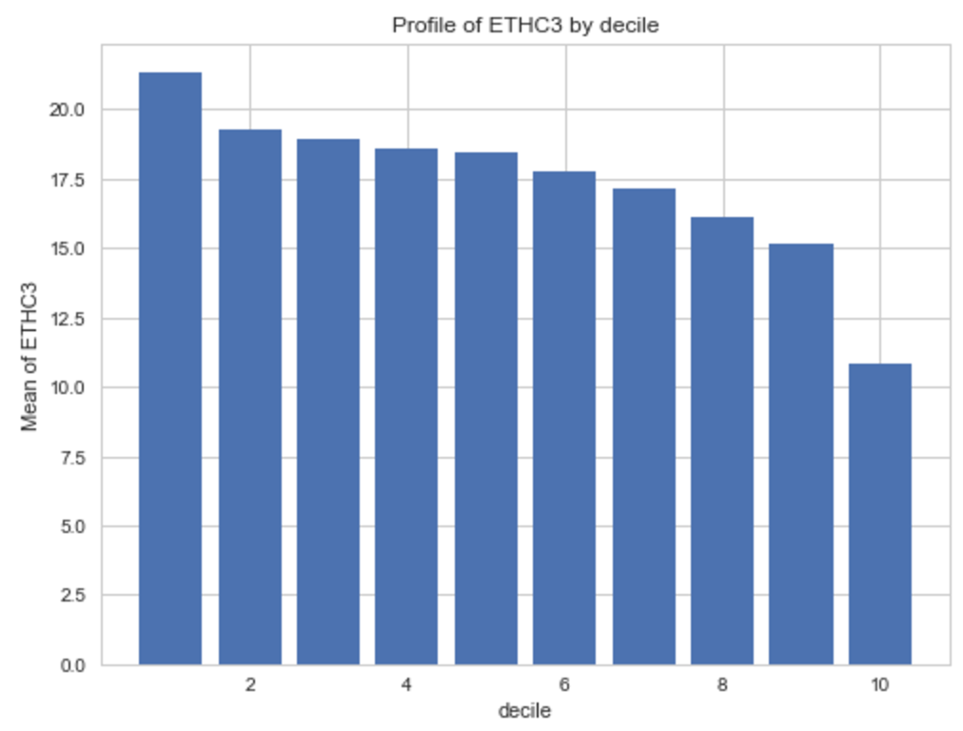
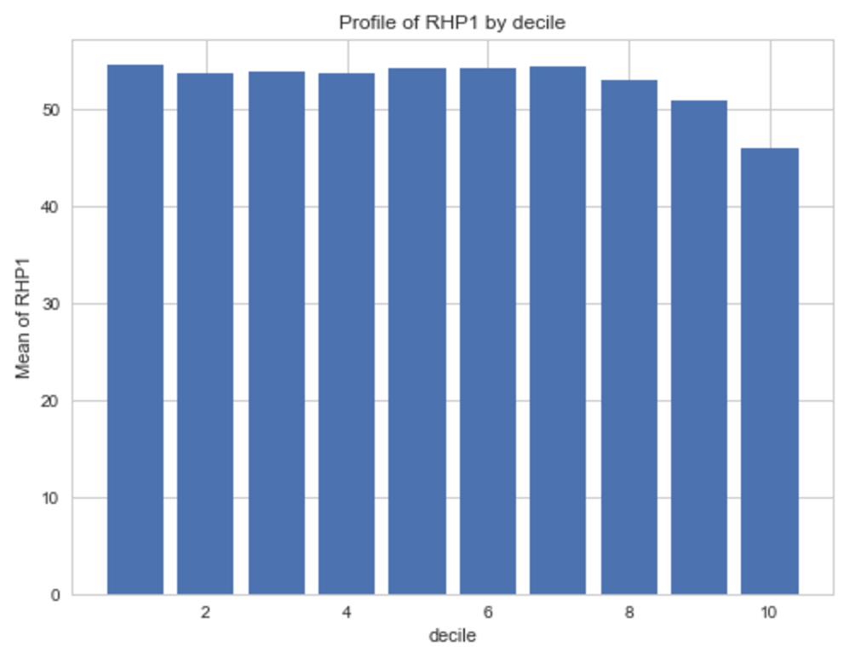
Variable Profiling by Decile - 1

Slide 25
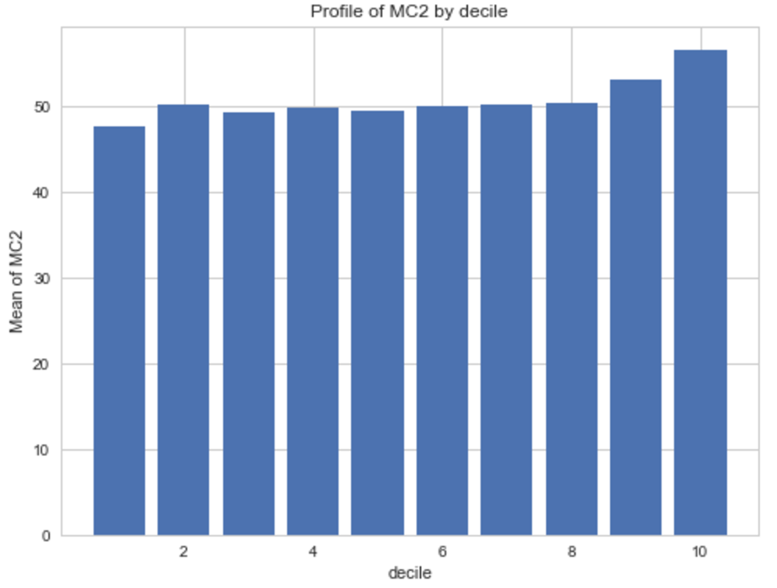
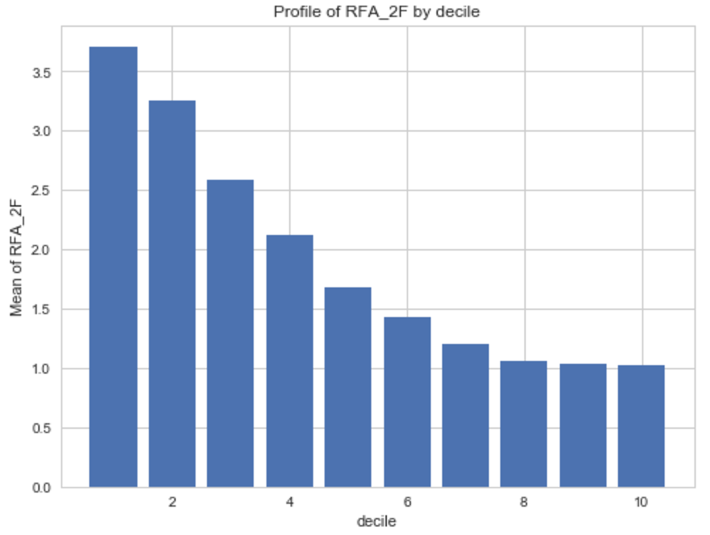
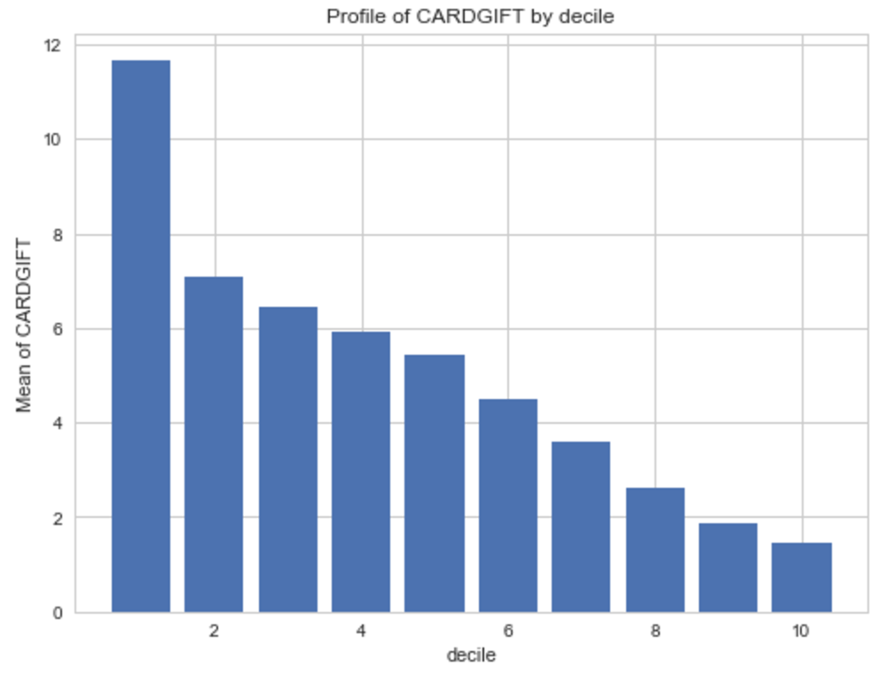
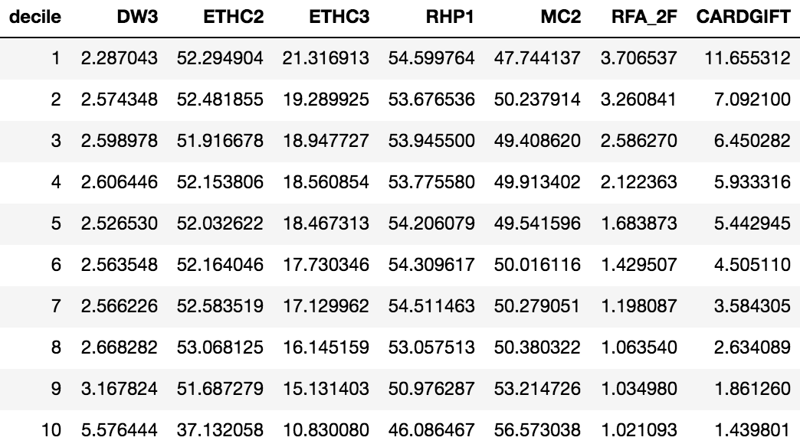
Variable Profiling by Decile - 2

Slide 26
Comments
About the model
Logistic model was used to predict the response possibility.
There are seven variables in the final model.
Frequency is the most important factor to predict the response possibility.
The model is stable according to out-of-sample validation. (for the train set auc_roc = 0.607, for the test set auc_roc = 0.601)
On the test set, the top one decile by predicted probability ranking captured 16.9% of total responders. (predictive power)
The numbers of responders captured by the top four deciles followed a descending order. (stability)
About building model using Python
Flexible and easy to pick up
Simple to archive amazing functions (RFECV, RFE, balanced weight)
Still requires some self-defined functions (partial correlation, VIF, confusion matrix)
sklearn focus more on the machine learning than statistics (no t-test option)

Slide 27
Outlooks
Plan to develop some feature engineering functions for this set of scripts (e.g. states grouping, capping and flooring, transformation)
Plan to develop variable reduction methods other than RFECV and RFE (e.g. variable score according to the significance of multiple models)
Plan to develop customized model score for REFCV (e.g. percentage of responders captured by the top three deciles)

Slide 28
Thank you!
Link to files
https://github.com/joeshan/kdd_cup_98

