Slide 1


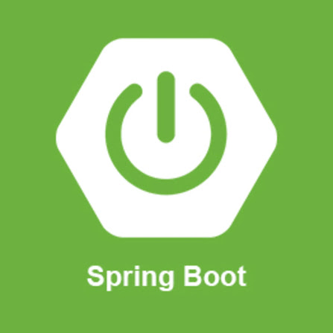
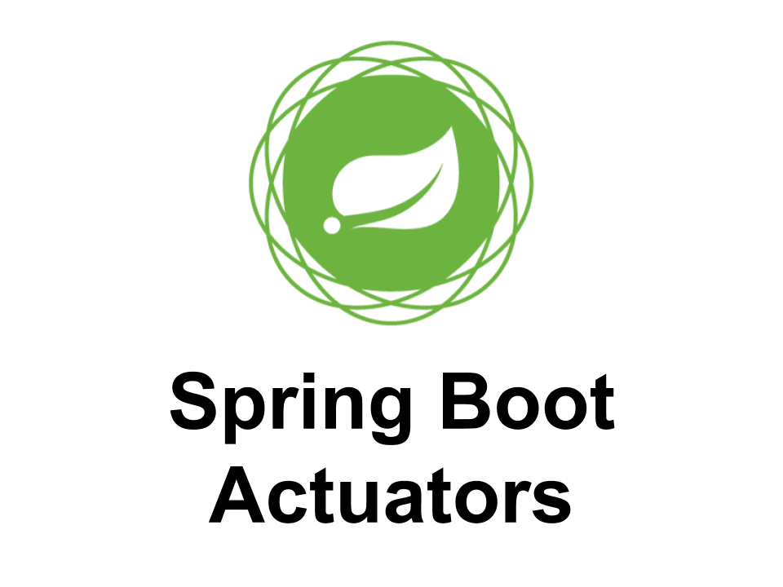





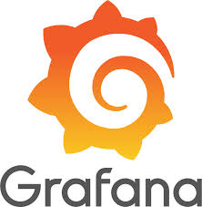





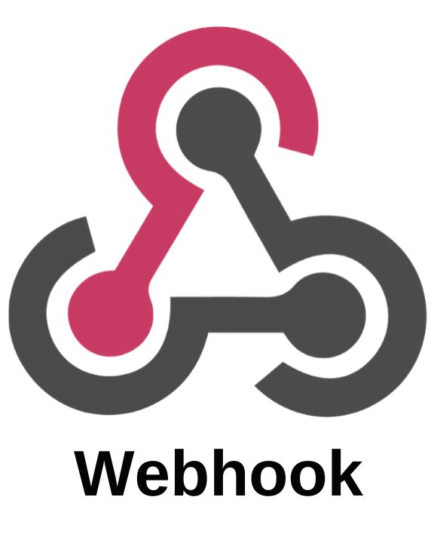
Zodiac observability platform:
VM metrics
VM metrics
App metrics
OTEL collector
Application metrics
Zodiac applications
Tracing data
Observability:
Metrics:
VM metrics: Glances➔Prometheus➔Grafana
App metrics: OpenTelemetry➔OTEL collector➔Prometheus➔Grafana
Events
Log: Fluentd➔Grafana loki➔Grafana
Logs
App log: Fluentd➔Grafana loki➔Grafana
Traces
OTEL collector➔Grafana Tempo➔Grafana
Alert & Notification
Grafana alert/notification
Spring Boot Admin
Log aggregation
Application observability
… https://grafana.com/docs/grafana/latest/alerting/configure-notifications/manage-contact-points/#list-of-supported-integrations

