Slide 1
Detecting IP Spoofing Using TTL Forensics
Joe Faulls - 1447637

Slide 2
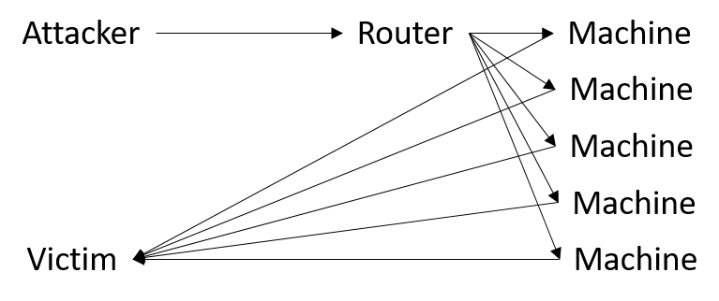
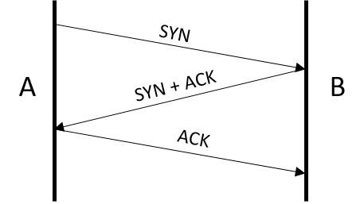
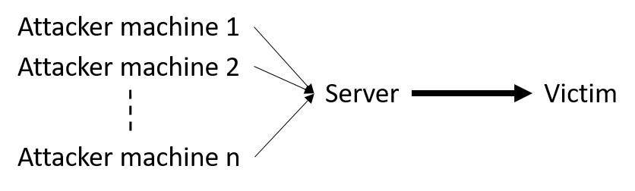
IP Spoofing
Smurf Attack
TCP-SYN Flood
Reflective UDP Amplification
A
SYN
B
SYN + ACK
C

Slide 3
Current Work
Eliminating spoofed packets when a router/device is close enough
Encoding route information in packets

Slide 4
Using TTL

Slide 5
Using TTL
Assumptions: - The route taken by separate requests from the same source are the same, or very similar
- Routes change infrequently and not by much

Slide 6
Using TTL
If a packet arrives with a TTL value statistically different enough from the expected one for the given source address, we can assume that the packet has taken a very different route to get there.

Slide 7
Data Collection

Slide 8
Data Collection – Engineering Challenges
Utilising threads
Efficient data structures
Multiple writes/one read

Slide 9

Data Structures

Slide 10
LEVEL UP

Slide 11
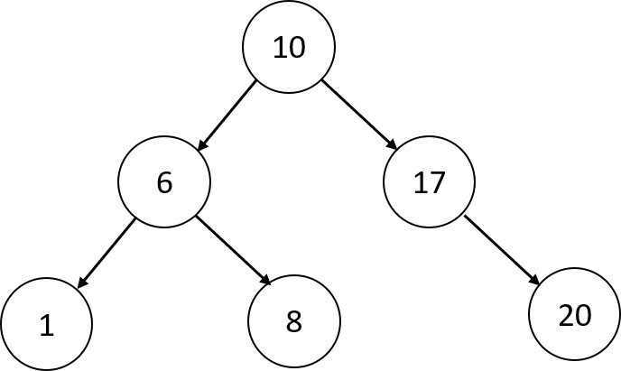
Data Structures
Hash Tables
Judy Arrays

Slide 12
Demonstration

Slide 13
From here
Collect data
Method of clustering IP addresses
Method of classifying correctness of TTL value

