Slide 1
Car Rental Management System
Group 4:
Anene Bekuma Terefe 610773
Joe Sleiman 610721
Namuun Sainbayar 610745
Tesfai Gebrekidan 110464

Slide 2
Introduction
Several years ago, if you want to rent a car you should go to the shop in personal, after taking an appointment, waiting your meeting, negotiate with the owner, check the cars that suits your budget, ask questions about the car like how much it take gas, how much miles already operated, how many accidents if there any, check any scratches, check if is it full of gas before you take it, and many more things.
But nowadays you can do all these features through an online Software, website, or apps,
Facilitating everything to the users and Customers, so they cannot waste time, they can book or rent a car in advance, especially if they are going or travelling somewhere else, they can manage everything in their places, plus now there are lot of websites or software for car rental management system, so there are lot of competitors, everyone need to make her/his car rental management system better than the other to attract more customers and gain more money.

Slide 3
Positioning
The problem of | Managing the rental of a car through a system
Affects | administrators, employees, customers
the impact of which is | Customers need to go to business place or make phone call to book rental cars
a successful solution would be | one tool which handle the functionalities of rental cars. The tool will provide an easy online reservation of cars based on availability and type of cars.
Problem Statement

Slide 4
Positioning
For | Any customer or Customer or any individual above 18 years old and has driver license
Who | Customer need a temporary car to rent
The “CarRental” | is a system that is used for car rental purposes.
That | Is globally available and provides online rental car reservation. Since the system is globally available to customers, it will boost the business process.
Product Position Statement

Slide 5
Stakeholders
Name | Description | Responsibilities
Administrators | Administrators is the super user of the system. It has the highest privileges. | Admin is responsible to add, edit or delete cars and employees.
Customer | Customer can browse the system, to check the available cars in specific date to rent them if they find the deals convenient to their requests. | Rent a car
Employee | The employee manages the rental process. | Employee manages booking of rental cars, review customer information.
Developers | Developers develop system on the basis of given document | Developers are responsible for developing system features, fixing bug, and maintaining the system’s availability
Testers | Testers should test all the scenarios could possible happened to check if there’s errors | Testers are responsible for integration testing.

Slide 6
Needs and Features
No | Problem | Need | Priority | Features
Admin
1 | Admins need to make business to rent cars online | Cars available to rent | Hight | Admin will insert the important information that will be interesting for the users, so the admin can add cars
2 | If the car wasn’t available anymore | Car should be deleted | High | Admin will delete the unavailable car,
3 | The admin has to change the rent price of the car depend on the season or he may to edit the miles operated of the car | Car should be edited | High | Admin will edit the specific car
4 | The admin should let the Customer who already rent a car to pay a fee because he didn’t return back the car in the exact time | Admin should specify the fee | High | Admin will give the Customer a fee
5 | Managing Employees | Admin should add new employee, edit, or delete | High | Admin has the privilege to manage the employees.
Employee
6 | manages the rental process. | Employee should check the customer when he arrives to take the car | High | Employee has the privilege to check the information of the customer.
Customer
7 | Customers need to rent cars online, to stop wasting time, and make it easy for them | Online system | 5 | Customer will browse the system and select the dates when he needs the car

Slide 7
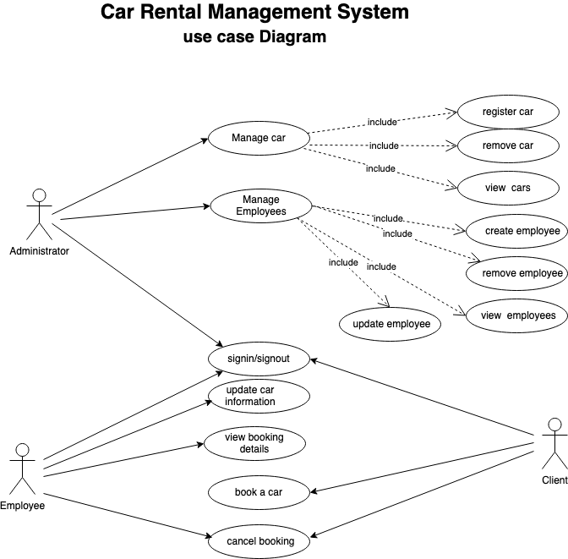
Use Case Model

Slide 8
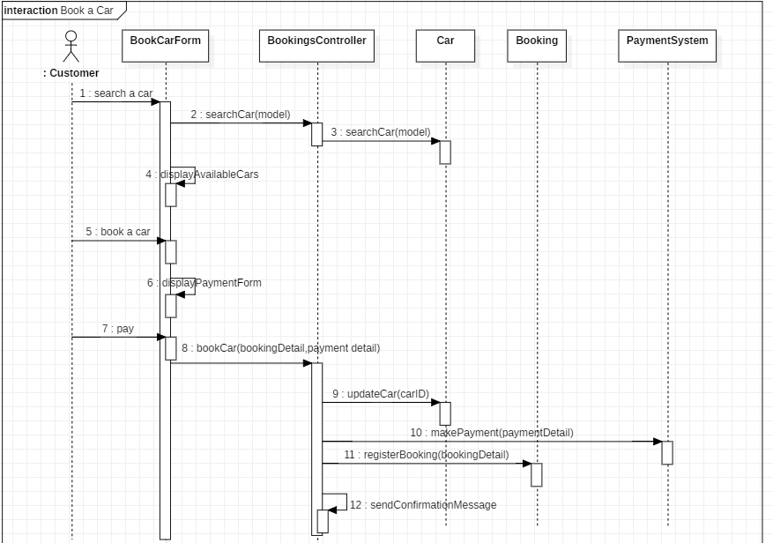
Sequence Diagram – Book a Car

Slide 9
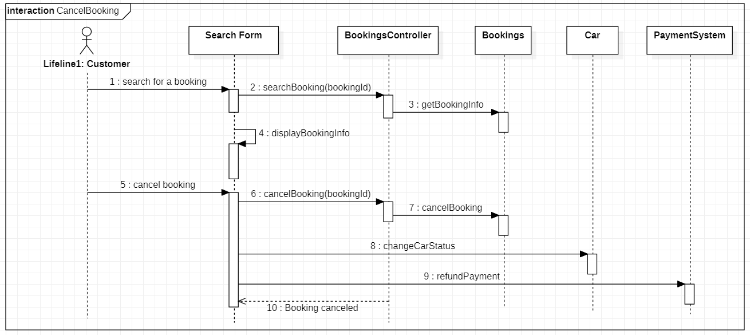
Sequence Diagram – Cancel Booking

Slide 10
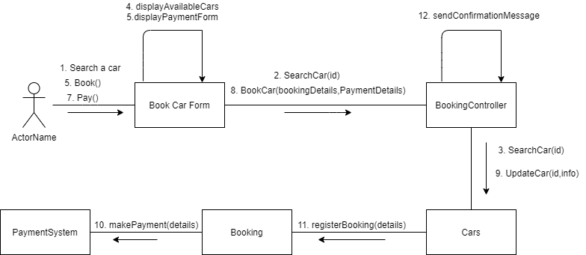
Collaboration diagram – Book a car

Slide 11
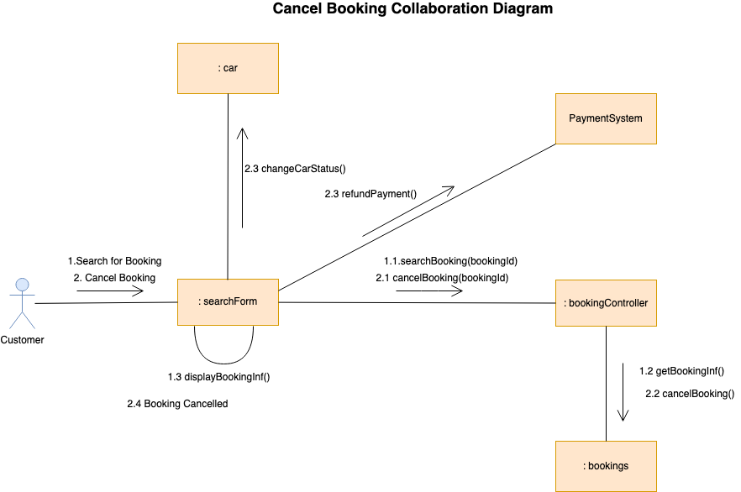
Collaboration diagram – Cancel booking

Slide 12
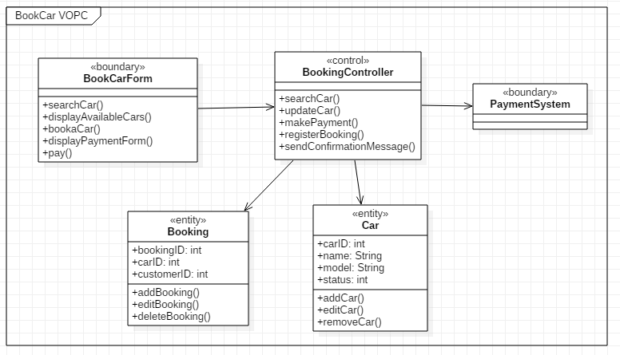
VOPC diagram – Book a car

Slide 13
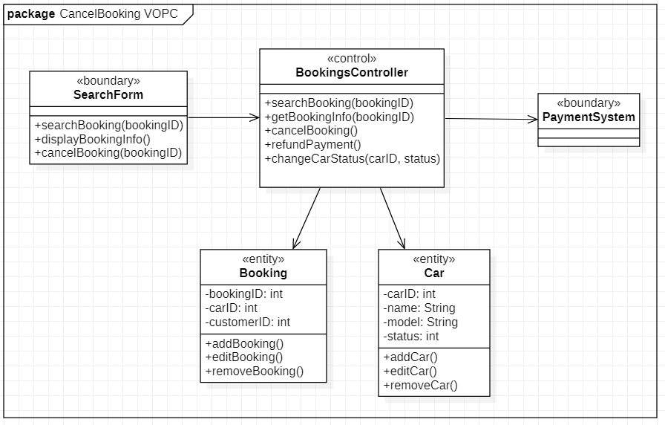
VOPC diagram – Cancel booking

