Slide 1
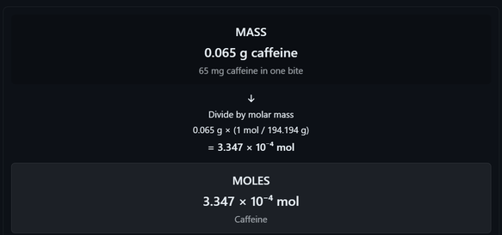
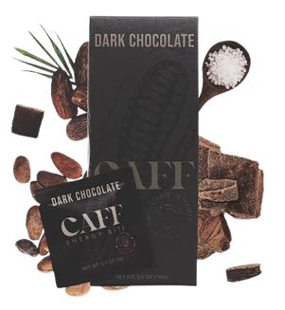

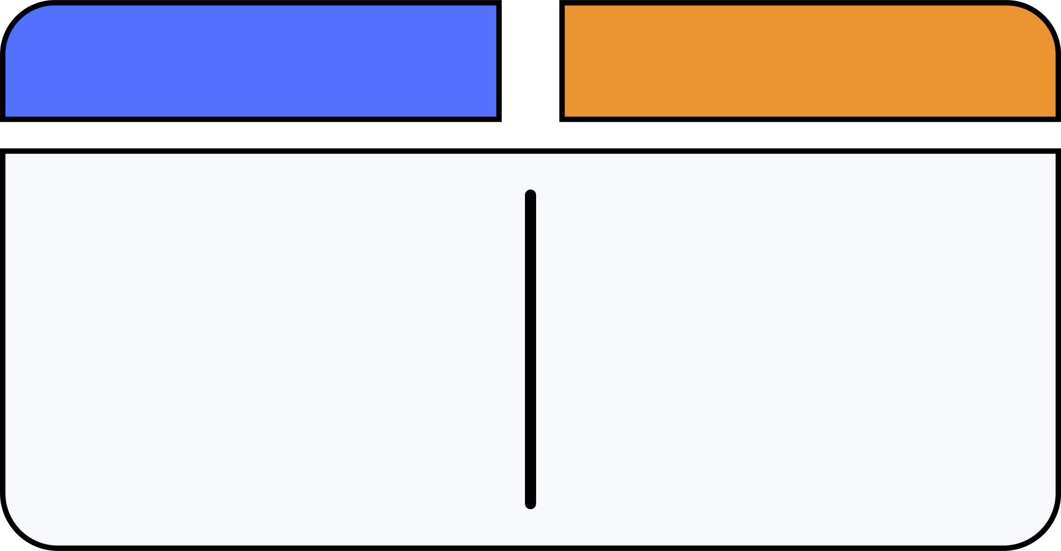



BSCpE - 1A
ATOM COUNT CARD
Mole Concept and Conversion
PRODUCT IDENTITY
Product Name:
CAFF Caffeinated Energy Bite, Dark Chocolate
Compound Name:
Caffeine
Formula:
C₈H₁₀N₄O₂
Why the Compound is in the Product:
Caffeine is included as a stimulant.
Product source:
https://eatcaff.com/products/energy-bites
ESQUILADOR, JOSE MIGUEL T.
BASE QUANTITATIVE DATA
Quantity
Value/Units
Source
Precision
MOLE MAP
Caffeine per bite
65 mg/bite
Manufacture’s product info
2 sig. fig.
Pack size used
20 bites/pack
Manufacturer's listed pack option
Exact
Scale- up scenario
20 bites
Assumption: 20 students, one bite each
Exact
Formula of Caffeine
C₈H₁₀N₄O₂
PubChem
Exact Subscript
Atomic masses
C -12.011, H- 1.008,
N- 14.007, O- 15.999
CIAAW
Not limiting
Avogadro's constant
6.02214076 × 10²³ mol⁻¹
IUPAC (2019)
Exact
MOLAR MASS BUILD-UP
Elements
Atoms
Atomic mass
(g/mol)
Contribution
(g/mol)
Percent by Mass
l
C
8
12.011
96.008
49.480%
H
10
1.008
10.080
5.191%
N
4
14.007
56.028
28.852%
O
2
15.999
31.998
16.477%
Total
24
43.025
194.194
100%
MOLE CONVERSION CALCULATIONS
Molar mass of C₈H₁₀N₄O₂:
REVERSE: FROM % COMPOSITION TO THE FORMULA
Assume a 100 g sample of caffeine (C₈H₁₀N₄O₂).
8(12.011) + 10(1.008) + 4(14.007) + 2(15.999) = 194.194 g/mol
Moles (mol)
Atomic Mass (g/mol)
Simplest Ratio
Label bridge: caffeine per package
Element
Mass%
Mass (g)
12.011
4
20 bites × (65 mg caffeine / 1 bite) = 1,300 mg caffeine
1,300 mg × (1 g / 1,000 mg) = 1.30 g caffeine
C
49.48%
49.48g
4.118
1.008
Mass → moles (one bite)
H
5.19%
5.19g
5.149
5
65 mg × (1 g / 1,000 mg) × (1 mol / 194.194 g)
= 3.347 × 10⁻⁴ mol caffeine
N
28.85%
28.85g
2.0160
14.007
2
Moles → molecules
O
16.48%
16.48g
1.030
15.999
1
3.347 × 10⁻⁴ mol × (6.02214076 × 10²³ molecules / 1 mol)
= 2.015 × 10²⁰ ≈ 2.0 × 10²⁰ caffeine molecules
Calculate moles
Moles = mass ÷ atomic mass
Atoms of one element inside the formula
C: 49.48 ÷ 12.011 = 4.118 mol
H: 5.19 ÷ 1.008 = 5.149 mol
N: 28.85 ÷ 14.007 = 2.060 mol
O: 16.48 ÷ 15.999 = 1.030 mol
2.015 × 10²⁰ molecules × (4 N atoms / 1 molecule)
= 8.06 × 10²⁰ = 8.1 × 10²⁰ nitrogen atoms
Find the simplest ratio
Percent composition + two-route check (Nitrogen)
Divide each mole value by the smallest value, 1.030.
%N =
4(14.007)
194.194
× 100 = 28.85% N
Route 1: Using percent composition
Empirical formula: C₄H₅N₂O
65 mg caffeine ×
28.85mg N
100mg caffeine
Molecular formula: C₈H₁₀N₄O₂
= 18.75 mg N ≈ 19 mg N
Reverse: how much CAFF energy bite product contains one mole of caffeine?
Route 2: Using moles and atomic mass
194.194
1 mol
1 bite
0.065g caffeine
1 package
20 bites
0.065 g caffeine × (1 mol caffeine / 194.194 g caffeine) ×
(4 mol N atoms / 1 mol caffeine) × (14.007 g N / 1 mol N atoms)
= 0.01875 g N × (1,000 mg / 1 g)
= 18.75 mg N ≈ 19 mg N
1.00 mol
x
x
x
= 149.38 packages
Both agrees
In the % composition of nitrogen atoms, 28.85% was used as the equivalent of 100% to determine the number of nitrogen atoms in caffeine (C₈H₁₀N₄O₂).
  ONE PACKAGE
SIGNIFICANT-FIGURE CHECK
Calculator: 2.0155... × 10²⁰ molecules
Reported: 2.02 × 10²⁰ molecules
1.3g of caffeine
6.70 × 10⁻³ mol
4.04 × 10²¹ molecules
ONE-NUMBER TAKEAWAY
  Limits: 65 mg (2 s.f.), Exact Nₐ, Exact subscripts.
  65 mg limits the final answer to 2 s.f.
  Therefore, the final reported value is rounded to 2 s.f.
2. ONE CLASSROOM, ONE DAY
"One mole of caffeine is equivalent to eating exactly 149.38 packages of CAFF energy bites."
Assume 20 students, 1 package/student
0.134 mol
SCALE-UP: FROM ONE PACKAGE TO THE WHOLE CAMPUS
8.07 × 10²² molecules
REFERENCE
3. CAMPUS, ONE YEAR
Assume 1,000 students, 100 packages/year
670 mol
CAFF, Inc. (n.d.). Caffeinated energy bite. https://eatcaff.com/products/energy-bites
National Center for Biotechnology Information. (n.d.). PubChem compound summary for CID 2519, caffeine. PubChem. https://pubchem.ncbi.nlm.nih.gov/compound/2519
International Union of Pure and Applied Chemistry. (2019). Atomic weights of the elements 2019. https://www.qmul.ac.uk/sbcs/iupac/AtWt/
CIAAW. (2021). Atomic weights of the elements. Commission on Isotopic Abundances and Atomic Weights. https://ciaaw.org/atomic-weights.htm
4.04 × 10²⁶ molecules
4. REVERSE
One mole of caffeine is in
149.38 packages
of CAFF energy bites.

