Slide 1
Patient Reviews of Antidepressant Drugs Across Multiple Domains
JOE STOICA, CONOR DEVINS, EUGENE KIM

Slide 2
RESEARCH OBJECTIVES
According to the World Health Organization, depression is the leading cause of disability and disease burden worldwide.
There is a considerable number of different pharmacological treatment options.
Research objectives:
1. Identify predominant choice of antidepressant drug types and brands.
2. Examine patients’ risk/benefit evaluations across varying treatment options.
3. Examine relations between multiple aspects of patients’ treatment
experience/evaluation.

Slide 3
DATA OVERVIEW
Source: Drug Review Dataset from UCI Machine Learning Repository
Patient reviews on drugs for treatment of various conditions (pooled from multiple web-sites).
Variables:
— Drug Brand Name
— Drug Classification (e.g. SSRI, SNRI, Other)
— Condition (filtered 499 cases where reason for treatment is depression)
— Effectiveness (5-step ordinal response: 1 (Ineffective) to 5 (Highly Effective)
— Side Effects (5-step ordinal response: 1 (Extremely Severe) to 5 (None)
— Overall Satisfaction (10 star patient rating)
— Benefits Review (patient written response)

Slide 4
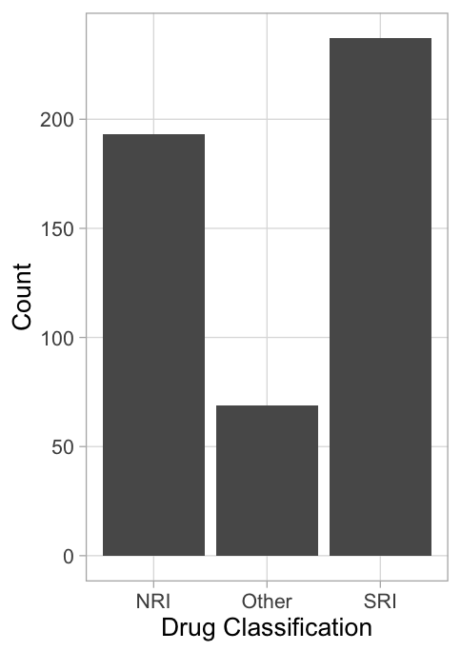
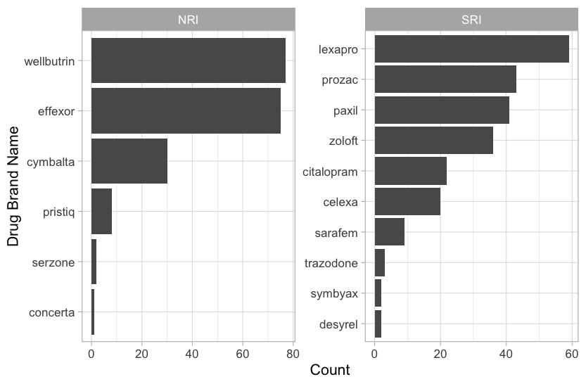
CHOICE IN DRUG TYPE AND BRAND
SSRIs and SNRIs accounted for the overwhelming majority (86%) of all cases.
Count
Drug Brand Name
Drug Classification
Count

Slide 5
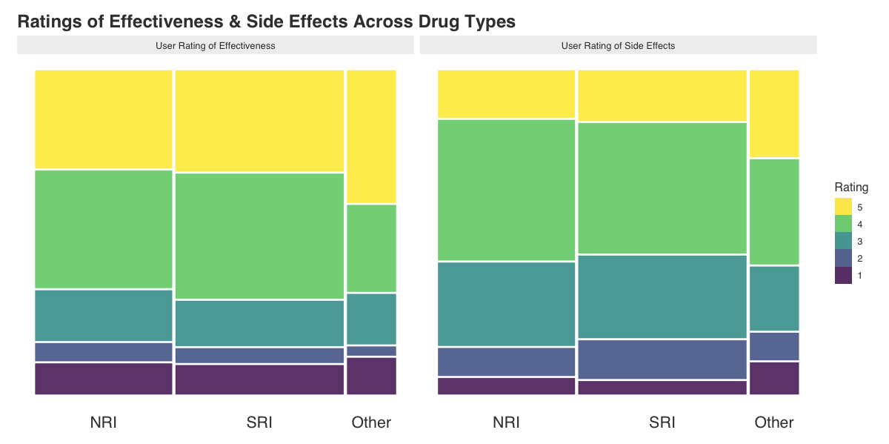
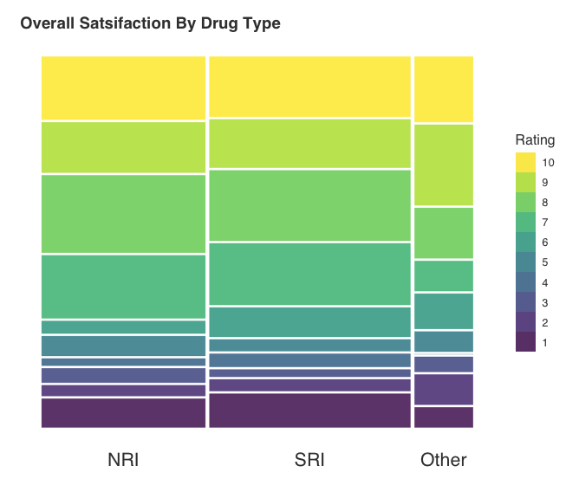
COMPARISON BY DRUG TYPE
Effectiveness
Side Effects
Drug Classification
Drug Classification
Effectiveness (1 = Ineffective … 5 = Highly Effective)
Side Effects (1 = Extremely Severe … 5 = None)

Slide 6
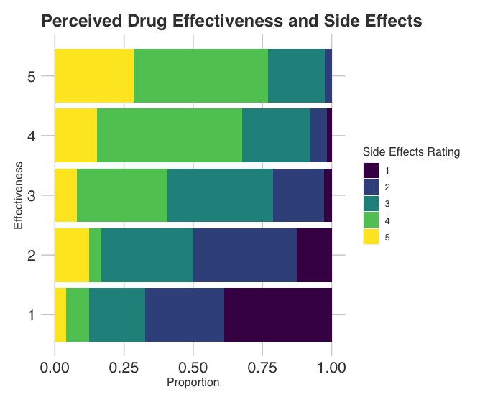
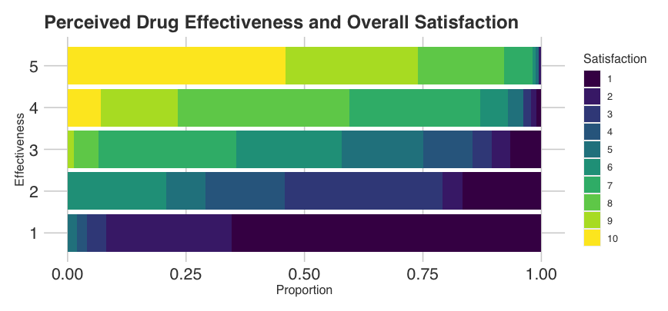
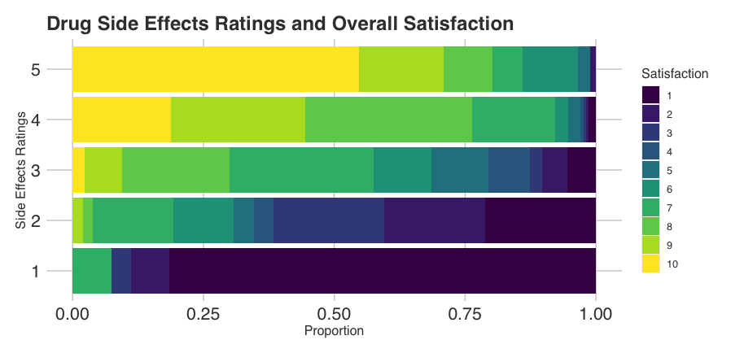
RELATIONS BETWEEN DRUG EVALUATIONS
Effectiveness Rating
Effectiveness Rating
Proportion
Side Effects Rating
Effectiveness (1 = Ineffective … 5 = Highly Effective)
Side Effects (1 = Extremely Severe … 5 = None)
Proportion

Slide 7
MODELING STUFF GOES HERE.

Slide 8
MORE MODELING STUFF IF WE HAVE IT

Slide 9
CONCLUSIONS

