Slide 1


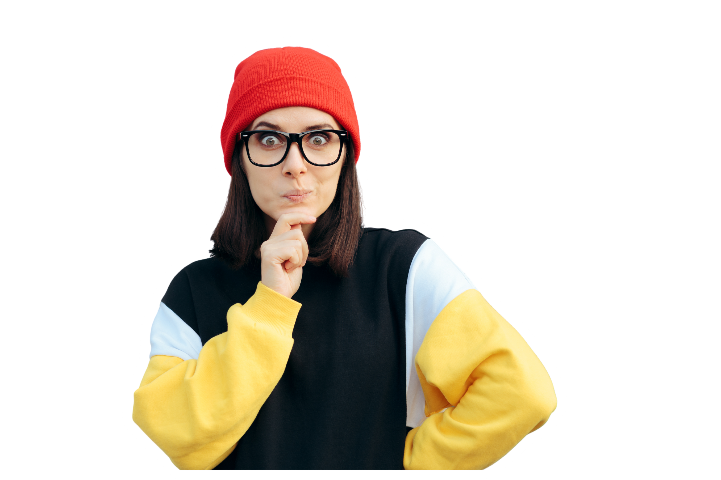



RED FLAG
GREEN FLAG
Be a teammate you wish you had!
Developed and facilitated by students – for students
From WORK3601 to BUSS1000 | Teamwork and peer feedback
Twelve scenarios. They get harder as you go. Move to the side of the room that matches your call, then be ready to say why

Slide 2


Introduction
Who are we? Final year students with Management & Leadership as a major/minor
01
RED FLAG, GREEN FLAG: What makes a good teammate?

Slide 3
LEARNING OUTCOMES
We are here to help you learn from our mistakes!
And we will do our best (also, this is our assignment – so be merciful and play with us)
For us – The Facilitators
Through preparing, delivering and reflecting on the session, we will be able to:
Translate experience into useful guidance: connect our teamwork experiences and management learning to challenges first-years face.
Facilitate an inclusive conversation: invite different perspectives, listen carefully and respond constructively to disagreement.
Evaluate our own practice: use participants’ feedback to identify how we can improve our facilitation, teamwork and leadership.
02
RED FLAG, GREEN FLAG: What makes a good teammate?

Slide 4
LEARNING OUTCOMES
For you – Our dear audience
By the end of the session, students will be able to:
Recognise effective teamwork: explain how everyday behaviours affect a team, using the five peer-review criteria and considering context.
Practise constructive feedback: describe a specific behaviour, explain its impact and suggest a next step while there is still time to act.
Put the learning into practice: choose one behaviour to improve personally and one agreement to establish with their team.
03
RED FLAG, GREEN FLAG: What makes a good teammate?

Slide 5
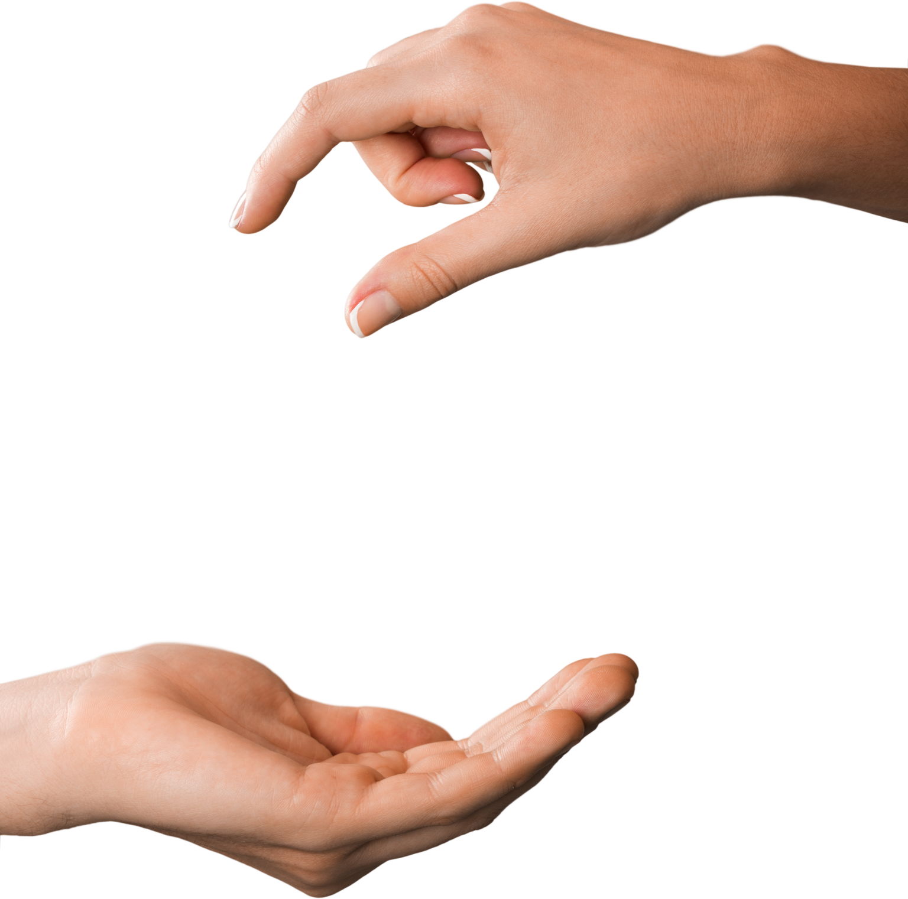



HOW IT
WORKS?
Twelve scenarios. They get harder as you go. Move to the corner that matches your call, then be ready to say why.
Read the scenario: You get one behaviour from a group assignment. That is all the information you have.
The later scenarios do not have a clean answer. When the room splits, that is the lesson, not a mistake.
Move: Go to RED, GREEN, or the DEPENDS zone in the middle. No standing between zones.
Defend it: A few people say why. Smallest group goes first.
04
RED FLAG, GREEN FLAG: What makes a good teammate?

Slide 6
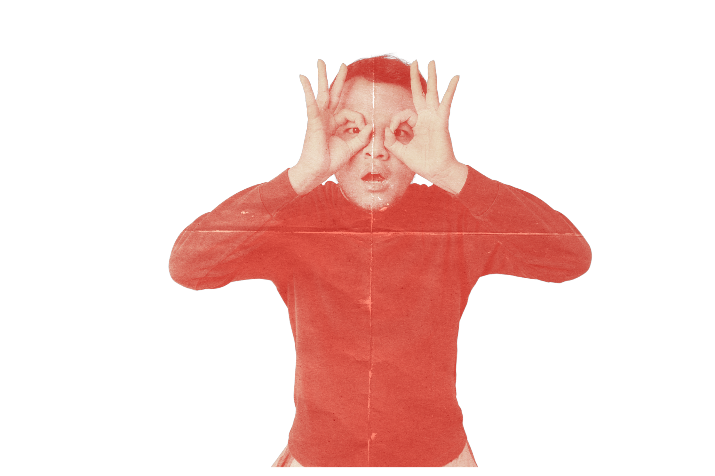

Level 1:
Level 1:
Warm Up
Warm Up
Warm up. Everyone should land in the same corner. If they don’t, that is worth a minute on its own.
05
RED FLAG, GREEN FLAG: What makes a good teammate?

Slide 7
SCENARIO 1: PRIYA
Priya joins every meeting with the brief already open. When the group spent twenty minutes going in circles in week 3, she said “we’ve got two real options, let’s list the pros of each and decide today.” They decided.
Red Flag
Green Flag
Red Flag
GreenFlag
06
RED FLAG, GREEN FLAG: What makes a good teammate?

Slide 8
Priya joins every meeting with the brief already open. When the group spent twenty minutes going in circles in week 3, she said “we’ve got two real options, let’s list the pros of each and decide today.” They decided.
Why?
She doesn’t just turn up, she moves the group forward. Preparation plus a willingness to force a decision is what stops meetings drifting.
Why?
GREEN FLAG
Who plays this role in your group? What happens in a group where nobody does?
07
RED FLAG, GREEN FLAG: What makes a good teammate?

Slide 9
SCENARIO 2: SAM
Sam volunteered for the market analysis in week 4. Between weeks 6 and 9 he didn’t reply to six messages. The group reallocated his section with a fortnight left, and neither of the two who picked it up had done the reading.
Red Flag
Green Flag
Red Flag
GreenFlag
08
RED FLAG, GREEN FLAG: What makes a good teammate?

Slide 10
Sam volunteered for the market analysis in week 4. Between weeks 6 and 9 he didn’t reply to six messages. The group reallocated his section with a fortnight left, and neither of the two who picked it up had done the reading.
Why?
Why?
The problem isn’t that he fell behind. It’s the silence. Three weeks of no contact turned a manageable problem into a crisis for two other people.
RED FLAG
What percentage of effort would you give Sam, and what would you write in the explanation box?
09
RED FLAG, GREEN FLAG: What makes a good teammate?

Slide 11
SCENARIO 3: JACK
Jack’s section is 800 words summarising the case study, with no analysis, no unit frameworks, and no sources. Asked to add analysis, he said the word count was already met.
Red Flag
Green Flag
Red Flag
GreenFlag
10
RED FLAG, GREEN FLAG: What makes a good teammate?

Slide 12
Jack’s section is 800 words summarising the case study, with no analysis, no unit frameworks, and no sources. Asked to add analysis, he said the word count was already met.
Why?
Why?
He met the letter of the commitment and none of the point of it. Someone else now has to rewrite it, which is unpaid work created by a teammate.
RED FLAG
Is submitting something on time enough? What is the difference between contributing and contributing thoughtfully?
11
RED FLAG, GREEN FLAG: What makes a good teammate?

Slide 13




Level 2:
Level 2:
OBVIOUS
OBVIOUS
LESS
LESS
The first real disagreement. Behaviours that look harmless, or look unhelpful, until you think about the effect.
12
RED FLAG, GREEN FLAG: What makes a good teammate?

Slide 14
SCENARIO 4: TOM
Tom has never missed a meeting. He stays muted with his camera off, and when asked directly he says “happy with whatever you all think.” He’s never blocked anything. His section, when it arrives, is fine.
Red Flag
Green Flag
Red Flag
GreenFlag
13
RED FLAG, GREEN FLAG: What makes a good teammate?

Slide 15
Tom has never missed a meeting. He stays muted with his camera off, and when asked directly he says “happy with whatever you all think.” He’s never blocked anything. His section, when it arrives, is fine.
Why?
Why?
Attendance is not engagement. The group never gets his judgement, so decisions go unchallenged and he can’t be held to a view he never gave.
RED FLAG
He is easy to work with and causes no trouble. Why is that not enough?
14
RED FLAG, GREEN FLAG: What makes a good teammate?

Slide 16
SCENARIO 5: CHLOE
Chloe replies three or four days later, usually with a thumbs up reaction rather than words. When someone suggested her section needed a stronger link to the recommendation, she read it, didn’t respond, and submitted the original.
Red Flag
Green Flag
Red Flag
GreenFlag
15
RED FLAG, GREEN FLAG: What makes a good teammate?

Slide 17
Chloe replies three or four days later, usually with a thumbs up reaction rather than words. When someone suggested her section needed a stronger link to the recommendation, she read it, didn’t respond, and submitted the original.
Why?
Why?
The slow replies are annoying. Ignoring a suggestion and submitting anyway is the real issue, because it tells the group that feedback is optional.
RED FLAG
What would you have done if you were the person who gave that suggestion?
16
RED FLAG, GREEN FLAG: What makes a good teammate?

Slide 18
SCENARIO 6: LEO
Leo read Grace’s draft in week 8 and messaged her directly. He quoted the specific line from the rubric her paragraph missed, offered two ways to fix it, and said her opening was the strongest framing anyone had written.
Red Flag
Green Flag
Red Flag
GreenFlag
17
RED FLAG, GREEN FLAG: What makes a good teammate?

Slide 19
Leo read Grace’s draft in week 8 and messaged her directly. He quoted the specific line from the rubric her paragraph missed, offered two ways to fix it, and said her opening was the strongest framing anyone had written.
Why?
Early, specific, private, and paired with something genuine. That combination is why she can act on it instead of defending herself.
Why?
GREEN FLAG
Would this still be green in week 12? Would it still be green in the group chat?
18
RED FLAG, GREEN FLAG: What makes a good teammate?

Slide 20
LEVEL 3
LEVEL 3
Genuinely split
Genuinely split
No consensus expected. Push them to name what their answer depends on.
19
RED FLAG, GREEN FLAG: What makes a good teammate?

Slide 21
SCENARIO 7: Marcus
Marcus talks for most of every meeting. His ideas are good and the group’s argument is stronger for them. Two members have gone from contributing regularly to just agreeing. When he asks “any objections?” there never are any.
Red Flag
Green Flag
Red Flag
GreenFlag
20
RED FLAG, GREEN FLAG: What makes a good teammate?

Slide 22
Marcus talks for most of every meeting. His ideas are good and the group’s argument is stronger for them. Two members have gone from contributing regularly to just agreeing. When he asks “any objections?” there never are any.
Why?
He would rate very well on engagement and contribution, and the work is better for him. He is also, without meaning to, shrinking the group to one person.
Why?
IT DEPENDS
What is the group losing? Whose job is it to fix this, his or theirs?
21
RED FLAG, GREEN FLAG: What makes a good teammate?

Slide 23
SCENARIO 8: Ben
Ben told the group in week 6 he had three assessments due, proposed a smaller section now and a larger one in week 10, and asked if that worked. They agreed. He delivered both on time, and week 10 was the longest section in the report.
Red Flag
Green Flag
Red Flag
GreenFlag
22
RED FLAG, GREEN FLAG: What makes a good teammate?

Slide 24
Ben told the group in week 6 he had three assessments due, proposed a smaller section now and a larger one in week 10, and asked if that worked. They agreed. He delivered both on time, and week 10 was the longest section in the report.
Why?
He didn’t ask to do less, he asked to do it differently, in advance, with a plan the group could accept or reject. Then he honoured it.
Why?
GREEN FLAG
Does the lighter fortnight change his percentage? What if he had told them in week 10 instead of week 6?
23
RED FLAG, GREEN FLAG: What makes a good teammate?

Slide 25
SCENARIO 9: JOSH
Josh has asked the group to reopen the recommendation three times. Each time he’s raised a real problem. The deadline is nine days away and nobody has started writing.
Red Flag
Green Flag
Red Flag
GreenFlag
24
RED FLAG, GREEN FLAG: What makes a good teammate?

Slide 26
Josh has asked the group to reopen the recommendation three times. Each time he’s raised a real problem. The deadline is nine days away and nobody has started writing.
Why?
Being right is not the same as being useful. Raising a problem without proposing a way forward turns disagreement into delay.
Why?
IT DEPENDS
Where is the line between healthy disagreement and holding the team up? What could Josh do differently while still making his point?
25
RED FLAG, GREEN FLAG: What makes a good teammate?

Slide 27
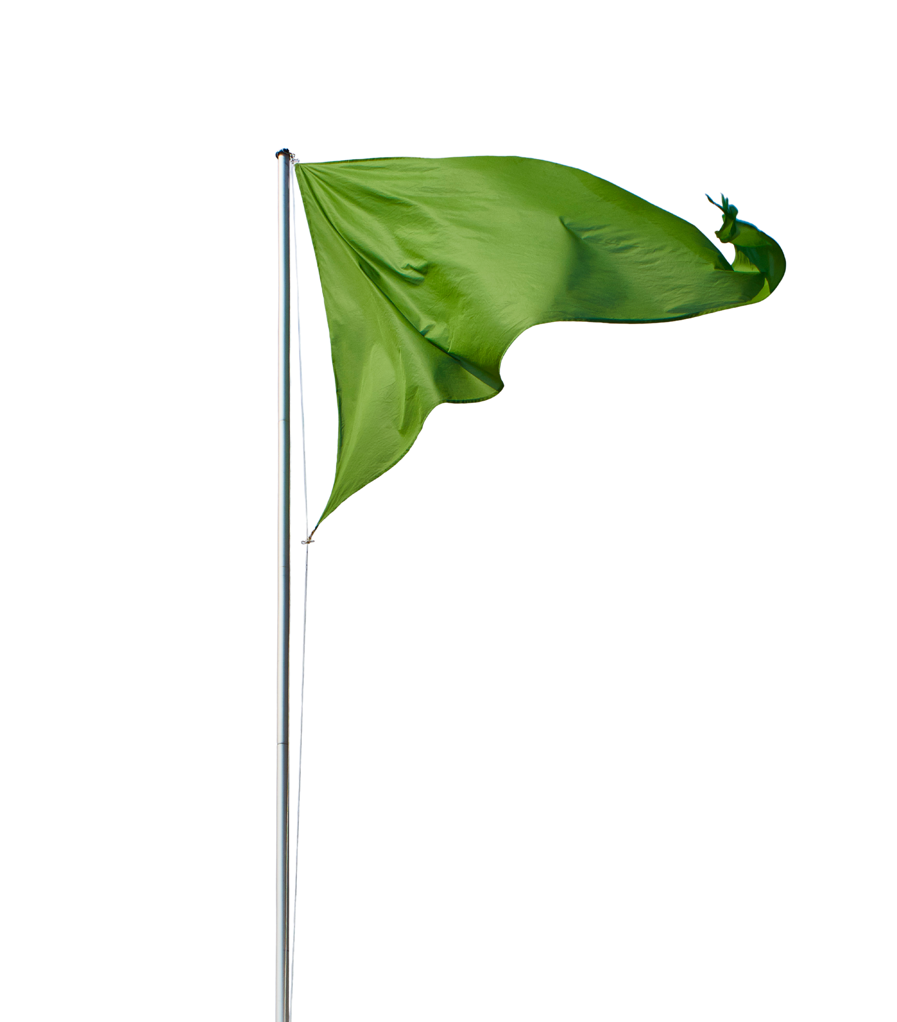
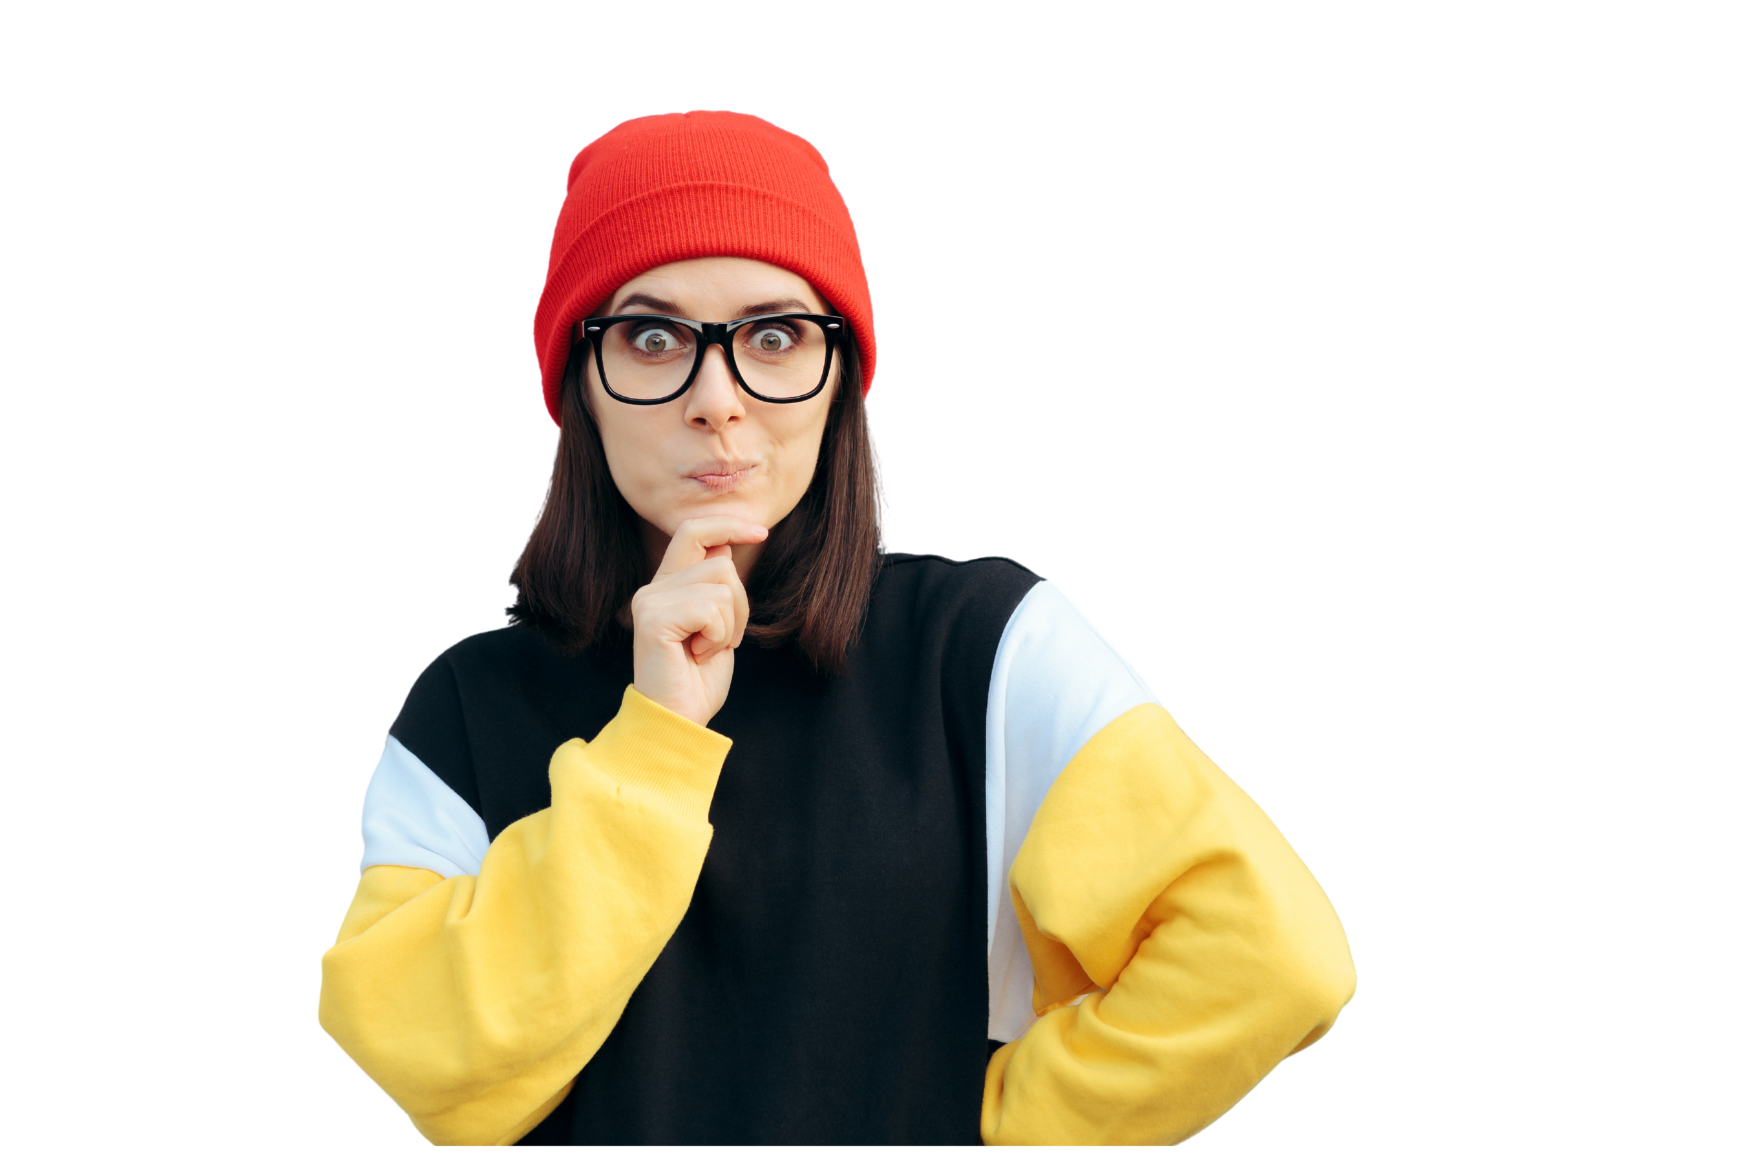

Level 4:
Level 4:
Depends entirely on how
Every one of these is both. Close each with the same question: what single change would make it clearly green?
26
RED FLAG, GREEN FLAG: What makes a good teammate?

Slide 28
SCENARIO 10: MIA
Four days out, Mia realised two teammates’ sections were nowhere near ready. She rewrote both herself, formatted the document, and submitted. The group got a distinction. She never told them, and rated everyone 100%.
Red Flag
Green Flag
Red Flag
GreenFlag
27
RED FLAG, GREEN FLAG: What makes a good teammate?

Slide 29
Four days out, Mia realised two teammates’ sections were nowhere near ready. She rewrote both herself, formatted the document, and submitted. The group got a distinction. She never told them, and rated everyone 100%.
Why?
She saved the mark and pulled far more than her weight. She also removed the only chance those two had to fix it, and then hid the evidence from the tutor.
Why?
IT DEPENDS
What should the other two get? How would the tutor ever know? What did Mia’s silence cost them?
28
RED FLAG, GREEN FLAG: What makes a good teammate?

Slide 30
SCENARIO 11: AMIR
Amir posted in the group chat that Grace’s section doesn’t meet the criteria and needs redoing. He’s right, and he’s given two weeks’ warning. Grace hasn’t posted since.
Red Flag
Green Flag
Red Flag
GreenFlag
29
RED FLAG, GREEN FLAG: What makes a good teammate?

Slide 31
Amir posted in the group chat that Grace’s section doesn’t meet the criteria and needs redoing. He’s right, and he’s given two weeks’ warning. Grace hasn’t posted since.
Why?
Accurate, specific, and early, which is three quarters of good feedback. The audience is the problem. Public correction reads as a verdict on the person
Why?
IT DEPENDS
What single detail would make this clearly green?
30
RED FLAG, GREEN FLAG: What makes a good teammate?

Slide 32
SCENARIO 12: ELLA
Nobody organised the group in the first fortnight, so Ella started assigning tasks and chairing meetings. The team is ahead of schedule. She never asked if anyone else wanted a role, and when someone proposed restructuring in week 8 she said the plan was locked.
Red Flag
Green Flag
Red Flag
GreenFlag
31
RED FLAG, GREEN FLAG: What makes a good teammate?

Slide 33
Nobody organised the group in the first fortnight, so Ella started assigning tasks and chairing meetings. The team is ahead of schedule. She never asked if anyone else wanted a role, and when someone proposed restructuring in week 8 she said the plan was locked.
Why?
She filled a vacuum nobody else would, and the group is genuinely better off. But a team that runs well and can’t be influenced is not a team, it’s an assistant pool.
Why?
IT DEPENDS
The team is functioning well. Is that enough for teamwork and respect?
32
RED FLAG, GREEN FLAG: What makes a good teammate?

Slide 34
FROM FLAG TO
What makes the second one work:
FEEDBACK
Specific, not general
Dated, so the tutor can see when it happened
About the behaviour, not the person
Says what could have been done differently, which is exactly what the form asks
NOT USABLE
USABLE
“Sam didn’t really contribute much and was pretty hard to get hold of.”
“Sam took the market analysis in week 4 and didn’t share a draft or reply between weeks 6 and 9. We reallocated it with two weeks left. Flagging early would have let us redistribute without losing time.”
33
RED FLAG, GREEN FLAG: What makes a good teammate?

Slide 35
DEBRIEF &
Q&A
34
RED FLAG, GREEN FLAG: What makes a good teammate?

Slide 36
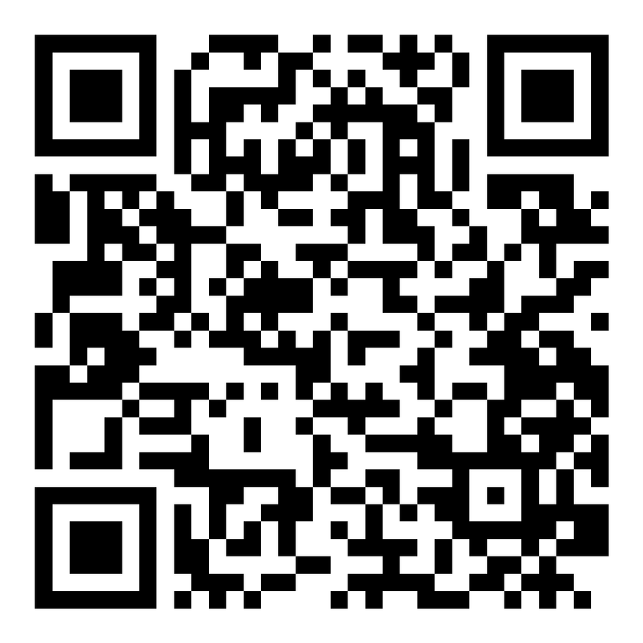
Feedback
https://joetherockhey.github.io/Class-Allocation/feedback.html
35
RED FLAG, GREEN FLAG: What makes a good teammate?

Slide 37
THANK YOU
SELFIE TIME?
36
RED FLAG, GREEN FLAG: What makes a good teammate?

