Slide 1


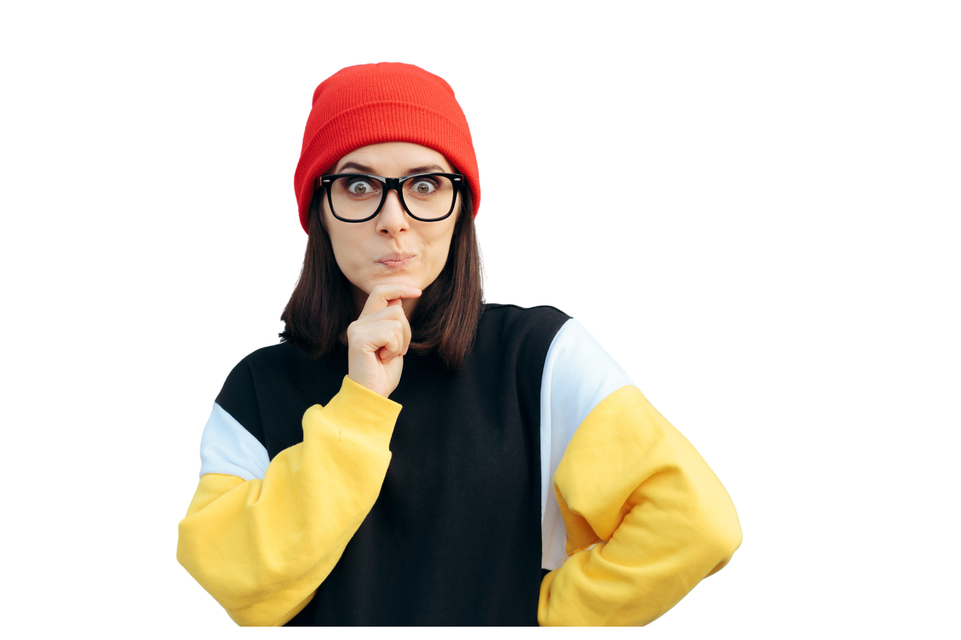



RED FLAG
GREEN FLAG
Be a teammate you wish you had!
Developed and facilitated by students – for students
From WORK3601 to BUSS1000 | Teamwork and peer feedback
6 scenarios. They get harder as you go. Move to the side of the room that matches your call, then be ready to say why

Slide 2


Introduction
Who are we? Final year students with Management & Leadership as a major/minor
01
RED FLAG, GREEN FLAG: What makes a good teammate?

Slide 3
LEARNING OUTCOMES
We are here to help you learn from our mistakes!
And we will do our best
(also, this is our assignment – so be merciful and play with us )
For us – The Facilitators
For you –Our dear audience
  Guide: Apply our experience to help you
  Facilitate: Lead constructive discussions
  Improve: Use feedback to refine our skills
  Recognise: behaviors that impact teamwork
  Give Feedback: specific, timely, and actionable
  Apply: a personal/team improvement.
02
RED FLAG, GREEN FLAG: What makes a good teammate?

Slide 4
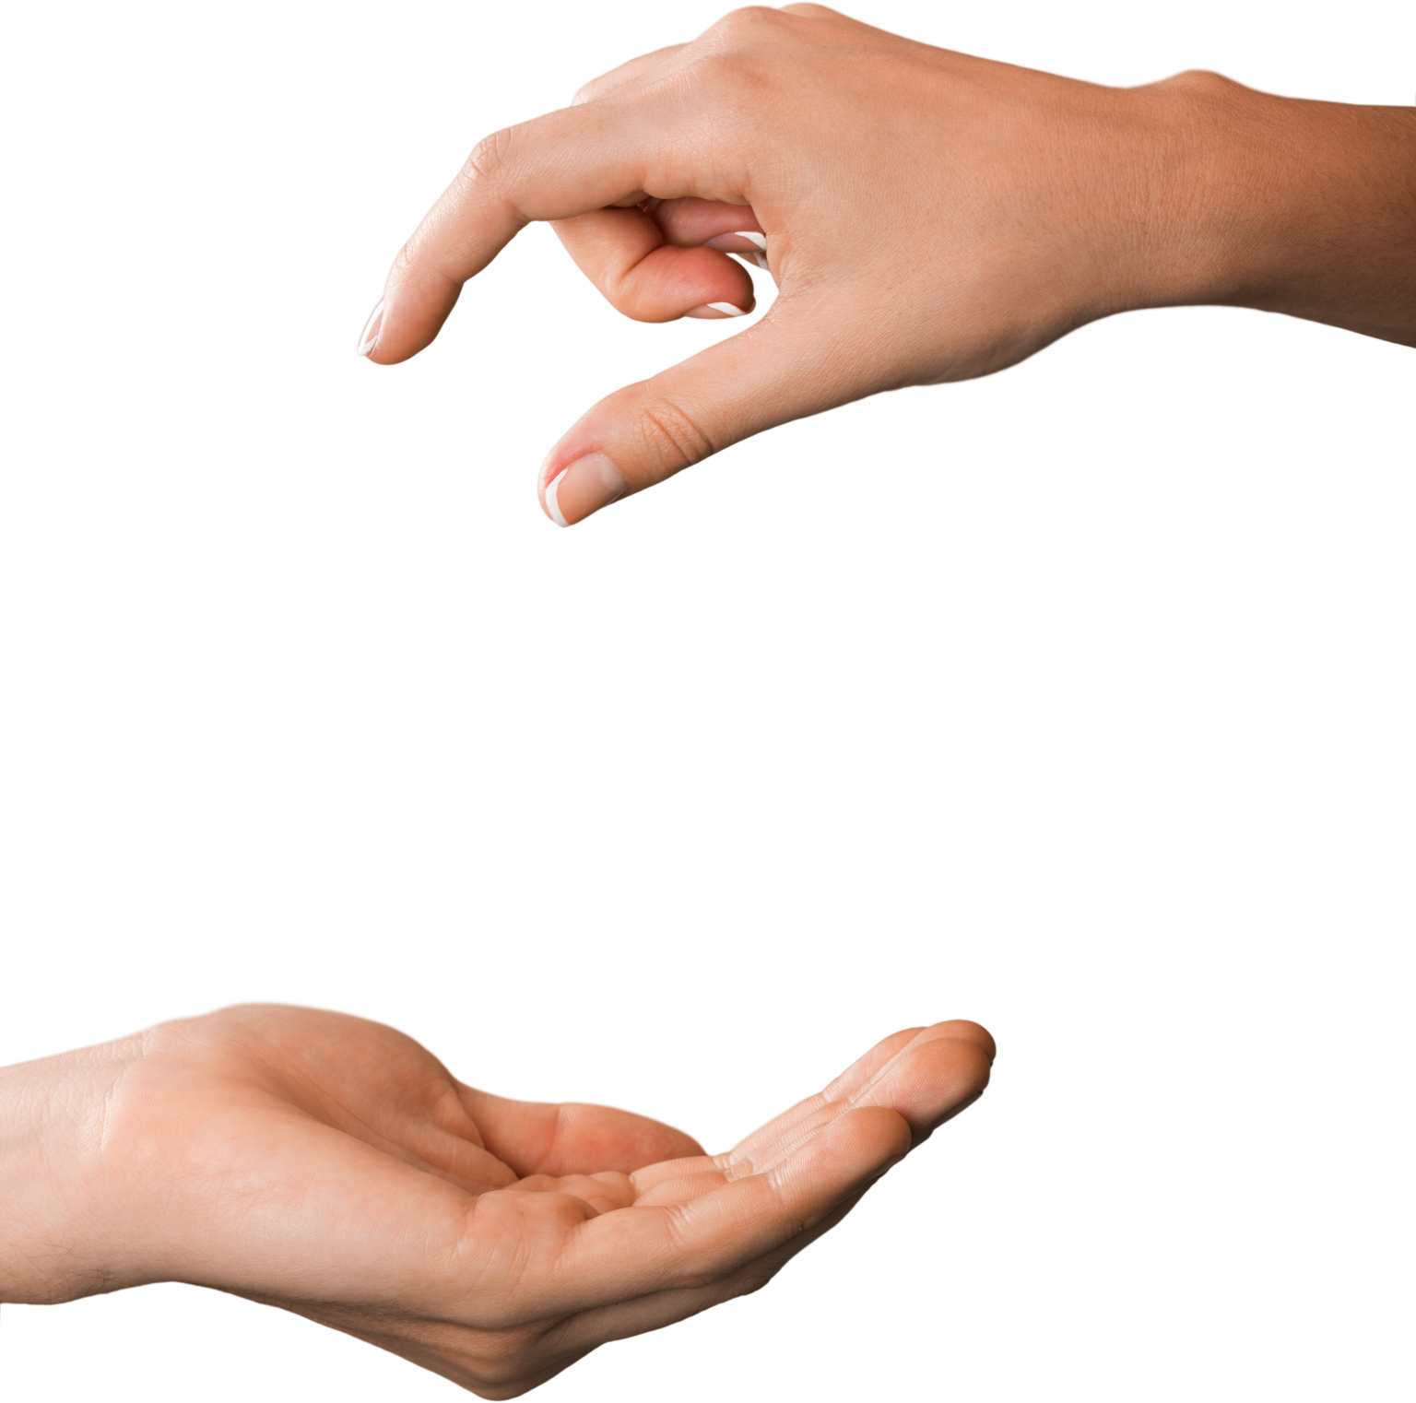



HOW IT
WORKS?
6 scenarios. They get harder as you go. Move to the corner that matches your call, then be ready to say why.
NOTE:
Read the scenario: You get one behaviour from a group assignment. That is all the information you have.
The later scenarios do not have a clean answer. When the room splits, that is the lesson, not a mistake.
Move: Go to RED, GREEN, or the DEPENDS zone in the middle. No standing between zones.
Defend it: A few people say why. Smallest group goes first.
03
RED FLAG, GREEN FLAG: What makes a good teammate?

Slide 5

LEVEL 1
LEVEL 1
Genuinely split
Genuinely split
No consensus expected. Name what your answer depends on
04
RED FLAG, GREEN FLAG: What makes a good teammate?

Slide 6
SCENARIO 1: Dilan
Dilan’s groupmate used Chatty(gpt) for their entire part of the report.
Dilan noticed this, but didn’t raise it with them as it wasn’t his responsibility. The group submitted the report and got a Credit.
Then in the peer review form Dilan gave that member a mark of 60%.
Red Flag
Green Flag
Red Flag
GreenFlag
05
RED FLAG, GREEN FLAG: What makes a good teammate?

Slide 7
Why?
Why?
If Dilan wasn’t happy with his team mates contribution he should have addressed it with them AND done so before handing in the assignement
RED FLAG
Who should Dilan have talked to about this?
06
RED FLAG, GREEN FLAG: What makes a good teammate?

Slide 8
SCENARIO 1: Marcus
Marcus talks for most of every meeting. His ideas are good and the group’s argument is stronger for them.
Two members have gone from contributing regularly to just agreeing. When he asks “any objections?” there never are any.
Red Flag
Green Flag
Red Flag
GreenFlag
07
RED FLAG, GREEN FLAG: What makes a good teammate?

Slide 9
Why?
Pros: He is contributing and the team is better for him.
Cons: He is without meaning to, shrinking the group to one person.
Why?
IT DEPENDS
Anyone can take over a group, only some can actually LEAD
08
RED FLAG, GREEN FLAG: What makes a good teammate?

Slide 10
SCENARIO 3: ELLA
In week 7 the group asked Ella to take a second section. She said no, that she had already done more than her fair share and had another assignment due soon. Instead, she offered to do the reference list and formatting.
Red Flag
Green Flag
Red Flag
GreenFlag
09
RED FLAG, GREEN FLAG: What makes a good teammate?

Slide 11
Why?
She gave a reason, said it at the point they could still reallocate, and put an alternative on the table.
The group knew exactly what she would deliver.
Why?
GREEN FLAG
In a workplace, good communication is MUCH more important than pretty much anything else
10
RED FLAG, GREEN FLAG: What makes a good teammate?

Slide 12
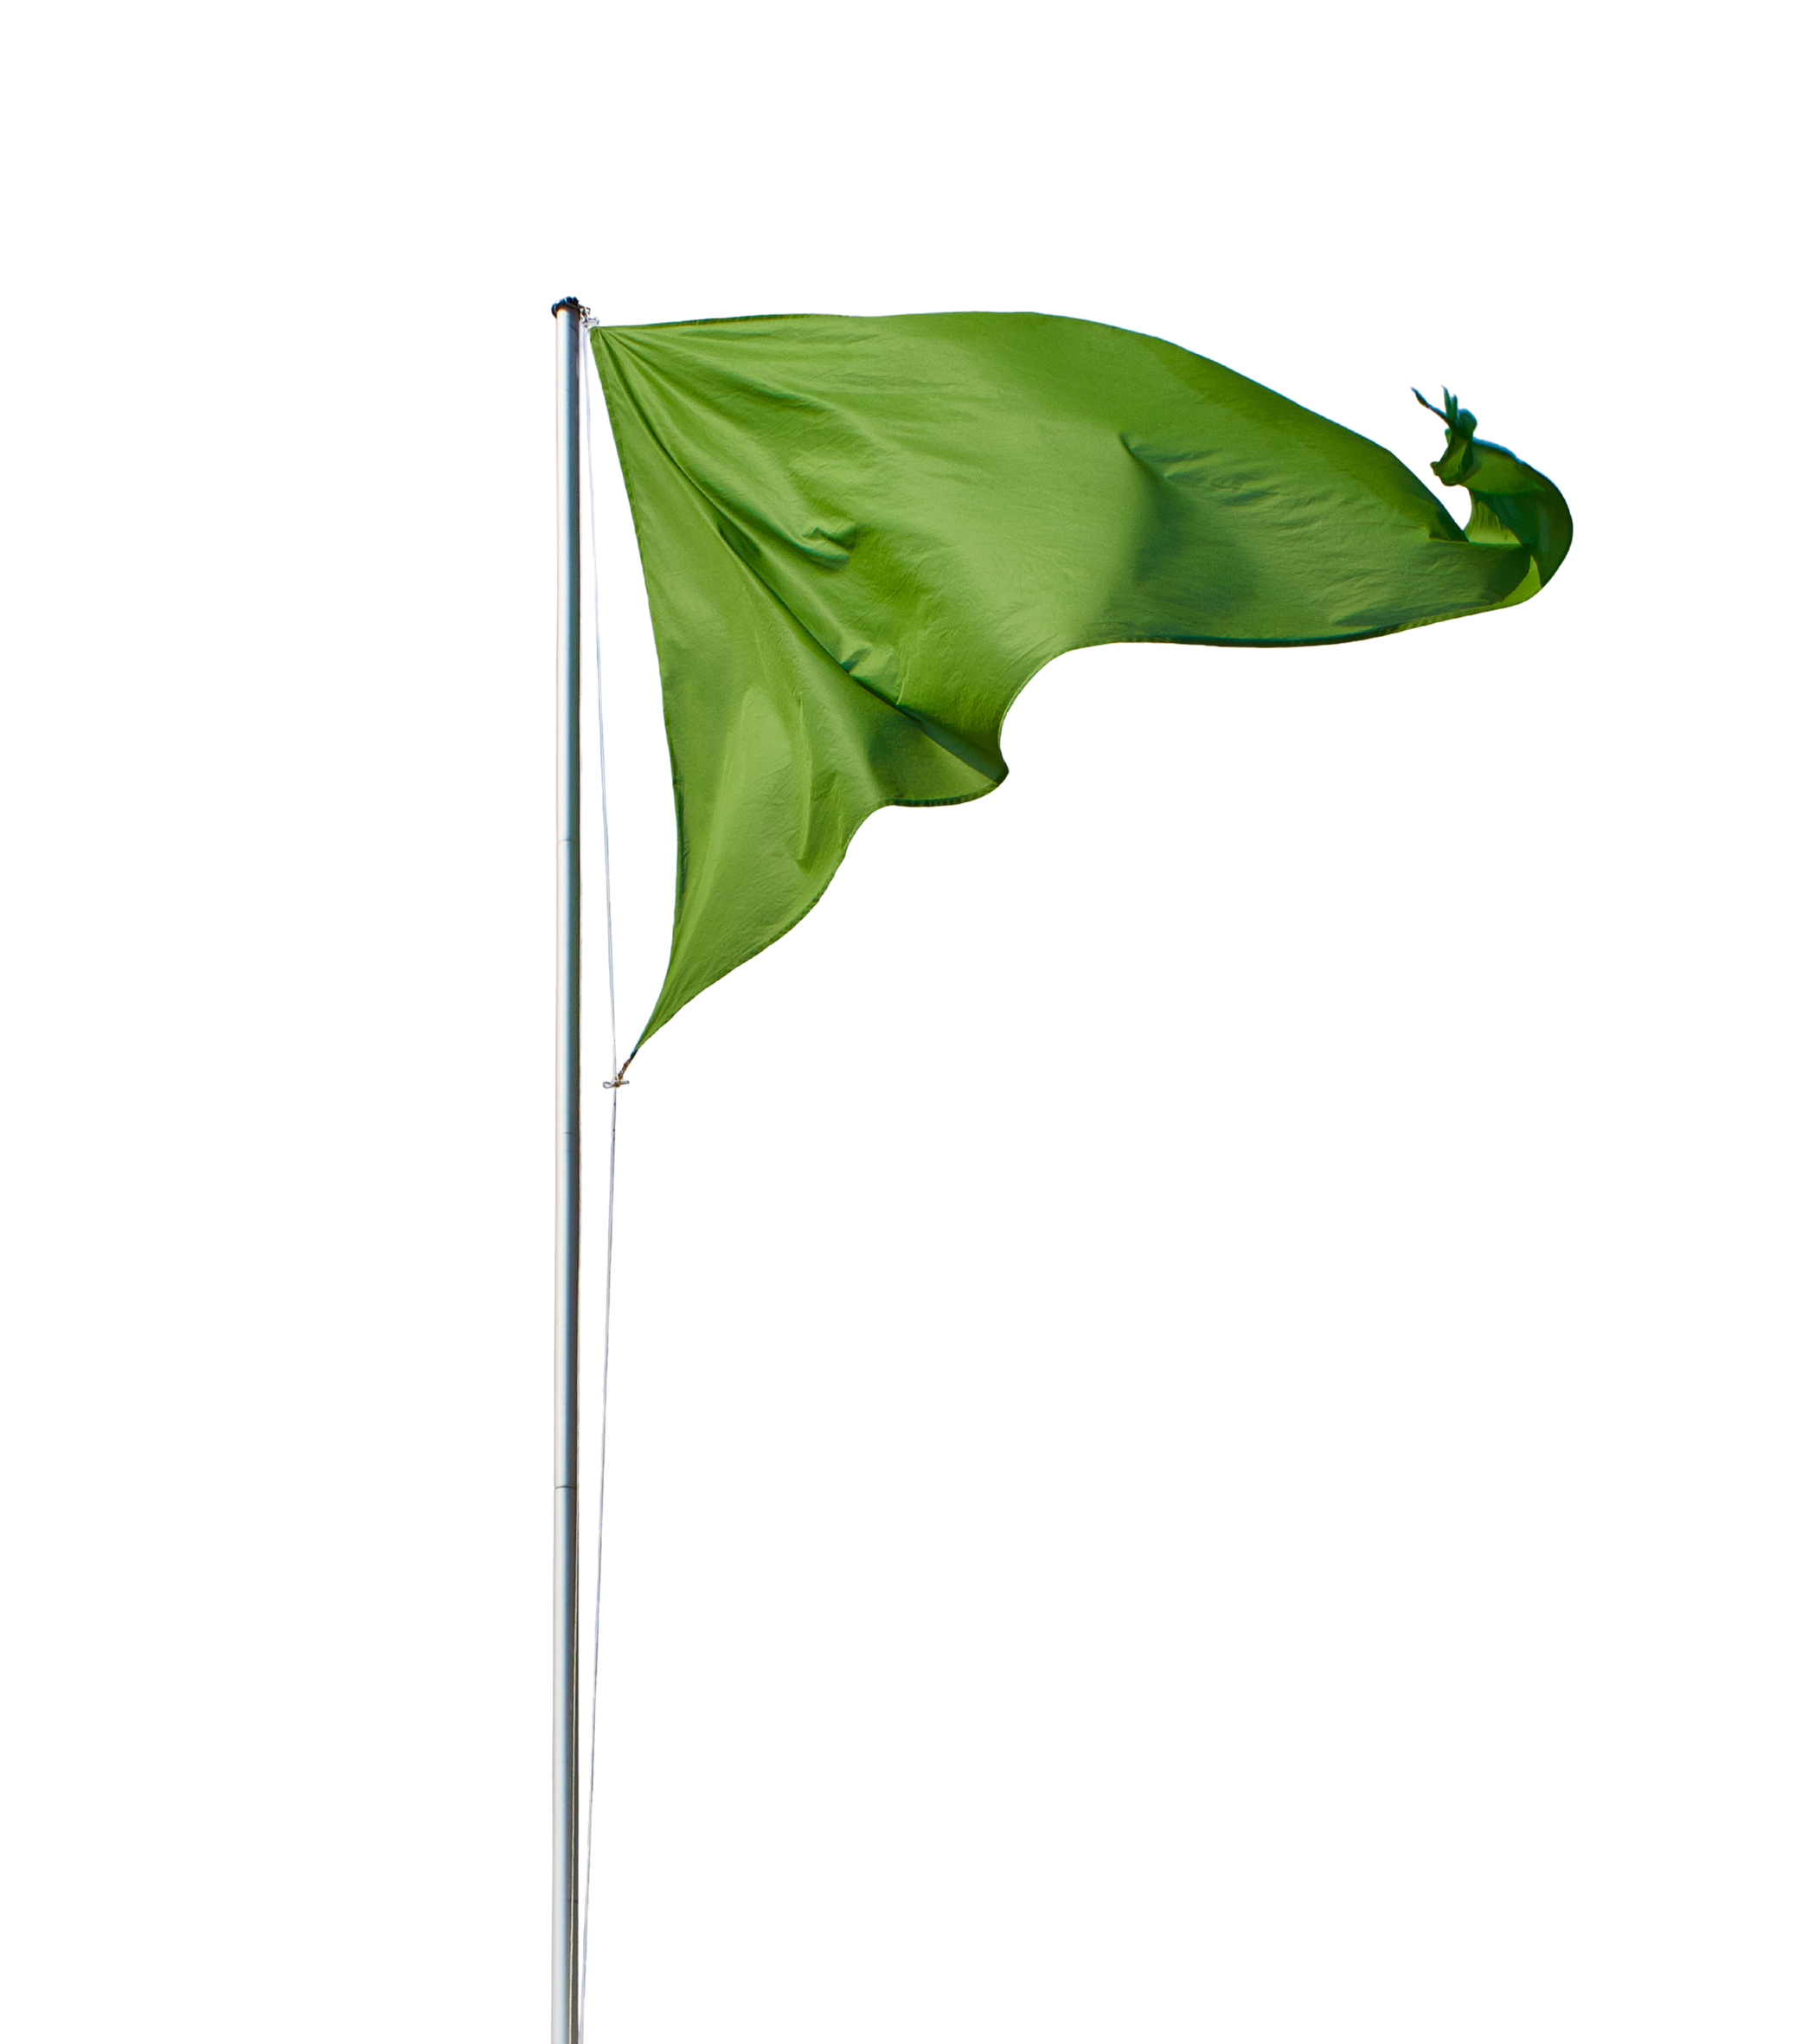
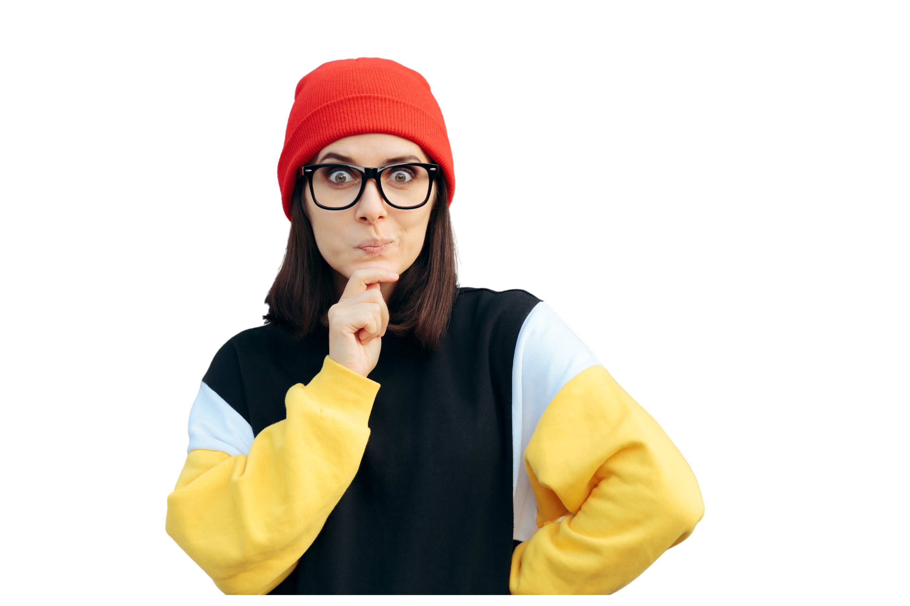

Level 2:
Level 2:
Depends entirely on how
These are much more debatable.
Discuss what would make them clearly a green or red.
11
RED FLAG, GREEN FLAG: What makes a good teammate?

Slide 13
SCENARIO 4: MIA
Four days out, Mia realised two teammates’ sections were nowhere near ready. She rewrote both herself, formatted the document, and submitted. The group got a distinction. She never told them, and rated everyone 100%.
Red Flag
Green Flag
Red Flag
GreenFlag
12
RED FLAG, GREEN FLAG: What makes a good teammate?

Slide 14
Why?
Pros: She saved the mark and pulled far more than her weight.
Cons: She also removed the only chance those two had to fix it, and then hid the evidence from the tutor.
Why?
RED FLAG
What should the other two get? How would the tutor ever know? What did Mia’s silence cost them?
13
RED FLAG, GREEN FLAG: What makes a good teammate?

Slide 15
SCENARIO 5: AMIR
Amir posted in the group chat that Grace’s section doesn’t meet the criteria, is a bit sloppy, and needs redoing.
He’s right, and he’s given two weeks’ warning. Grace hasn’t posted since.
Red Flag
Green Flag
Red Flag
GreenFlag
14
RED FLAG, GREEN FLAG: What makes a good teammate?

Slide 16
Why?
Accurate, specific, and early, which is three quarters of good feedback.
The audience is the problem. Public correction is not necessary to begin with.
Why?
IT DEPENDS
What single detail would make this clearly green?
15
RED FLAG, GREEN FLAG: What makes a good teammate?

Slide 17
SCENARIO 6: ELLA
Nobody organised the group in the first fortnight, so Ella started assigning tasks and chairing meetings.
The team is ahead of schedule. She never asked if anyone else wanted a role, and when someone proposed restructuring in week 8 she said the plan was locked.
Red Flag
Green Flag
Red Flag
GreenFlag
16
RED FLAG, GREEN FLAG: What makes a good teammate?

Slide 18
Why?
Why?
Pros: She filled a vacuum nobody else would, and the group is genuinely better off.
Cons: But a team that runs well and can’t be influenced is not a team, it’s an assistant pool.
IT DEPENDS
The team is functioning well. Is that enough for teamwork and respect?
17
RED FLAG, GREEN FLAG: What makes a good teammate?

Slide 19
DEBRIEF &
Q&A
19
RED FLAG, GREEN FLAG: What makes a good teammate?

Slide 20
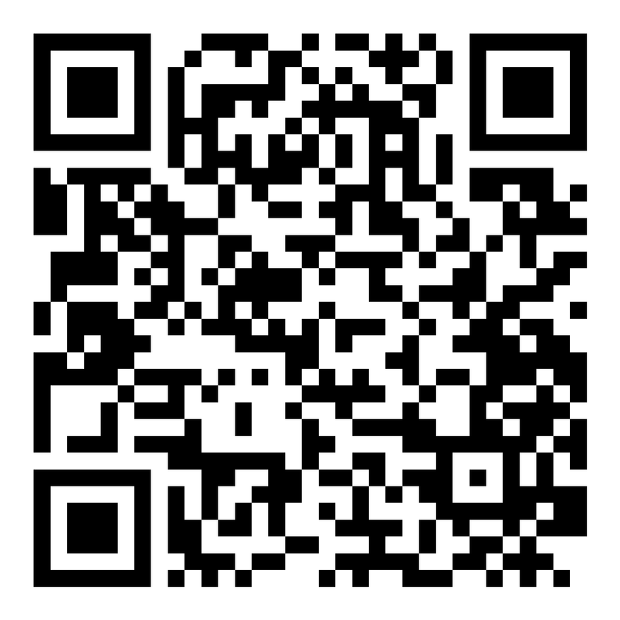
Feedback
https://joetherockhey.github.io/Class-Allocation/feedback.html
20
RED FLAG, GREEN FLAG: What makes a good teammate?

Slide 21
THANK YOU
SELFIE TIME?
21
RED FLAG, GREEN FLAG: What makes a good teammate?

