Slide 1

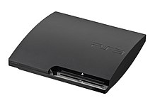
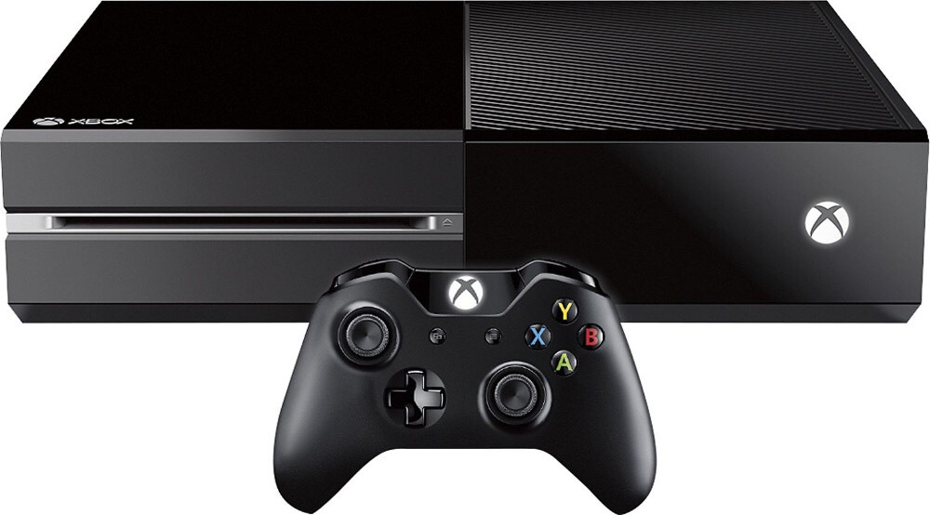
Video Game Scores and Sales
2015
Joseph Torre
IS 362
12/11/17

Slide 2
Game Rating Data
Getting games sales data from MSSQL, I also change platform name from original data source name to the one that we have in ratings dataset, so we could later map it. We're selecting top 10 gaming platforms by global sales. Sales are in millions.
 | Game | Platform | Score | Genre
0 | Wolfenstein: The New Order | Xbox One | 7.8 | Shooter
1 | Mario Kart 8 | Wii U | 9.0 | Racing, Action
2 | Sportsfriends | PlayStation 3 | 8.7 | Action, Compilation
3 | Sportsfriends | PlayStation 4 | 8.7 | Action, Compilation
4 | Sportsfriends | PC | 8.7 | Action, Compilation

Slide 3
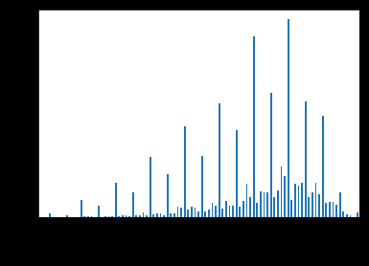
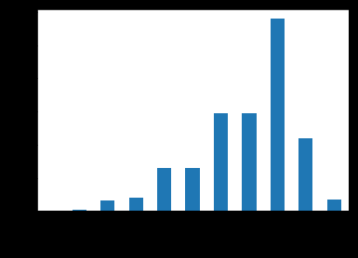
Game Score Distributed
Round up values for easier analysis
From the graph we can see that most games have a score of 8 that is pretty high for average score. This could say us that average game is rated higher than average score.

Slide 4
Looking at game scores by game platforms
From this data we should exclude systems that have under 100 games for more correct view.
Now we can see that mean score is around 7 and if we would look at score normalizing it would be around 8.
 | Score | Normalized Score | recordnumber
Platform
WonderSwan Color | 8.600000 | 1.000000 | 1
Pocket PC | 8.500000 | 0.986842 | 1
Macintosh | 8.104286 | 0.934774 | 70
Atari 5200 | 8.000000 | 0.921053 | 2
TurboGrafx-CD | 8.000000 | 0.921053 | 3
Web Games | 8.000000 | 0.921053 | 1
Game Boy | 7.813636 | 0.896531 | 22
Super NES | 7.732143 | 0.885808 | 28
iPad | 7.704255 | 0.882139 | 94
PlayStation 4 | 7.697872 | 0.881299 | 47
Linux | 7.550000 | 0.861842 | 8
Xbox One | 7.545714 | 0.861278 | 35
Android | 7.503030 | 0.855662 | 33
Wii U | 7.496154 | 0.854757 | 78
Dreamcast | 7.370280 | 0.838195 | 286
NeoGeo Pocket Color | 7.322581 | 0.831919 | 31
iPhone | 7.298896 | 0.828802 | 815
Saturn | 7.283333 | 0.826754 | 6
PlayStation Vita | 7.259649 | 0.823638 | 114
Nintendo 3DS | 7.238150 | 0.820809 | 173
Xbox | 7.199635 | 0.815741 | 822
PlayStation 3 | 7.186718 | 0.814042 | 1295
Wireless | 7.177680 | 0.812853 | 905
Lynx | 7.146341 | 0.808729 | 82
PC | 7.105849 | 0.803401 | 3026
Xbox 360 | 7.104172 | 0.803181 | 1582
GameCube | 7.036542 | 0.794282 | 509
Sega CD | 7.000000 | 0.789474 | 1
Nintendo 64 | 6.974751 | 0.786151 | 301
iPod | 6.906250 | 0.777138 | 16
PlayStation 2 | 6.869162 | 0.772258 | 1683
Master System | 6.769231 | 0.759109 | 13
Windows Phone | 6.757143 | 0.757519 | 14
PlayStation Portable | 6.751840 | 0.756821 | 625
N-Gage | 6.730000 | 0.753947 | 30
Windows Surface | 6.700000 | 0.750000 | 1
Game Boy Advance | 6.629194 | 0.740683 | 620
Nintendo 64DD | 6.628571 | 0.740602 | 7
TurboGrafx-16 | 6.600000 | 0.736842 | 39
PlayStation | 6.562290 | 0.731880 | 952
Genesis | 6.525862 | 0.727087 | 58
NES | 6.519565 | 0.726259 | 46
NeoGeo | 6.500000 | 0.723684 | 10
WonderSwan | 6.500000 | 0.723684 | 4
Atari 2600 | 6.500000 | 0.723684 | 5
Commodore 64/128 | 6.416667 | 0.712719 | 6
Nintendo DSi | 6.369804 | 0.706553 | 255
Wii | 6.300074 | 0.697378 | 1347
Nintendo DS | 6.283173 | 0.695154 | 1040
Vectrex | 6.250000 | 0.690789 | 2
Game Boy Color | 6.199438 | 0.684137 | 356
Arcade | 6.036364 | 0.662679 | 11
Sega 32X | 5.455556 | 0.586257 | 18
Game.Com | 5.333333 | 0.570175 | 3
Dreamcast VMU | 3.000000 | 0.263158 | 1
DVD / HD Video Game | 1.000000 | 0.000000 | 1
 | Score | Normalized Score | Record number
Platform
Dreamcast | 7.370280 | 0.838195 | 286
iPhone | 7.298896 | 0.828802 | 815
PlayStation Vita | 7.259649 | 0.823638 | 114
Nintendo 3DS | 7.238150 | 0.820809 | 173
Xbox | 7.199635 | 0.815741 | 822
PlayStation 3 | 7.186718 | 0.814042 | 1295
Wireless | 7.177680 | 0.812853 | 905
PC | 7.105849 | 0.803401 | 3026
Xbox 360 | 7.104172 | 0.803181 | 1582
GameCube | 7.036542 | 0.794282 | 509
Nintendo 64 | 6.974751 | 0.786151 | 301
PlayStation 2 | 6.869162 | 0.772258 | 1683
PlayStation Portable | 6.751840 | 0.756821 | 625
Game Boy Advance | 6.629194 | 0.740683 | 620
PlayStation | 6.562290 | 0.731880 | 952
Nintendo DSi | 6.369804 | 0.706553 | 255
Wii | 6.300074 | 0.697378 | 1347
Nintendo DS | 6.283173 | 0.695154 | 1040
Game Boy Color | 6.199438 | 0.684137 | 356

Slide 5
Looking at game scores by game Platforms
Adding score data to our top 10 platforms by sales all time.
Now we can see that our global sales data and record number is not really correlated, this is the result of having two different data sets that are not related to each other, so we can not conclude any meaningful analysis.
 | Global Sales | Platform | Score | Normalized Score | Record number
0 | 1233.46 | PlayStation 2 | 6.869162 | 0.772258 | 1683
1 | 969.61 | Xbox 360 | 7.104172 | 0.803181 | 1582
2 | 949.35 | PlayStation 3 | 7.186718 | 0.814042 | 1295
3 | 909.81 | Wii | 6.300074 | 0.697378 | 1347
4 | 818.96 | Nintendo DS | 6.283173 | 0.695154 | 1040
5 | 727.39 | PlayStation | 6.562290 | 0.731880 | 952
6 | 313.56 | Game Boy Advance | 6.629194 | 0.740683 | 620
7 | 291.71 | PlayStation Portable | 6.751840 | 0.756821 | 625
8 | 278.10 | PlayStation 4 | 7.697872 | 0.881299 | 47
9 | 255.05 | PC | 7.105849 | 0.803401 | 3026
 | Score | normalizedScore | recordnumber | Platform
Platform
WonderSwan Color | 8.600000 | 1.000000 | 1 | WonderSwan Color
Pocket PC | 8.500000 | 0.986842 | 1 | Pocket PC
Macintosh | 8.104286 | 0.934774 | 70 | Macintosh
Atari 5200 | 8.000000 | 0.921053 | 2 | Atari 5200
TurboGrafx-CD | 8.000000 | 0.921053 | 3 | TurboGrafx-CD
Web Games | 8.000000 | 0.921053 | 1 | Web Games
Game Boy | 7.813636 | 0.896531 | 22 | Game Boy
Super NES | 7.732143 | 0.885808 | 28 | Super NES
iPad | 7.704255 | 0.882139 | 94 | iPad
PlayStation 4 | 7.697872 | 0.881299 | 47 | PlayStation 4
Linux | 7.550000 | 0.861842 | 8 | Linux
Xbox One | 7.545714 | 0.861278 | 35 | Xbox One
Android | 7.503030 | 0.855662 | 33 | Android
Wii U | 7.496154 | 0.854757 | 78 | Wii U
Dreamcast | 7.370280 | 0.838195 | 286 | Dreamcast
NeoGeo Pocket Color | 7.322581 | 0.831919 | 31 | NeoGeo Pocket Color
iPhone | 7.298896 | 0.828802 | 815 | iPhone
Saturn | 7.283333 | 0.826754 | 6 | Saturn
PlayStation Vita | 7.259649 | 0.823638 | 114 | PlayStation Vita
Nintendo 3DS | 7.238150 | 0.820809 | 173 | Nintendo 3DS
Xbox | 7.199635 | 0.815741 | 822 | Xbox
PlayStation 3 | 7.186718 | 0.814042 | 1295 | PlayStation 3
Wireless | 7.177680 | 0.812853 | 905 | Wireless
Lynx | 7.146341 | 0.808729 | 82 | Lynx
PC | 7.105849 | 0.803401 | 3026 | PC
Xbox 360 | 7.104172 | 0.803181 | 1582 | Xbox 360
GameCube | 7.036542 | 0.794282 | 509 | GameCube
Sega CD | 7.000000 | 0.789474 | 1 | Sega CD
Nintendo 64 | 6.974751 | 0.786151 | 301 | Nintendo 64
iPod | 6.906250 | 0.777138 | 16 | iPod
PlayStation 2 | 6.869162 | 0.772258 | 1683 | PlayStation 2
Master System | 6.769231 | 0.759109 | 13 | Master System
Windows Phone | 6.757143 | 0.757519 | 14 | Windows Phone
PlayStation Portable | 6.751840 | 0.756821 | 625 | PlayStation Portable
N-Gage | 6.730000 | 0.753947 | 30 | N-Gage
Windows Surface | 6.700000 | 0.750000 | 1 | Windows Surface
Game Boy Advance | 6.629194 | 0.740683 | 620 | Game Boy Advance
Nintendo 64DD | 6.628571 | 0.740602 | 7 | Nintendo 64DD
TurboGrafx-16 | 6.600000 | 0.736842 | 39 | TurboGrafx-16
PlayStation | 6.562290 | 0.731880 | 952 | PlayStation
Genesis | 6.525862 | 0.727087 | 58 | Genesis
NES | 6.519565 | 0.726259 | 46 | NES
NeoGeo | 6.500000 | 0.723684 | 10 | NeoGeo
WonderSwan | 6.500000 | 0.723684 | 4 | WonderSwan
Atari 2600 | 6.500000 | 0.723684 | 5 | Atari 2600
Commodore 64/128 | 6.416667 | 0.712719 | 6 | Commodore 64/128
Nintendo DSi | 6.369804 | 0.706553 | 255 | Nintendo DSi
Wii | 6.300074 | 0.697378 | 1347 | Wii
Nintendo DS | 6.283173 | 0.695154 | 1040 | Nintendo DS
Vectrex | 6.250000 | 0.690789 | 2 | Vectrex
Game Boy Color | 6.199438 | 0.684137 | 356 | Game Boy Color
Arcade | 6.036364 | 0.662679 | 11 | Arcade
Sega 32X | 5.455556 | 0.586257 | 18 | Sega 32X
Game.Com | 5.333333 | 0.570175 | 3 | Game.Com
Dreamcast VMU | 3.000000 | 0.263158 | 1 | Dreamcast VMU
DVD / HD Video Game | 1.000000 | 0.000000 | 1 | DVD / HD Video Game

Slide 6
Conclusion
The average rating of the game is above average mark after brief analysis why is it like that I found out few interesting stories. Sometimes game publishers rely on scores so much that everything that is rated below 8 is considered a below average game. So there are a lot of interest to please game review companies to get the higher score. The second reason for it might be that game reviewers only look at the newest and most trending games that are usually higher quality. Sales data by platform did not surprise me at all, all most popular consoles and other means of gaming are there. It is shame that there is no data for mobile games like android or IOs. This task is also a great example how few data sets that should be linked together are not. Because of quite small data size these data sets are more suitable to be analyzed separately than together. Thank you for your time.

