Slide 1
Practical I
Thursday/Friday, 30/31 January 2025, 2pm – 5pm
Department of Biology, University of Oxford

Slide 2





Demonstrators
Joseph, DPhil student in Biology (he/him)
Main research interests: Genomic epidemiology & disease surveillance
Rosario, DPhil student in health data science (she/her)
Main research interests: AI in infectious disease epidemiology and clinical research
Mahan, Wellcome Trust Early Career Fellow (he/him)
Main research interests: Molecular evolution of pathogens with pandemic potential
Moritz, Professor of Epidemiology (he/him)
Main research interests: Computational & genomic epidemiology of infectious diseases, global health
Rhys, DPhil student (he/him)
Main research interests: Genomic epidemiology, climate-sensitive diseases

Slide 3
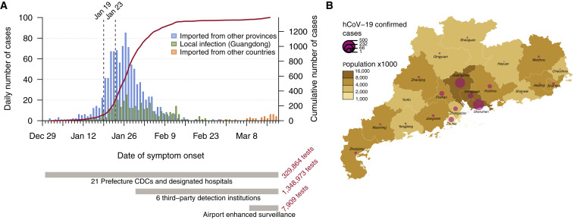
What are we learning today?
How to download, analyse, and interpret infectious disease data using the R-package ‘EpiEstim’
Specifically estimating the time varying reproduction number Rt

Slide 4
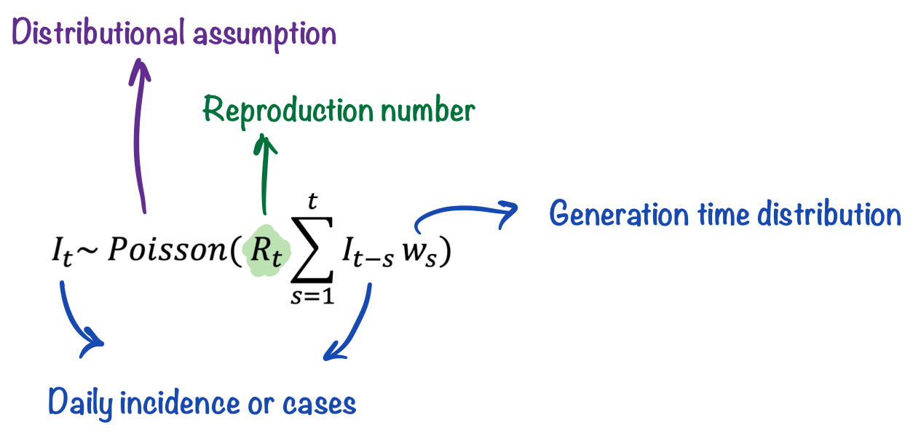
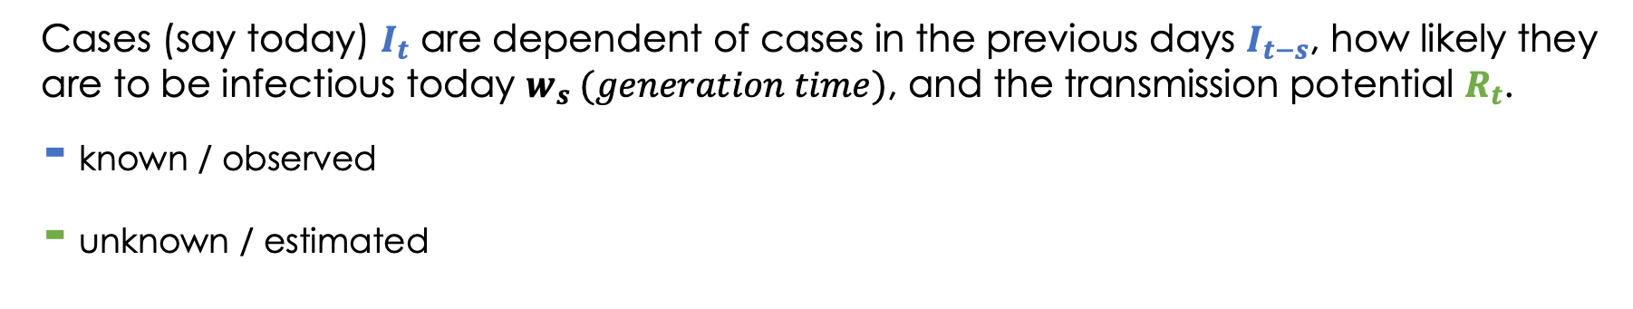
Renewal model for Rt estimation
Cases (say today) $I_{t}$ are dependent of cases in the previous days $I_{t−s}$, how likely they are to be infectious today $w_{s} (generation time)$, and the transmission potential $R_{t}$.
- known / observed
- unknown / estimated

Slide 5
How are we learning today?
There are handouts on GitHub with questions and example code: https://github.com/kraemer-lab/Mbiol-Practical-2025
We offer a short break after ca. 1 ½ hours
Raise your hand should you need assistance or have specific questions
Early next week (after Practical II) we will give you access to the model answers and you can email us with any questions following the sessions

