Slide 1

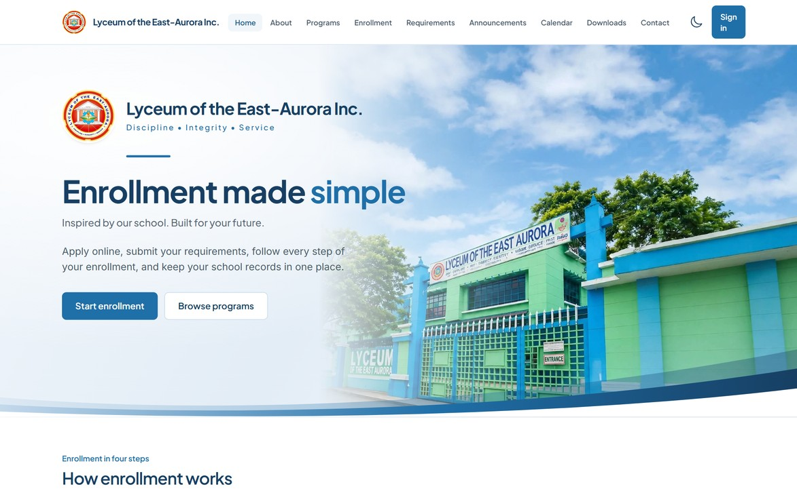
Lyceum of the East Aurora Inc.
SchoolHub
Enrollment and School Management System
PRESENTED BY
Shella Erika Gomez
Juvirena P. Pascual
Chunlie L. Martinez
Kyla J. Verial
Carlo Jay I. Villaflor
John Carmel M. Galande
Accountancy, 2nd Year · October 16, 2026
Notes:
Good day, everyone. We are the SchoolHub team, and we are presenting SchoolHub, an enrollment and school management system built for Lyceum of the East Aurora Inc.
In the next fifteen minutes we will show you what it does, how it keeps records safe, and what it would take to use it at the school. We will follow one student, Maria, through the whole process, so you can see how the pieces fit together.
Please keep your questions for the end. We will also be glad to show the system live.
Our team members are Shella Erika Gomez, Juvirena P. Pascual, Chunlie L. Martinez, Kyla J. Verial, Carlo Jay I. Villaflor, and John Carmel M. Galande.

Slide 2



Today, school work lives on paper and spreadsheets
Slow
Error-prone
Hard to check
Students line up, and staff retype the same details at every window.
A wrong amount, a missing document, a payment in the wrong account.
Who approved it? Is this ID real? The answer is buried in paper.
SchoolHub fixes all three.
Notes:
Let us start with the problem. Today, a lot of school office work depends on counters, paper, and spreadsheets. Think of enrollment week. A student enrolls at one window, pays at another, and the cashier writes the payment into an Excel ledger. The registrar keeps the requirements in folders.
That causes three problems. First, it is slow: students line up, and staff type the same information again and again. Second, it is easy to make mistakes, like a wrong amount, a missing document, or a payment recorded in the wrong account. Third, it is hard to check. When someone asks who approved this, or whether an ID is real, the answer is buried in paper.
SchoolHub is built to fix those three things, one by one.

Slide 3





One system for the whole school office
Students apply, pay, and follow their records online
Staff work from role-based portals, each with only its own tools
Walk-in students are served at the counter too
Works in any browser, on a PC or a phone
The public landing page
Notes:
So what is SchoolHub? It is one web system for the whole school office. This is its front page, the one the public sees. Students can apply online, upload their documents, pay, and see their schedule and grades.
Staff work in the same system, but each from a portal with only the tools they need. It also serves walk-in students, because not everyone has a phone or internet at home, and the counter must keep working.
Nothing special is needed to use it. It runs in a browser, on a computer or a phone, so there is nothing to install.

Slide 4

One student's journey, from application to enrolled
1
2
3
4
5
6
Apply
Documents
Approval
Fees
Payment
Enrolled
Online, or at the counter
Checked, or returned with a reason
A section is assigned
The assessment is created automatically
An official receipt is issued
A student number is issued
Student or registrar
Registrar
Registrar
System
Cashier
System
Every step records who did it and when, so nothing depends on memory.
Notes:
Here is the journey, using Maria as our example. Maria applies, online or at the counter. The registrar checks her documents, and either approves, or sends the application back with a reason she can read.
When it is approved, Maria gets a section, and her fee assessment is created automatically from the school's fee schedule, so nobody computes it by hand. She pays, online with proof or at the cashier, and the cashier issues an official receipt.
When the payment policy is met, Maria is officially enrolled and receives a student number. The important part is the line at the bottom of the slide: every step records who did it and when, so nothing depends on memory.

Slide 5




Five roles, each with its own portal
Student
Teacher
Registrar
Cashier
Administrator
Apply and upload documents
Pay and see the balance
Schedule and grades
Record attendance
Enter grades
Class lists and schedule
Review and approve
Sections and curriculum
Student records
Fees and payments
Receipts and ledger
Cash book and reports
Accounts and roles
Audit log
Backups and settings
Notes:
There are five kinds of users, and each has a separate portal. Students apply, pay, and view their records. Teachers record attendance and grades for their own classes.
The registrar handles enrollment, sections, the curriculum, and academic records. The cashier handles fees, payments, receipts, and the books. The administrator manages accounts, settings, backups, and the audit log.
The key idea is that nobody sees more than their job needs. A teacher cannot open payments, and a cashier cannot change grades. That protects the students, and it also protects the staff.

Slide 6
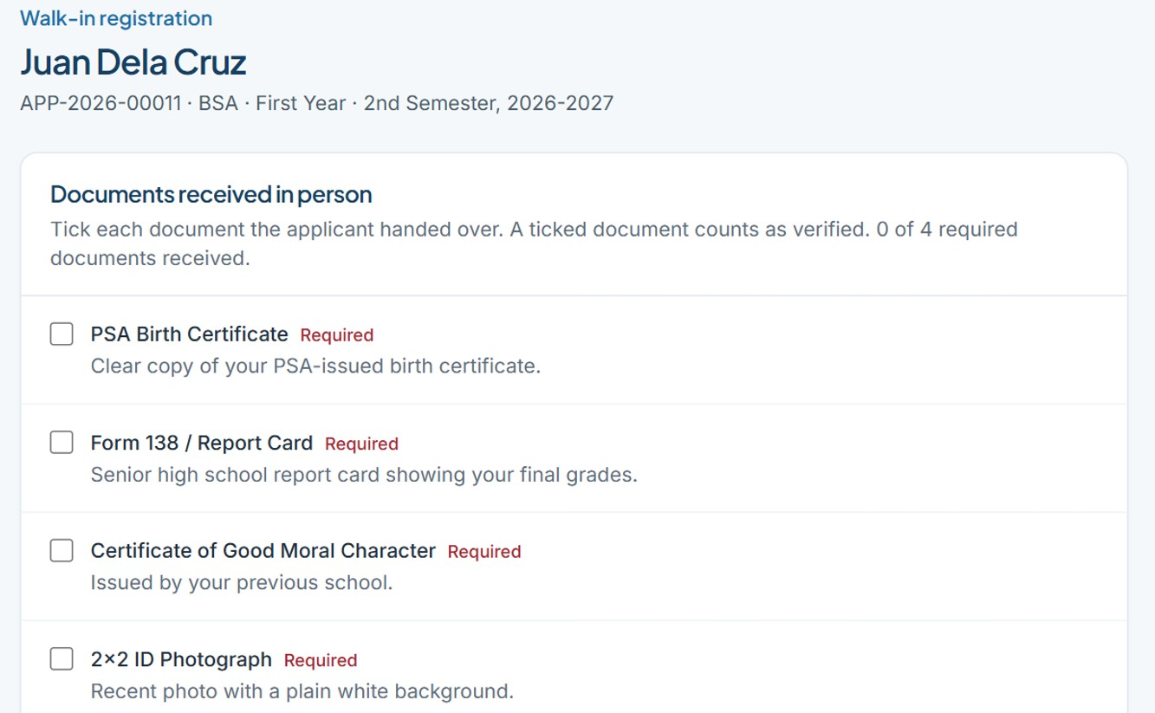
Walk-in enrollment, done in one pass
Every mistake shown at once, not one per click
Warns if the person is already registered
Documents ticked and photo taken at the counter
Submit goes straight to review. No shared passwords.
The registrar's documents step
Notes:
Let us show the counter. Walk-in enrollment was built for the registrar. The registrar enters the applicant once, and the form checks everything in a single pass. It shows every missing field at the same time, instead of one mistake per click, which is what used to waste the most time.
It also warns if the person is already registered, and returning students are found by name or number, so no second account is made. Then the registrar ticks the documents received in person, can take the applicant's photo, and submits. The application goes straight to review, because the registrar already saw the originals.
And the student receives a one-time link to choose their own password. No password is ever shared or written down.

Slide 7
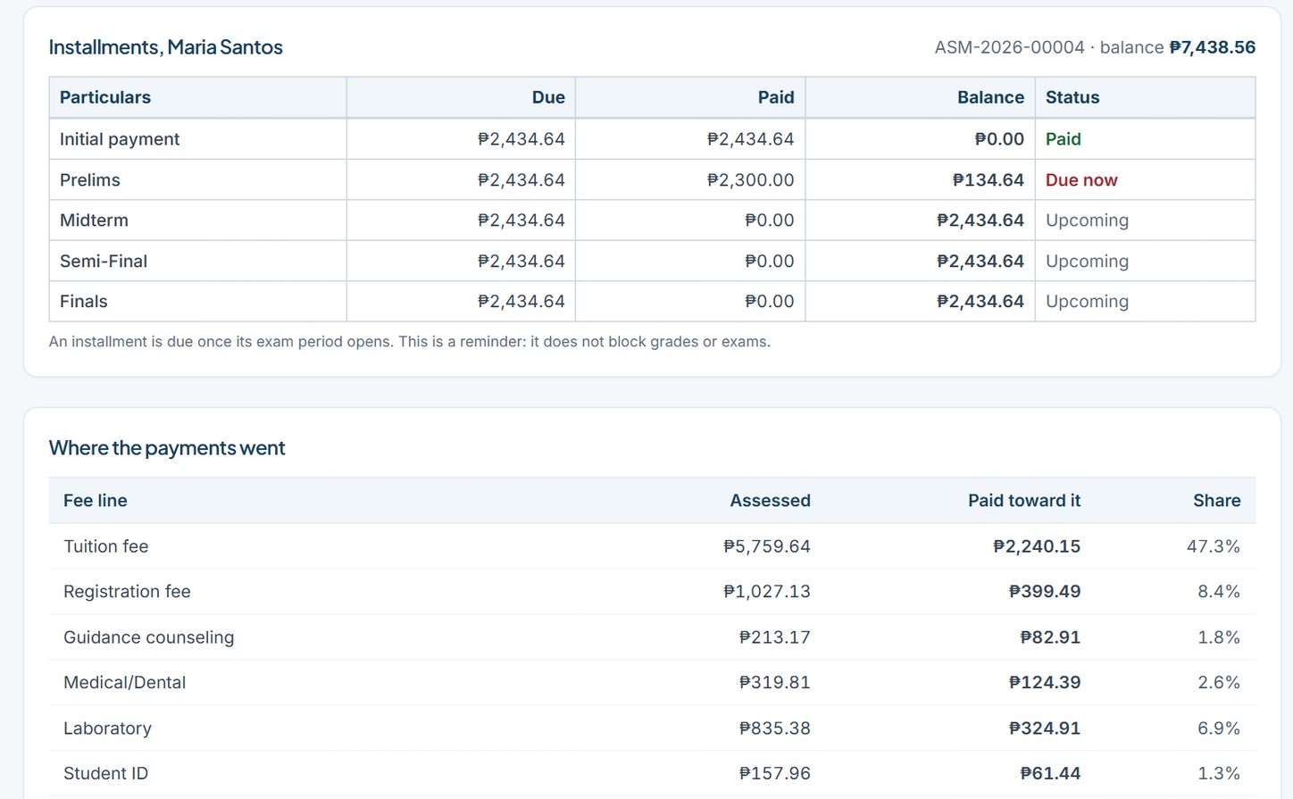
The cashier sees the whole account at the window
Installments and where each peso went, on one screen
Quick buttons: next installment or full balance
Numbered receipts. Payments are reversed, never deleted.
Count the drawer, then close and lock the day
Walk-in payments: installments, and where each peso went
Notes:
Now Maria goes to the cashier. The cashier's window shows everything on one screen: the installments, which are the initial payment, prelims, midterm, semi-final, and finals, and underneath, where each peso went. Quick buttons fill in the amount, either the next installment or the full balance, so the cashier does not type it.
Every payment gets a numbered official receipt, and a reprint is marked as a duplicate. Mistakes are never deleted. A payment is reversed with a written reason, and the reversal is recorded beside the original, so the history stays honest.
At the end of the day, the cashier counts the drawer, the system shows any difference, and the day is closed and locked. The cashier can also send a reminder to students who are due, and it appears in their portal.

Slide 8
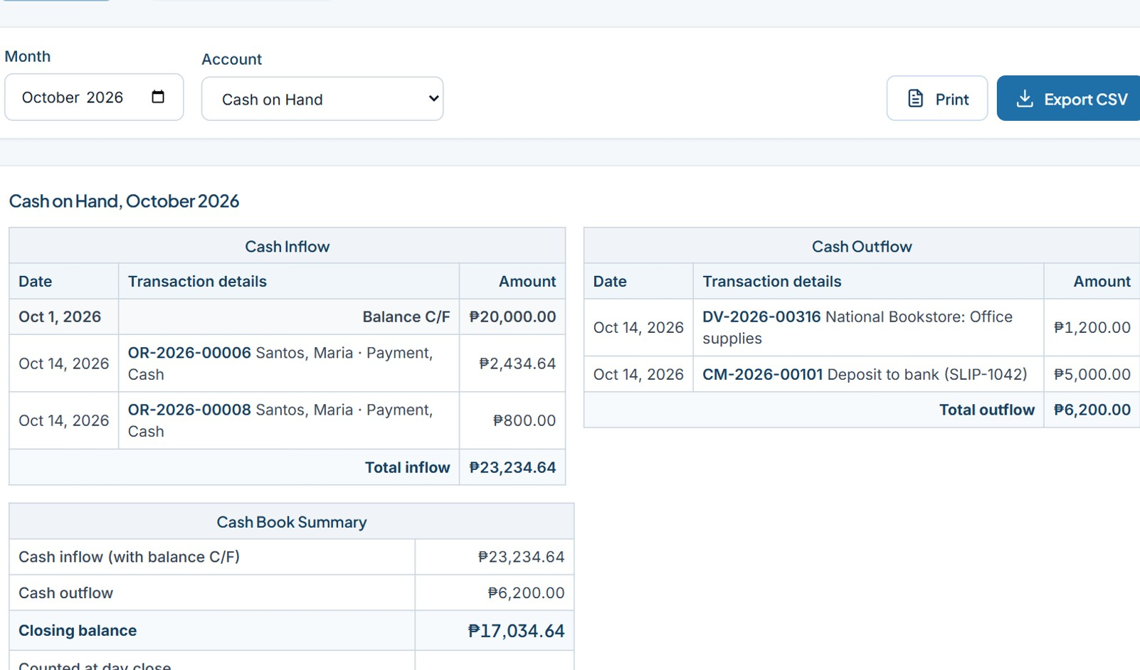
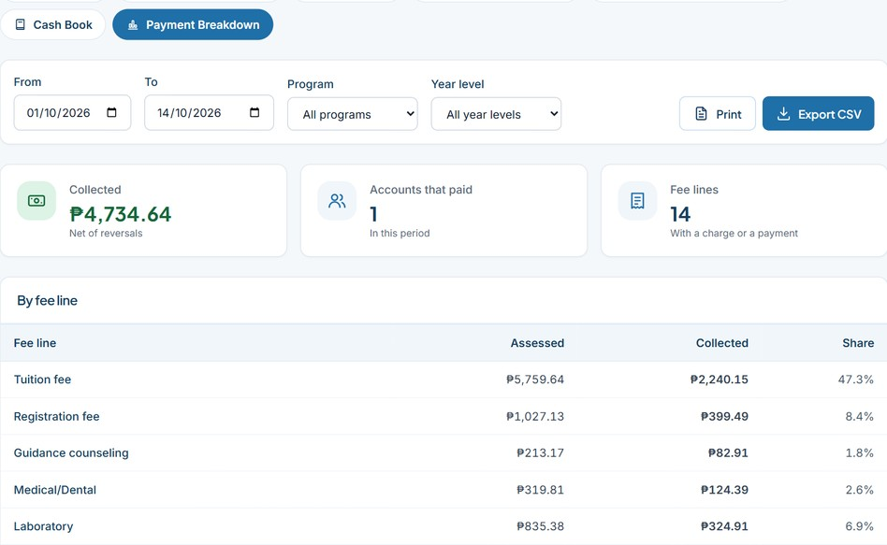
The school's books, computed, not retyped
Payment breakdown
Where the money went: by fee line, by payment method, and by day
Cash book: cash in on the left, cash out on the right, balance carried forward
The general ledger and trial balance are computed from the same records, so they always agree.
Notes:
Maria's payment is already in the cashier's books. This part was modeled on the school's own Excel ledger. The general ledger and the trial balance are computed from the real records, so they always agree with the receipts and vouchers. There is nothing to retype.
The cash book uses the two-sided format the office already knows: cash in on the left, cash out on the right, with the balance carried forward. Opening balances and bank deposits are entered once, and you can see Maria's two cash payments on the left.
The payment breakdown report shows how much went to tuition, registration, and each other fee, by payment method and by day. Because the totals come from the same records, they cannot drift apart.

Slide 9
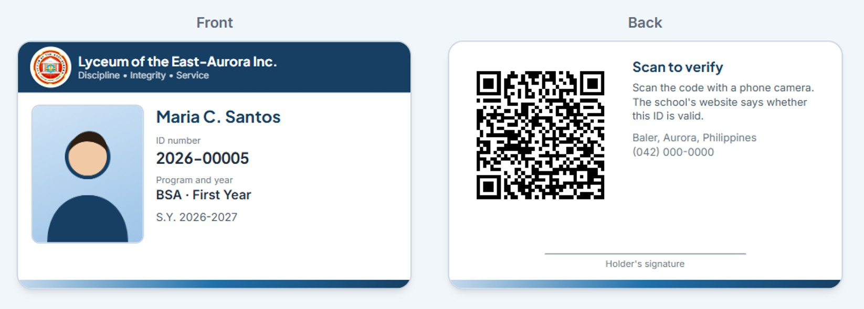
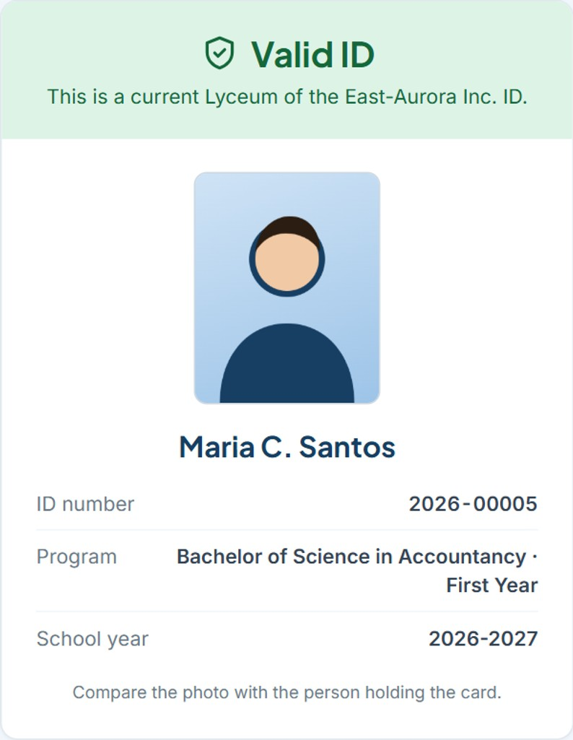



An e-ID anyone can verify by scanning
A random code, not the student number
A scan shows only photo, name, ID number, program
Lost card: reissue, and the old QR stops working
What a scan shows
Notes:
Now that Maria is enrolled, she can have an e-ID with a QR code. On the left is the card, front and back. When a guard or an office scans the code with a phone, the school's website opens, as you see on the right, and says Valid or Not valid, with the photo, name, ID number, and program. Nothing else. No birthday, no address, no grades.
The code is a long random string, not the student number, so IDs cannot be guessed. If a card is lost, the registrar reissues it, and the old QR stops working immediately.

Slide 10






Security and privacy are built in
Role-based access
Audit trail
Private files
Checked on every page, not only in the menu
Every important action is recorded and cannot be edited
Uploads are never public; only allowed people see them
Safe forms
Strong sign-in
Data privacy
Forgery and injection attacks are tested for
Hashed passwords, lockout, idle timeout, one-time links
RA 10173: consent recorded; only the minimum on the public ID check
Notes:
The panel will care about security, so let us be specific. Access is by role and permission, and it is checked on every page, not only hidden in the menu. Passwords are stored hashed, accounts lock after repeated failures, and sessions expire when idle.
Uploaded files are stored privately and only shown to people who are allowed to see them. Every important action is written to an audit log that cannot be edited. Forms are protected against forged requests, and the system is tested against injection attacks.
For data privacy under RA 10173, the system records consent, collects only what it needs, and the public verification page shows the minimum.

Slide 11
Built and tested like a real system
399
2,703
30
37
0
automated tests
page and security checks
specification documents
tested database updates
outside libraries
Documentation first. Tests with every feature. Each update rehearsed on a copy before it goes live.
Notes:
How do we know it works? We treated this like a real system. Every feature is written in the documentation first, 30 documents in all, and then built.
There are 399 automated tests, plus a crawler that opens every page as every role, 2,703 checks, including attacks such as forged forms and injection attempts. The system uses no outside software libraries that could go out of date or be abandoned.
Updates reach the live site by a tested routine: back up, run the database script, upload the files. We test that script on a copy first, so the live records are never the first place a change is tried.

Slide 12

Running today, and what it costs to launch
Per year (estimate) | Cost
Domain name (.com) | ₱700–1,200
Shared hosting with backups | ₱1,800–5,000
Email service | Free–₱1,500
Total, roughly | ₱3,000–8,000
Live today
Running as a pilot on free hosting
Works from enrollment to payment
Email is off; links are handed over
Estimates only. Confirm current prices before buying.
Notes:
SchoolHub is already running on a free hosting service as a pilot, and it works from enrollment to payment.
For real use, the cost is small. A domain name is about 700 to 1,200 pesos a year. Good shared hosting, with backups and scheduled jobs, is about 1,800 to 5,000 pesos a year. Email can be free or cost up to 1,500. So the total is roughly 3,000 to 8,000 pesos a year. These figures are estimates and should be confirmed before buying.
Compare that with the staff time spent on manual entry, and with the risk of mistakes in money records. There is also no per-student license fee, and the school owns the system.

Slide 13
Honest limits, and the next steps
Honest limits
Next steps
Email is off on the pilot
1
Set up email
2
Move to paid hosting, data kept in the Philippines
Free hosting suits a pilot, not real student records
3
Load every fee schedule
Fee amounts for other programs are still to be entered
4
Train the registrar and the cashier
The e-signature is an image, not a legal digital signature
5
Run one term as a supervised pilot
Notes:
We want to be honest about the limits, because you should know them before deciding. Email is switched off on the pilot, so password links are handed over directly instead of emailed. Walk-in students are not affected, but password help goes through the administrator.
The free hosting is fine for a pilot, but not for real student records, so the next step is proper hosting, preferably with the data kept in the Philippines. The fee amounts for programs other than Public Administration still need to be entered. The e-signature is an image of a signature, not a legal digital signature. And the system is for one school.
The next steps are on the right: set up email, move to paid hosting, load every fee schedule, train the registrar and the cashier, and run one term as a supervised pilot.

Slide 14
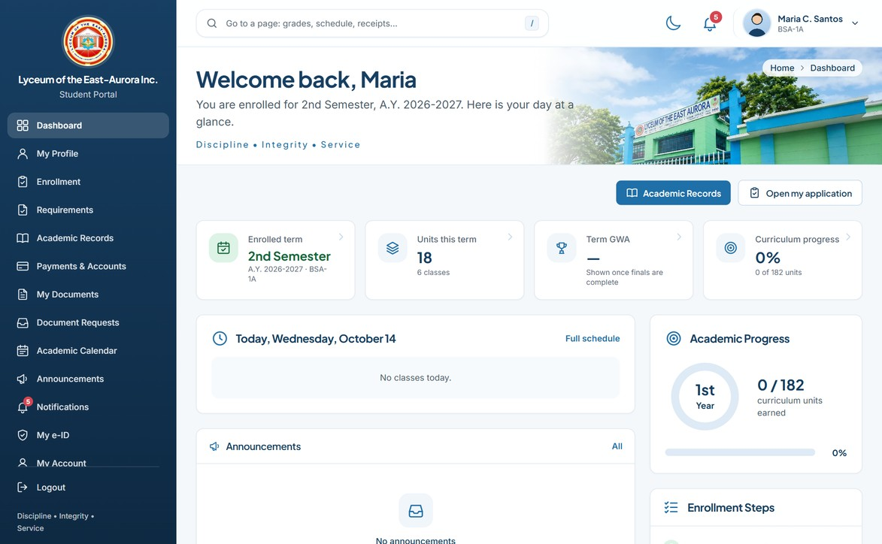
Lyceum of the East Aurora Inc.
Thank you
Questions?
PRESENTED BY
Shella Erika Gomez
Juvirena P. Pascual
Chunlie L. Martinez
Kyla J. Verial
Carlo Jay I. Villaflor
John Carmel M. Galande
Accountancy, 2nd Year · October 16, 2026
Notes:
Thank you for your time. SchoolHub is built to make enrollment faster, payments clearer, and records easier to trust.
We are happy to answer your questions, and we can show the system live.

