Slide 1
A Tale of Two Bugs:
Driving granulation by taking advantage of metabolic differences
Joe Weaver
jeweave4@ncsu.edu

Slide 2
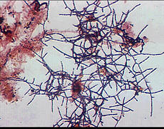
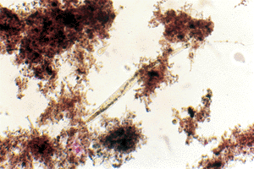
There are two bugs competing in my system
Both are aerobic heterotrophs, but they use air and food differently
Filamentous bacteria
Floc-forming bacteria
Fast growers
Can’t store food
Slow growers
Can store food

Slide 3
In 4 mins, you will be able to design a granulation reactor.
Water flows this way
Should food go here?
Should food go here?
Dense clumps
should come out here
Should air go here?
Should air go here?

Slide 4
Let’s grow two clumps of bugs
You’re going to fill in the handout from the next slide
One clump always has air and food
The other will have either air, food, or both each turn
The bugs grow according to these rules:
Air and food
Only Air
Only Food
Randomly add one for ~ every 3

Slide 5
ALWAYS Air and food
The slid says if there is air, or food, or both

Slide 6
Example Round 1
(don’t fill in your handout)
‘Rules’ reminder
AIR and FOOD
Air and food
FOOD
Randomly add one for ~ every 3
Only Air
AIR
Only Food

Slide 7
Round 1
Right hand side has: AIR and FOOD
Air and food
Only Air
Only Food
Randomly add one for ~ every 3

Slide 8
Round 2
Right hand side has: FOOD
Air and food
Only Air
Only Food
Randomly add one for ~ every 3

Slide 9
Round 3
Right hand side has: AIR
Air and food
Only Air
Only Food
Randomly add one for ~ every 3

Slide 10
Round 4
Right hand side has: AIR and FOOD
Air and food
Only Air
Only Food
Randomly add one for ~ every 3

Slide 11
Round 5
Right hand side has: FOOD
Air and food
Only Air
Only Food
Randomly add one for ~ every 3

Slide 12
Round 6
Right hand side has: AIR
Air and food
Only Air
Only Food
Randomly add one for ~ every 3

Slide 13
Round 7
Right hand side has: AIR and FOOD
Air and food
Only Air
Only Food
‘storage’
Randomly add one for ~ every 3

Slide 14
Pick a neighbor, what did you notice?

Slide 15
I promised you’d be able do this
Water flows this way
Should food go here?
Should food go here?
Dense clumps
should come out here
Should air go here?
Should air go here?

