Slide 1
Investing in Your Neighborhood
Presented by Joe Webb
January 28th, 2019

Slide 2
What are the best predictors of Home Sale Prices? (Of the properties in the data)
Date house was sold
# of Bedrooms/House
# of Bathrooms/House
Square footage of the home
Lot Size
Floors
Waterfront
# of Views (by prospective buyers)
Condition
Grade: based on King County grading system
Square footage above basement
Basement Size
Year Built
Year Renovated
Zipcode
House Square footage of the nearest 15 neighbors
Lot square footage of the nearest 15 neighbors

Slide 3
81% Accuracy
How is accuracy defined? 81% of Home Sales will be “GOOD” Investments
60% of the variation is explained by the model.
Best predictors: Square Foot Living Space, Grade (Condition), Year Built, & Views
Assumptions to Invest? We will invest at a level of 80% of the Predicted Sale Price
model is Not meant to predict houses >$1,614,000, > 5,900 sq ft, nor Grade > 11

Slide 4
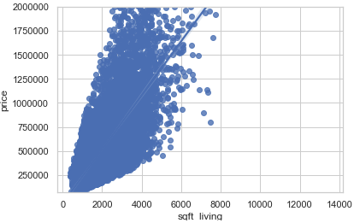
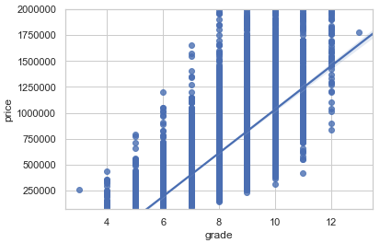
Predictor Visualizations

Slide 5
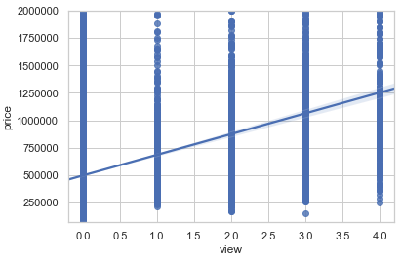
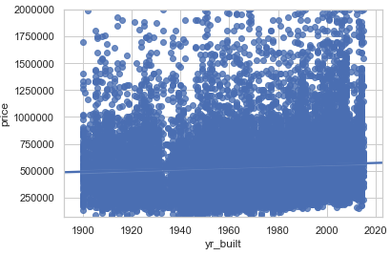
Predictor Visualizations

Slide 6
Model Summary
Square Foot: Sale Price increases $108 for each square foot
Grade (based King County grading system): Price increase $124,400 with each increase in Grade number up to 11
Viewed by Prospect Buyers: adds ~$44,200 up to 4 viewings.
The age of the home increases the Sale Price by ~ $2,671 per year.

Slide 7
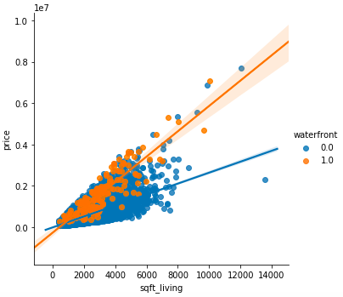
Question: Waterfront properties v. Not

Slide 8
model WATERFRONT homes separately
Waterfront: Having a Waterfront View adds $370,000 to the Price
Assumed other predictors are kept constant (relatively)
Sale Price predicted by Square Foot Living Space only
Assumptions to Invest? We will invest at a level of 80% of the Predicted Sale Price
76% of Home Sales will be “GOOD” Investments

Slide 9
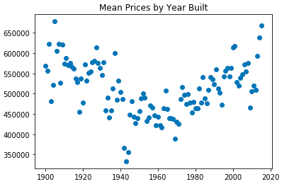
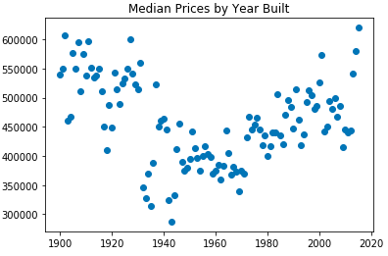
Question: Year Built has a negative coef in the model………..Here’s why?

