Slide 1
Northwinds Trading Company Business Review
Areas of Concern
Affect of Discounts on Overall Sales
Discount Affect on each Product Category
Sales Team Performance
Growth Opportunities

Slide 2
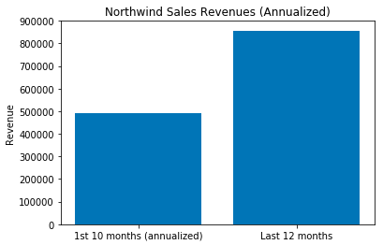
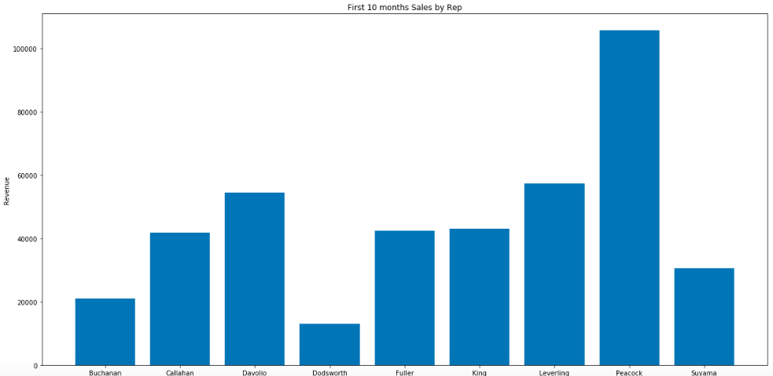
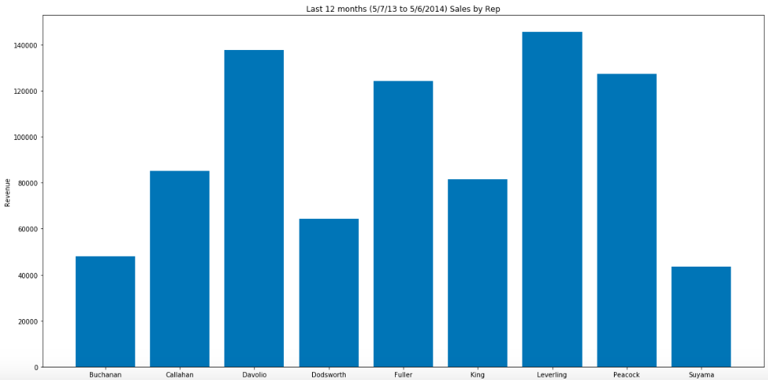
Annual Sales Summary
Notes:
Northwinds has orders dating from July 4th, 2012 to May 6th, 2014. It is important to compare sales on a 12 month basis, so sales were analyzed in two segments: 1st segment is the first 10 months of operations and the 2nd segment is the last 12 months. The 1st segment is 10 month as a result of the 2nd segment being 12 months. It is noted that the 1st segment sales are annualized to compare with the 2nd segment.

Slide 3
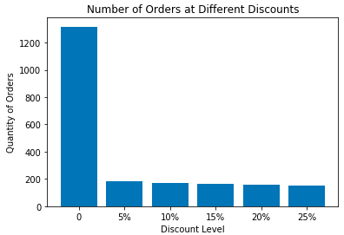
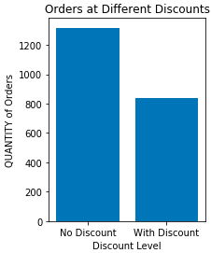
Discount Affect
2155 orders written in 22 months
1317 orders were sold with NO discount, 838 sold with discount
Discounts ranged from 5% to 25%

Slide 4
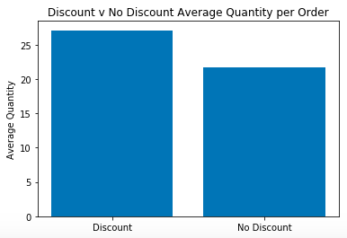
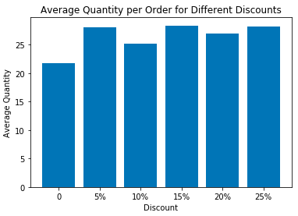
Discount Affect
Average Size of order increases from 21.7 to 27.1
Size of Discount is irrelevant (5% ~ 25%)
Category is relevant
Notes:
Since the p-value for the Ttest is <.05, then it can be stated there is >95% chance that discounted orders are not from the same sample as non-discounted orders. Therefore, the null hypothesis is rejected. DISCOUNTING DOES INCREASE THE QUANTITY OF ORDERS.

Slide 5
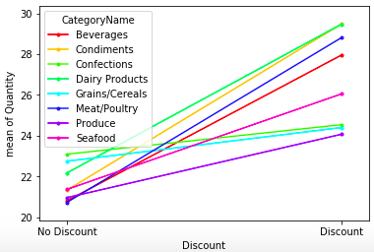
Conclusions: 1. Discounts increase the average size of the order from 21.7 to 27.1 2. The size of the discount is irrelevant 3. Discount: Meat/Poultry, Condiments, Beverages 4. There’s no need to discount Confections and Grains/Cereals
Notes:
The higher the slope, the more reactive to a discount. Flat line categories are unaffected by discounts.

Slide 6
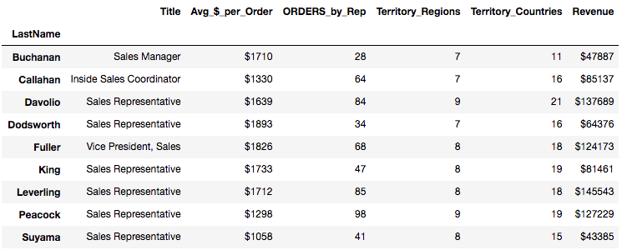
Sales Team Overview
9 Regions & 21 Countries
9 Salespeople are based in 2 locations: Seattle, WA and London
No sales’ territories appear to exist
Orders are last 12 months
Notes:
It appears that each salesperson sells into most of the countries and regions. There are not sales territory boundaries.

Slide 7
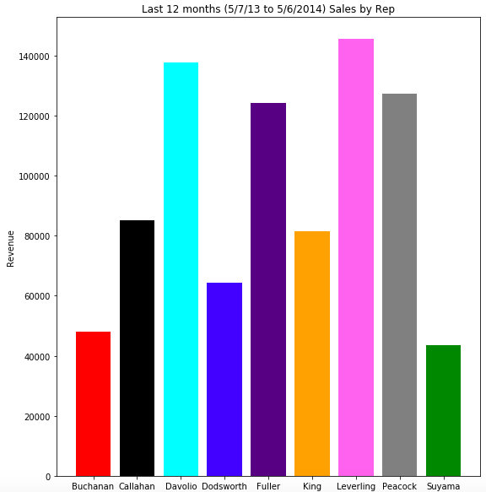
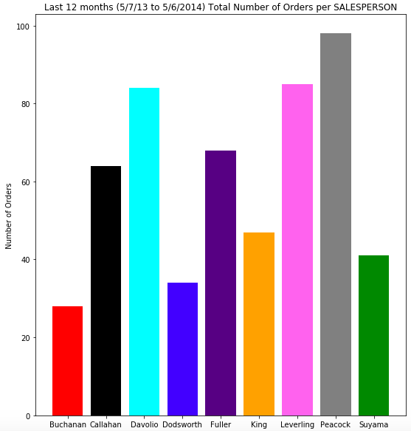
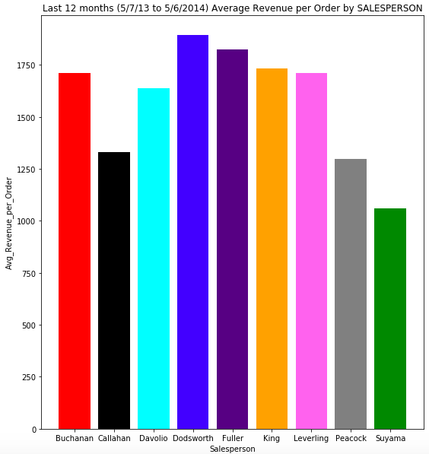
Notes:
-Leverling is the Salesperson with the highest total revenue, followed by Davolio. Suyama had the lowest total Revenue.
-Peacock has the highest Total Number of Customers, followed by Davolio. Buchanan has the smallest number of Customers.
-Leverling has the highest average revenue per customer, followed by King. Suyama has the lowest.
-Callahan has the highest average number of orders per customer, followed closely by Leverling and Peacock. Suyama has the lowest.
-Peacock has the highest number of total number of orders, followed by Leverling and Davolio. Buchanan has the lowest.
-Dodsworth has the highest average revenue per order, followed by Fuller. Suyama has the lowest.

Slide 8
Sales Team Insight
Salespeople are statistically similar
Predictor of Overall Performance
Strongest: “Total Number of Orders”
“Average Order Revenue” is similar by Salesperson
Compensation
Align with Company Goals
Recommendation: Incentivize Total Number of Orders
Notes:
CONCLUSION: The pvalue is greater that alpha (.05), so we FAIL TO REJECT the null hypothesis. Therefore, we conclude that each salesperson is similar in terms of Average Revenues per Customer. Business Insight: There is a noticeable difference in Revenue produced by each salesperson. Number of Orders and Revenue per order are strong predictors of Salesperson Total Revenue, with Number of Orders being the most influencial. So, the Salesperson should devote his/her time to increasing their number of orders..

Slide 9
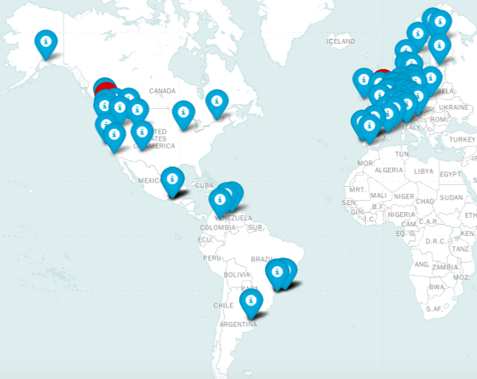
Customer Overview

Slide 10
Customer Overview
88 Customers & 540 Orders
Concentration:
Customers in:
W. Europe (27), N.America (16), S. America(16)
USA (13), Germany (11, France(10)
Orders in:
W. Europe (179), N. America (103)
USA (262), Germany (210), Brazil (134)
Notes:
540 orders in the LAST 12 MONTHS

Slide 11
Conclusion:
Countries are NOT the same in terms of "REVENUE PER ORDER.
Austria and Ireland are statiscally different than 2 or more other countries to the right (greater) of the mean.
France and Italy are statistically different than 2 or more other countries to the left (less) of the mean.
BUSINESS INSIGHT:
There's an opportunity to increase "REVENUE PER ORDER" with NEW customers in France and Italy.
There's an opportunity to increase "REVENUE PER ORDER" with CURRENT customers in France and Italy.
Notes:
results in a clear, actionable way for non-technical audiences

