Slide 1
MVC An introduction
By Joe Ulyatt

Slide 2
MCV Overview
MVC is a server-based ‘architectural pattern’ for software development
One of the most popular patterns today
Powerful, practical and precise

Slide 3
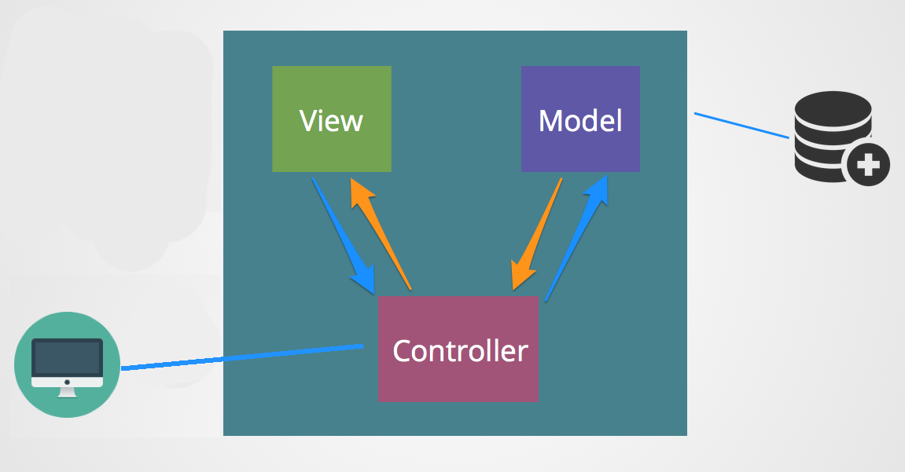
What does MVC stand for?
MODEL VIEW CONTROLLER
Model
Listens for data requests from controller
Gets database data and hands back to controller
Controller
Listens for HTTP requests from client
Speaks to Model and View to complete requests
Responds with compiled data back to client
Views
Listens for view requests from controller
Presents received data for browser
Hands presented data back to controller

Slide 4

Why MVC?
Separation of concern
Easy to change individual parts of an app
More ‘bulletproof’ and harder to break
Easier to debug
Easy to understand what part you’re looking at
Collaboration
Different developers can easily work on separate parts
Specialised developers can work on what they’re best at

Slide 5
Controller in detail
Lives on server
Acts as a ‘go-between'
Listens for HTTP requests from client
Requests any Database info from the Model
Requests presentation of data from the Views
Compiles these things and returns to the client
Has NO direct access to DB or HTML

Slide 6
Model in detail
Listens for database requests from controller
Gets requests data from database
Returns data to controller
CANNOT talk to Views

Slide 7
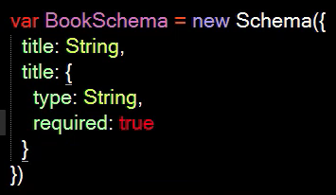
Model Continued (Mongoose)
Mongoose is based off of the ever-popular MongoDB Database
It’s a ‘schema based’ solution for your apps models
‘Schemas’ enable you to write certain Database code in your app
Schemas create entry templates - protecting your code from inaccurate entries
Allow developers to understand a Database without having direct access to it

Slide 8
Views in detail
Listens for requests from Controller
Uses this info to present data, such as HTML
Passes this presented data back to Controller
CANNOT talk to the Models or Database

Slide 9

Summary
In a complex app there will be many, many Controllers, Views & Models
It needs time to set up, but is well worth the results
The popularity of the MVC model is proof of it’s usefulness

Slide 10
Thanks for listening! A presentation by Joe Ulyatt

