Slide 1
Visual imagery and false memory for pictures
Melissa, Justin, Peiwu, and Joe
PSYCH 214 Oct. 17 2016

Slide 2
Introduction
Encoding and retrieval - two critical and complementary angles for understanding the mechanism of neural codes in the brain
Goal: investigate the neural basis of discriminating images from perceived pictures in individuals with high visual imagery abilities

Slide 3
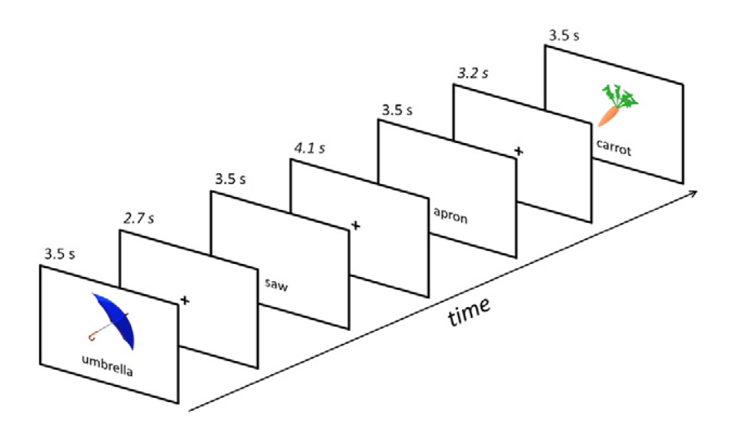
Experimental Design
26 healthy subjects
45 words / 45 images
Scanned during encoding and recall

Slide 4
Experimental Design
Implicit encoding: Presentation of images & words – is this a vegetable?
Immediate Retrieval: Were you shown a picture, or a word?

Slide 5
Event types (Stimulus / Recall)
Picture / Picture (Hit) | Picture / Word (Miss)
Word / Picture (False Alarm) | Word / Word (Correct Rejection)
False Imagery

Slide 6
Demographic and Clinical Data
Age
Gender
Education level
Verbal IQ
Launay-Slade Hallucination Scale
Visual Imagery Score
Peters Delusion Inventory

Slide 7
Task Data
Hits
Omissions
False alarms
Correct rejections
Response Time

Slide 8
Project Goals
Contrast Image vs Word trials during encoding
Contrast Hits vs False Alarms during recall
Contrast Correct Rejections vs Omissions during recall
Regress with Visual Imagery, Hallucination, and Delusion scores

Slide 9
Preprocessing steps (ROI analysis)
Outlier detection
Slice-timing correction
Motion correction
Notes:
Potentially not doing between-subject normalization and spatial smoothing

Slide 10
First-level analysis (ROI analysis)
Mask data to only include voxels within brain
Fit fMRI BOLD time series from each voxel with event time series to obtain beta maps
Compute contrast map for first run
Mask data to include voxels from first run analysis
Fit fMRI BOLD time series from voxels with event time series for second run to obtain beta map
Compute contrast map for second run
Extract mean signal from each contrast map

Slide 11
Second-level analysis (ROI analysis)
Compute t statistics
Regress clinical scores

Slide 12
Preprocessing steps (whole brain)
Outlier detection
Slice-timing correction
Motion correction
Within-subject registration
Between-subject normalization
Spatial smoothing

Slide 13
First-level analysis (whole brain)
Mask data to only include voxels within brain
Fit fMRI BOLD time series from each voxel with event time series to obtain beta maps
Compute contrast images from beta maps of interest

Slide 14
Second-level analysis (whole brain)
Compute t maps using first-level contrasts
Regress clinical scores with first-level contrasts
Calculate t map from beta map
Control for multiple comparisons using random field correction

