Slide 1
Project-blue: False visual memory
Melissa, Justin, Peiwu and Joe
PSYCH 214 Dec. 5 2016

Slide 2
Outline
Project design & goals
Preprocessing
Outlier detection
Slice-timing correction
Motion correction
First analysis (Picture vs. Word)
Second analysis (Hits vs. False Alarms)
Regressions

Slide 3
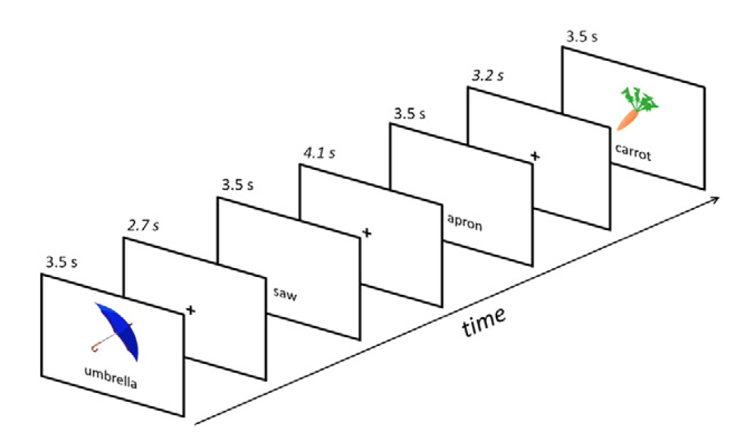
Experimental Design
Run 1 - Implicit encoding: Presentation of images & words – is this a vegetable?
Run 2 - Immediate Retrieval: Were you shown a picture, or a word?

Slide 4
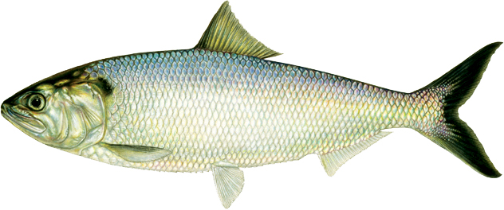
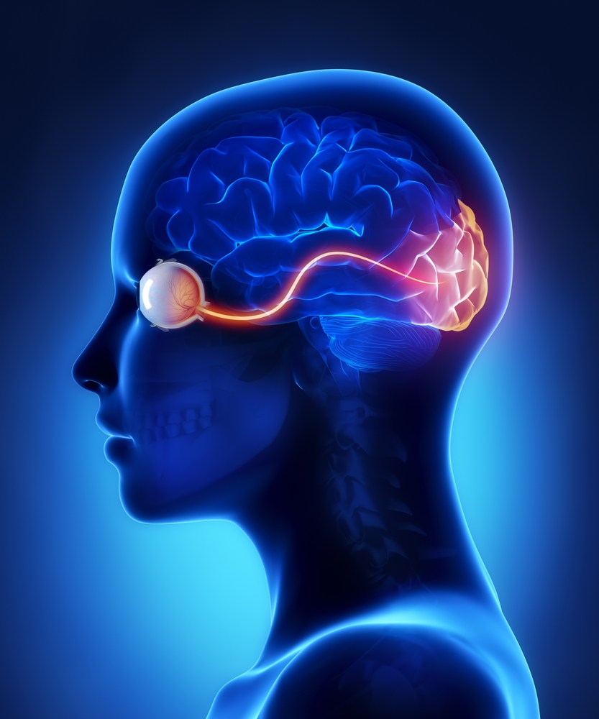
Project Goal
Question: What happens in the brain when a false visual memory is encoded?
?
fish
fish
Encoding
Recall

Slide 5
Event types (Stimulus / Recall)
Picture / Picture (Hit) | Picture / Word (Miss)
Word / Picture (False Alarm) | Word / Word (Correct Rejection)
False Imagery

Slide 6
Project Goal
For encoding trials, contrast [PICTURE] – [WORD]
Generate subject-specific ROIs based on this contrast
Within ROI, contrast encoding trials subsequently recalled correctly with those misremembered as images ([FA] – [CR])
?
fish
fish
Encoding
Recall

Slide 7
4) Regressions
Launay-Slade Hallucination Scale
Visual Imagery Score
Peters Delusion Inventory
Q: Are subjective reports of visual imagery associated with differences in brain activity?

Slide 8
Hypothesis
Subjects who report being more prone to hallucination & visual imagery will show greater brain activation associated with subsequent false memory of an image
Specifically in regions associated with viewing an image

Slide 9
Preprocessing
Wrapper script pulls up subject files:
Outlier detection
Slice timing correction
Motion correction
… on toward statistics

Slide 10
Outlier Detection
Input: 4D data
Output: Cleaned 4D data, list of outliers
How: Remove mean outliers & stdev outliers according to interquartile range
detectors.py

Slide 11
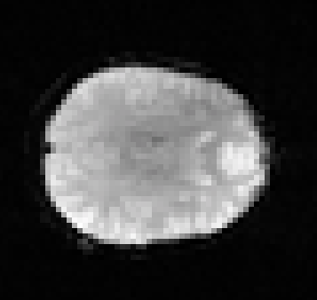
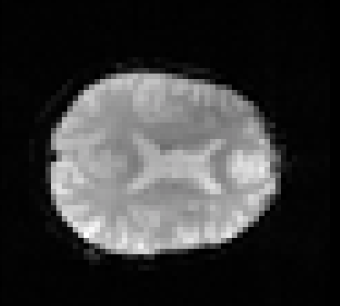
Slice Timing Correction
Input: 4D data, TR
Output: Corrected 4D data, interpolated time series
How: Scipy Interpolate function
Align slice timing as though all slices were collected at the beginning of each TR
Original
Timing Corrected
slice_timing_corr.py

Slide 12
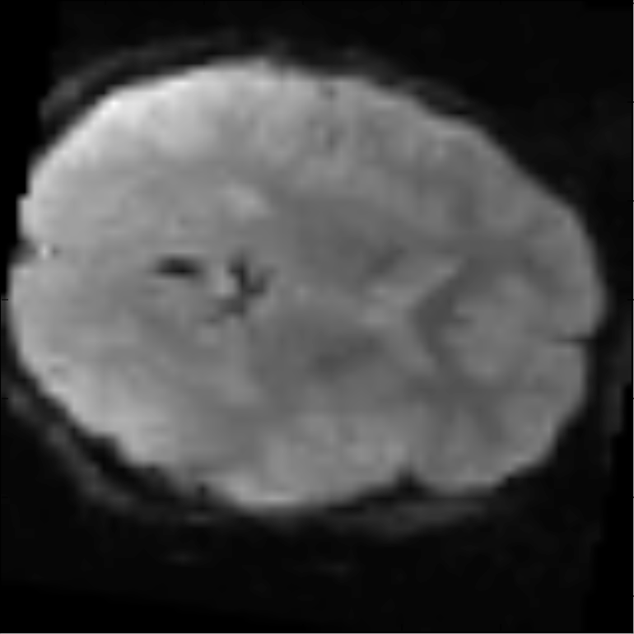
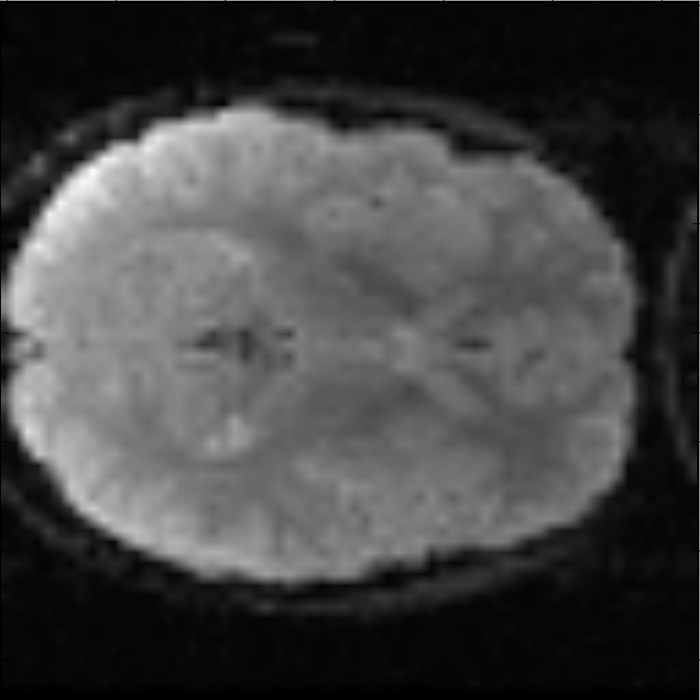
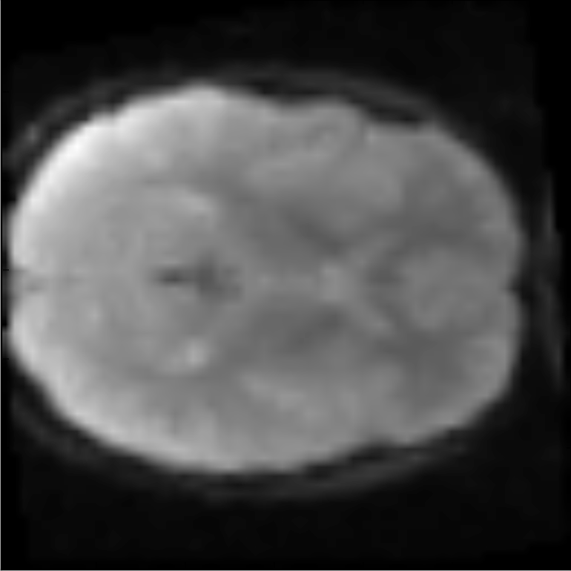
Motion Correction
Input: 4D data, rotation & transformation matrices
Output: Corrected 4D data, correction parameters
How: Using optimization with fmin_powell, find best parameters to apply transformation and obtain greatest correlation between each volume in 4D data and a reference volume.
Original single volume
Reference volume
Corrected single volume
motion_correction.py

Slide 13
Statistics
After preprocessing:
Picture vs. Word contrast
Generate subject ROIs
Hits vs. False Alarms contrast
… end product is list of t & p values

Slide 14
Model Signal Script
Create design matrix
Event time course
Betas & contrast matrices
Compute t-map and p-map
model_signal.py

Slide 15
Picture vs. Word
[ X Y Z T1 HIT]
[ X Y Z T2 FALSE ALARM]
[ X Y Z T3 CORR REJECT]
[ X Y Z T4 MISS]
[ X Y Z T5 HIT]
[ X Y Z T6 FALSE ALARM]
[ X Y Z T7 CORR REJECT]
[ X Y Z T8 MISS]
…
…
[ X Y Z T90 HIT]
model_signal.py

Slide 16
Picture vs. Word
[ X Y Z T1 HIT]
[ X Y Z T2 FALSE ALARM]
[ X Y Z T3 CORR REJECT]
[ X Y Z T4 MISS]
[ X Y Z T5 HIT]
[ X Y Z T6 FALSE ALARM]
[ X Y Z T7 CORR REJECT]
[ X Y Z T8 MISS]
…
…
[ X Y Z T90 HIT]
model_signal.py

Slide 17
Picture vs. Word
[1]
[-1]
[-1]
[1]
[1]
[-1]
[-1]
[1]
…
…
[1]
[ X Y Z ]
[ X Y Z ]
[ X Y Z ]
[ X Y Z ]
[ X Y Z ]
[ X Y Z ]
[ X Y Z ]
[ X Y Z ]
…
…
[ X Y Z ]
X
model_signal.py

Slide 18
ROI / Mask
Generate t-map from Picture x Word contrast
Set a t-threshold to create a mask
Pull means from ROI for Hits x FA t-test
Considering multiple comparison correction
Reduces number of voxels in analysis
model_signal.py

Slide 19
False Visual Memory
[ ROI X Y Z T1 HIT]
[ ROI X Y Z T2 FALSE ALARM]
[ ROI X Y Z T3 CORR REJECT]
[ ROI X Y Z T4 MISS]
[ ROI X Y Z T5 HIT]
[ ROI X Y Z T6 FALSE ALARM]
[ ROI X Y Z T7 CORR REJECT]
[ ROI X Y Z T8 MISS]
…
…
[ ROI X Y Z T90 HIT]
model_signal.py

Slide 20
False Visual Memory
[-1]
[1]
[0]
[0]
[-1]
[1]
[0]
[0]
…
…
[-1]
[ ROI X Y Z ]
[ ROI X Y Z ]
[ ROI X Y Z ]
[ ROI X Y Z ]
[ ROI X Y Z ]
[ ROI X Y Z ]
[ ROI X Y Z ]
[ ROI X Y Z ]
…
…
[ ROI X Y Z ]
X
model_signal.py

Slide 21
Regressions
Hallucination, Visual Imagery, Delusions
Extract scores from subject files
Regress ‘false imagery’ mean t-value with scores
Could also split into groups for t-tests

Slide 22
Limitations
No information about brain regions across subjects
Contrast of means but not regions
Regression allows for investigating subject / group differences
Mask may obscure differences in some subjects

