Slide 1
Visual imagery and false memory for pictures
Melissa, Justin, Peiwu and Joe
PSYCH 214 Oct. 17 2016

Slide 2
Introduction
Encoding and retrieval - two critical and complementary angles for understanding the mechanism of neural codes in brain
Goal: investigate the neural bases of discriminating images from perceived pictures in individuals with high visual imagery abilities

Slide 3
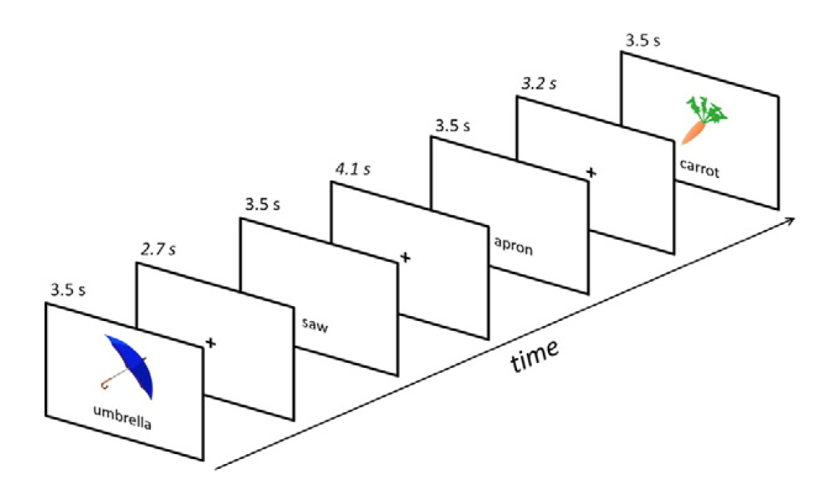
Experimental Design
26 healthy subjects
45 words / 45 images
Scanned during encoding and recall

Slide 4
Experimental Design
Implicit encoding: Presentation of images & words – is this a vegetable?
Immediate Retrieval: Were you shown a picture, or a word?

Slide 5
Event types (Stimulus / Recall)
Picture / Picture (Hit) | Picture / Word (Miss)
Word / Picture (False Alarm) | Word / Word (Correct Rejection)
False Imagery

Slide 6
Demographic and Clinical Data
Age
Gender
Education level
Verbal IQ
Launay-Slade Hallucination Scale
Visual Imagery Score
Peters Delusion Inventory

Slide 7
Task Data
Hits
Omissions
False alarms
Correct rejections
Response Time

Slide 8
Preprocessing steps
Motion correction
Outlier detection
Slice-timing correction
Spatial filtering
Temporal filtering
Global intensity normalization
Preprocessing Steps

Slide 9
Analyses
Replicate control results from Stephan-Otto et al. (2016)
Contrast Hits and False Alarms
Contrast Correct Rejections and Omissions
Correlate with Visual Imagery, Hallucination, and Delusion scores

Slide 10
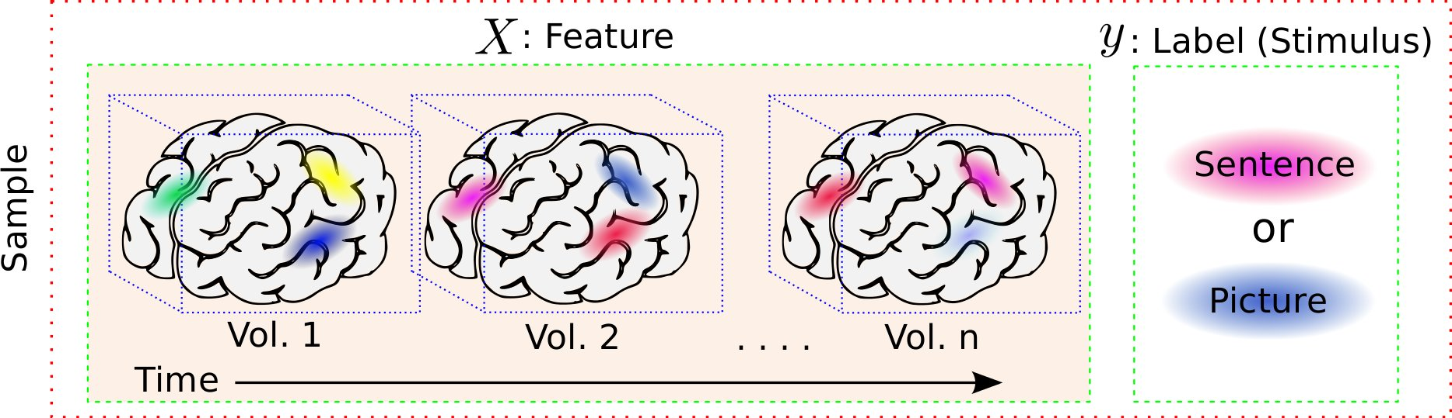
Preliminary planned Workflow
Outlier detection
Extraction of relevant voxel or VOI (volumes of interest)
Statistical modeling of BOLD signals to task data (Brain response modeling)
Normalization of fMRI BOLD amplitude
Minimize the baseline difference across individuals
GLM for individual vovel’s fMRI BOLD time series and the fitted parameters will be used to explain the functional activities of voxels.
http://ssp.dml.ir/wp-content/uploads/2013/07/braindecodingsample.jpg

