Slide 1
Big Mountain Resort – Executive Pricing Strategy
Guided Capstone • Joey Carroll • 29 April 2025

Slide 2
Problem Identification
Current adult weekend ticket: $81
Peer-resort data show under‑pricing (optimal ≈ $96)
Lost revenue limits capital improvements

Slide 3
Opportunity
Executive team seeks sustainable revenue growth
Capital needed for lift upgrades & snow‑making
Data‑driven approach reduces pricing risk

Slide 4
Recommendation & Key Findings
Stage 1: Raise ticket to $89 next season, market new quad lift
Stage 2: Move to $95–$96 following year if demand holds
Validate with A/B weekend: 50 % inventory at $81 vs $89

Slide 5
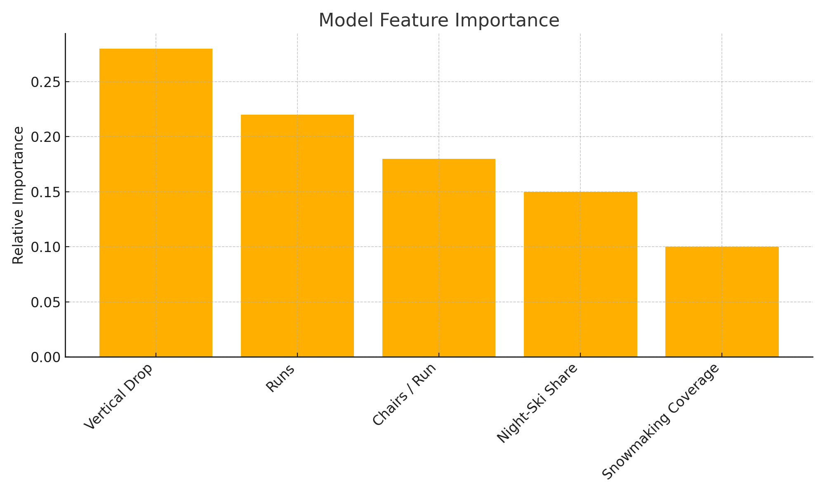
Modeling Results
Dataset: 277 US ski resorts, 25 engineered features
Model: Random‑forest regressor (MAE ≈ $9.8)
Key drivers: vertical drop, runs, chairs‑per‑run ratio

Slide 6
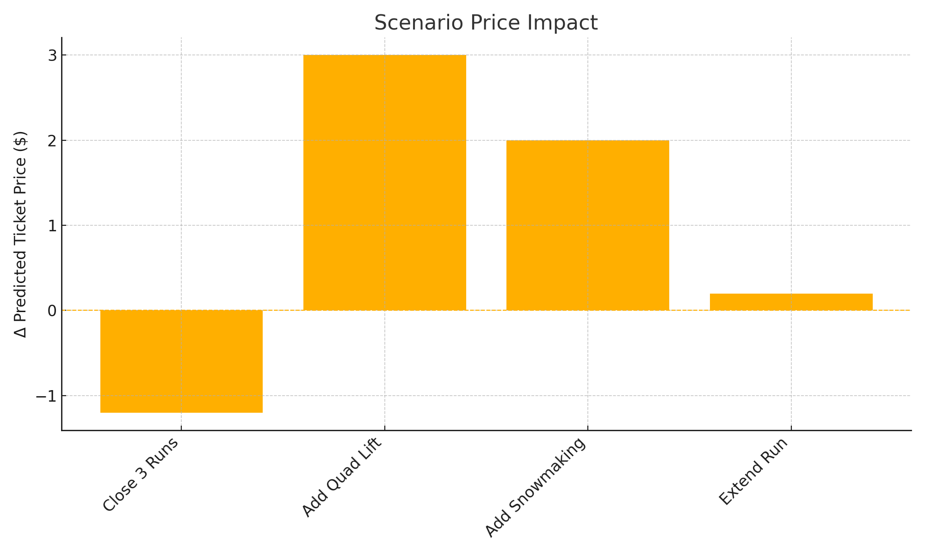
Scenario Analysis
Close 3 runs: –$1.20 per ticket (not advised)
Add 1 run + detachable quad: +$3 per ticket
Expand snow‑making: +$2; profit offset by energy costs
Extend longest run: negligible revenue change

Slide 7
Projected Financial Impact
New lift operating cost: ~\$0.75 M/yr (≈ $1.14 per ticket)
Price uplift $3–$15 covers cost with margin
Net profit gain estimated $3–$4 M annually

Slide 8
Summary & Conclusion
Big Mountain is under‑priced relative to peers
Two‑stage price increase funds growth while testing demand
Data‑driven framework ready for ongoing decision support

