Slide 1
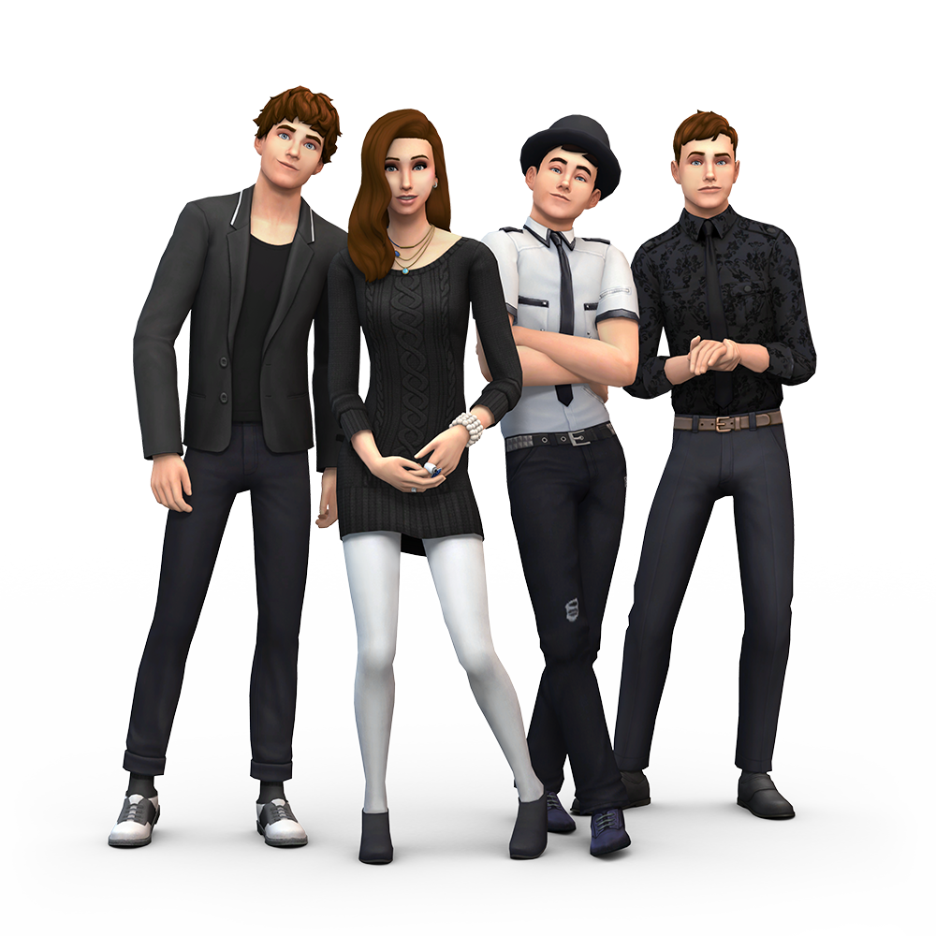

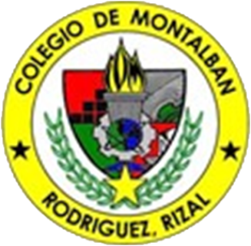
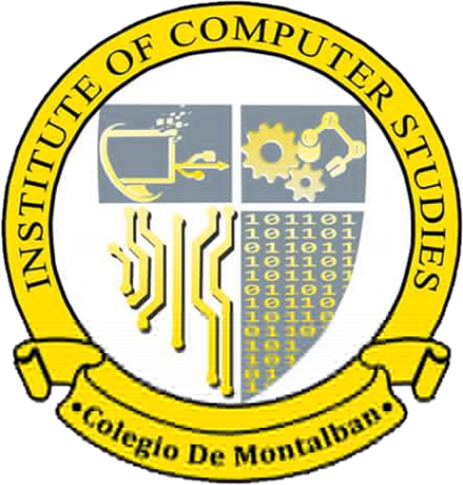
REGATE: ENHANCING INTERACTION AND EDUCATIONAL RESOURCES AT COLEGIO DE MONTALBAN

Slide 2

Chapter 1
Introduction

Slide 3
Background of the Study
reGate is a dynamic web application designed to enhance the school portal at Colegio de Montalban. It aims to improve communication, streamline processes, and provide a more user-friendly experience for students, teachers, and administrators. By integrating advanced technologies, reGate will transform the way the school community interacts and learns.

Slide 4
OBJECTIVES OF THE PROJECT
Create a school portal management system that focuses on simplicity, efficiency, and flexibility, enhancing interaction and resource management compared to the current system.

Slide 5
OBJECTIVES OF THE PROJECT
Design a system that displays the school's homepage to streamline announcements, news, updates, and other information, emphasizing a user-friendly, efficient layout to improve the end-user experience.

Slide 6
OBJECTIVES OF THE PROJECT
Build a digital platform that enables both instructors and students to access their portals, fostering better time management, resource allocation, and interaction.

Slide 7
OBJECTIVES OF THE PROJECT
Design and implement pages for enrollment, organization, administration, and the "About Us" section, providing up-to-date resources and information for all users.

Slide 8
OBJECTIVES OF THE PROJECT
Create a system that improves communication between deans, program heads, instructors, and students, promoting better interaction and resource sharing at Colegio de Montalban.

Slide 9
Significance of the Study
The reGate system will benefit students, teachers, administrators, the school, the community, and future developers. Students will have easier access to their academic information. Teachers will have less administrative work. Administrators will have tools to manage the school efficiently. The school will be more organized and can communicate better. The community will be more informed about the school. Future developers can learn from this project.

Slide 10
Scope and Delimitations
The "reGate" project aims to improve Colegio de Montalban's school portal. It will create a new, user-friendly website for students, teachers, and administrators. The website will improve communication, access to resources, and administrative tasks. Key features include personalized portals, real-time notifications, and document request systems. The project will be completed by the end of the first semester of the 2024-2025 school year.

Slide 11
Scope and Delimitations
Despite its comprehensive capabilities, certain functionalities are excluded due to time and resource constraints. Features such as online tuition payment integration, advanced analytics tools, live chat, and a mobile app version are beyond the current scope.

Slide 12
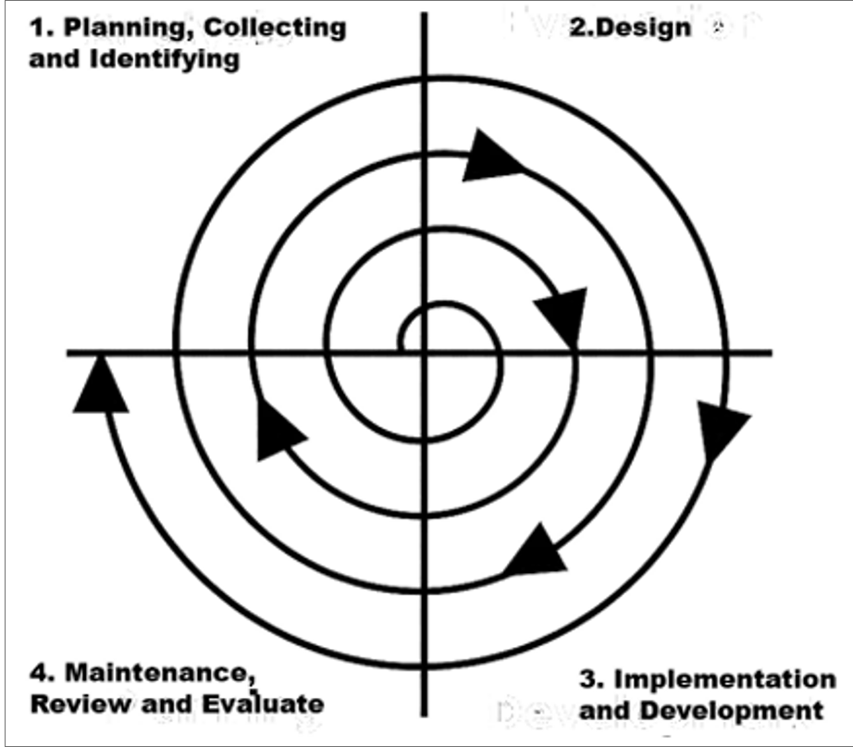
Operational Framework
The "reGate" project used the Spiral Model for development. This iterative approach involved multiple phases of planning, design, development, and testing. The team used Figma to create visual prototypes and gather user feedback. By addressing potential risks and incorporating user feedback, the team ensured the system's functionality and user-friendliness.

Slide 13
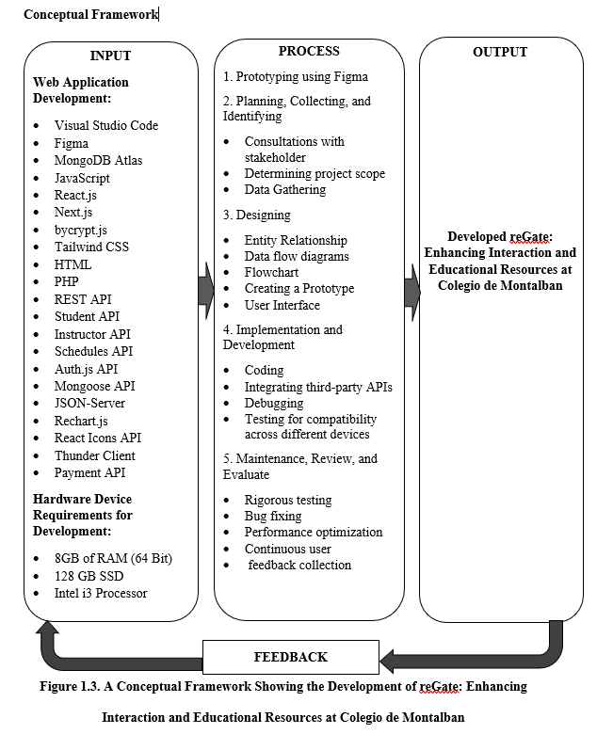
Conceptual Framework

Slide 14
Chapter 2
Review of Related Literature, Studies, and Systems

Slide 15
SYNTHESIS OF THE REVIEW
The development of user-friendly school portals enhances the academic experience. It benefits students, teachers, and administrators alike in various ways.Studies emphasize the need for well-designed, secure, and accessible platforms. These platforms streamline communication, information management, and processes. Focusing on user needs ensures that the portal addresses current challenges. Continuous feedback helps the portal adapt to future demands. Structured development methodologies support successful implementation.

Slide 16
SYNTHESIS OF THE REVIEW
The development of an efficient school portal enhances communication. It improves operational efficiency and academic engagement within institutions. Key features like real-time data management enhance the educational experience. Seamless navigation and personalized experiences support user satisfaction. Research highlights the importance of user-centric design and security. Adopting best practices ensures the system meets stakeholder needs. Portals foster student engagement and improve access to academic resources. They support the evolving demands of modern education.

Slide 17
SYNTHESIS OF THE REVIEW
Web-based school portals modernize educational institutions. They enhance communication, improve data management, and provide centralized access. Research shows the diverse applications of these systems in education.They improve administrative efficiency and create user-friendly platforms. As institutions embrace digital technologies, continuous improvement is essential. Evaluation ensures the portals meet the evolving needs of users. Focusing on usability, functionality, and design enhances the experience.

Slide 18
Chapter 3
Research Methodology

Slide 19
RESEARCH DESIGN
The project developers used a quantitative-qualitative descriptive research design. This approach aimed to collect data on the system's current implementation. The goal was to identify areas for improvement in the system. The quantitative aspect involved structured surveys to measure effectiveness. The qualitative aspect used interviews and open-ended questions for detailed feedback. Combining both methods allowed for comprehensive analysis of user experiences. It ensured representative feedback from students, instructors, and staff. This helped identify strengths, weaknesses, and necessary adjustments for improvement.

Slide 20
SETTING OF THE STUDY
The study was conducted at Colegio de Montalban (CdM) a public educational institution located in Montalban, Rodriguez in the province of Rizal, Philippines (Latitude: 14. 750561", Longitude 121. 141668"). Founded in September 25, 2003. The campus is surrounded by several types of residential neighborhoods, business buildings, and an increasing number of organizations, and it is conveniently accessible by public transportation.

Slide 21
RESPONDENTS OF THE STUDY
The proponents of reGate: Enhancing Interaction and Educational Resources at Colegio de Montalban have randomly selected participants who consist exclusively of faculty members, administrative staff, and 100 students enrolled in the Bachelor of Science in Information Technology course at Colegio de Montalban for the first semester of the school year 2024-2025.

Slide 22
Data Collection Method
The data collection method for this research will involve a structured survey designed to gather data from students, faculty, and administrative staff at Colegio de Montalban (CDM). This mixed-methods approach, combining quantitative and qualitative data collection, aligns with the project's quantitative-qualitative descriptive research design. The survey aims to understand the current challenges and perceptions related to the existing school portal system and to evaluate the potential reception and impact of reGate: Enhancing Interaction and Educational Resources at Colegio de Montalban.

Slide 23
Data Collection Analysis
The proponents prepared the data thoroughly before conducting the data analysis. The data analysis process for evaluating reGate: Enhancing Interaction and Educational Resources at Colegio de Montalban integrates both quantitative and qualitative data to provide a comprehensive assessment of the school portal management system’s effectiveness in meeting its objectives. The proponents will ensure that data are thoroughly prepared and verified for accuracy and completeness, including consistency and reliability checks.

Slide 24
WE ARE NOW READY FOR YOUR QUESTIONS

