Slide 1

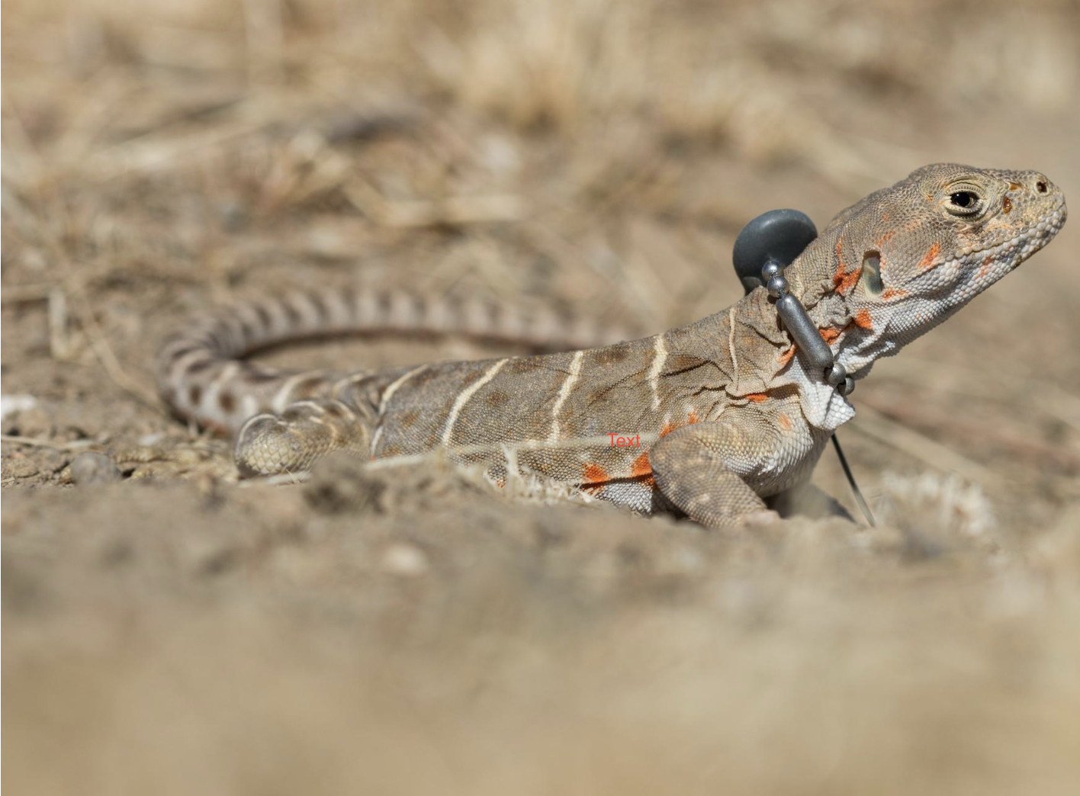
Lizard Localization Week 6 Project Update: May 19th, 2023
Vinit Saah, Joey Schnecker,
Ryan Margraf, Hassan Ahmad
Project GitHub Link
https://github.com/joey-public/WES207CapstoneProject

Slide 2
Agenda
Lab Testing and Data Result on PPS synced Transmitter Behavior (Ryan)
APP design (Includes Networking updates) (Vinit)
DSP updates (Joey)
Localization simulation updates (Ryan)
Future Items (Hassan)
Design decision discussion

Slide 3
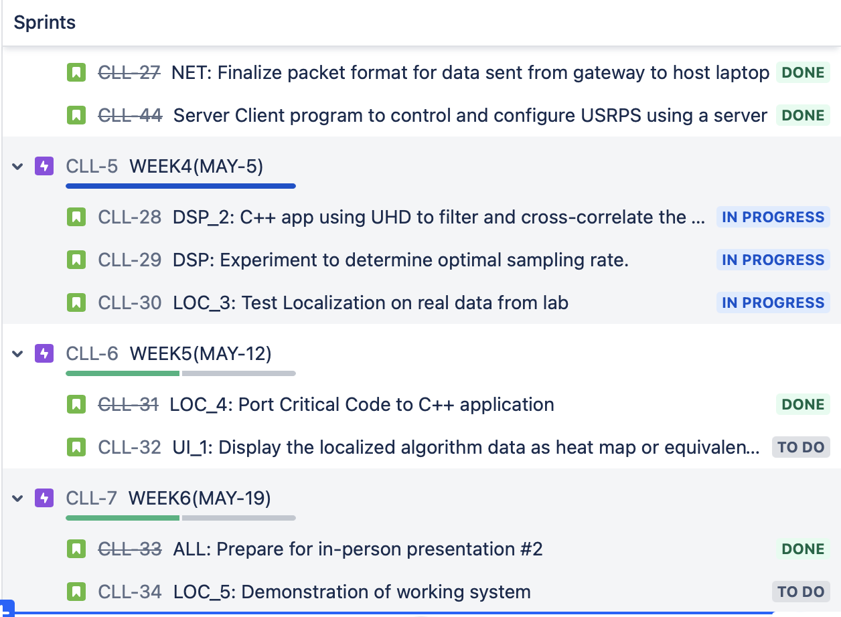
Overall JIRA updates

Slide 4
Host Controller – Host(DSP) Interaction
Coding for MVP done. (Almost!)
HC Sending Sequential commands to config, sync, stream, send.
Host: Performs corresponding actions
Data collection by HC is currently asynchronous. Would change to sequential if issues.
Code integrated with:
DSP Handler,
Localization (On going)
Highlights:
Packet Utils helps create Packet Header, Packet Data, Packet control message
It has Parser to parse the function.
Testing :
Unit tested Packet creation and Parsing.
End to End testing starts today.

Slide 5
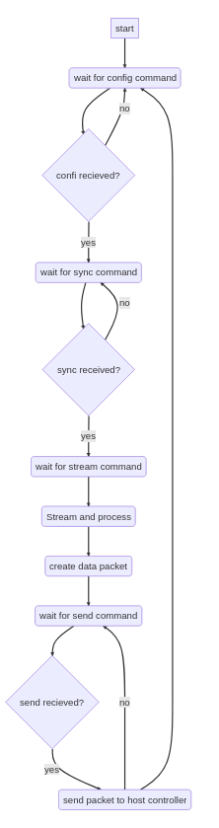
DSP Updates
Simplified Processing algorithm to remove requirement of streaming and processing at the same time.
2 weeks ago, the plan was to have a processing thread and a streaming thread both running continuously.
New design is single-threaded and collects 3 seconds of data at max sample rate (25 Mbps for N210s, and hopefully 61Mbps for B200s). Then the host processes this data to detect the first pulse and sends relevant data to the host controller for further calculations.
Downside is we will only be able to provide a position estimate once every 10-20 seconds, but we think this should be ok for our application.
If the lizard is moving, then we can't track it (real-time positioning not feasible)
RX_ID
RX_GPS_LOC
RX_TOA_EST
Raw_RX_Data_Stream (Maybe?)

Slide 6
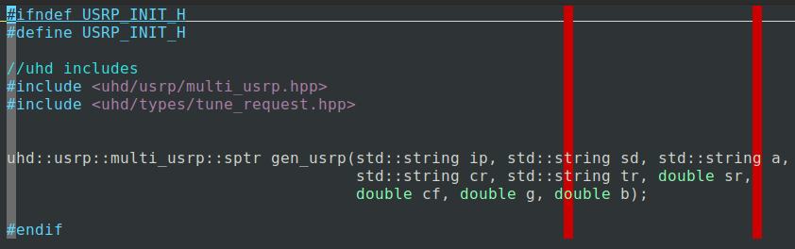
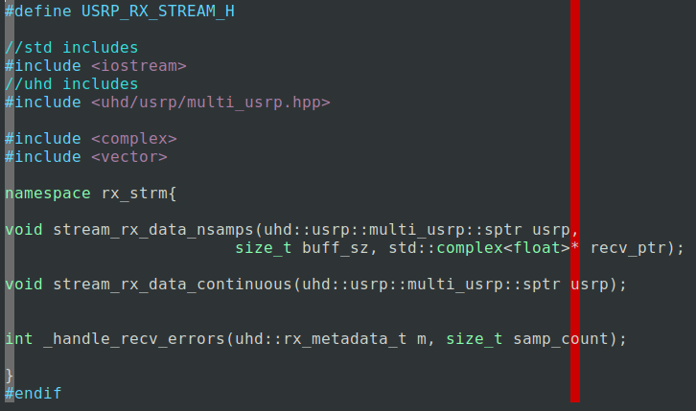
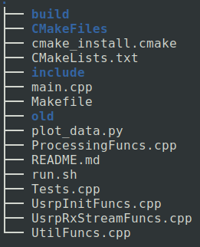
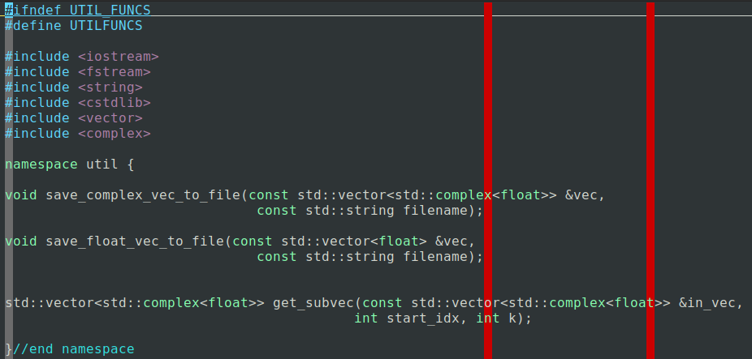
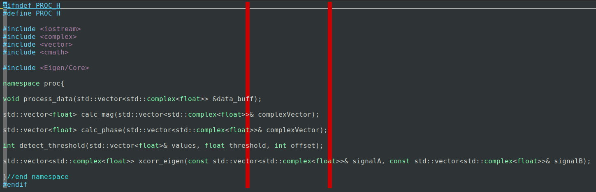
DSP Code Update
Created and tested all streaming and dsp code in the dsp/src directory on github
Broke the Code into several files
UsrpInitFuncs.cpp -> Holds functions for configuring the usrp object
UsrpRxStreamFuncs.cpp -> Holds functions for streaming the usrp data
ProcessingFuncs.cpp -> Holds functions for processing the streamed data
UtilFuncs.cpp -> Holds convenience functions
Tests.cpp -> holds some unit test functions
Main.cpp -> For testing all the dsp code before integrating into main codebase.
Created a new branch (working) on the github repo.
This branch merges the dsp code into the main/host and main/host controller as appropriate.
Working branch will be merged into main for our MVP testing.

Slide 7
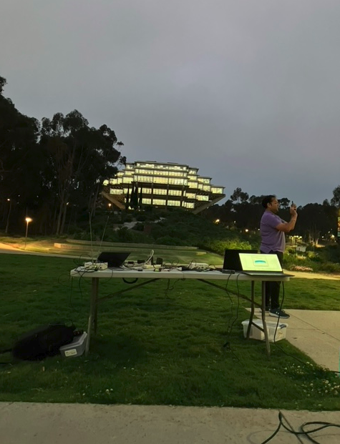
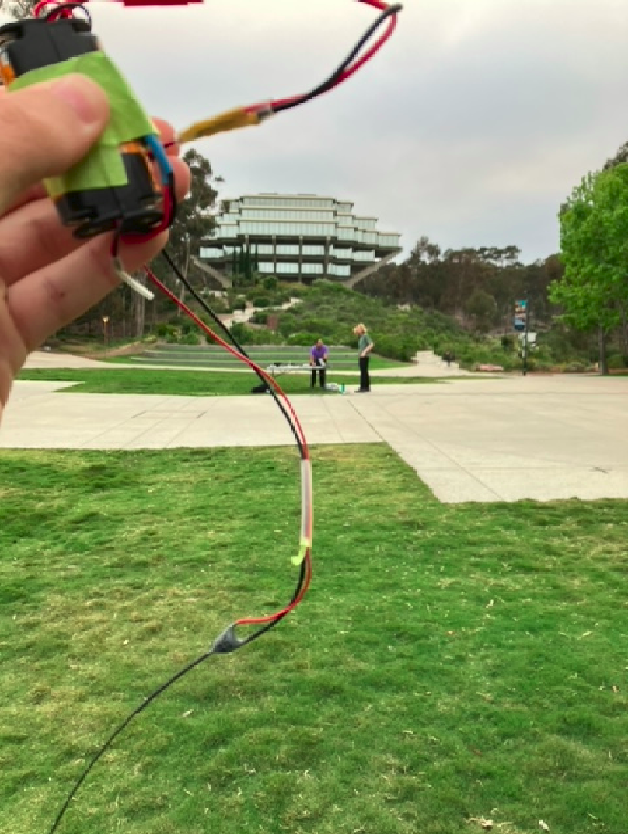
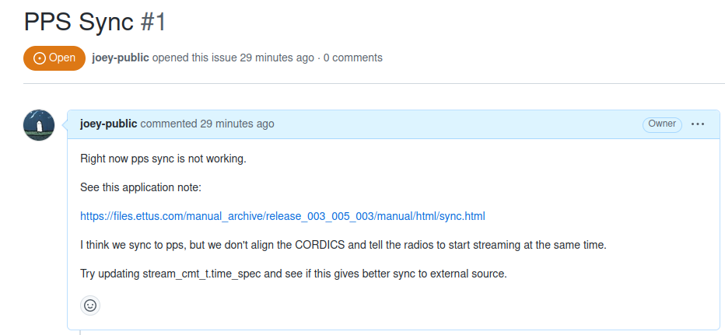
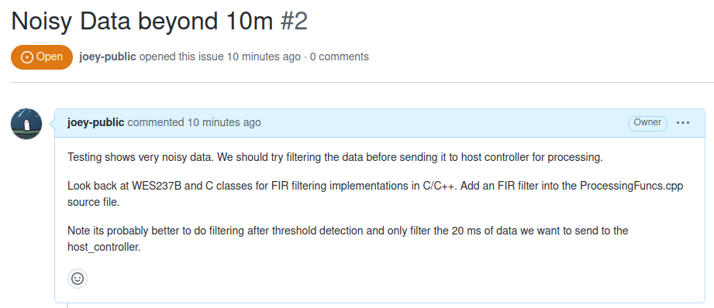
DSP Synchronization Issue
We tried a full system test on Monday (05-15-23) but had mixed results
Even though the receivers were right next to each other we still saw large difference in the time of arrival on the data we collected.
We also noticed the data was noisy, so adding an FIR filter into the processing flow may be necessary.
Created github issues for these two problems.

Slide 8
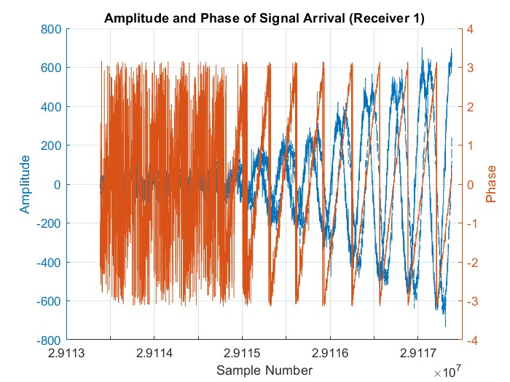
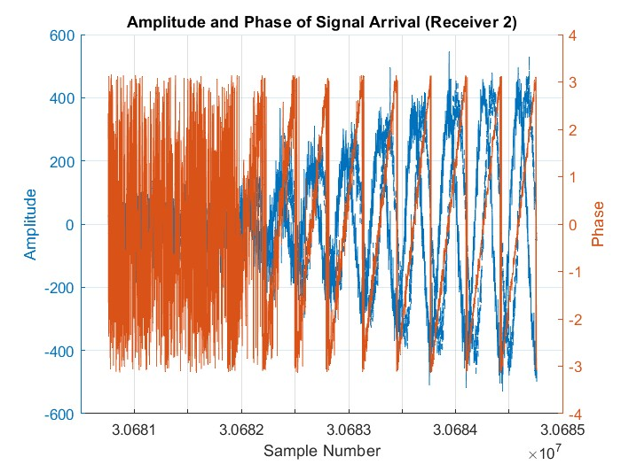
GPS Synchronization
We performed testing on Monday (05-18-23) to test our PPS synchronization.
We setup 2 receivers next to each other and measured signals from the transmitter from 10-50 meters.
Time synchronization was off by approximately 0.15s

Slide 9
At-Risk Items
UI_1: Display the localized algorithm data as heat map or equivalent graphical representation
DSP_3: Use Angle of arrival to fine tune the received signal timestamp.
MVP: now targeted on Saturday, May 20, 2023.

Slide 10

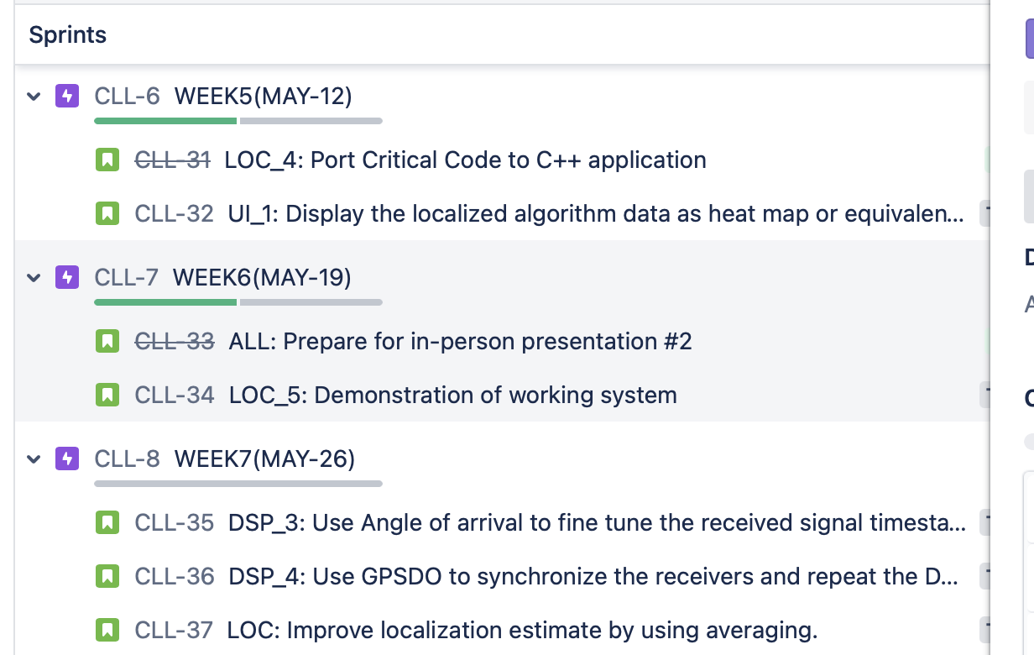

Slide 11
Design Decision Discussion
Lab testing
Existing GPSDOs are not synced well. Fractional part 0.15/0.20 seconds
Course of action:
-> GPS time synced stream start with PPS
Collected raw samples using synced PPS receivers; Still very noisy.
Course of action:
-> Use a filter to improve received signal waveform

