Slide 1
College LMS Database
By Joey Qytyku

Slide 2
Purpose of the project
The goal is to simulate a Learning Management System (LMS) such as Canvas.
The DB simulates the operations of the school in one semester. This sort of database would be rebuilt per-semester while migrating data that does not (frequently) change, such as courses and students.

Slide 3
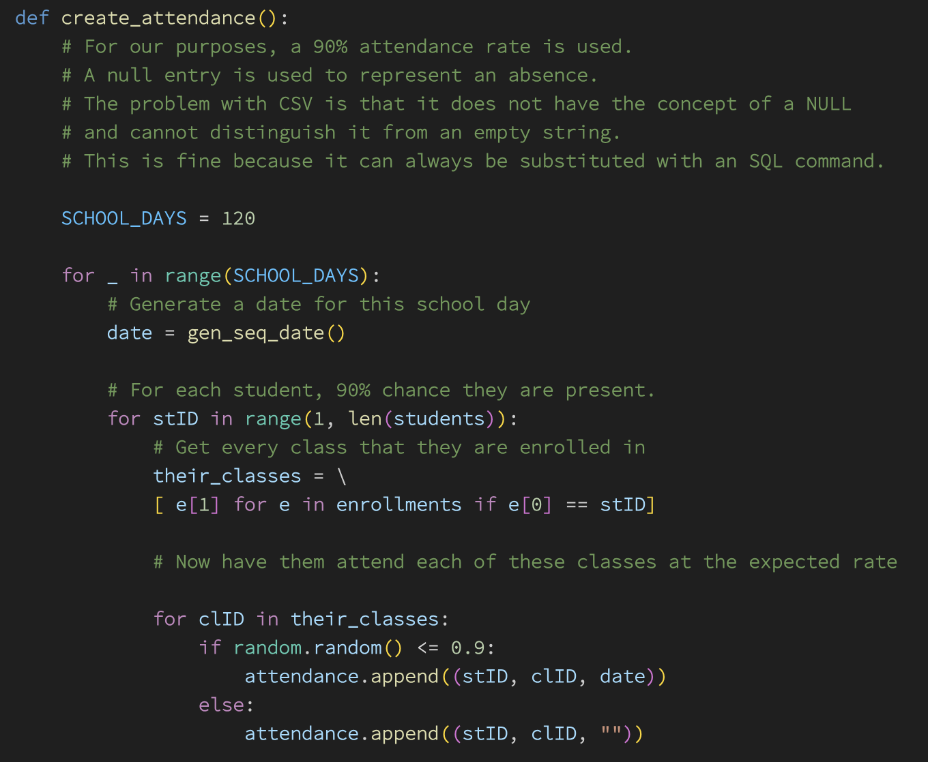
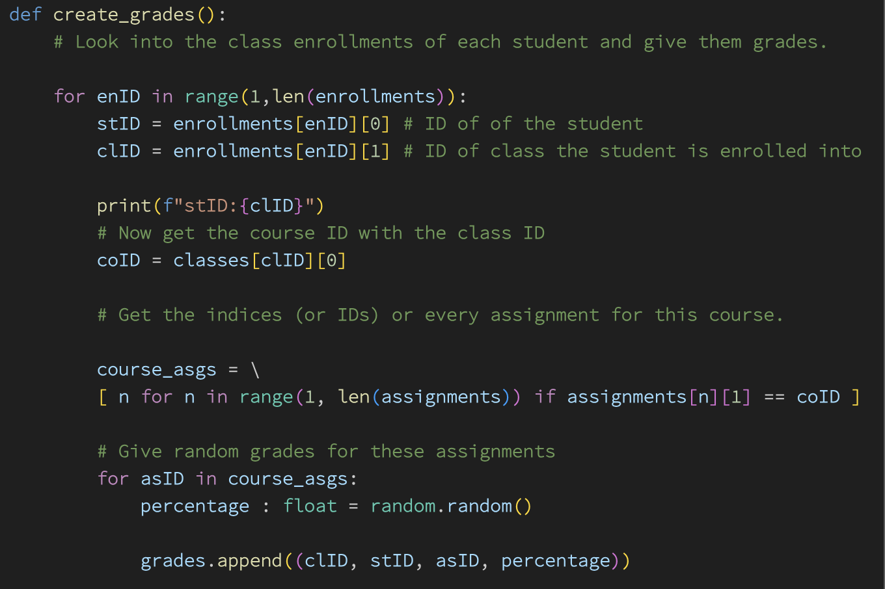
The data set
A python script generated the data using random generation
Sources:
List of courses from Ursinus in code form (e.g. CHEM-340)
1000 different full names from the internet
This was used to create the following tables in CSV:
Students (to give them enrollment dates)
Grades
Attendance (random chance of the student attending school)
Classes (assigning students to each class)

Slide 4
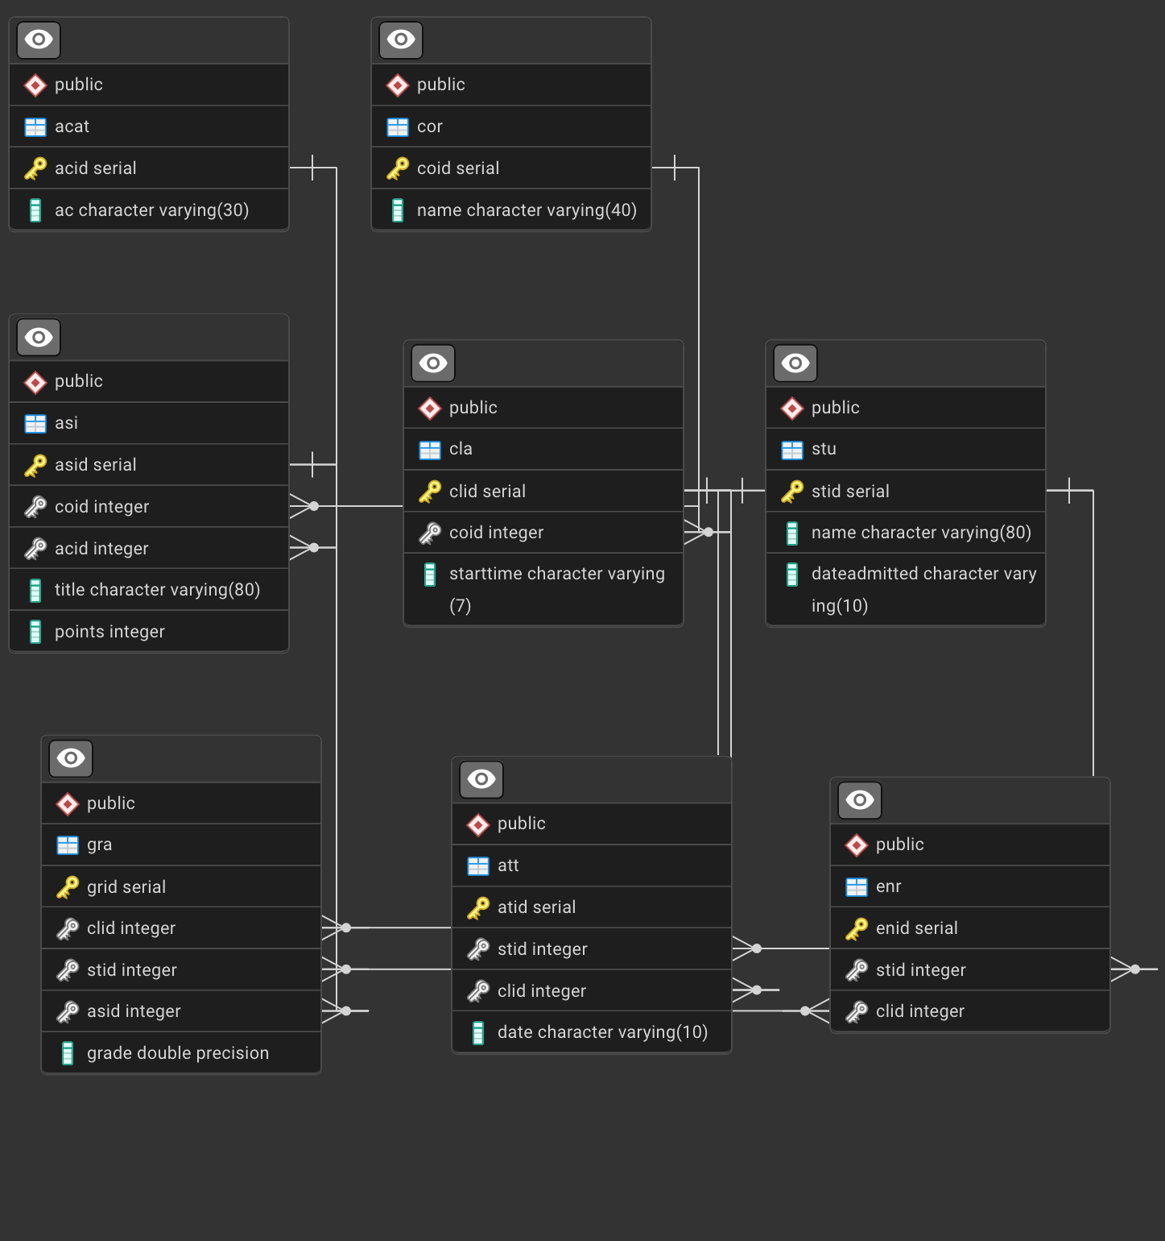
Tables
Dates and times are stored as strings in zero-padded form so that they can be lexicographically sorted.
“Enrollments” acts as a junction between classes and students
Students are enrolled in classes, not courses
Classes relate many-to-one with courses.

Slide 5
Example Queries
Most tasks on this database require multiple joins to work.
Some of the complicated grade-related queries were due to the strange choice of a double precision percentage for grades, necessitating multiplications and casts.
Simple queries are mostly given directly
Complex queries are mostly expressed as functions that return tables.
STRING_AGG and CAST are new features used here.

Slide 6
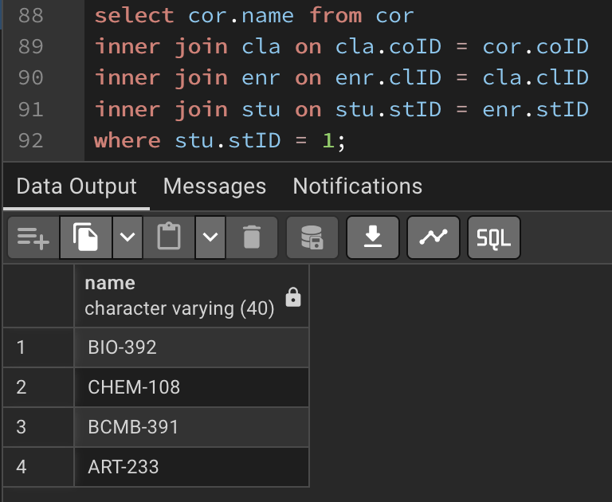
Simple task #1
Returns one column containing all the courses the student is taking. Joining onto classes and enrollments is necessary before getting the course.
Removing the last clause and selecting “stu.name” shows which courses each student is enrolled in.

Slide 7
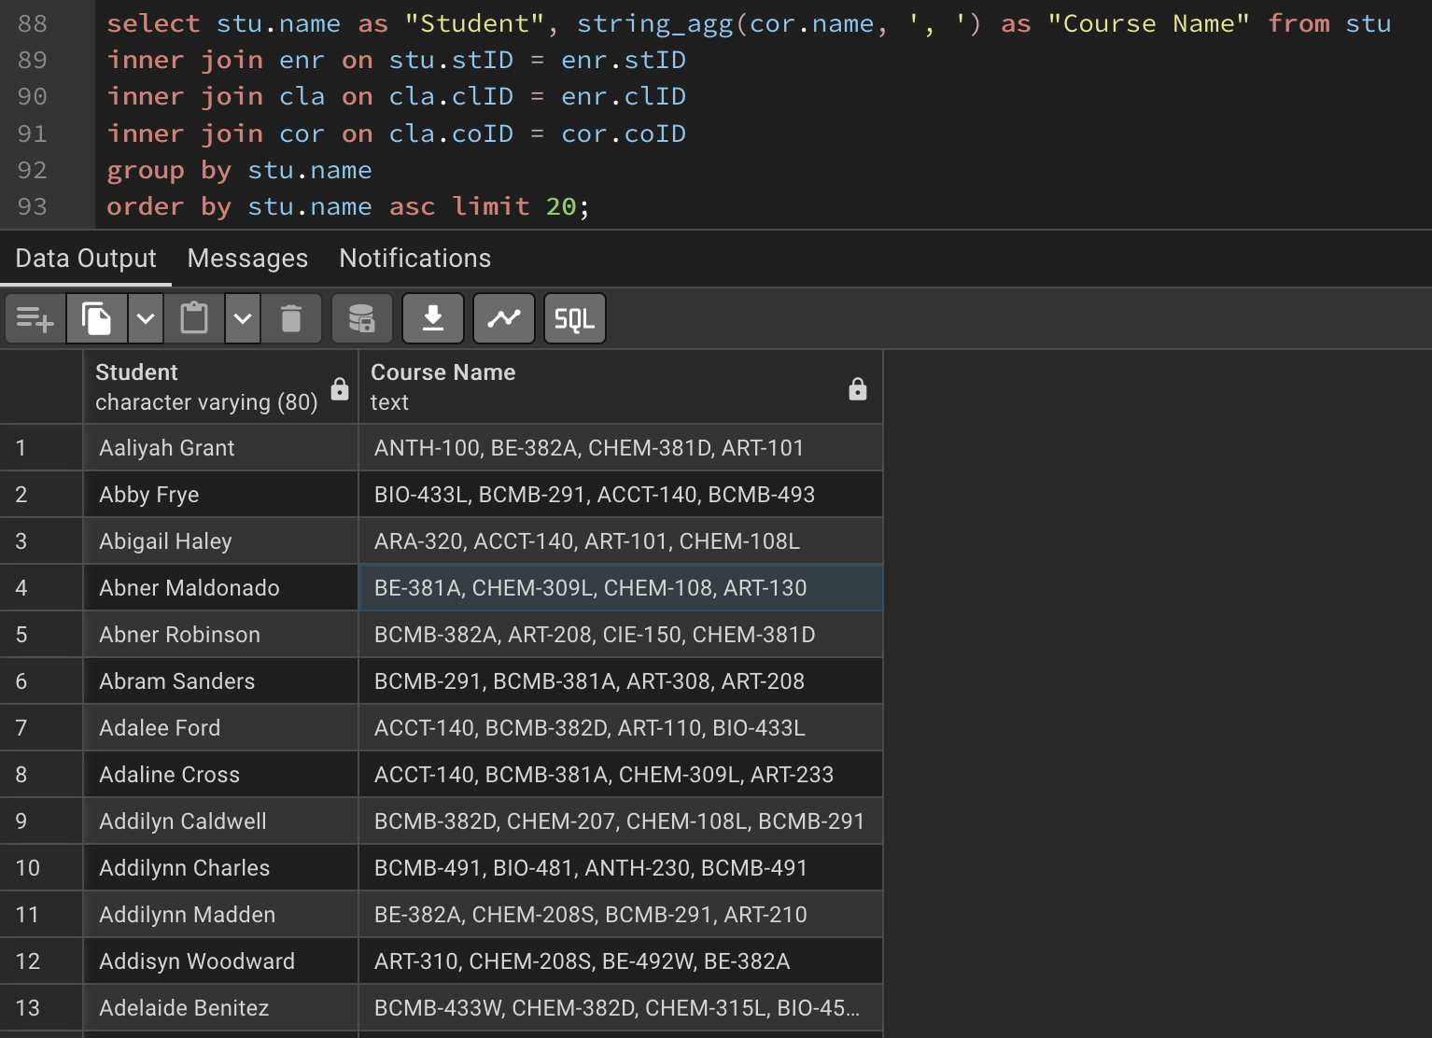
Simple task #2
Uses STRING_AGG to concatenate every course taken by the student, and groups by student.
Name and comma-delimited list are returned.

Slide 8
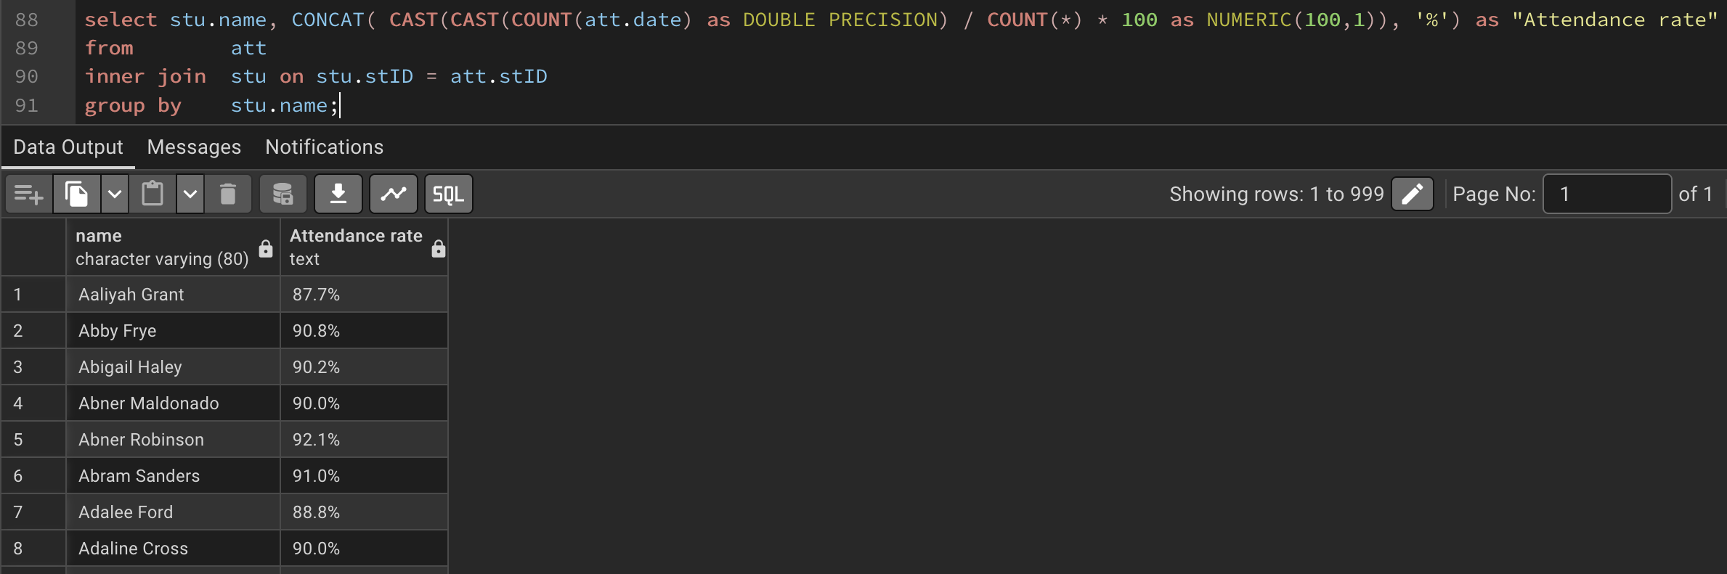
Simple Task #3
This query returns the attendance rate of each student
Sorted by the students’ names
Uses COUNT(*) to get total rows, COUNT(att.date) to get the number filled
NULL dates are considered absences

Slide 9
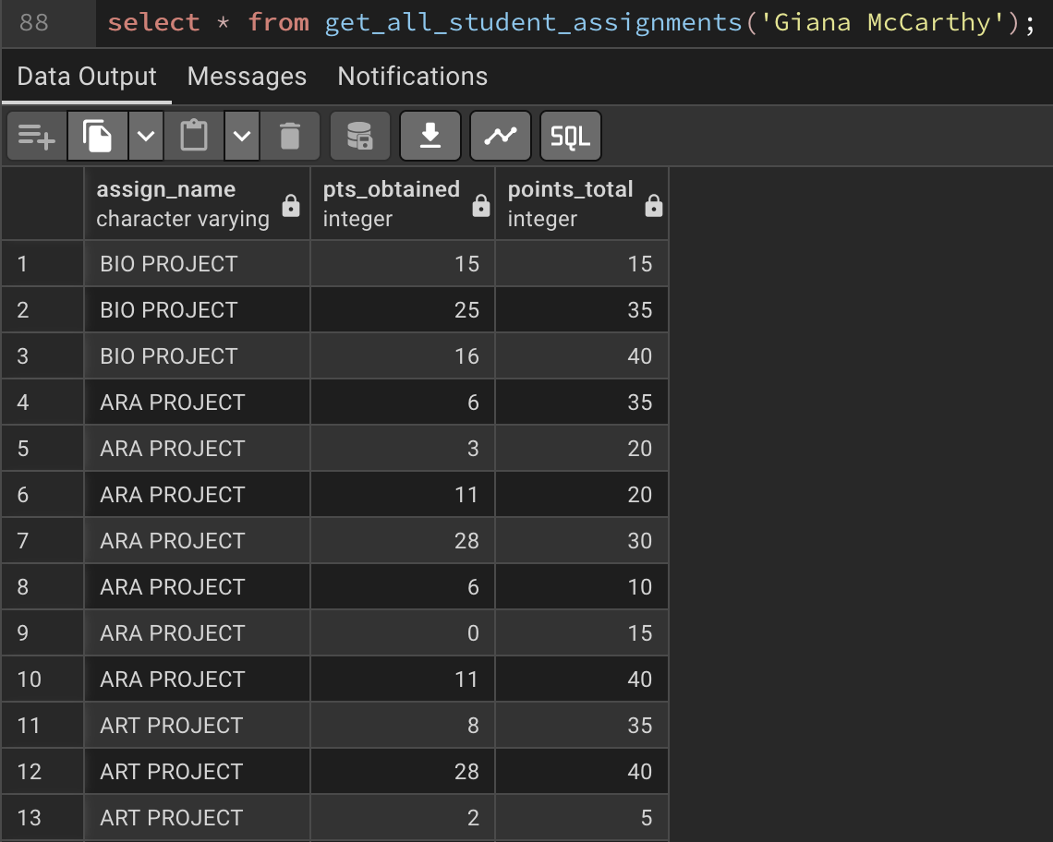
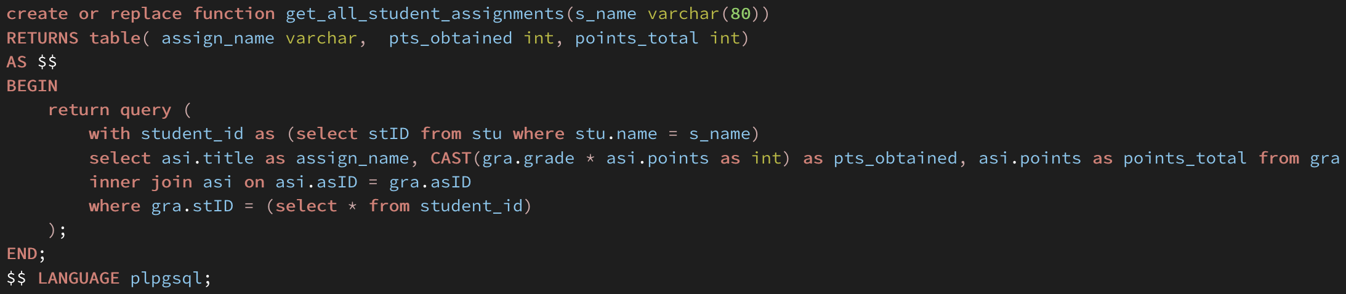
Complex task #1
Gets all assignments done by the student and all the grades.
Takes name of student as VARCHAR

Slide 10
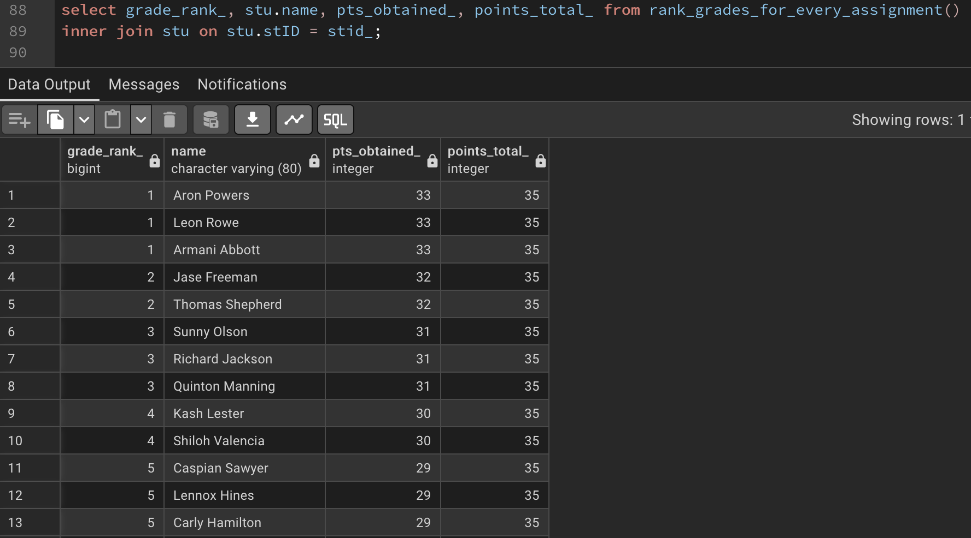
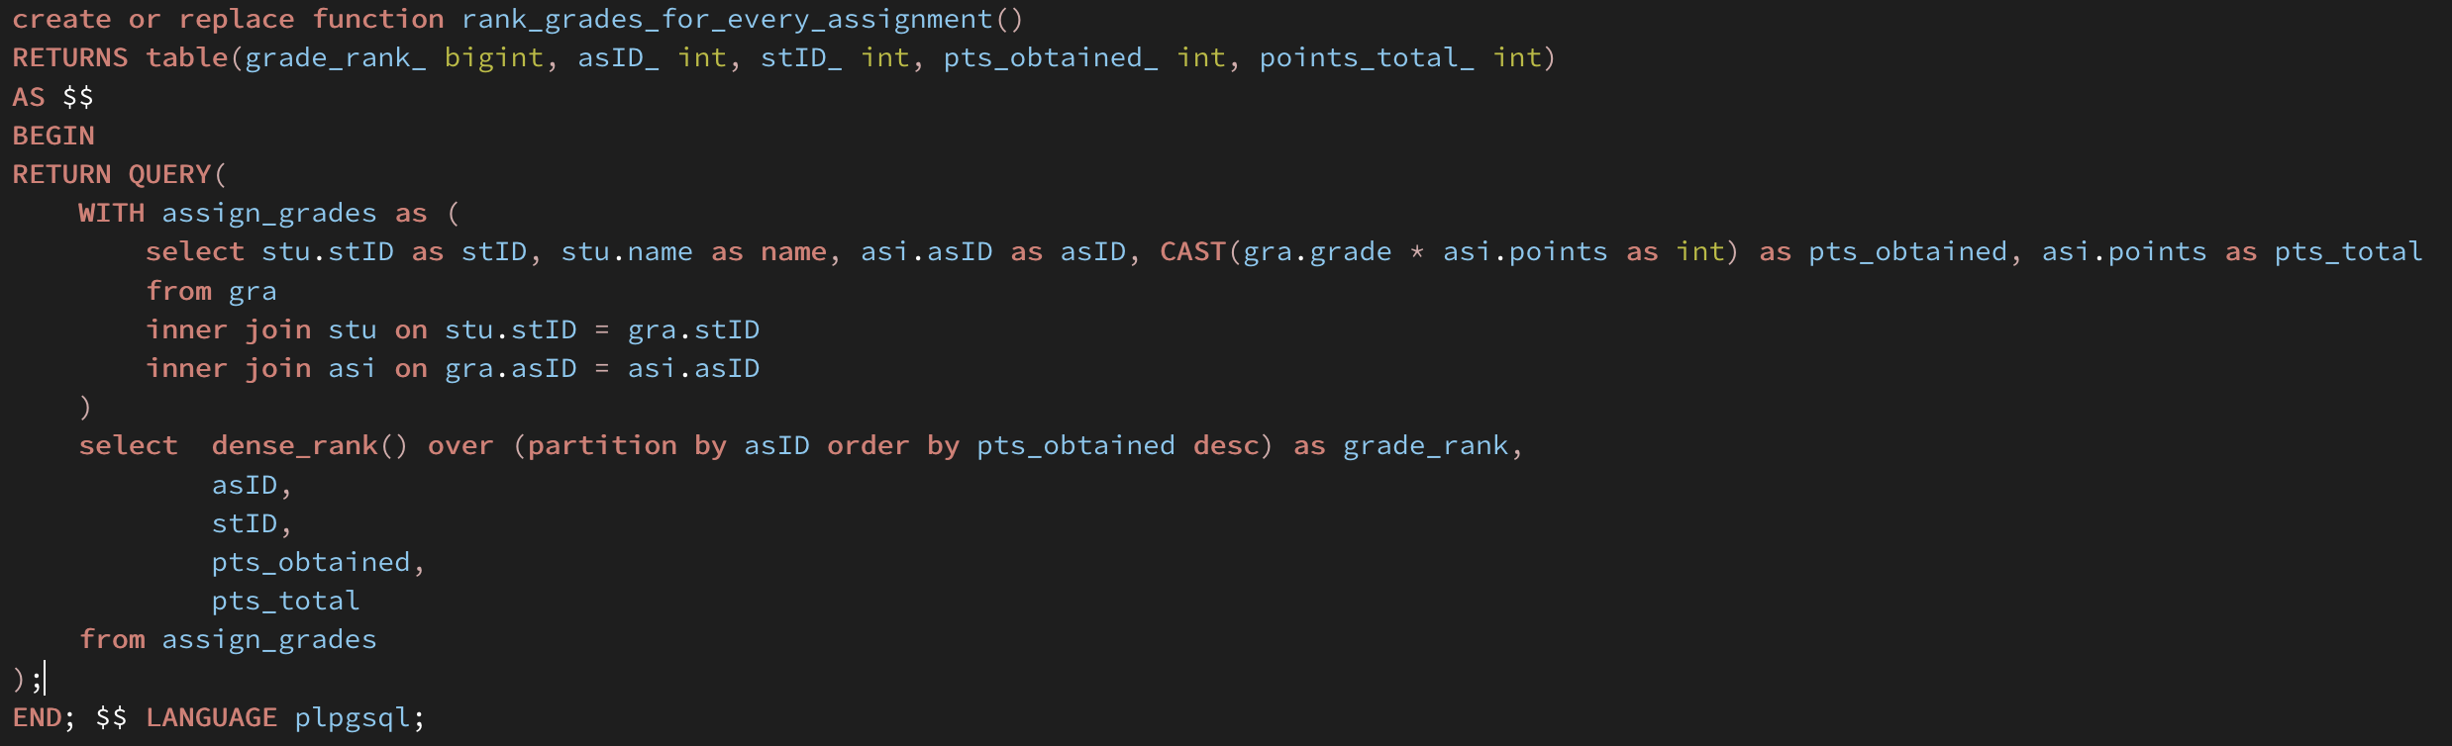
Complex Task #2
Locally ranks the grades for each assignment done for every class
Uses DENSE_RANK and partitions by the assignment to get per-assignment ranks.

Slide 11
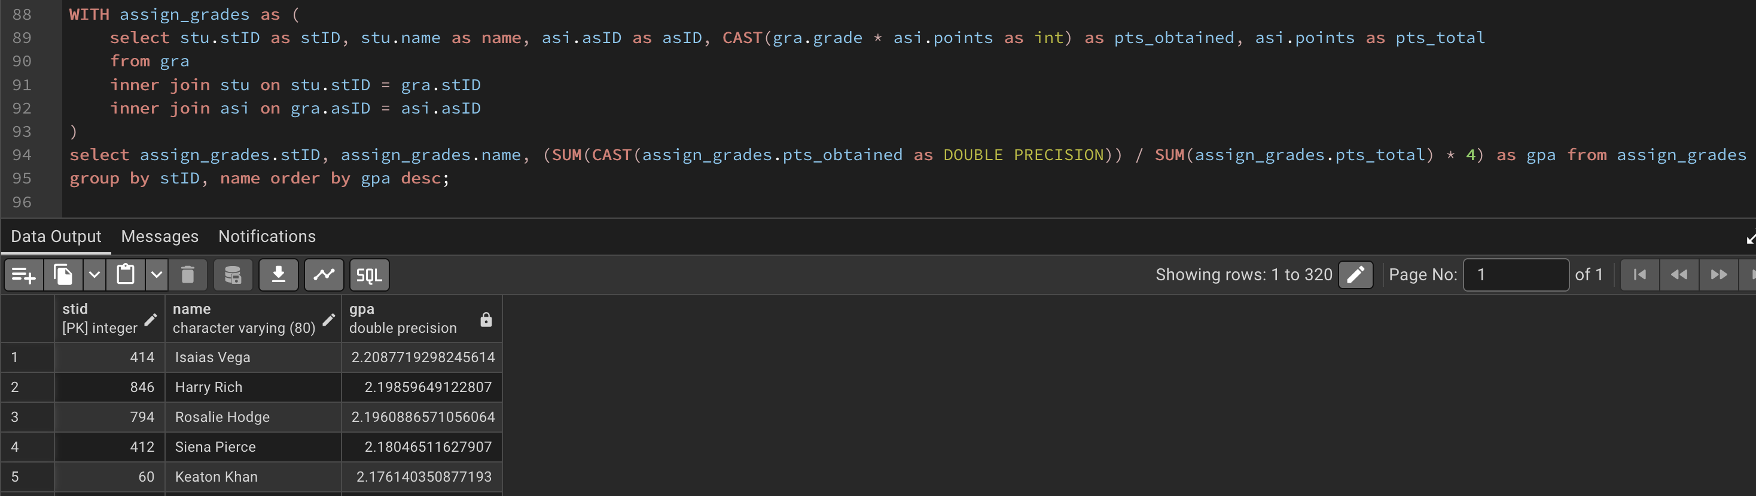
Complex Task #3
This query calculates the GPA of every student and ranks them in descending order.
Groups by the student ID and the name

