Slide 1
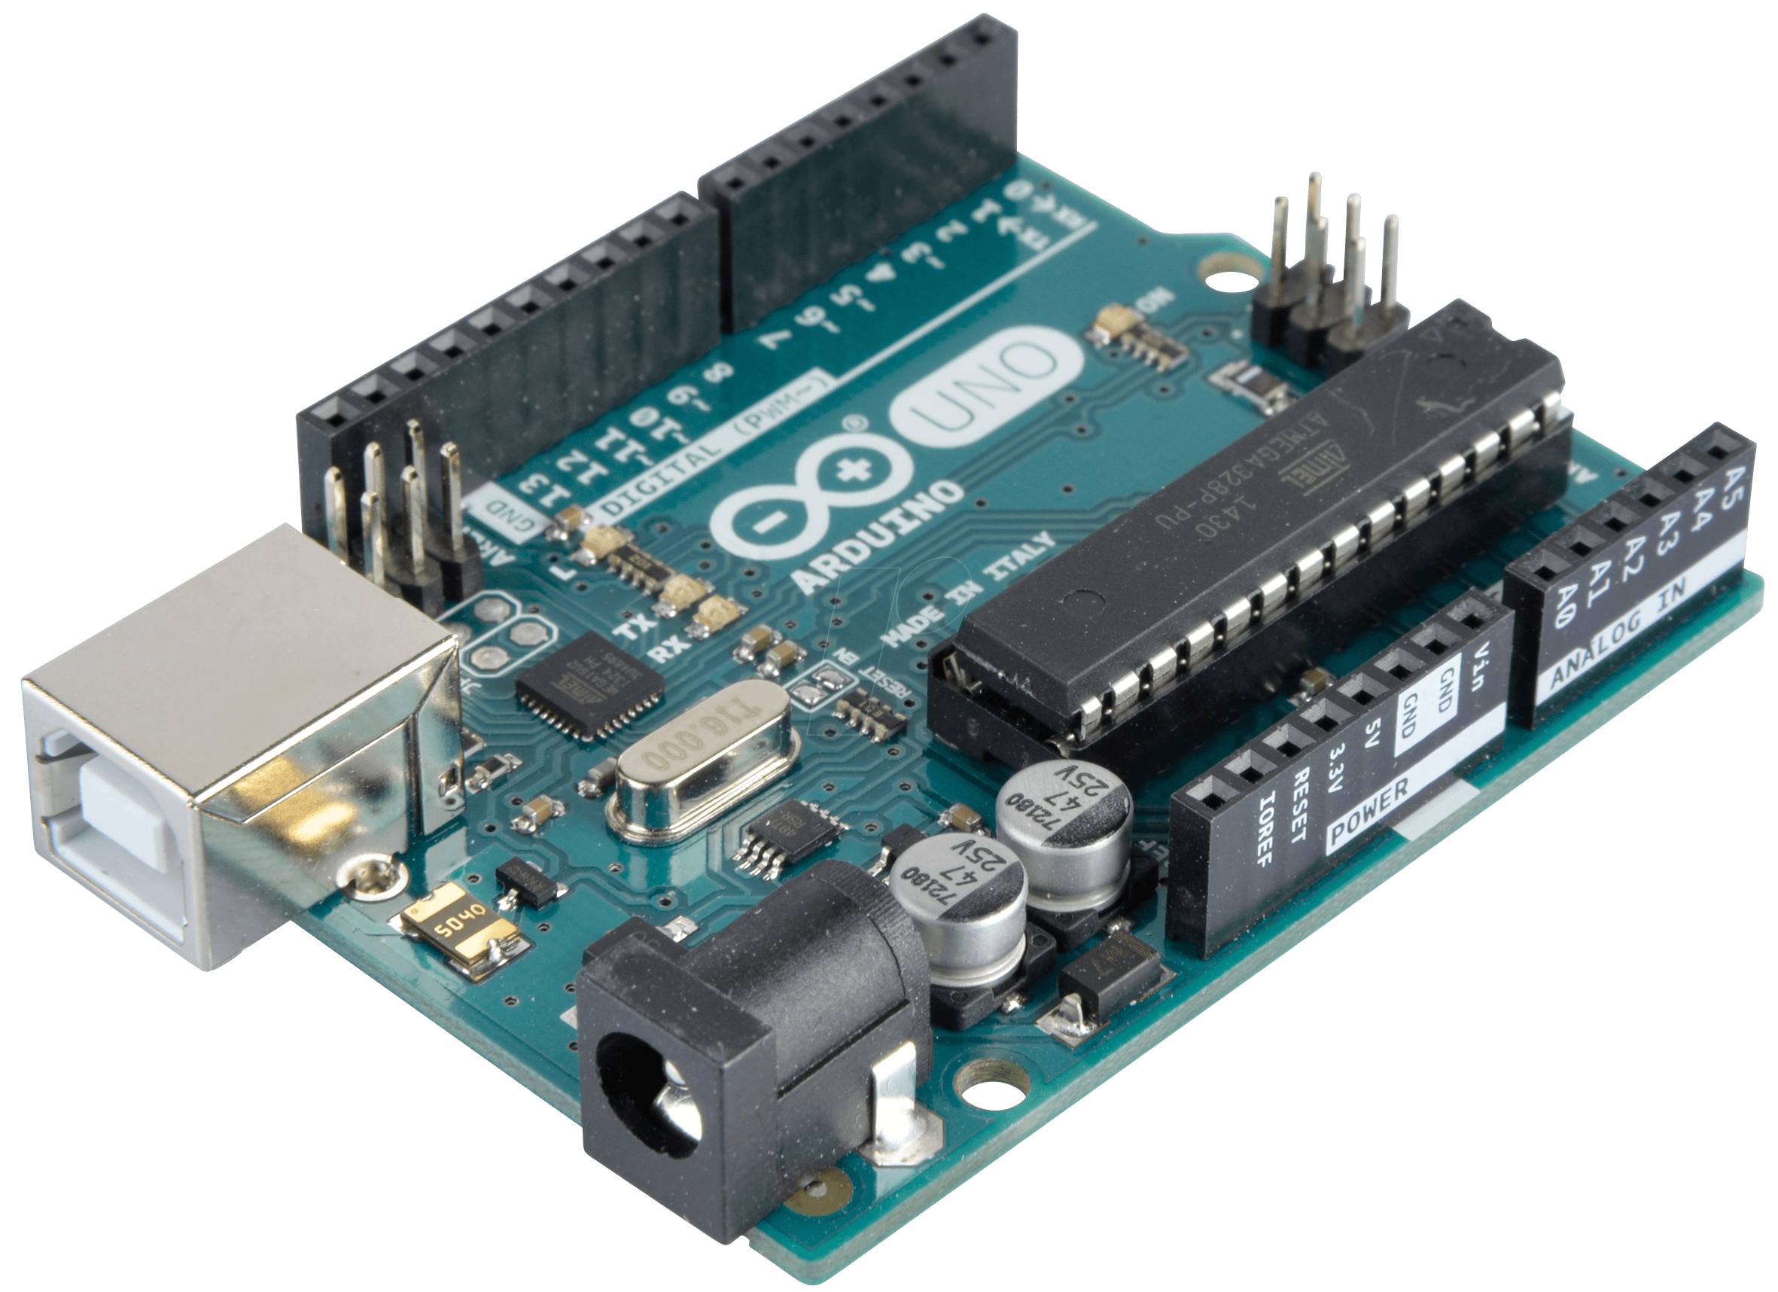
Arduino
By Jawad Tanana

Slide 2
What is the Arduino?
Arduino used for building electronic projects/robotics.
Two parts to it:
Software
Physical circuit board

Slide 3
What is the Arduino?
The Arduino is the best way for starting out with electronics
they've made it easier to learn to program.

Slide 4
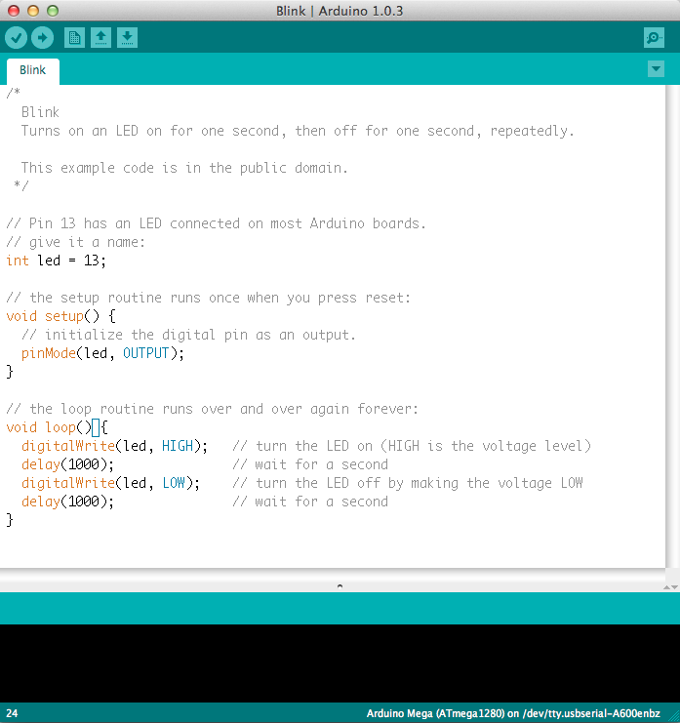

Slide 5

Things you can do with the Arduino

Slide 6
Why I want it and what it provides
I find electronics awesome
I would like to pursue a career and this is a good start
Passes time in an educational and informative way
Programming is about solving problems and reasoning(exact skill needed for the Umat)
Understand people(Umat skill)
Patterns that what umat and programming are about

