Slide 1

Web Development Workshop

Slide 2
Content
Recap on HTML, Bootstrap & CSS
Hands-On Practise
JavaScript
JQuery
Plugins
Animation Effects
Smooth Scroll
Bootstrap with JavaScript
Owl Carousel Slider

Slide 3
HTML
Hyper Text Mark-up Language

Slide 4
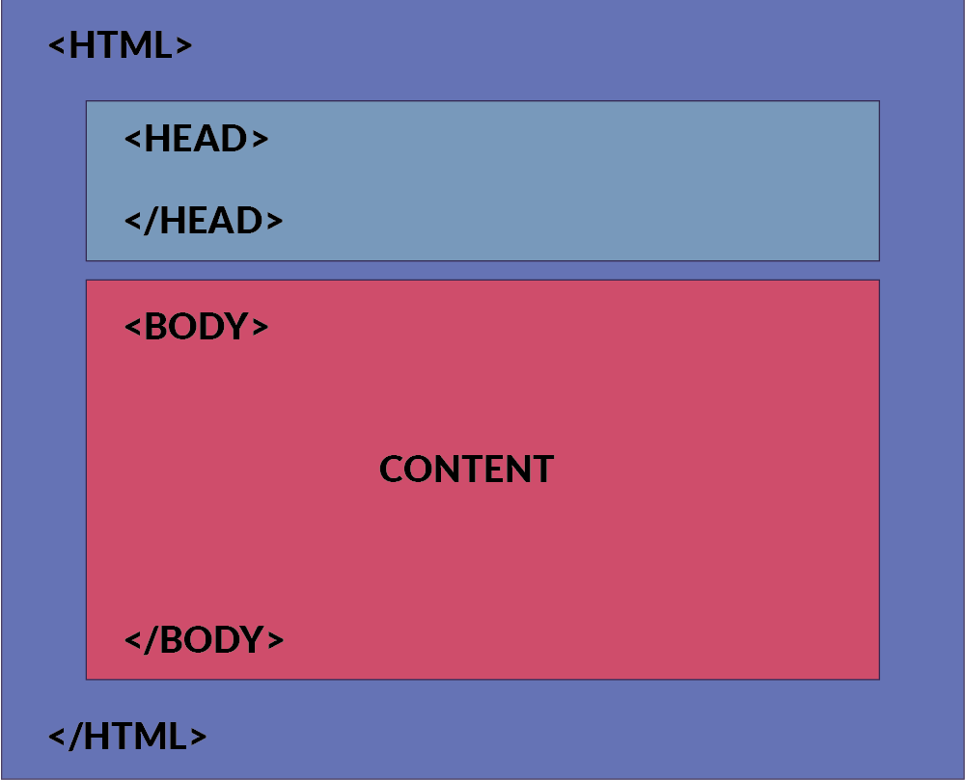
HTML Structure
Notes:
All those boxes shown in the structure are the html elements.
So, what are html elements?
They are what make up of html pages and determine the content. They are the building block so html pages. As you can see, they are represented by tag. And the ag usually consider of start & end tag.
The opening tag: This consists of the name of the element (in this case, p), wrapped in opening and closing angle brackets. This states where the element begins, or starts to take effect — in this case where the start of the paragraph is.
The closing tag: This is the same as the opening tag, except that it includes a forward slash before the element name. This states where the element ends — in this case where the end of the paragraph is. Failing to include a closing tag is a common beginner error, and can lead to strange results.
The content: This is the content of the element, which in this case is just text.
The element: The opening tag, plus the closing tag, plus the content, equals the element.

Slide 5
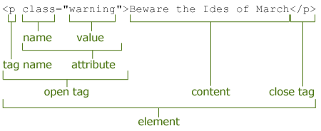
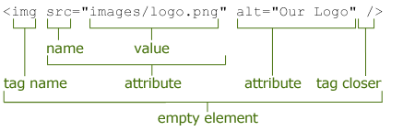
Recap on HTML Syntax
Normal HTML Tag
Consist of both Open & Close Tag
Empty Element Tag
Consist of Open Tag ONLY

Slide 6
HTML CHEAT SHEET
Full list of HTML Elements - “HTML-CheatSheet.PDF” [by hostingfacts.com]
HTML 5 Cheat Sheet - https://cdn.makeawebsitehub.com/wp-content/uploads/2015/06/HTML5-mega-cheat-sheet.jpg
Some example of HTML tag is in the RESOURCES folders

Slide 7
Bootstrap & Font-Awesome
CSS Framework
Twitter Bootstrap @ https://getbootstrap.com/docs/3.3/
Font-Awesome @ http://fontawesome.io

Slide 8
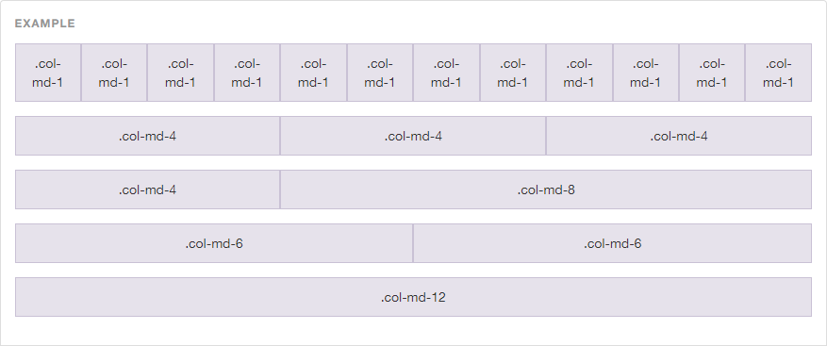
Bootstrap – Grid System
# of Column = 12

Slide 9
Adding Bootstrap
<link > tag to include external resources
Resources Link:
<link rel="stylesheet" href="https://cdnjs.cloudflare.com/ajax/libs/twitter-bootstrap/3.3.7/css/bootstrap.min.css" />
Add it to the head segment of the HTML

Slide 10
How to use Bootstrap
Using the class attribute of HTML tags
Lookup their documentation for class name to use
Apply it to your html attributes
Notes:
Documentation link for CSS : https://getbootstrap.com/docs/3.3/css/

Slide 11
How to use Font-Awesome?
Same procedure as Bootstrap
Includes the link reference to the resources <link rel="stylesheet" href="https://cdnjs.cloudflare.com/ajax/libs/font-awesome/4.7.0/css/font-awesome.min.css" />
Find your desire icon on their website http://fontawesome.io/icons/
Add to your HTML pages through class attributes

Slide 12
Example of Font-Awesome Usage
Adding Instagram icon
<i class="fa fa-instagram" aria-hidden="true"></i>
Changing the size of the icon to 5x the size
<i class="fa fa-instagram fa-5x" aria-hidden="true"></i>

Slide 13
CSS
Cascading Style Sheets

Slide 14
CSS Syntax
Selector
{
Property
:
Value
;
}

Slide 15
CSS Selector
ELEMENT Selector
CLASS Selector
ID Selector
Determine by HTML tag name
h1 , h2 , p , a , table , img
Determine by dot (.) symbol in CSS file
.blueText { color : blue } | class = “blueText”
Determine by hash (#) symbol in CSS file
#redText { color : red } | id= “redText”
Mix Style : h1 # redText

Slide 16
Different type of CSS Style & their Priority
Inline Element
In Head Section of HTML
External CSS File
<h1 style = “ color : red “> HELLO </h1>
<style>
h1 { color : red; }
</style>
<link rel=“stylesheet” href=“style.css” />

Slide 17
Ordering of CSS Style
Within style sheet, won’t affect
Order of including the style sheet matters
HTML will be read from top-down approach. **
Latest CSS include will overwrite previous style if conflicting
Notes:
HTML is been process in a top-down approach. When it read the link tag, it will read in a top down and apply the style as it process the style sheet. Hence if two different style sheet make changing the style of the same element. The last link tag, will rewrite the previous style sheet. You could see HTML process thing step by step, hence the latest step applied will be shown to the end-user.
Order of rules within the style sheet won’t affect, as the HTML is the determine factor of which rule will be applied first.

Slide 18
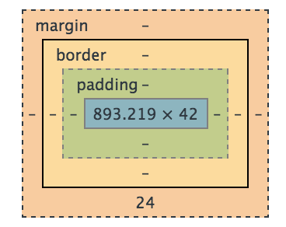
CSS Box Model
Content – The content of the box, where text and images appears
Padding – Clears an area around the content. The padding is affected by the background and color of the box
Border – A border that goes around the padding and content. The border is affected by the background color of the box.
Margin – The empty area around the border. The margin is completely transparent, no background color

Slide 19
CSS CHEAT SHEET
Full list of CSS Property & Value - “CSS3-CheatSheet.PDF” [by makeawebsitehub.com]

Slide 20
Hands-On Practise
Practise what you had learnt

Slide 21


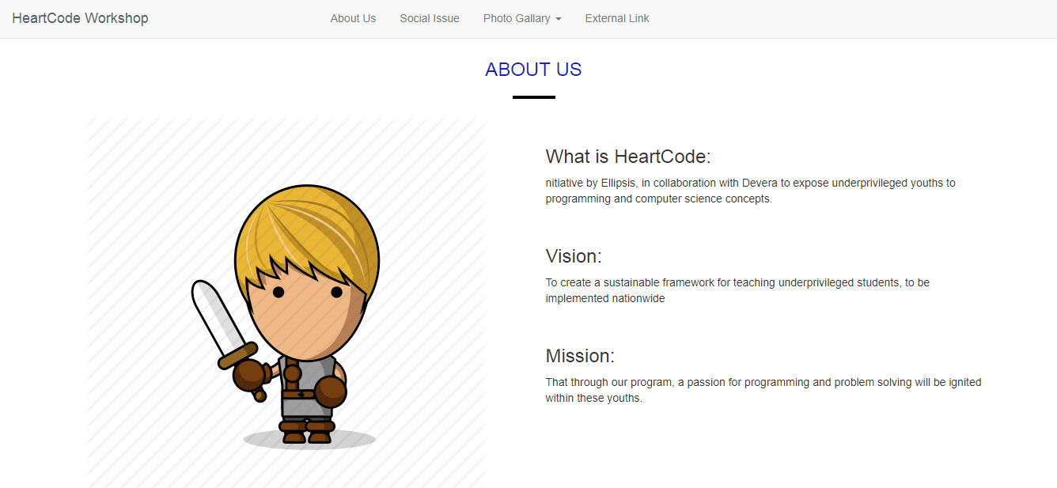
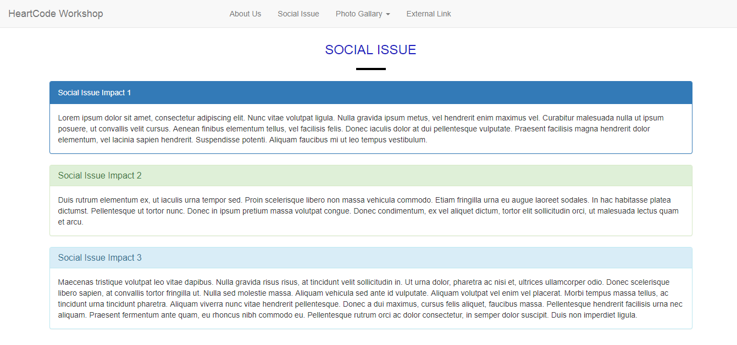
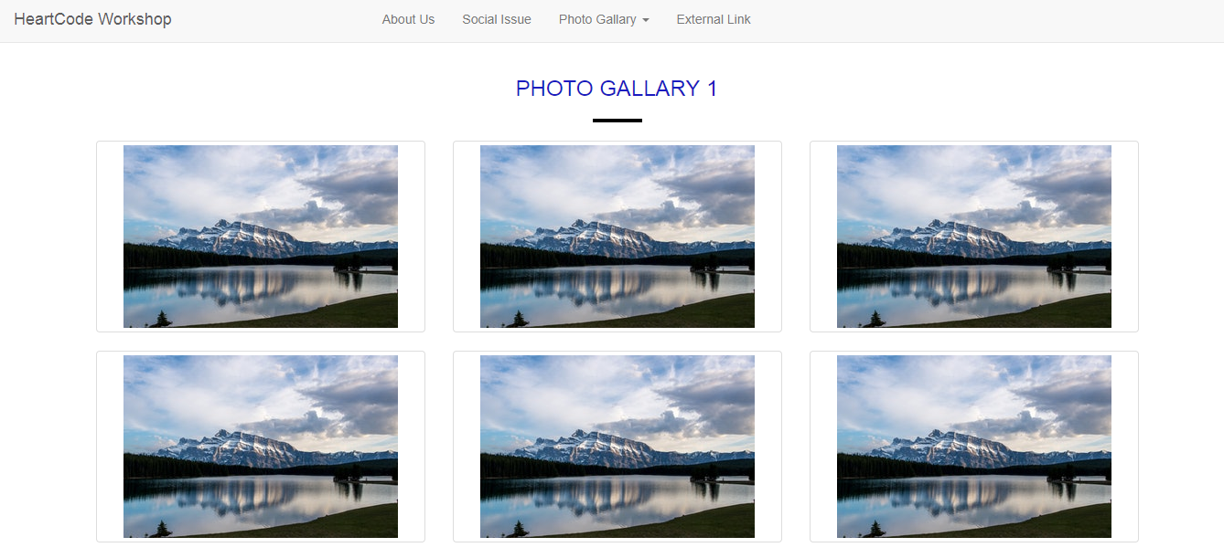
Complete the Pages

Slide 22
JS
JavaScript

Slide 23

What is JavaScript?

Slide 24
What is JavaScript?
To program the behaviour of web pages.
Add interactivity and effects to websites.

Slide 25
How to Includes JS?
Similar to CSS
Internal JavaScript
External JavaScript
JavaScript are normally placed in the body segment
Normally Placed at the bottom of the pages
Order of JavaScript library matters as well
Notes:
Why does JS are placed in the body instead of the head segment?
1. To Speed up the loading time of the pages, when HTML DOM are loaded. It will load the head segment first before loading the body. The white blank pages we see when we visit any browser, that the loading time for the head resources.
Why does JS Script tend to be place at the bottom of the pages?
1. HTML is execute in a top-down order approach. That includes the js scripts.
2. If the script is place above the element (id=A) and calles the element(id=A) within the script then it will not work. Cause when it execte the script, it could not find the element (id=A).

Slide 26
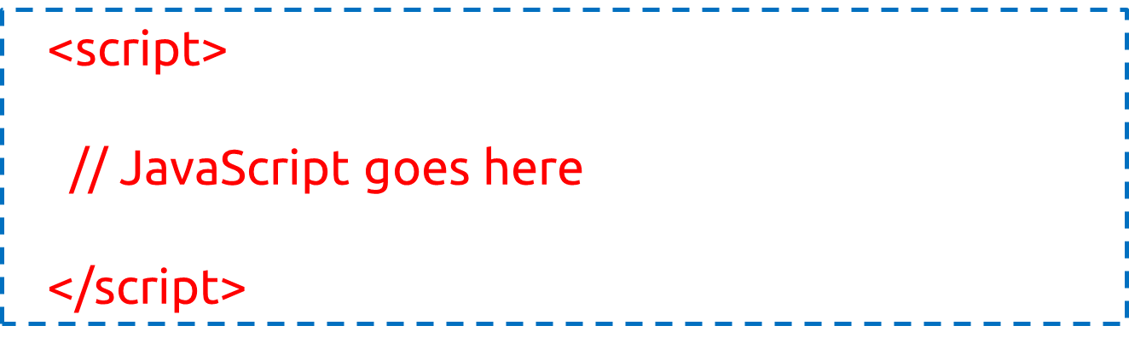
Internal JavaScript
Written within the HTML
Using <script> elements
Notes:
Do you wonder why we do not have type="text/javascript" inside the <script> tag? This is not required in HTML5. JavaScript is the default scripting language in HTML5 and in all modern browsers!

Slide 27

External JavaScript
Has “ .js “ filename extension. E.g. script.js
Using <script> tag to include the js file

Slide 28
JavaScript - Variables Syntax
Main Variable Type
Number
String
Boolean
Arrays
Objects
var i = 10 ;
var i = “a string” ;
var i = true;
var myArray = [1,2,3,"Wee", "Ryan"]
var aStudent = { "name" : "Ryan", "age" : 12, "gender" : "male"};
Notes:
Arrays are a collection of JavaScript data values
myArray[3] gives "Wee" as output
myArray.length gives 5
Objects are a set of key : value pairs declared inside curly ({ }) braces
aStudent["name"] or sStudent.name outputs "Ryan"
Objects are also called as dictonary. It works like how a normal languages dictonary, in which the key is the words and the value meaning of the words.

Slide 29
JavaScript - Basic Usage
Adding Comments to JavaScript
Single Line Comments
Multi-line Comments
Pop-up Alerts message
Write to console for debug
Access and Change the elements of an HTML document
HTML DOM Object
Single line comments start with //.
Multi-line comments start with /* and end with */
alert(“alert message to display”);
console.log(“writing message to console”);
Notes:
DOM = Document Object Model

Slide 30
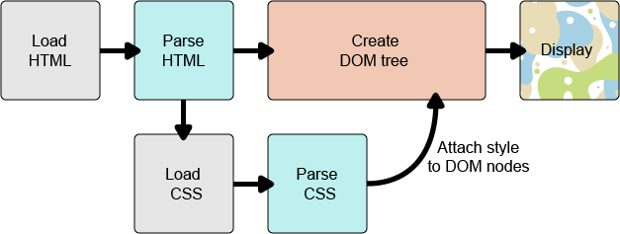
HTML DOM
The HTML DOM is a standard for how to get, change, add, or delete HTML elements.
Notes:
The browser converts HTML and CSS into the DOM (Document Object Model). The DOM represents the document in the computer's memory. It combines the document's content with its style.
The browser displays the contents of the DOM.
DOM (Document Object Model)
A DOM has a tree-like structure. Each element, attribute and piece of text in the markup language becomes a DOM node in the tree structure. The nodes are defined by their relationship to other DOM nodes. Some elements are parents of child nodes, and child nodes have siblings.
Understanding the DOM helps you design, debug and maintain your CSS because the DOM is where your CSS and the document's content meet up.

Slide 31
DOM - Finding HTML Elements
document refers to the current HTML document (web page)
Find an element by:
Element id
Class name
Tag name
document.getElementById(id)
document.getElementsByClassName(name)
document.getElementsByTagName(name)

Slide 32
Chrome Browser
Developers Tools (F12 / Clt+Shift+i)
Allow you to write JavaScript in Console Tab
JavaScript applied is only temporary
Great tools for debugging and trying out new script

Slide 33
JQuery
JavaScript Library

Slide 34
What’s JQuery?
JavaScript Library
Simplifies JavaScript programming
"write less, do more“
A lot of plugins / library extended from JQuery

Slide 35
Adding JQuery
Include the following tag into the HTML
<script src="https://cdnjs.cloudflare.com/ajax/libs/jquery/3.2.1/jquery.min.js"></script>

Slide 36
JQuery Syntax
Basic syntax = $(selector).action()
A $ sign to define/access jQuery
A (selector) to HTML elements
A jQuery action() to be performed on the element(s)

Slide 37
JQuery - Selector
Similar to CSS, select the specific element(s)
Element Selector
Class Selector
ID Selector
// select all <p> elements on a page
$("p“)
// Find an element with a specific id
$(“#IDName“)
// find elements with a specific class
$(“.ClassName“)

Slide 38
JQuery - Document Ready Event
Almost all jQuery methods are inside a document ready event
Prevent any jQuery code from running before the document is finished loading
$(document).ready(function(){ // jQuery methods go here... });
$(function(){ // jQuery methods go here... Shorter version });

Slide 39
PLUGINS
Animations Effect
Owl Carousel Slider

Slide 40
Animation Effects
Animated.css
CSS only Library
https://daneden.github.io/animate.css/
WOW.js
Add on of JavaScript to animated.css
http://mynameismatthieu.com/WOW/
Notes:
WOW.js is used in addition to animated.css to includes more effects. It provides effects when scrolling down.

Slide 41
Animated.css
Include the following stylesheet (Animated.css) <link rel="stylesheet“ href="https://cdnjs.cloudflare.com/ajax/libs/animate.css/3.5.2/animate.min.css">
Add the class “animated” to the element
Add the class “infinite” for infinite loop
Add the class name of the effect to the same element
Full List of animation effect is found on their website
Example : <h1 class="animated infinite bounce">Example</h1>

Slide 42
WOW.js
Include Animated.css & WOW.js https://cdnjs.cloudflare.com/ajax/libs/wow/1.1.2/wow.min.js
Add the following script to activate WOW.js <script> new WOW().init(); </script>
Add the class “wow” to the element followed by animation effect name
Animation effect name is from Animated.css
Example <h1 class="wow bounceInUp"> Example </h1>
Notes:
Animated.css link is on previous slides

Slide 43
WOW.js Advanced Options
data-wow-duration: Change the animation duration
data-wow-delay: Delay before the animation starts
data-wow-offset: Distance to start the animation (related to the browser bottom)
data-wow-iteration: Number of times the animation is repeated
Add the following attributes to the HTML element.
Example:
<h1 class="wow slideInLeft" data-wow-duration="2s" data-wow-delay="5s"> Example </h1>

Slide 44
Smooth Scroll
Used on navigation to another link within the same page
Animation of scrolling the page to the new link
Default effect is jump there directly

Slide 45
Smooth Scroll
Save the JS from https://kryogenix.org/code/browser/smoothscroll/smoothscroll.js
Include smoothscroll.js to the HTML page
Using id and ‘#’ to navigate within same page
Example:
<a href=“#aboutUs”> Link to About Us </a>
<h1 id=“aboutUs”> Content of About Us </h1>
Notes:
Documentation and more usage of smooth scroll can be found at https://github.com/galambalazs/smoothscroll-for-websites/wiki

Slide 46
Bootstrap with JavaScript
https://getbootstrap.com/docs/3.3/javascript/
Bring Bootstrap's components to life
Uses JQuery
Include bootstrap.js to the HTML page
<script src="https://cdnjs.cloudflare.com/ajax/libs/twitter-bootstrap/3.3.7/js/bootstrap.min.js"></script>

Slide 47
Bootstrap - carousel
Include the example code from Bootstrap Documentation
Modify the HTML to update the image and caption
Include the following script
$('.carousel-control').click(function(e){
e.preventDefault();
$('#myCarousel').carousel( $(this).data() );
});

Slide 48
Owl Carousel Slider
https://owlcarousel2.github.io/OwlCarousel2/
Image Sliders Plugins
Uses JQuery
Notes:
https://owlcarousel2.github.io/OwlCarousel2/index.html

Slide 49
How to use Carousel Slider?
Search the following at cdnjs.com and add them to HTML
JQuery
OwlCarousel2

Slide 50
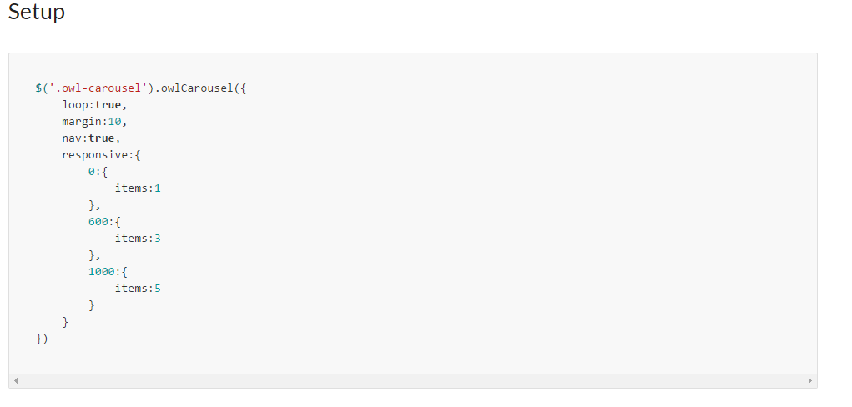
How to use Carousel Slider?
From owlcarousel2 website, Select Demos -> Basic
Copy the ‘Setup’ over to our own script at HTML

Slide 51
How to use Carousel Slider?
Following the HTML Structure in the demo and modify your HMTL to the same format
For more options, go to Docs -> Options

Slide 52
Emailjs
http://www.emailjs.com/
Allows sending of email to own accounts
Fee & Easy to use
Minimum configuration
Used in the contact me form segment

Slide 53
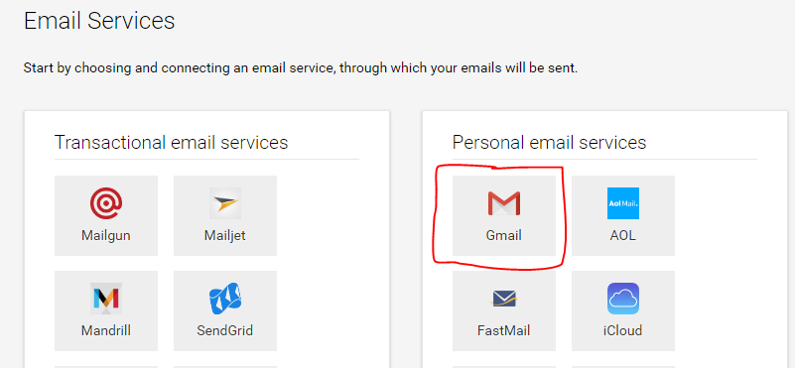
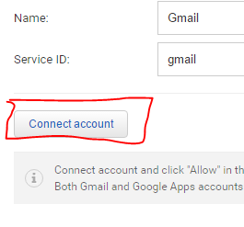
Emailjs – How to
Create an Account
Select Gmail as the Email Service
Connect a Gmail Account
Add services

Slide 54
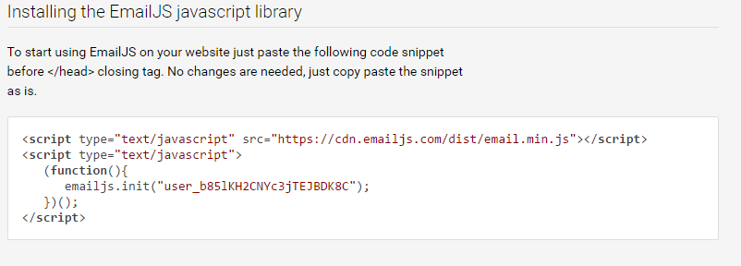
Emailjs – How to
Go to instruction & copy the js script to your HTML

Slide 55
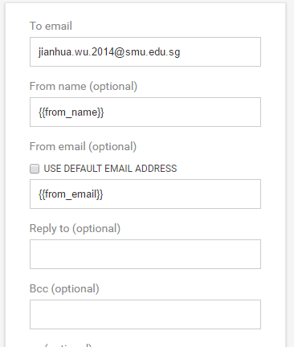
Emailjs – How to
Go to Email template & Edit
Change to the following settings

Slide 56
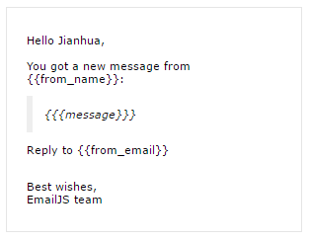
Emailjs – How to
Change the content to the following and Save the changes

Slide 57
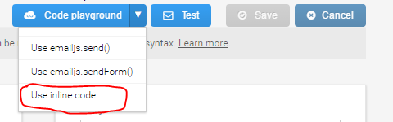
Emailjs – How to
Select “Use inline code” from Code Playground
Copy the code over to our HTML

Slide 58

Thanks you!
Any Questions?

