Slide 1
Angular Service

Slide 2
Agenda
依赖注入(Dependency Injection) Service 实例说明 管道（pipe） 作业与练习 Q&A
Copyright © 2017 Accenture All rights reserved.
1

Slide 3
什么是依赖注入
什么是依赖注入？
依赖注入最初是后端概念，被引入Angular。使用广泛，比如Spring，.Net
等平台都有依赖注入的概念。
依赖注入是实现控制反转的一种软件设计模式，一个依赖是一个被其他对象(client)调用的对象（服务）,注入则是将被依赖的对象(service)实例传递给依赖对象(client)的行为。
简单的说就是要求对抽象进行编程，不要对实现进行编程，这样就降低了客户与实现模块间的耦合，分离了服务和调用者的依赖，符合低耦合的程序设计原则。
在Stack Overflow上面有一个有趣的问题，如何向一个5岁的小孩解释依赖注入
为什么需要依赖注入，有什么好处？
将被依赖类的创建代码从依赖类中移出，不用显式的写new。
不用自己管理生命周期。
可以单独维护被依赖类的创建过程。减少依赖关系，实现低耦合设计。
Copyright © 2017 Accenture All rights reserved.
2
Notes:
Focus
Distributed Agile
Notes to Faculty:
Discuss why distributed agile is required and what ADM for DA offers
Agile University Delivery School
D01-M02-P01_ADM for Distributed Agile Overview
Copyright © 2012 Accenture All Rights Reserved.
2

Slide 4
Angular依赖注入 1/3
Angular有自己的依赖注入框架，该框架也可以作为一个单例模块供
其他app或框架使用。
2. Angular2中我们不需要自己配置injector，当系统加载
（platformBrowserDynamic().bootstrapModule(AppModule);）
时会自动创建全局的。
3. 注册Provider有两个地方：NgModule 或者 components.
Injector providers
Value providers
提供一个预先做好的对象会比请求注入器从类中创建它更容易。
Factory providers
我们需要动态创建这个依赖值，因为它所需要的信息直到最后一刻才能确定
https://angular.io/guide/dependency-injection
https://www.w3cschool.cn/angular/angular-l9oa24no.html
Copyright © 2017 Accenture All rights reserved.
3
Notes:
Focus
Distributed Agile
Notes to Faculty:
Discuss why distributed agile is required and what ADM for DA offers
Agile University Delivery School
D01-M02-P01_ADM for Distributed Agile Overview
Copyright © 2012 Accenture All Rights Reserved.
3

Slide 5
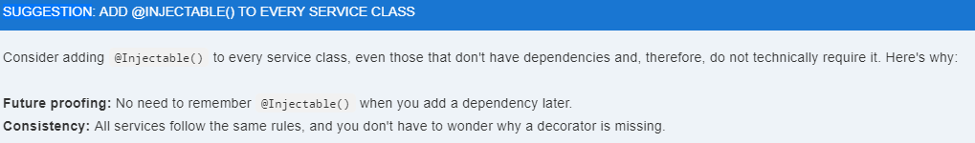
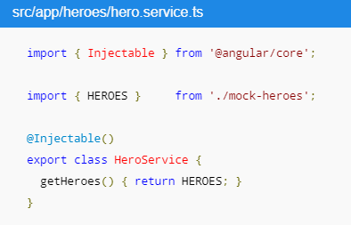
Angular依赖注入 2/3
@Injectable()
@Injectable()标志着一个类可以被一个注入器实例化;通常来讲,在试图实例化一个没有被标识为@Injectable()的类时候,注入器将会报告错误.
为什么我们的Component不需要加@injectable()？
因为包括@Component，@Directive，@Pipe都是@injectable的子类型。
Copyright © 2017 Accenture All rights reserved.
4
Notes:
Focus
Distributed Agile
Notes to Faculty:
Discuss why distributed agile is required and what ADM for DA offers
Agile University Delivery School
D01-M02-P01_ADM for Distributed Agile Overview
Copyright © 2012 Accenture All Rights Reserved.
4

Slide 6
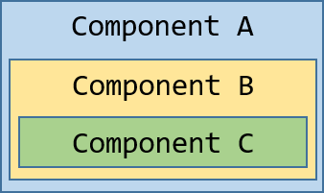
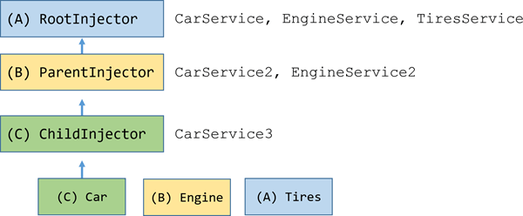
Angular依赖注入 3/3
分层依赖注入(Hierarchical Dependency Injectors)
An Angular application is a tree of components. Each component instance has its own injector. The tree of components parallels the tree of injectors.
https://angular.io/guide/hierarchical-dependency-injection
Copyright © 2017 Accenture All rights reserved.
5
Notes:
Focus
Distributed Agile
Notes to Faculty:
Discuss why distributed agile is required and what ADM for DA offers
Agile University Delivery School
D01-M02-P01_ADM for Distributed Agile Overview
Copyright © 2012 Accenture All Rights Reserved.
5

Slide 7
Service 实例说明
Copyright © 2017 Accenture All rights reserved.
6
Notes:
Focus
Distributed Agile
Notes to Faculty:
Discuss why distributed agile is required and what ADM for DA offers
Agile University Delivery School
D01-M02-P01_ADM for Distributed Agile Overview
Copyright © 2012 Accenture All Rights Reserved.
6

Slide 8

管道Pipe 1/3
Introducing Angular pipes, a way to write display-value transformations that you can declare in your HTML.
1. Built-in pipes
2. Parameterizing a pipe
3. Chaining pipes
4. Custom pipes
5. Pure pipes/Impure pipes/AsyncPipe
6. No FilterPipe or OrderByPipe
Copyright © 2017 Accenture All rights reserved.
7
Notes:
Focus
Distributed Agile
Notes to Faculty:
Discuss why distributed agile is required and what ADM for DA offers
Agile University Delivery School
D01-M02-P01_ADM for Distributed Agile Overview
Copyright © 2012 Accenture All Rights Reserved.
7

Slide 9
管道Pipe 2/3
Built-in pipes
AsyncPipe DatePipe I18nPluralPipe
I18nSelectPipe JsonPipe LowerCasePipe
CurrencyPipe DecimalPipe PercentPipe
SlicePipe UpperCasePipe TitleCasePipe
https://angular.io/api?query=pipe
2. Parameterizing a pipe
<p>The hero's birthday is {{ birthday | date:"MM/dd/yy" }} </p>
<p>The hero's salary is {{ money | currency:'EUR' }} </p>
3. Chaining pipes
<p>The chained hero's birthday is {{ birthday | date | uppercase}}</p>
<p>The chained hero's birthday is {{ birthday | date:"MM/dd/yy" | uppercase}}</p>
Copyright © 2017 Accenture All rights reserved.
8
Notes:
Focus
Distributed Agile
Notes to Faculty:
Discuss why distributed agile is required and what ADM for DA offers
Agile University Delivery School
D01-M02-P01_ADM for Distributed Agile Overview
Copyright © 2012 Accenture All Rights Reserved.
8

Slide 10
管道Pipe 3/3
4. Custom pipes
@Pipe({name: 'exponentialStrength'})
export class ExponentialStrengthPipe implements PipeTransform {
transform(value: number, exponent: string): number {
let exp = parseFloat(exponent);
return Math.pow(value, isNaN(exp) ? 1 : exp);
}
}
5. Pure pipes/Impure pipes/AsyncPipe
6. No FilterPipe or OrderByPipe
Copyright © 2017 Accenture All rights reserved.
9
Notes:
Focus
Distributed Agile
Notes to Faculty:
Discuss why distributed agile is required and what ADM for DA offers
Agile University Delivery School
D01-M02-P01_ADM for Distributed Agile Overview
Copyright © 2012 Accenture All Rights Reserved.
9

Slide 11
作业与练习
内容 | 说明 | 完成条件
写一个Service组件 | 写一个Service类，完成读取mock数据的功能并显示在画面上。 | 画面正常显示Mock数据。
使用Pipe | 1.练习使用日期相关Pipe 2.自定义个Pipe，完成输入数值（如12.9显示为13，11.2显示为11）只保留整数并且四舍五入。 | 画面正常显示Mock数据。
Copyright © 2017 Accenture All rights reserved.
10
Notes:
Focus
Distributed Agile
Notes to Faculty:
Discuss why distributed agile is required and what ADM for DA offers
Agile University Delivery School
D01-M02-P01_ADM for Distributed Agile Overview
Copyright © 2012 Accenture All Rights Reserved.
10

Slide 12
Questions & Answers
Q & A
Copyright © 2014 Accenture All rights reserved.
11
Notes:
Agile University Delivery School
D01-M02-P01_ADM for Distributed Agile Overview
Copyright © 2012 Accenture All Rights Reserved.
11

