Slide 1
RxJS

Slide 2
Agenda
什么是Reactive Programming 流 什么是Observables Rx 实现 Observables常用方法 环境搭建 Angular Observables Example
Copyright © 2017 Accenture All rights reserved.
1

Slide 3
什么是Reactive Programming
Responsive programming is based on a reaction to change。
Works with asynchronous data streams Data streams can be created from many thing
UI Events Http Requests Array-like objects
Copyright © 2017 Accenture All rights reserved.
2

Slide 4
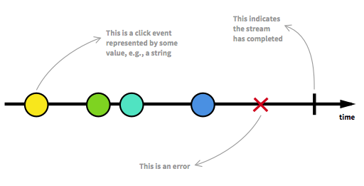
流
A sequence Get value、 error and complete signal
Copyright © 2017 Accenture All rights reserved.
3

Slide 5
什么是Observables
The observable object is a special function that accepts an "observer" object as a parameter (the "next", "wrong", "complete" and so on) in this observer object, and it Will return a logic to relieve the relationship with the observer. Observables are used to watch streams and emit functions when value, error or completed signal returned Observables can be subscribed to be an observer Watch streams and update accordingly
Copyright © 2017 Accenture All rights reserved.
4

Slide 6
Observables & Stream & Observer
Observable
Various Data Sources
UI Events Http Request, Array-like objects..
Handle Data
Handle Error
Handle Completion
Observer
Copyright © 2017 Accenture All rights reserved.
5
Notes:
Focus
Distributed Agile
Notes to Faculty:
Discuss why distributed agile is required and what ADM for DA offers
Agile University Delivery School
D01-M02-P01_ADM for Distributed Agile Overview
Copyright © 2012 Accenture All Rights Reserved.
5

Slide 7
Rx 实现
Java: RxJava JavaScript: RxJS C++: RxCpp Python: RxPY Swift: RxSwift Kotlin: RxKotlin … http://reactivex.io/languages.html
Copyright © 2017 Accenture All rights reserved.
6

Slide 8
Observables常用方法
Data streams from UI events Creating observables from array-like objects Creating observables from scratch Promise & Creating observables Promise Many operators (timer, range, interval, map, pluck, merge, MergeMap, SwitchMap)
http://reactivex.io/rxjs/class/es6/Observable.js~Observable.html
Copyright © 2017 Accenture All rights reserved.
7

Slide 9
环境搭建
Three ways
Reference CDN (https://cdnjs.cloudflare.com/ajax/libs/rxjs/5.4.2/Rx.js) Download RxJS Library Webpack & Babel (https://babeljs.io/) ES6 (http://es6.ruanyifeng.com/)
Copyright © 2017 Accenture All rights reserved.
8

Slide 10
Angular Observables
Copyright © 2017 Accenture All rights reserved.
9

Slide 11
作业与练习
内容 | 说明 | 完成条件
observable | Executing multiple concurrent http request

Slide 12
Questions & Answers
Q & A
Copyright © 2014 Accenture All rights reserved.
11
Notes:
Agile University Delivery School
D01-M02-P01_ADM for Distributed Agile Overview
Copyright © 2012 Accenture All Rights Reserved.
11

