Slide 1
Angular4 Directives

Slide 2
Agenda
为什么需要指令 什么是指令 指令的分类 Angular内置指令 自定义指令 Component 与 directive区别 例子 练习
Copyright © 2017 Accenture All rights reserved.
1

Slide 3
为什么需要指令
Page1
Page2
Component
Component
Component
(list)
Component(item)
Component
(list)
Component(item)
Component(item)
Component(item)
Component(search)
Component(search)
Change code
Copyright © 2017 Accenture All rights reserved.
2
Notes:
Focus
Distributed Agile
Notes to Faculty:
Discuss why distributed agile is required and what ADM for DA offers
Agile University Delivery School
D01-M02-P01_ADM for Distributed Agile Overview
Copyright © 2012 Accenture All Rights Reserved.
2

Slide 4
为什么需要指令
Create behavior
Directive
Import Directive
Pages
Component1
Component1
Directive
Component2
Component2
Component3
Directive
Component3
Component4
Directive
Directive
Component4
Component5
Directive
Directive
Copyright © 2017 Accenture All rights reserved.
3
Notes:
Focus
Distributed Agile
Notes to Faculty:
Discuss why distributed agile is required and what ADM for DA offers
Agile University Delivery School
D01-M02-P01_ADM for Distributed Agile Overview
Copyright © 2012 Accenture All Rights Reserved.
3

Slide 5
为什么需要指令
Reusable code Code Modular Manageable
Copyright © 2017 Accenture All rights reserved.
4

Slide 6
什么是指令
Directive extends HTML with new attributes DOM is transformed according to directives Appear within an element tag Angular provides a set of built in directive Create custom directives
Copyright © 2017 Accenture All rights reserved.
5

Slide 7
指令的分类
1. Components
Directives with a template
2.Structural directives
Change the DOM layout by adding and removing DOM elements
3. Attribute directives
Change the appearance of behavior of an element,
component or another directive
Copyright © 2017 Accenture All rights reserved.
6

Slide 8
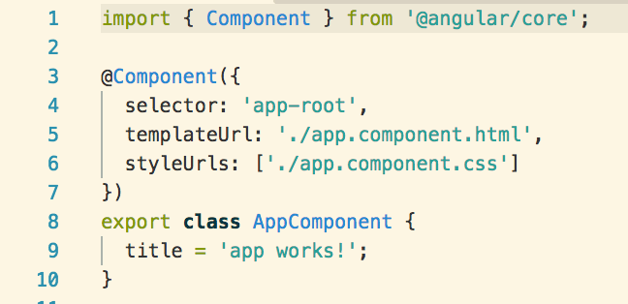
组件型指令
@Component decorator is a directive decorator extended with template-oriented feature
Use @Component meta-data annotation.
Components are typically used to create UI widgets.
template or templateurl template are mandatory in the component.
Copyright © 2017 Accenture All rights reserved.
7

Slide 9
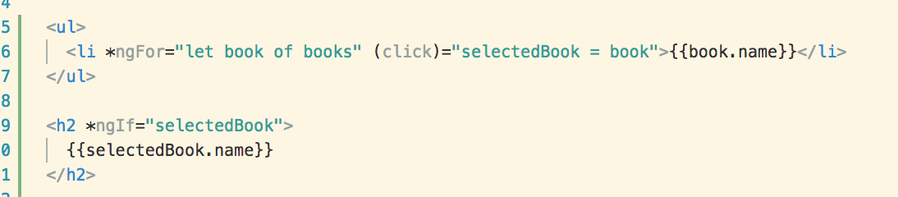
结构型指令
https://angular.io/guide/structural-directives#asterisk
Structural Directive later layout by adding, removing and replacing element in DOM and asterisk(*) precedes the directive attribute name
*ngFor tell angular iterate Per book in the books list.
*ngIf include h2 element if a selected book exists.

Slide 10
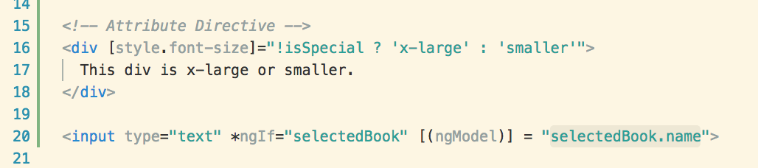
属性型指令
Attribute directive alter the appearance or behavior of an existing element
Display value property and responds to changing events

Slide 11
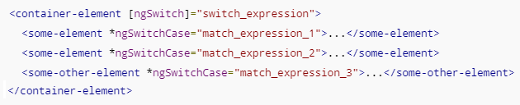
Angular内置指令
https://angular.io/guide/template-syntax
NgClass
Add and remove a set of CSS classes
Add and remove a set of HTML styles
NgStyle
Two-way data binging to an HTML form element
NgModel
NgIf
Conditionally add or remove an element from the DOM
NgFor
Repeat a template for each item in a list
A set of directives switch among alternative views
NgSwitch

Slide 12
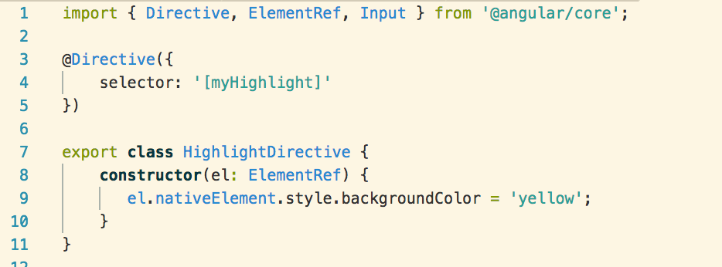
自定义指令
Provides the functionality of the Directive decorator
Contains the directive metadata a configuration object
Identifies the HTML in the selector that is associated with the directive
Directive Class that performs operation

Slide 13
Component 与 directive区别
Component | Directive
For register component we use @Component meta-data annotation | For register directives we use @Directive meta-data annotation.
Components are typically used to create UI widgets. | Directives is used to add behavior to an existing DOM element.
Component is used to break up the application into smaller components. | Directive is use to design re-usable components.
Only one component can be present per DOM element. | Many directive can be used in a per DOM element.
Template or templateurl template are mandatory in the component. | Directive don’t have View.
Example – import {Component} from '@angular/core'; @Component({ selector: 'app-index', template:‘<div>Hi</div>' }) | Example – import {Directive} from '@angular/core'; @Directive({ selector: ' [myDirective] ', hostListeners: { 'click': 'show()' } })

Slide 14
Example

Slide 15
作业与练习
内容 | 说明 | 完成条件
Create Directive | Create a Structural/Attribute Directive and call it.

Slide 16
Questions & Answers
Q & A
Copyright © 2014 Accenture All rights reserved.
15
Notes:
Agile University Delivery School
D01-M02-P01_ADM for Distributed Agile Overview
Copyright © 2012 Accenture All Rights Reserved.
15

