Slide 1


Lecture 9
Strings

Slide 2
Strings
Strings:
A sentence, text, characters…
EX: ‘Hello’, ‘This is an example of a string’, ‘whatever…’
Stored in a row vector with each element containing one letter
(or a symbol, character, and… even a space!)
May access these elements just like any other row vectors

Slide 3
Strings
How to assign a string variable:
Use a pair of single quote! (‘)
What if I have a single quote in the sentence?
Use two single quote (‘ ‘)

Slide 4
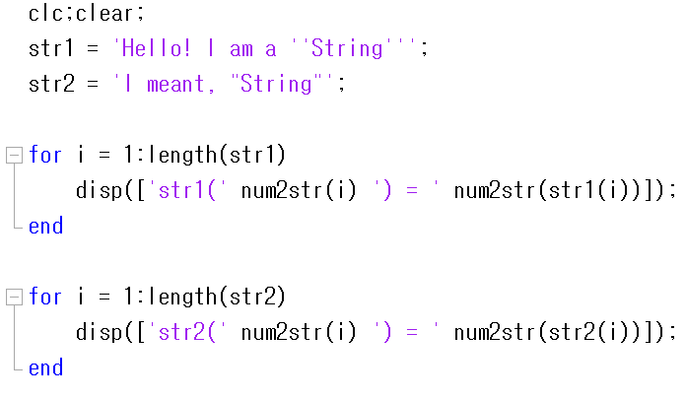
Strings

Slide 5

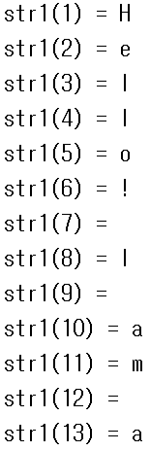
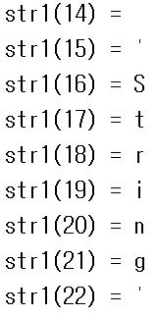
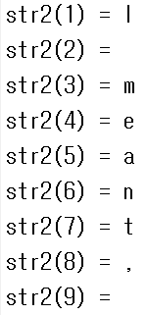
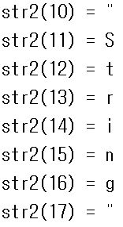
Strings

Slide 6
Strings
How does MATLAB understand the character?:
Computers understand only 1 or 0, not ‘ABCD’
ASCII(American Standard Code for Information Interchange) Code
All characters(letters), including numbers, are assigned to a numerical value(code)

Slide 7
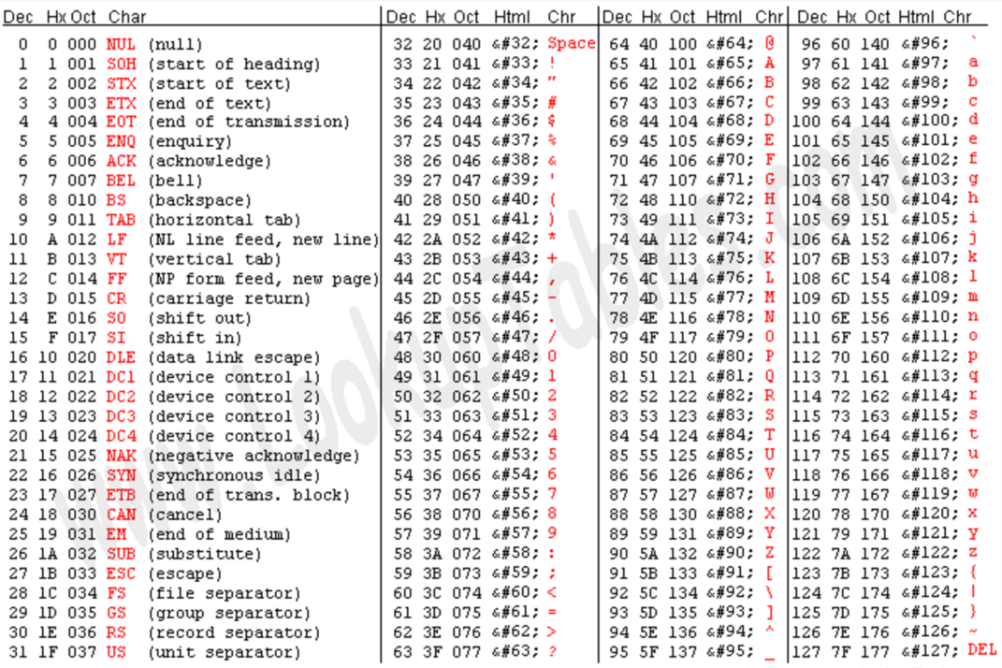
Strings

Slide 8
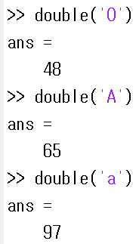
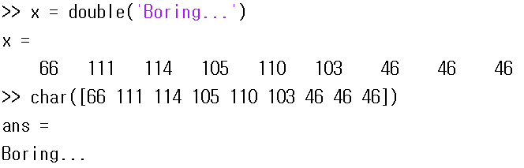
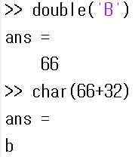
Strings

Slide 9
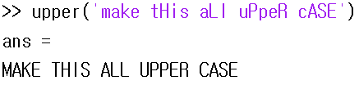
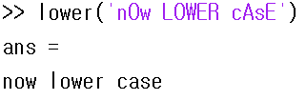
Strings
Strings Manipulation:
Some useful function:
upper: make the whole string upper case
lower: make the whole string lower case

Slide 10
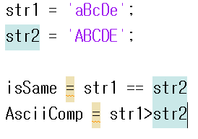
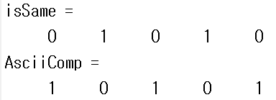
Strings
Strings Comparison:
Using Logical Operator
TWO STRINGS(row vectors) MUST HAVE THE SAME LENGTH!!

Slide 11
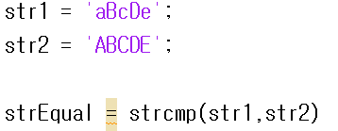
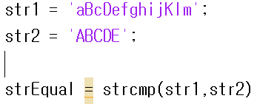


Strings
2. strcmp command
Compare the two string as whole!
Can take care of different lengths

Slide 12
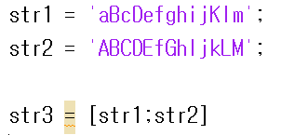
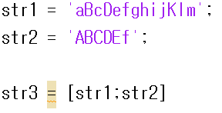

Strings
Strings Matrix:
Concatenation
TWO STRINGS(row vectors) MUST HAVE THE SAME LENGTH!!

Slide 13
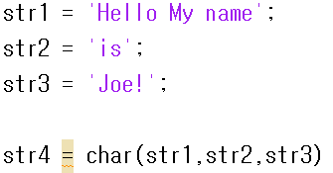
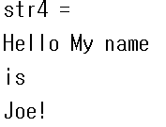
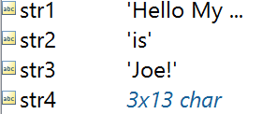
Strings
Using char function

Slide 14
Exercise 1
Exercise 1
Receive a sentence from the user and
  Convert upper to lower case
  Convert lower to upper case
  Leave all other characters as it is
  (space, symbols, etc)
Example:
hElLo iS tHiS oK? => HeLlO Is ThIs Ok?

Slide 15
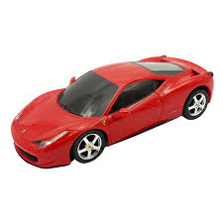

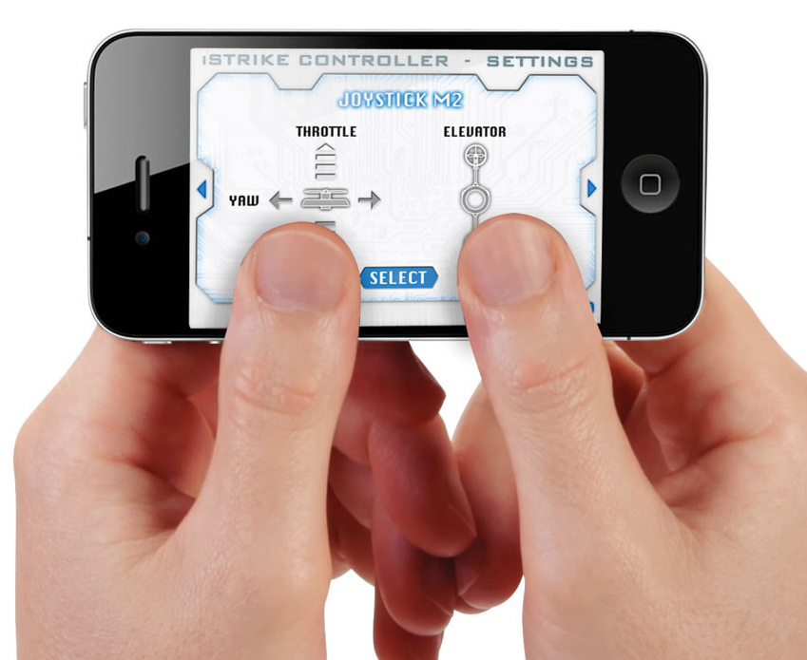
Exercise 2
Exercise 2:
Phone-controlled toy-car
Phone sends the message to car telling it where to move
(input from user)
MOVE LEFT!

Slide 16
Exercise 2
The message is usually sent in a bundle, instead of individual command [ex: LUULDRRDDDLLU] (for efficient communication)
You are controlling two separate toy cars, and you are designing the receiving part of this task.
Car can only move Left / Right / Up / Down
(Imagine you are watching this car from the top of a building)
The first character of the message indicates the ID of car (1 or 2)
Decode the message and create two vectors keep tracking the car’s movement
Plot the coordinate to see how the car moved
(Try to use a marker instead of line to see the movement)
Repeat this and terminate the program when user enters ‘exit’

