Slide 1


Lecture 6
Looping Mechanism

Slide 2
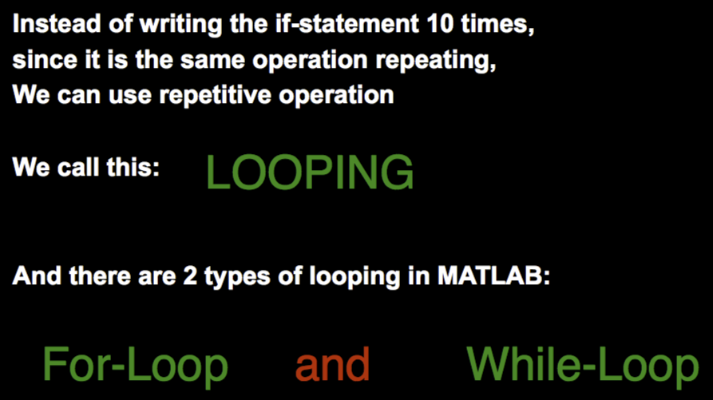
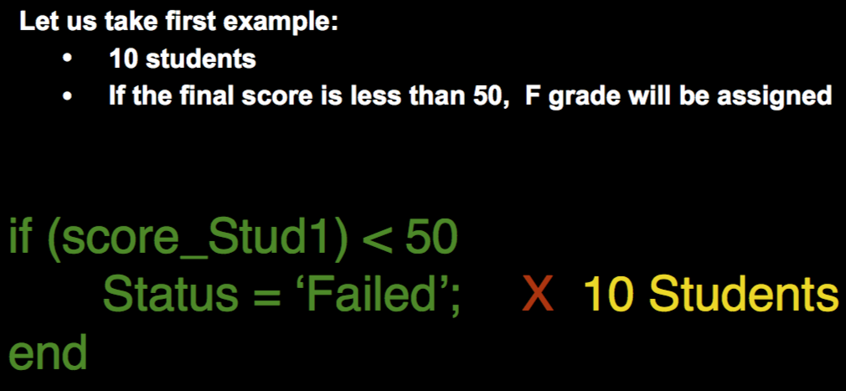
Looping
Repetitive Actions

Slide 3
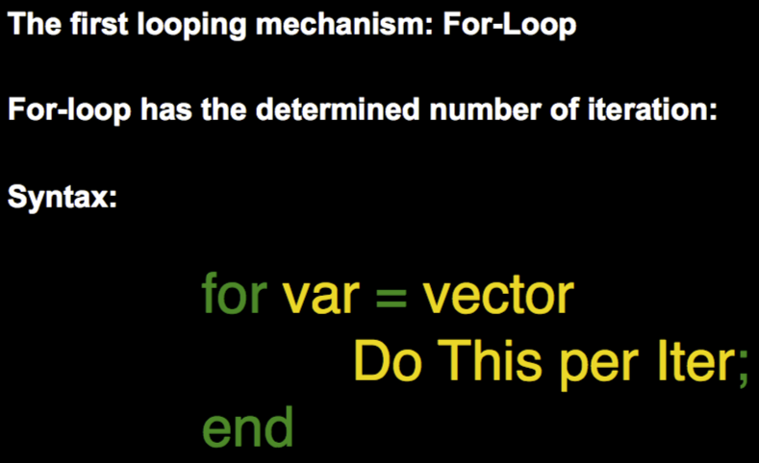
Looping
For-Loop
‘var’ takes EACH value in a vector one at a time
Number of Iteration = Number of element in a given vector
Can utilize the value of ‘var’ or simply use it to create the necessary iteration

Slide 4
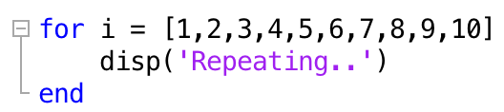
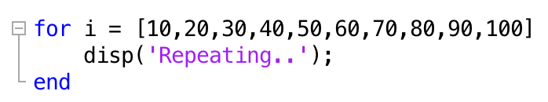
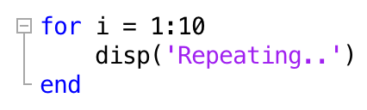
Looping
Simple Iteration
(Ex: Printing a message 10 times)
No need for ‘number’ that changes per iteration
Simply need a loop to iterate!

Slide 5


Looping
Most common way:
Create a (row) vector with colon(:) operator!
end number = number of iteration (with starting number of 1)

Slide 6
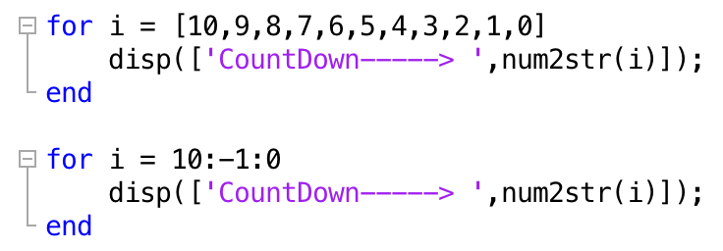
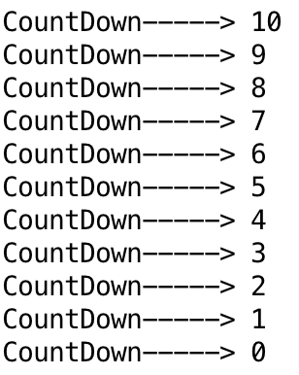
Looping
2. Utilizing the ‘changing’ variable
(Ex: Count Down!)
Need a variable that goes from 10 to 0
Construct a for-loop with a vector going from 10 to 0 !

Slide 7
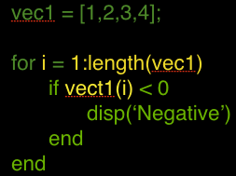
Looping
Very Very VERY important usage of for-loop
(At least for this course)
Sweep-through indexing:
Create a vector with 1-to-length of
the-vector
Pass this to for-loop and use
the changing variable as an index

Slide 8
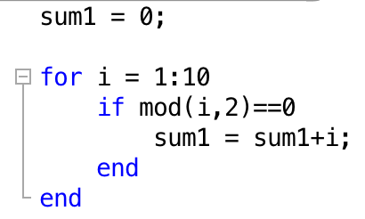
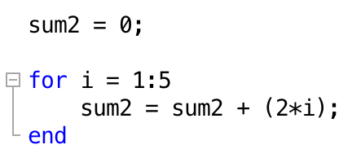
Looping
Think Smart!
Ex: Adding even numbers from 1 to 10
(At least for this course, utilizing this changing variable should be relatively obvious)

Slide 9
Looping
Quick Check!: Determine whether the for-loop would be simple-iteration purposes or utilizing a Changing variable
Receiving 5 inputs from the user and calculating the mean
Given a vector that contains a score of mid-terms, find out how many students have failed ( < 50)
Simulate rolling a die 100 times (but display the roll each time!)

Slide 10
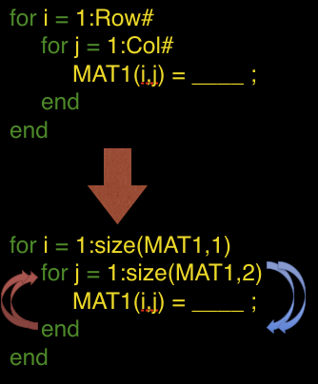

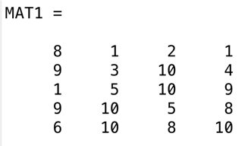


Looping
Nested For-loop (matrix sweep-through)
Need 2 changing-variables (for both directions)
Inner-loop gets completed FIRST

Slide 11
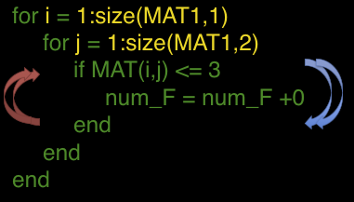
Looping
Example: the number of ’F’ grade (3 or below)

Slide 12
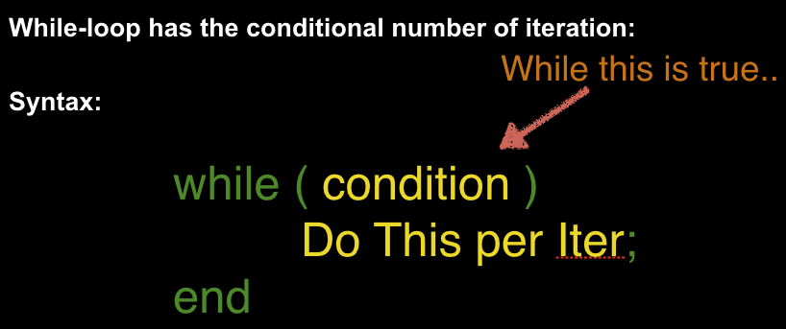
Looping
While-loop
Don’t know how exact number of iterations (usually)
Number of Iteration depends on the ‘condition’ of the problem

Slide 13
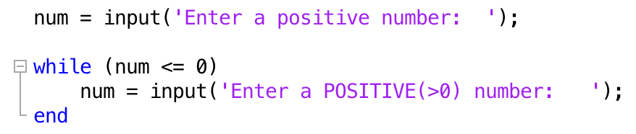
Looping
Example: Ensuring the user input!
Preventing user to give wrong input
(Keep asking again, if not satisfied)
Think carefully about the imposing condition!

Slide 14
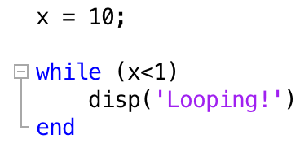
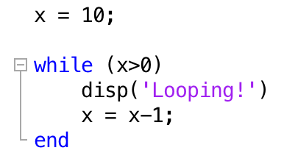
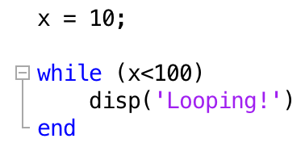
Looping
Quick Check: How many iterations?
1.
3.
2.

