Slide 1
Python Performance
Joey Bernard – November 2022

Slide 2
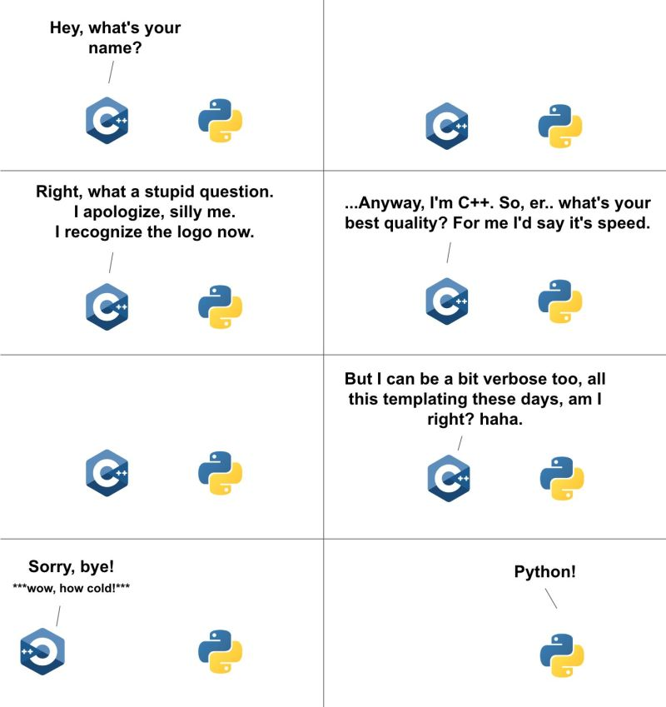
Python is slow – isn’t it?
A common complaint is that Python is slow
Is this true?
Like everything else, the answer is yes and no

Slide 3
Using Python incorrectly
In scientific computing, there is a huge amount of history from C/C++ and FORTRAN
There are bad habits that are language specific
Need to learn the idioms of the language you want to use
Python is an untyped object-oriented language
This means that Python always needs to inspect every object before a function can be applied
What if we want to find the tangent of an array of values?

Slide 4
Straight Python
import time
import math
t0 = time.time()
size = 10000000
A = list(range(size))
B = list(range(size))
for i in range(size):
B[i] = math.tan(A[i])
t1 = time.time()
print(t1 - t0)

Slide 5
Fixed Datatypes
import time
import math
import numpy
t0 = time.time()
size = 10000000
A = numpy.arange(size)
B = numpy.arange(size)
for i in range(size):
B[i] = math.tan(A[i])
t1 = time.time()
print(t1 - t0)

Slide 6
Full numpy
import time
import math
import numpy
t0 = time.time()
size = 10000000
A = numpy.arange(size)
B = numpy.tan(A)
t1 = time.time()
print(t1 - t0)

Slide 7
Comparisons?
Code Version (10,000,000 elements) | Time (s)
Pure Python | 2.361333
Numpy datatypes | 3.466689
Numpy functions | 0.152022

Slide 8
Jupyter timing
%%timeit
C = np.zeros((rows,cols))
for i in range(rows):
for j in range(cols):
for k in range(rows):
C[i][j] += A[k][i] * B[j][k]
6.14 s ± 53 ms per loop (mean ± std. dev. of 7 runs, 1 loop each)

Slide 9
Jupyter timing
%%timeit
C = A * B
20 µs ± 291 ns per loop (mean ± std. dev. of 7 runs, 100,000 loops each)

Slide 10
Other Interpreters?
Python is a language specification
Cpython is just the default implementation from the Python consortium
There are other options – pypy is popular
Issue is that not all modules are available, you may need to do some manual installation/tweaking

Slide 11
Code Version | Cpython time | Pypy time
Array.py | 2.146039 | 0.763002
Numpy_array.py | 0.158998 | 0.166613

Slide 12
What about parallel programming
A common “solution” to speed issues is to parallelize your code
This is a pair of undergraduate course in CS
Two broad categories : multithreading and multiprocessing
Multithreading – multiple threads within a single process
Multiprocessing – multiple processes, talking to each other

Slide 13
Multithreading and the GIL
In Cpython, we have the Global Interpreter Lock (GIL)
This means that only one thread can run on the CPU at a time
No speed up if it is CPU bound
Great if code is IO bound
Can have threads start IO tasks and wait for them to finish
This allows another thread to run on the CPU instead of everybody waiting for IO
There are GIL-less interpreters, but not universal yet

Slide 14
Multiprocessing – multiple GILs?
We can get around the GIL by spreading the work across multiple processes
Each process uses a separate instance of the interpreter
This involves breaking your algorithm into discrete independent parts
The trade off becomes number of processes vs amount of communication

Slide 15
from multiprocessing import Process
def f(name):
('hello', name)
if __name__ == '__main__’:
p = Process(target=f, args=('bob',))
p.start()
p.join()

Slide 16
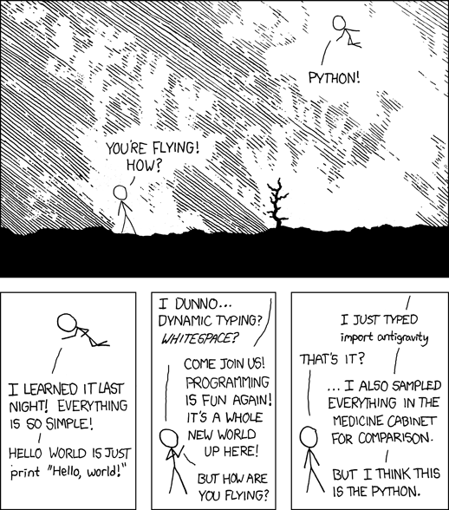
Modules?
Before doing too much work, look
The pYthon community of available packages is huge
https://pypi.org currently has 414,076 packages

Slide 17
Cython – for when you have to do it yourself
Let’s say that your research is so cutting edge, nobody has ever done anything similar
There is the option to write code in a lower level language for highly tuned algorithms
The default binding is for C, but other options exist

Slide 18
Fibonacci example
from __future__ import print_function
def fib(n):
"""Print the Fibonacci series up to n."""
a, b = 0, 1
while b < n:
print(b, end=' ')
a, b = b, a + b
print()

Slide 19
How to compile
First you need cython
Python –m pip install cython
You also need a C compiler
Then you need a setup.py file to manage the compilation
python setup.py build_ext –inplace
This gives you a binary file that you can import, just like any other module

Slide 20
Setup.py
from setuptools import setup
from Cython.Build import cythonize
setup(
ext_modules=cythonize("fib.pyx"),
)

Slide 21
Comparison
Parameter size | Python time | Cython time | Ratio
1000 | 618 ns | 326 ns | 1.8957
10000 | 853 ns | 468 ns | 1.8226
100000 | 1060 ns | 596 ns | 1.7785

Slide 22
Partial Compilations?
What if you only have parts of your code that need to be optimized?
You can use a Just-In-Time (JIT) compiler
A popular one is numba
You can use the JIT to compile individual functions that might need to be optimized

Slide 23
import time
import math
from numba import jit
@jit
def arr(size):
A = list(range(size))
B = list(range(size))
for i in range(size):
B[i] = math.tan(A[i])
t0 = time.time()
arr(10000000)
t1 = time.time()
print(t1 - t0)

Slide 24
Comparison
Array size | Python time | Pypy time | Numba time
100000 | 0.026575 | 0.012557 | 0.221454
1000000 | 0.261230 | 0.068846 | 0.264646
10000000 | 2.520349 | 0.750271 | 0.746917
100000000 | died | 42.667011 | 7.067443

Slide 25
Conclusions
What order should you try things for optimized code?
Write correct Python
Use optimized modules (Most people can stop here)
Use a different interpreter or a JIT
Hand-code lower level code to import

