Slide 1


4A – Architecture des Logiciels
ESGI 2013/2014
Lundi 09 Décembre 2013
Journey Calculator
Joey Bronner | Amine Bouabdallaoui
Notes:
Hello everybody, i will introduce about the cloud computing in few words and slides.

Slide 2
Sommaire
Présentation générale
Modèle Conceptuel de Données
Le Code
Conclusion
Notes:
That’s the sommary
In a first time, i will define the term of ‘CLOUD COMPUTING’
Secondly, the security
After, we will looking to see the advantages and the drawbacks
Finally, i wil do a short conclusion

Slide 3
PRESENTATION GENERALE
Notes:
Here you can see a definition from the famous website : Wikipedia
So, to summarize, that’s a concept how allow to dematerialize computer ressources

Slide 4

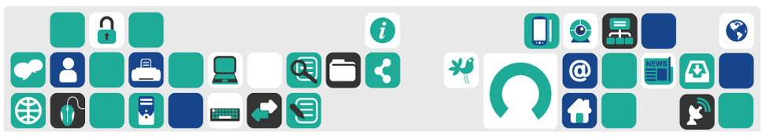
Présentation générale (1/4)
Les données sources
http://data.ratp.fr/fr/les-donnees.html
Notes:
Here you can see a definition from the famous website : Wikipedia
So, to summarize, that’s a concept how allow to dematerialize computer ressources

Slide 5
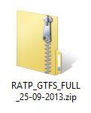
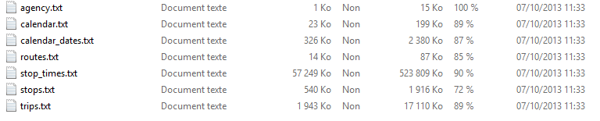
Présentation générale (2/4)
Les données sources
Notes:
Here you can see a definition from the famous website : Wikipedia
So, to summarize, that’s a concept how allow to dematerialize computer ressources

Slide 6
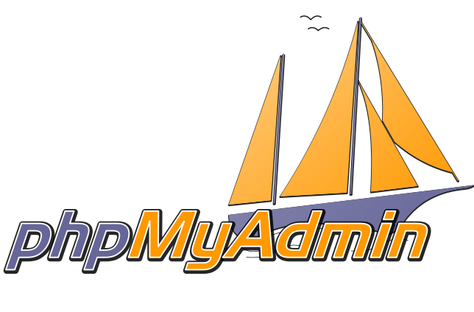
Présentation générale (3/4)
Le stockage des données
Notes:
Here you can see a definition from the famous website : Wikipedia
So, to summarize, that’s a concept how allow to dematerialize computer ressources

Slide 7
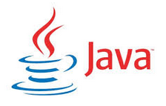
Présentation générale (4/4)
L’interface
Swing
Notes:
Here you can see a definition from the famous website : Wikipedia
So, to summarize, that’s a concept how allow to dematerialize computer ressources

Slide 8
MODELE CONCEPTUEL
Notes:
Here you can see a definition from the famous website : Wikipedia
So, to summarize, that’s a concept how allow to dematerialize computer ressources

Slide 9
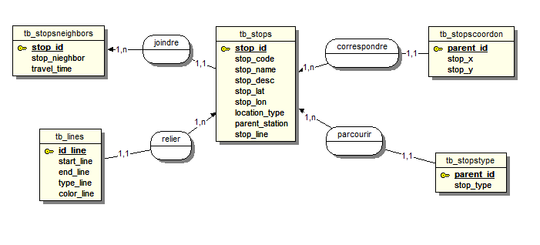
Modèle Conceptuel de Données (1/1)
Le MCD
Notes:
Here you can see a definition from the famous website : Wikipedia
So, to summarize, that’s a concept how allow to dematerialize computer ressources

Slide 10
LE CODE
Notes:
Here you can see a definition from the famous website : Wikipedia
So, to summarize, that’s a concept how allow to dematerialize computer ressources

Slide 11
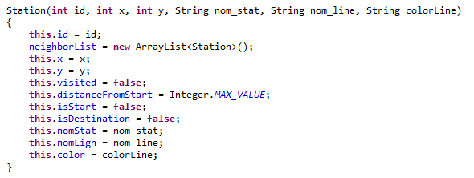
Le Code (1/6)
Station()
Notes:
Here you can see a definition from the famous website : Wikipedia
So, to summarize, that’s a concept how allow to dematerialize computer ressources

Slide 12
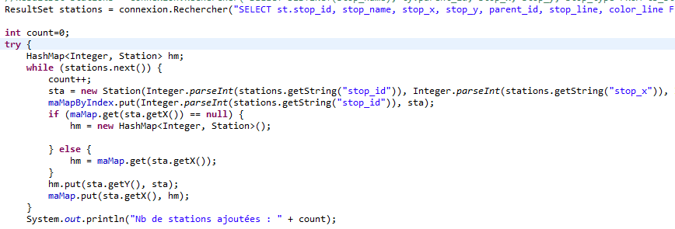
Le Code (2/6)
createMap()
Notes:
Here you can see a definition from the famous website : Wikipedia
So, to summarize, that’s a concept how allow to dematerialize computer ressources

Slide 13
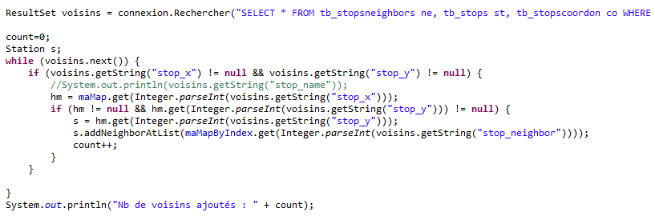
Le Code (3/6)
registerNeighbors()
Notes:
Here you can see a definition from the famous website : Wikipedia
So, to summarize, that’s a concept how allow to dematerialize computer ressources

Slide 14
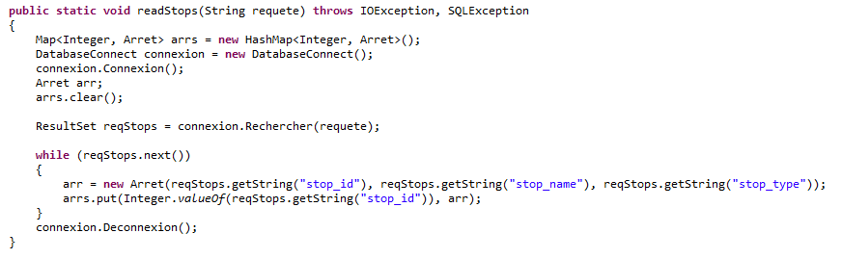
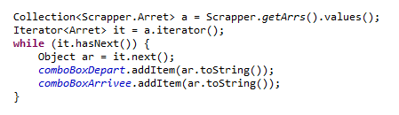
Le Code (4/6)
readStops()
Notes:
Here you can see a definition from the famous website : Wikipedia
So, to summarize, that’s a concept how allow to dematerialize computer ressources

Slide 15


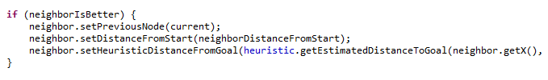
Le Code (5/6)
calcShortestPath()
Affectation du point de départ et de destination
Parcours des voisins
Ajout du meilleur voisin à l’itinéraire
Notes:
Here you can see a definition from the famous website : Wikipedia
So, to summarize, that’s a concept how allow to dematerialize computer ressources

Slide 16
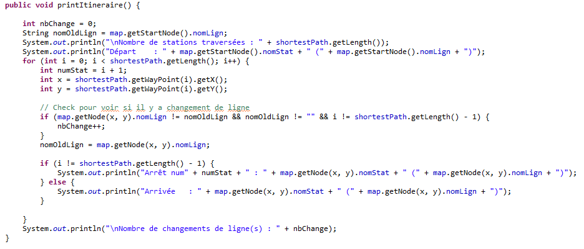
Le Code (6/6)
printItineraire()
Notes:
Here you can see a definition from the famous website : Wikipedia
So, to summarize, that’s a concept how allow to dematerialize computer ressources

Slide 17
CONCLUSION
Notes:
Here you can see a definition from the famous website : Wikipedia
So, to summarize, that’s a concept how allow to dematerialize computer ressources

Slide 18
Conclusion (1/1)
Améliorations
Re-programmer l’heuristique (ClosestHeuristic.java)
Modifier la requête d’ajout des voisins (registerNeighbors())
Notes:
Here you can see a definition from the famous website : Wikipedia
So, to summarize, that’s a concept how allow to dematerialize computer ressources

Slide 19
MERCI POUR VOTRE ATTENTION
Notes:
Here you can see a definition from the famous website : Wikipedia
So, to summarize, that’s a concept how allow to dematerialize computer ressources

