Slide 1
Floor Makeover
Unit Testing?
https://github.com/joeybrown/tiles
https://github.com/joeybrown/tiles-presentation

Slide 2

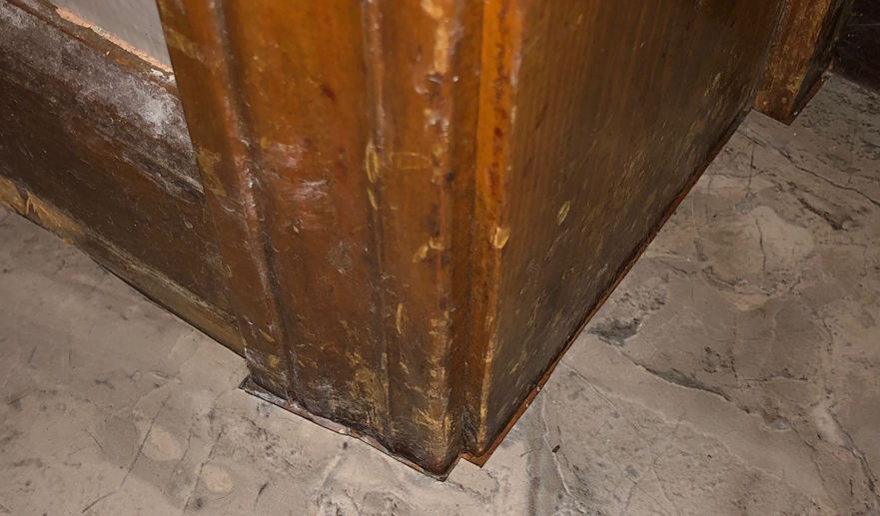
Hard to get all the way to the wall

Slide 3
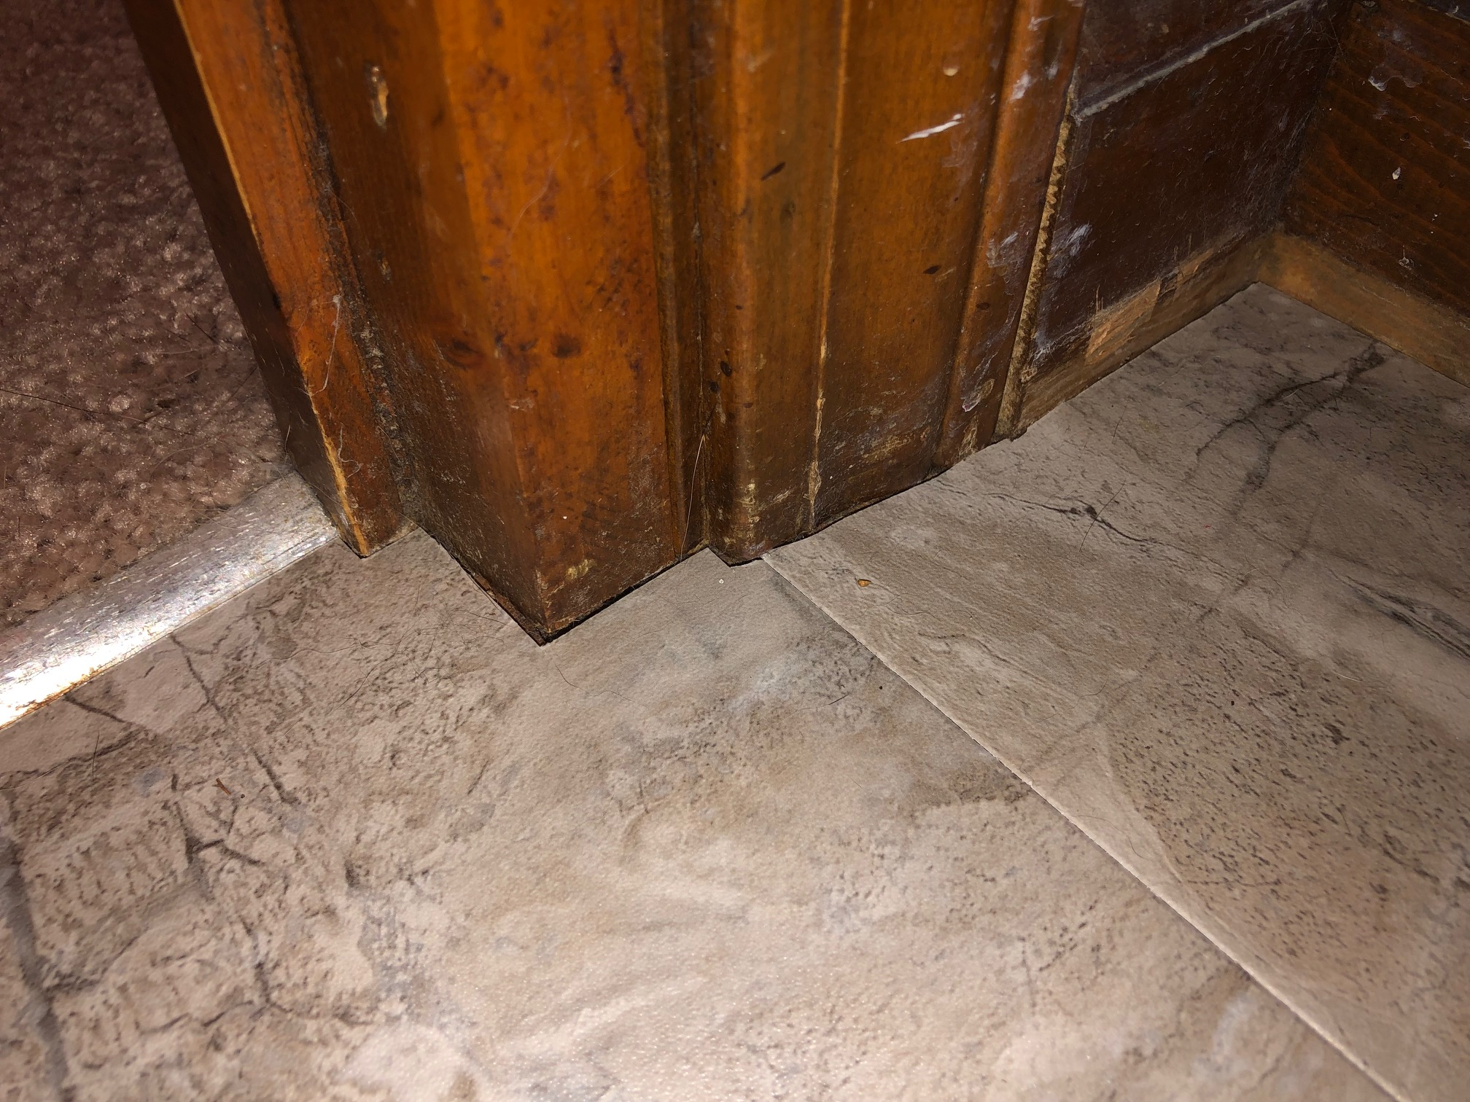
Hard to line up tiles

Slide 4
Tile Robots
Layout Scanning Robot
Tile Cutting Robots
Tile Laying Robot

Slide 5
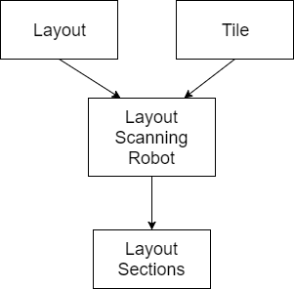
Layout Scanning Robot

Slide 6
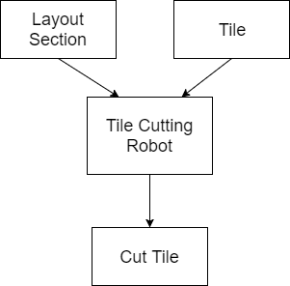
Tile Cutting Robots

Slide 7
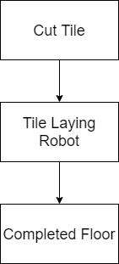
Tile Laying Robot

Slide 8
Tile Cutting Robots
Parallelizable
Different Types
Score Cutting Robot
Jig Cutting Robot
Laser Cutting Robot

Slide 9
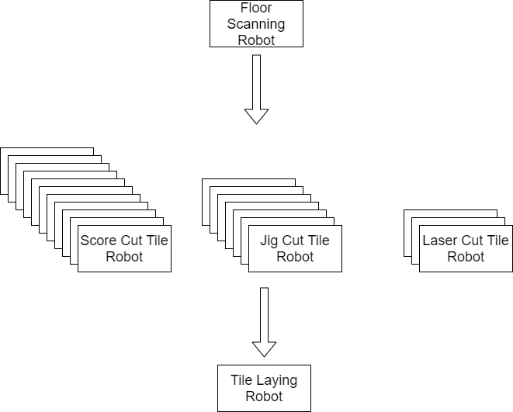
Robot Pipeline

Slide 10
Tile Robots
Layout Scanning Robot
Extract
Tile Cutting Robots
Transform
Tile Laying Robot
Load

Slide 11
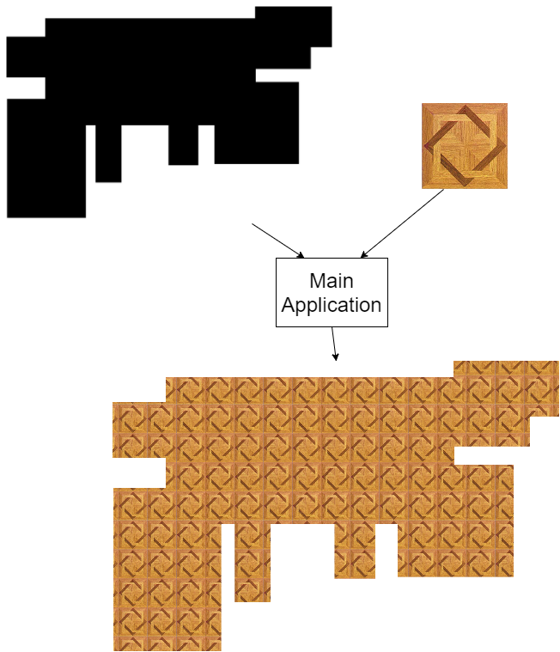
Demo
Notes:
Show main application and then Run via command line.

Slide 12
Unit Testing

Slide 13
Tools
xUnit
Moq
Fluent Assertions
Notes:
Explain a bit about each one. Framework has lots of ways to set things up. Mock is like using a stunt double. Fluent Assertions makes things readable.

Slide 14
Detour - Architecture
Inversion of Control
Design against Interface
Single Responsibility Principle
Enables Mocking
Notes:
Your code architecture directly affects how it can be tested. Tests cannot always “come later” because of how things are designed.

Slide 15
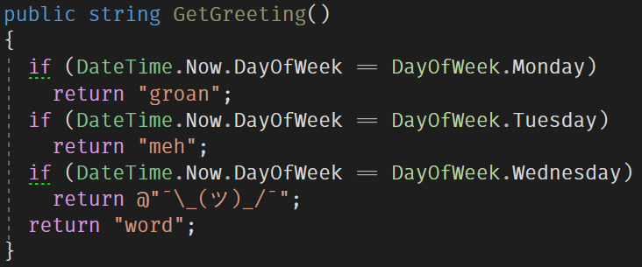
Inversion of Control
Notes:
Not deterministic. Not function in mathematical sense. Subroutine.

Slide 16
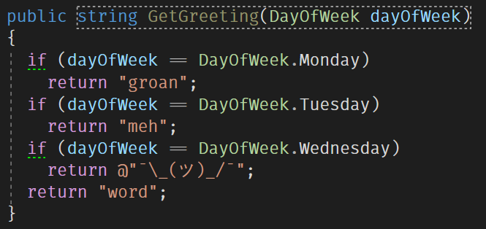
Inversion of Control

Slide 17
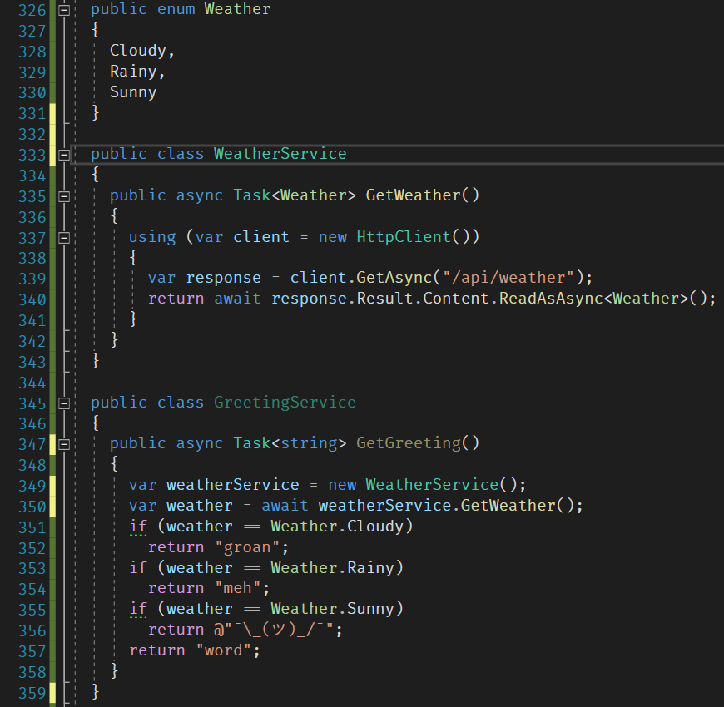
Design Against Interface

Slide 18
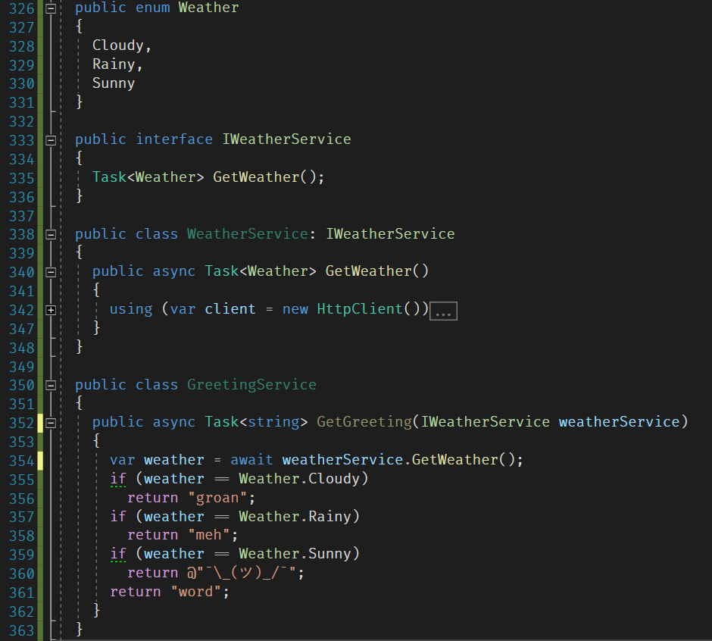
Design Against Interface

Slide 19
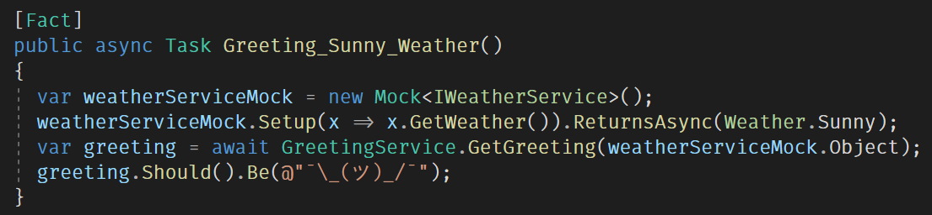
Mocking

Slide 20
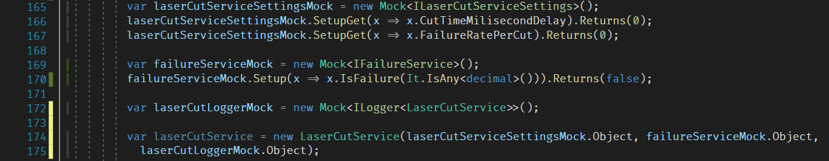
Mocking Dependencies
Notes:
Context of Mocking: Two things that affect this test: speed & failure rate.

Slide 21

Mock Costly Things
Notes:
CutService ln 116

Slide 22
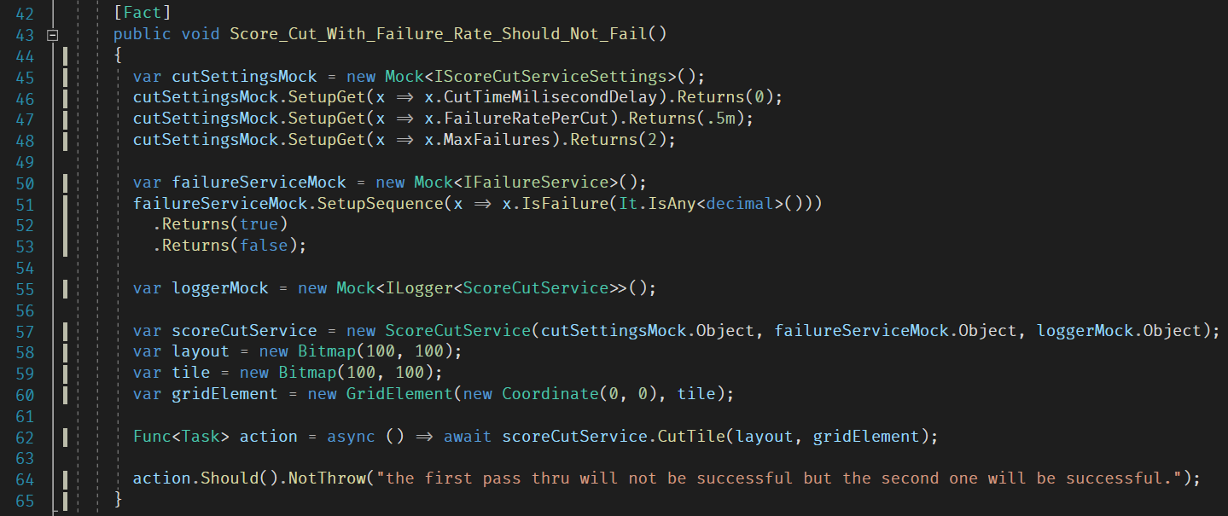
Test Non-Deterministic Things
Notes:
CutService ln 116

Slide 23
Architecture
Black-box Unit Testing
Not too concerned with implementation details
Not TDD
Single Responsibility Principle
Able to build robots independently
Notes:
Back to tiles…

Slide 24
Triple A’s of Unit Testing
Arrange, Act, Assert

Slide 25
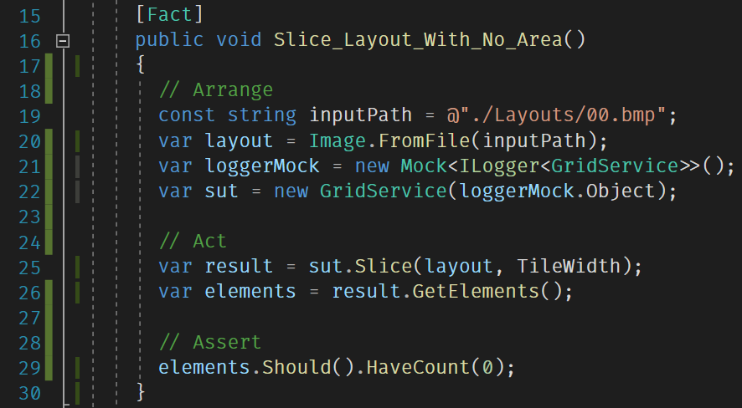
Notes:
Triple A’s

Slide 26
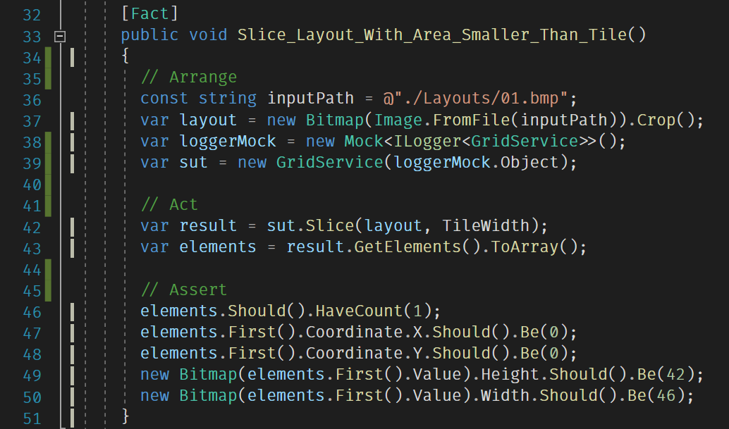
Notes:
Triple A’s

Slide 27
Sufficient Unit Tests
Peer Review
100% Code Coverage != No Bugs

Slide 28
Demo Changing Implementation Details
bool HasAnyColor(this Bitmap bitmap)
Bitmap Crop(this Bitmap bitmap)

Slide 29
Benefits
Confidence to make changes
Provides examples

Slide 30
Anti-patterns
Testing Implementation Details
Was this particular method called
Junk test cases
Should pay attention to edge cases
Testing non-branching logic
Testing external library

Slide 31
Recap
Triple A’s
Code to Interfaces & Inversion of Control
Single Responsibility Principle
Confidence to make changes

Slide 32

Kitchen Floor Update
Floor still not done

