Slide 1

AI Agentic Team
Architecture
Conceptual · Logical · Physical / Deployable
Shared skills · AKS deployment · Enterprise tool integration
Architecture Design Document

Slide 2


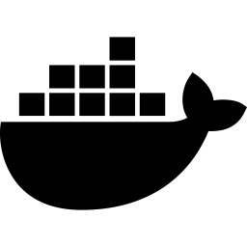



Agenda
Conceptual architecture
Business capabilities, agent roles, and shared skills model
Logical architecture
Components, skill registry, data flows, and service boundaries
Physical / deployable architecture
AKS cluster topology, namespaces, pods, and scaling
Skill reuse matrix
12 shared skills mapped across 6 agent roles
Permission & integration model
Agent-to-tool RBAC and MCP adapter patterns
Deployment considerations
HPA, network policy, workload identity, hot-reload

Slide 3





Conceptual architecture
Agent team roles and orchestration
Human-in-the-loop oversight
Orchestrator agent
Intent → plan → delegate → synthesise → report
BA / PO
Architect
Engineer
Requirements
Design & ADRs
Code & review
QA expert
Security expert
DevOps
Test & validate
Scan & audit
CI/CD & infra

Slide 4

Conceptual architecture
Reusable skill registry — composable, versioned, hot-pluggable
Skill registry
Code generation
Test generation
Security scanning
Doc authoring
TS · PY · Java · .NET
Unit · integ · e2e
SAST · CVE · secrets
ADR · runbook · API
KQL analytics
JIRA workflow
Git operations
Deploy & rollback
ADX log queries
Tickets · sprints
Branch · PR · review
Helm · K8s · canary
Observability
Requirement parse
Code review
Change mgmt
NewRelic · alerting
AC · BDD · stories
Style · perf · logic
ServiceNow CRs
Skills are versioned, composable units — agents compose, not duplicate
Any agent can invoke any skill it has been granted via RBAC policy
New skills added without redeploying agents — hot-pluggable registry
Human approval gates on high-risk skill invocations

Slide 5
Skill reuse matrix
Each cell shows how the agent uses the shared skill — same skill, different prompt/parameters
Skill | BA/PO | Architect | Engineer | QA | Security | DevOps | #
Code generation | — | Skeleton | Full impl | Test stubs | — | IaC | 4
Test generation | — | — | Unit tests | Full suites | Sec tests | — | 3
Git operations | — | ADRs | Branch+PR | Push tests | Scan PRs | Merge | 5
JIRA workflow | Create/edit | Read specs | Read tasks | Log defects | Block ticket | Read status | 6
KQL analytics | Usage data | — | — | Error rates | Anomalies | Deploy logs | 4
Security scan | — | — | Pre-commit | — | Full audit | Pipeline gate | 3
Doc authoring | Stories | ADRs | Inline docs | Test plans | Sec reports | Runbooks | 6
Deploy & rollback | — | — | — | — | — | Full access | 1
Observability | — | Baselines | — | Regression | Alert audit | SLO setup | 4
Change mgmt | — | — | — | — | — | CR creation | 1
Requirement parse | Refine ACs | Read ACs | Read ACs | Read ACs | — | — | 4
Code review | — | Design rev | Peer rev | Quality rev | Sec review | — | 4
Active grant
Reuse count

Slide 6

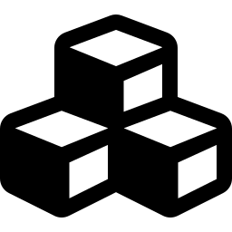
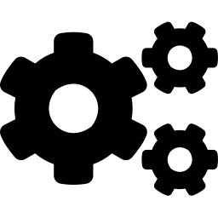
Logical architecture
Components, services, and data flows
Ingress layer
API gateway · webhooks · scheduler triggers
Orchestration service
Task planner · agent router · state machine · result synthesiser
Agent runtime pool
Agent container (persona + memory) · skill executor · MCP tool caller
Skill registry service
Skill catalog · RBAC policy engine · prompt templates · version control
Shared services
LLM gateway · vector DB · event bus · credential vault · audit sink
Tool adapters (MCP)
JIRA · GitHub · ServiceNow · ADX · NewRelic · AKS · CA Scheduler

Slide 7
Logical architecture
Agent container internals — how skills are resolved and executed
Agent container
Skill executor
MCP tool caller
LLM reasoning core
Skill resolver (gRPC)
Adapter registry
Persona (role prompt)
Sandboxed runtime
Auth shim (vault)
loads
skills
calls
tools
Conversation memory
I/O guard (validation)
Retry + circuit breaker
Task context window
Prompt template engine
Request/response audit
Skill resolution flow
Agent receives
task from orchestrator
Skill executor resolves
skill by name + version
RBAC engine validates
agent has grant
Prompt template loaded
with task context
Tool calls routed
via MCP adapters

Slide 8
Physical / deployable architecture
AKS cluster topology — ai-agent-platform
ns: agent-ingress
NGINX ingress · webhook receiver · Azure API Mgmt gateway
ns: agent-orchestration
Orchestrator pod (2 replicas) · Redis StatefulSet · Event broker (Kafka)
ns: agent-workers
6 agent pods with skill-executor + MCP-tool-caller sidecars + Envoy proxy
ns: agent-skills
Skill registry gRPC svc (3 replicas) · Azure Files PVC · PostgreSQL catalog
ns: shared-services
LiteLLM gateway · Qdrant vector DB · Azure Key Vault agent · Fluentd → ADX · NewRelic DaemonSet
ns: tool-adapters
jira-mcp · github-mcp · snow-mcp · adx-mcp · nr-mcp · aks-adapter · ca-sched

Slide 9
Physical architecture
Agent worker pod configurations
ba-po-agent
1 replica
architect-agent
1 replica
Runtime: Python 3.12
Runtime: Python 3.12
Skills: Requirement parse · JIRA workflow · KQL · Doc authoring
Skills: Code gen · Git ops · Doc authoring · Observability · Code review
sr-engineer
2 replicas (HPA)
qa-agent
1 replica
Runtime: Node 20 + Python 3.12
Runtime: Node 20 + .NET 8
Skills: Code gen · Git ops · Test gen · Security scan · Code review
Skills: Test gen · Git ops · KQL · Observability · Code review
sec-agent
1 replica
devops-agent
1 replica
Runtime: Python 3.12
Runtime: Python 3.12 + Helm
Skills: Security scan · Git ops · KQL · Test gen · JIRA workflow
Skills: Deploy · Git ops · Change mgmt · Observability · KQL
Each pod includes sidecars: skill-executor · MCP-tool-caller · Envoy proxy (mTLS service mesh)

Slide 10
Agent-to-tool permission matrix
Least-privilege RBAC — each agent scoped to minimum required operations
Agent | JIRA | GitHub | ServiceNow | AKS | ADX | NewRelic | CA Sched
BA / PO | R/W | Read | Read | — | Read | Read | Read
Architect | R/W | R/W | Read | — | Read | Read | —
Engineer | R/W | R/W | — | — | Read | — | —
QA expert | R/W | R/W | — | — | Read | Read | —
Security expert | Write | Read | — | — | Read | Read | —
DevOps | R/W | Approve | R/W | Approve | Read | R/W | R/W
R/W
Read
Write
Approve-gated
No access

Slide 11

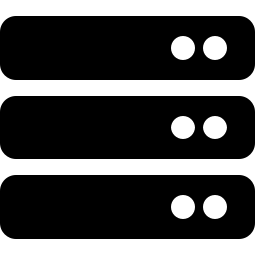


AKS deployment considerations
Horizontal pod autoscaling
Node pool strategy
Sr. Engineer pod scales 1→4 on CPU and message queue depth. Other agents stay at fixed 1–2 replicas. Skill registry at 3 replicas for availability.
System pool (orchestration + ingress), Worker pool (agent pods), GPU pool (optional — only if self-hosting LLM inference instead of API-based).
Network policy
Workload identity
Agent-workers → tool-adapters (allow). Agent-workers ↔ internet (deny). All external calls route through MCP adapter pods — single exit point.
Azure Workload Identity per namespace. Each namespace gets its own AAD identity with least-privilege access to Azure resources (Key Vault, ADX, AKS API).
Skill hot-reload
Observability & audit
Skill registry pushes updates over gRPC stream. Agent pods pick up new versions on next skill resolution — no pod restart needed. Blue-green for major versions.
NewRelic DaemonSet for APM on all pods. Fluentd sidecar ships every tool call (input, output, latency, agent ID) to ADX for full audit lineage.

Slide 12
Summary & next steps
6 specialised agents
BA/PO, Architect, Sr. Engineer, QA, Security, DevOps — coordinated by a supervisor orchestrator
12 reusable skills
Versioned, composable capabilities shared across agents via a centralised skill registry with RBAC
7 enterprise tool integrations
JIRA, GitHub, ServiceNow, ADX, NewRelic, AKS, CA Scheduler — connected via MCP adapters
Production-grade AKS deployment
6 namespaces, HPA scaling, network policies, workload identity, mTLS service mesh
Next steps
1. Define skill schemas and build initial skill catalog (sprint 1)
2. Stand up AKS cluster with namespace isolation and network policies (sprint 1–2)
3. Implement orchestrator + 2 pilot agents (BA/PO, Sr. Engineer) with JIRA + GitHub adapters (sprint 2–3)
4. Expand to full 6-agent team with all MCP adapters and approval gates (sprint 4–6)

