Slide 1


Slide 2

*All data and code can be found on my GitHub*

Slide 3
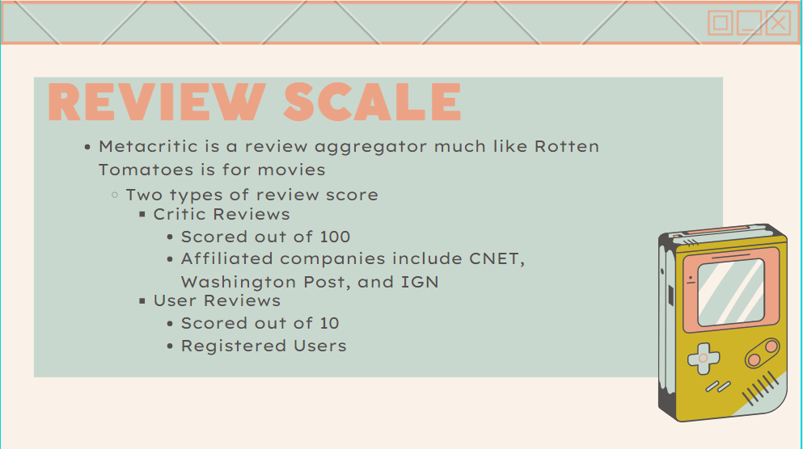

Slide 4


Slide 5
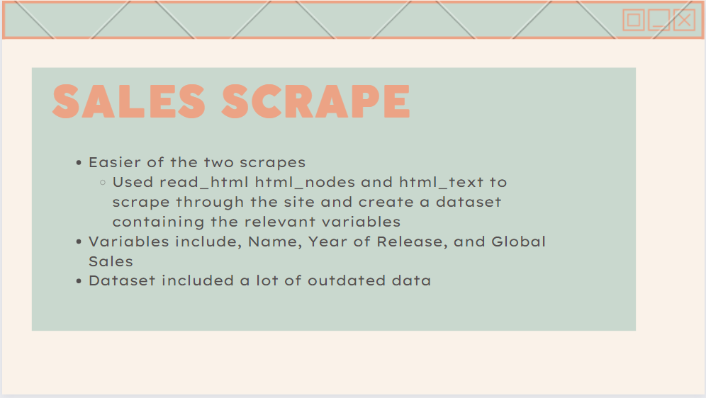

Slide 6
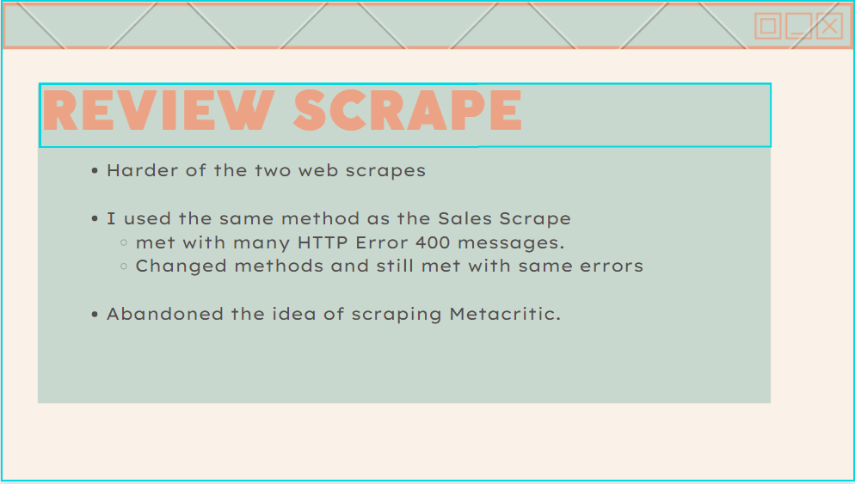

Slide 7
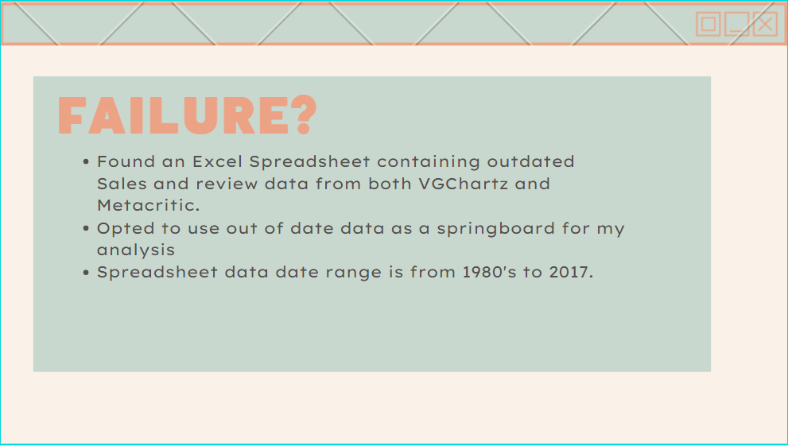

Slide 8
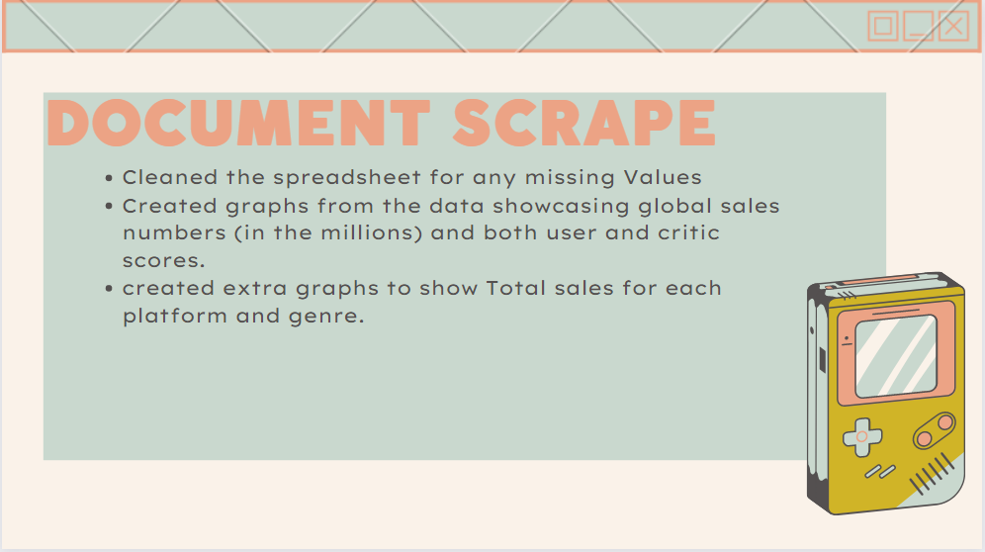

Slide 9
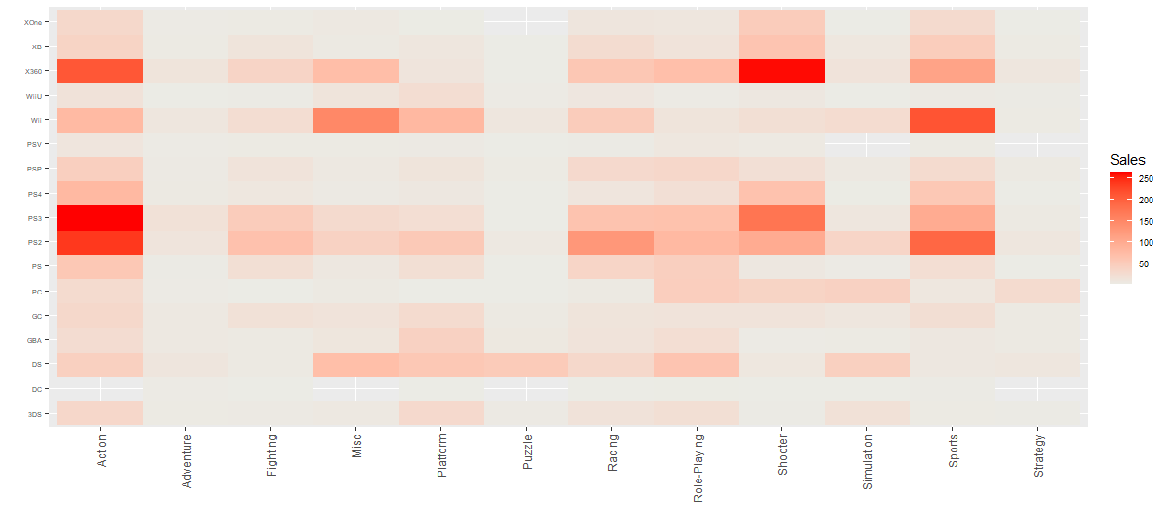
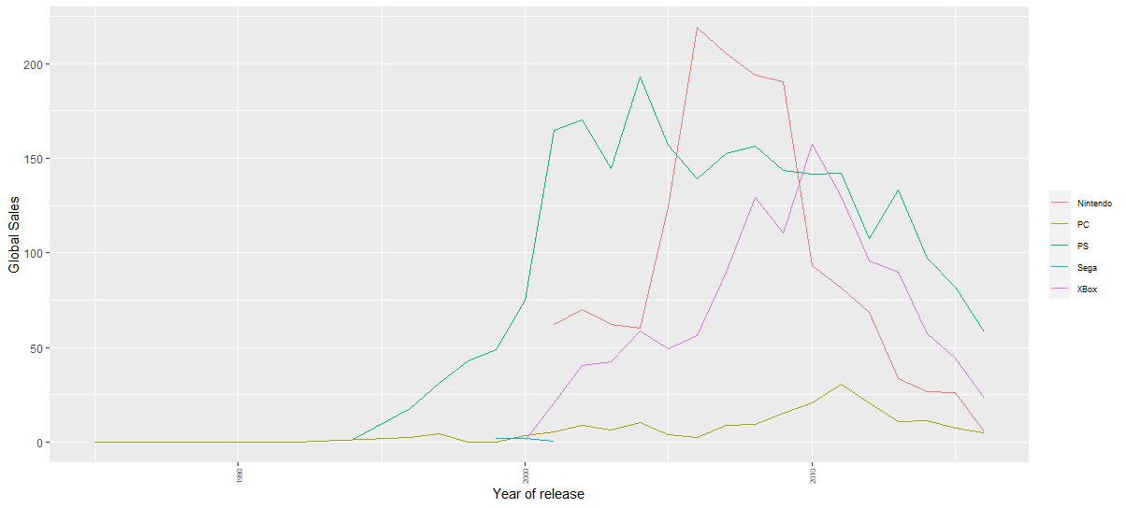
Global Sales per Year per Platform
Nintendo console titles exceed sales of PlayStation and Xbox titles
Games sales peaked between the years 2004-2010 for the 3 main consoles (PS, Xbox, Nintendo)
Sales of Titles per Genre per Platform
We see that Action, Sports, and Shooters were the more prevalent Genres in the data set

Slide 10
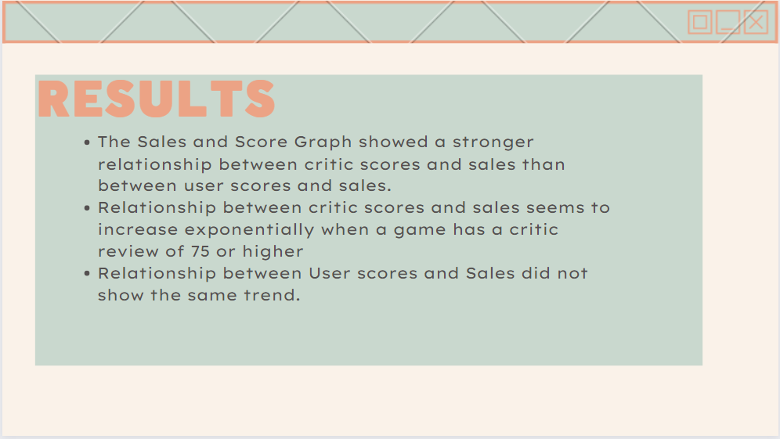

Slide 11
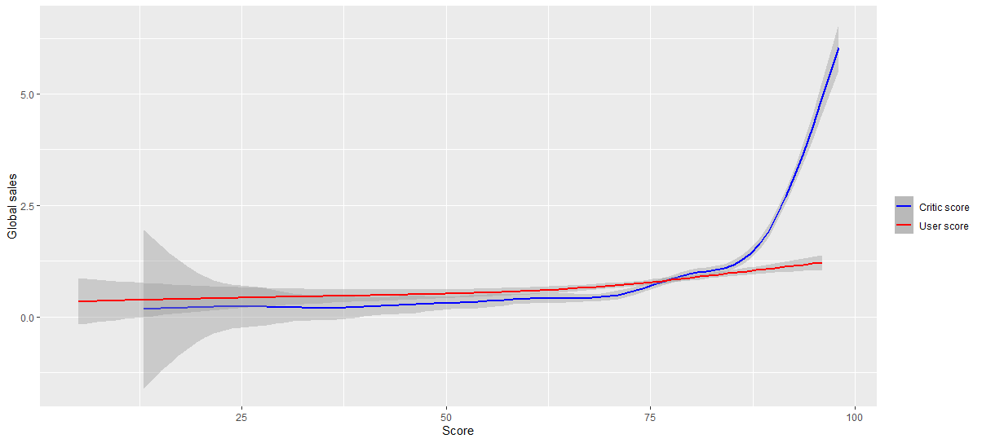
Sales & Score Graph

Slide 12
Future Scraping
Find a way to scrape metacritic for data after 2017
See if the trend of critic scores affecting global sales more than user scores continues
Analyze the trend of genres throughout the years.
Is there a certain genre that dominates Global Sales throughout the years?

