Slide 1
BFS and DFS
19th Sep tutorial

Slide 2
Agenda
Graph
Represent graph in programming language
DFS
BFS

Slide 3
Graph
Graph is a mathematical structure used to represent a set of objects and the relationships between them
Graphs are composed of vertices (also called nodes) and edges. Each edge connects two vertices and indicates that there is some relationship between the two vertices.
Mathematical representation of graph → G=(V,E) where V is a set of vertices (or nodes), E is the set of edges

Slide 4
Graph types
Undirected Graph :Each edge e is an unordered pair of vertices (u, v), where u, v belongs to V. This means that the edges (u, v) and (v, u) are considered the same.
Directed Graph
Weighted Graph :There is usually a weight function, w :E → R, maps each edge to a real number (weight). Therefore, the weighted graph can be expressed as a triple G = ( V, E, w).
Unweighted Graph

Slide 5
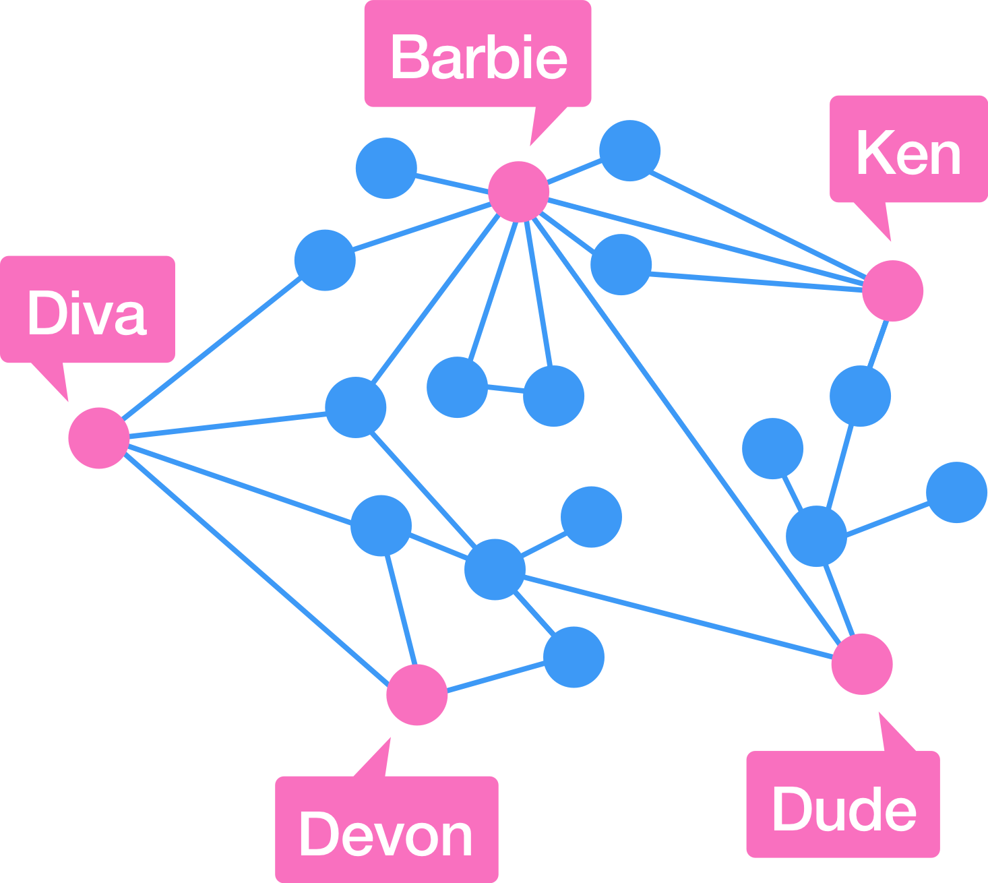
Graph example - Social network
In social networks (such as Facebook, Twitter, etc.), each person can be used as a vertex, and the friend relationship or follower relationship can be used as an edge. In this way, the entire social network can be represented by a graph.
Vertex: User
Edge: Friend relationship or following relationship

Slide 6
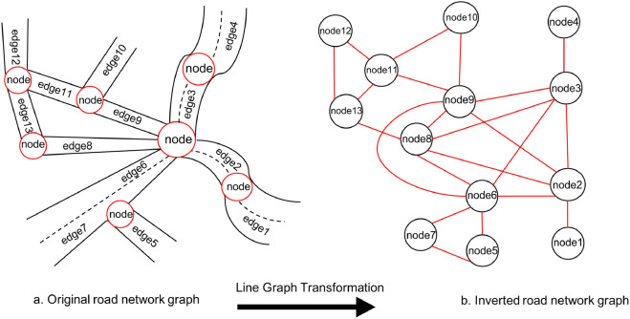
Traffic Network
In a transportation network (such as road, rail, or air), intersections, stations, or airports can serve as vertices, and roads, tracks, or routes can serve as edges.
Vertex: city or station
Side: road or route
Edge weight: distance or time

Slide 7
Graph representation in programming language
Adjacency List → a data structure to represent graph
In an adjacency list, each vertex has a list associated with it that contains all the other vertices connected to that vertex.
Example #1 adjacency list

Slide 8
BFS
BFS implements "breadth-first" traversal by prioritizing all adjacent unvisited nodes when expanding the search path.
1. Start at a starting vertex, mark it as visited, and put it into a queue.
2. Remove a vertex from the front of the queue.
3. Check all unvisited neighbors of this vertex.
4. Mark all unvisited neighbors as visited and enqueue them.
5. Repeat steps 2–4 until the queue is empty.

Slide 9
DFS
Unlike Breadth-First Search (BFS), DFS first accesses a child node of a node, and then accesses the child nodes of that child node, and so on until it reaches a certain leaf node, and then backtracks
1. Starting from the starting node (source node), mark the node as visited.
2. Find unvisited neighbor nodes of the current node.
3. If an unvisited neighbor node is found, go to that neighbor node and repeat steps 1 and 2.
4. If the current node has no unvisited neighbor nodes, backtrack to the previous node.
5. Repeat steps 2-4 until all visited nodes are traversed.

