Slide 1
Please read the instructions carefully.

Slide 2

This is Bob, he’s an engineer.
His job is to perform maintenance on several factories.

Slide 3
In this task you will watch Bob move around several factories.
You will have to figure out what the maintenance procedure is for that factory.

Slide 4
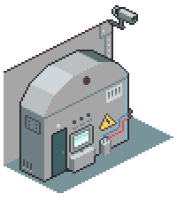
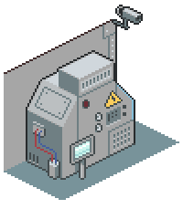
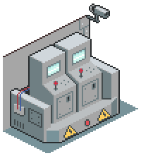
Bob maintains factories by accessing these machines.
For every factory, Bob knows where to find each machine.
A
B
C

Slide 5
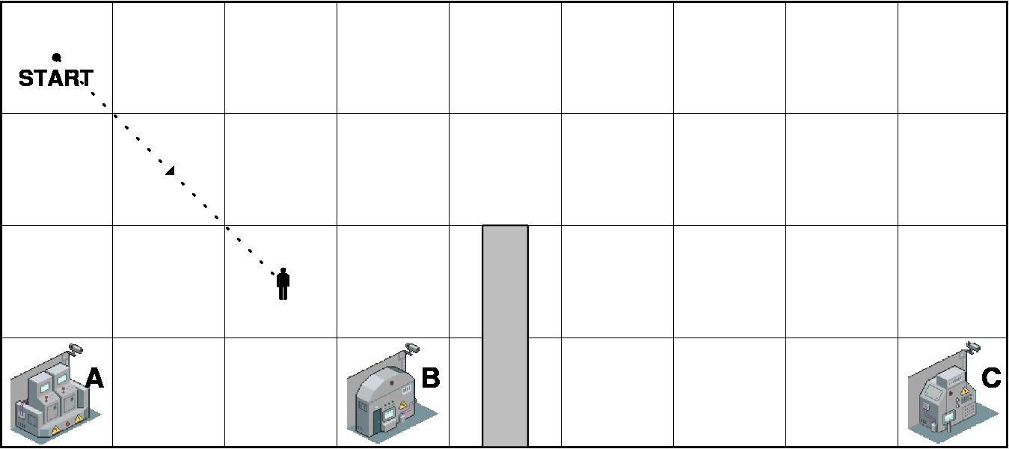

Here’s one example of Bob at the factory:
The indicates Bob’s starting point.
The indicates Bob’s path.
The indicates Bob’s last location.
The gray bar is a wall.

Slide 6
Factories have many kinds of maintenance procedures.

Slide 7
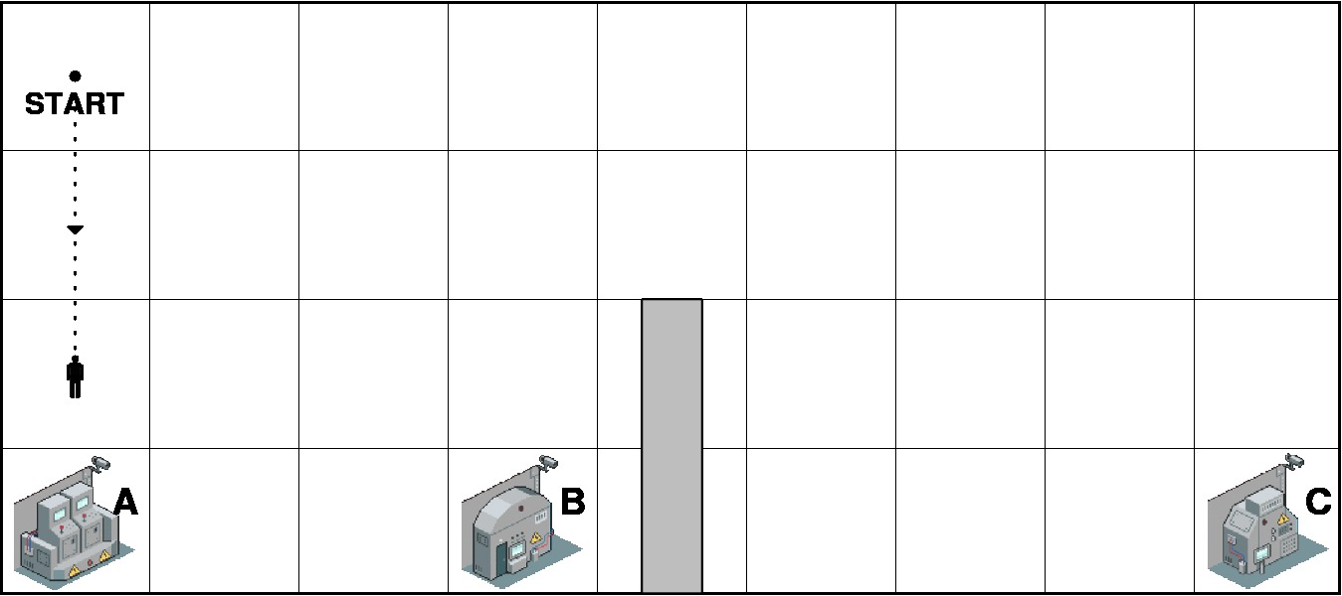
Example 1: Bob can perform maintenance by accessing any machine.

Slide 8
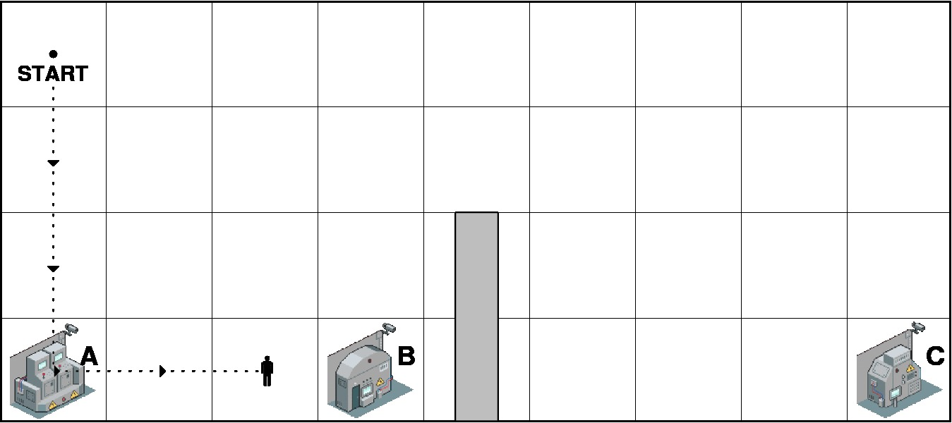
Example 2: Bob needs to access machine A and then B, in that order.

Slide 9
Example 3: Bob needs to access machines A and B, in any order.

Slide 10
Sometimes, a factory has two rooms.
But thankfully, all rooms in a factory share the same maintenance procedure.

Slide 11
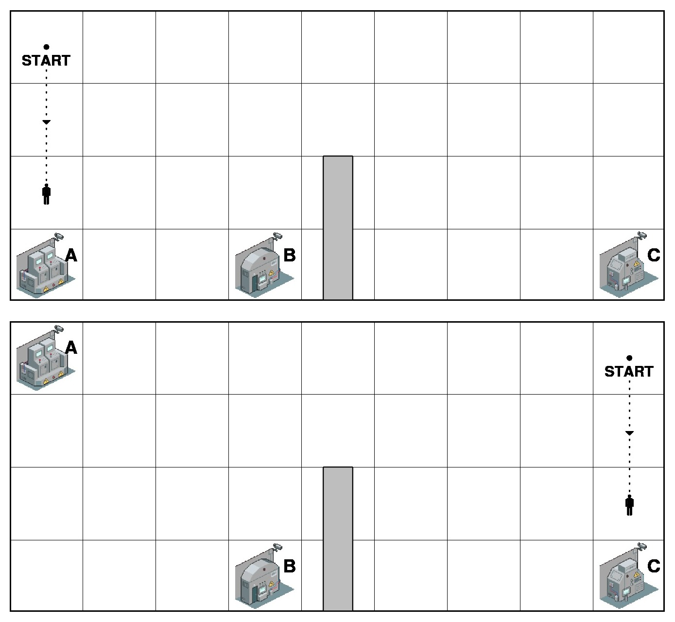
Example 1: Bob needs to access either machine A or C.

Slide 12
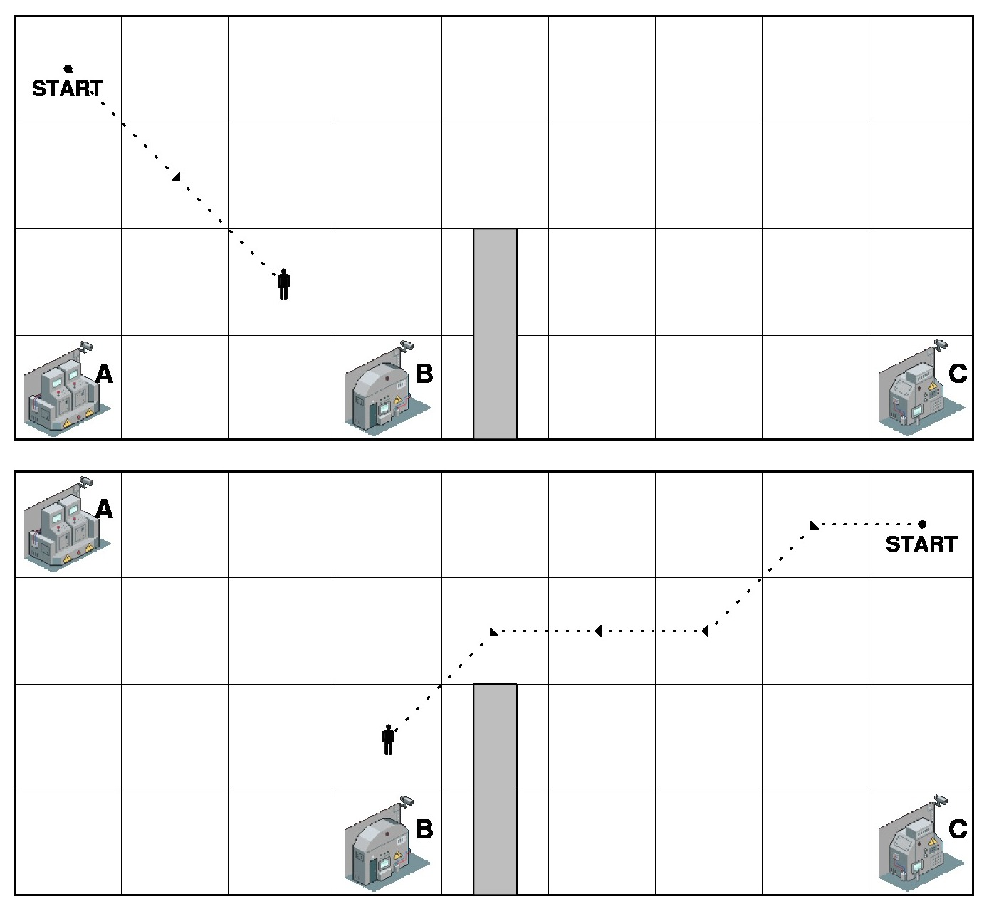
Example 2: Bob needs to access machine B.

Slide 13
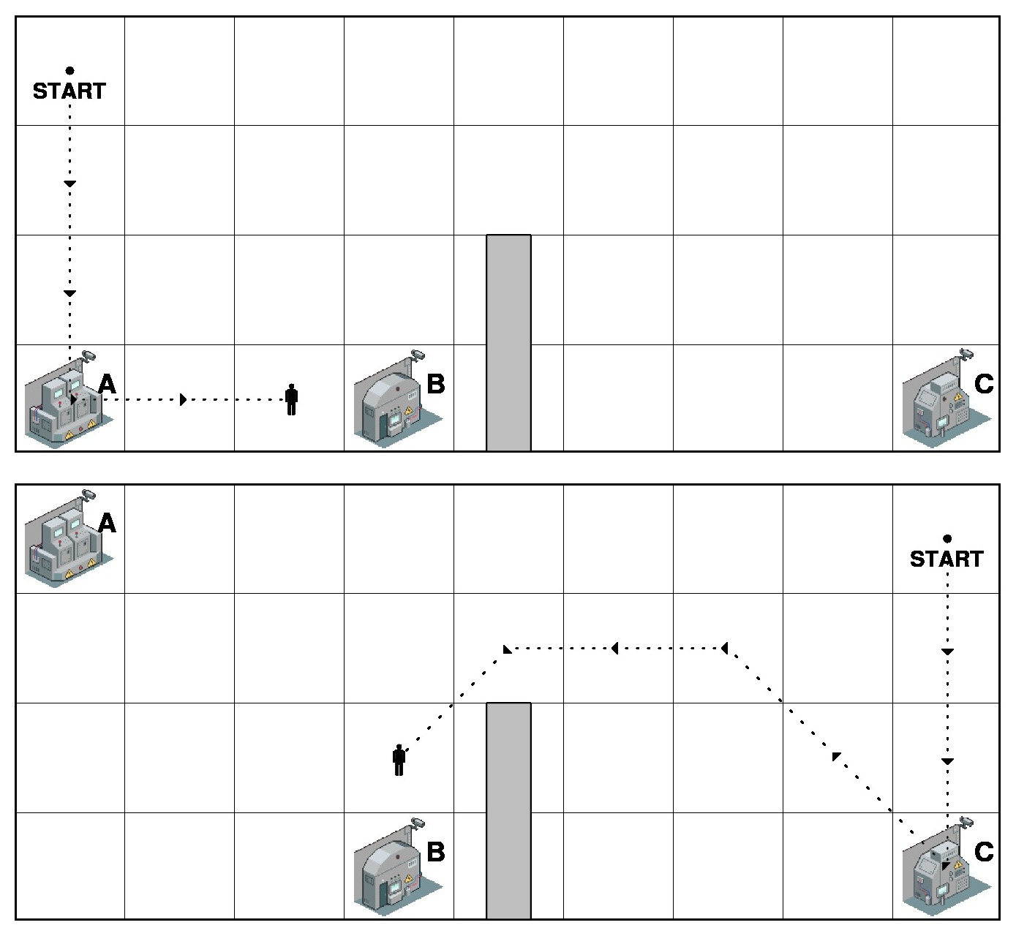
Example 3: Bob needs to access either machine A or C, and then machine B.

Slide 14
You will be shown images similar to what you’ve just seen, showing part of Bob’s maintenance procedure.
And you will be asked to rate a set of descriptions about what the maintenance procedure is for that factory.

