Slide 1
CS 6349 - Network Security
Cryptography

Slide 2
Intro to cryptography
The uses of cryptography
  Privacy
    Transmitting secret data over an insecure channel
    Storing secret data on an insecure media
  Message integrity
  Authentication
Cryptography vs cryptanalysis
  Cryptography – involves both algorithms and secret value (key)
  Cryptanalysis – involves algorithms, sample plain/crypto text
plaintext/
cleartext
encryption
ciphertext
decryption
plaintext/
cleartext
key
key

Slide 3
Intro to cryptography
How secure a crypto algorithm is?
  Not impossible to break
  Depends on how much effort it takes to break
  Can be made more secure by using longer keys
Crypto algorithms – to publish or not to publish?
  Keeping it secret helps – if others don’t know it !!!
  Publishing it helps
    If good people breaks it, you get to know about it (free testing service)
    Bad guys will learn the algorithm anyway
  Today
    most commercial algorithms are published and
    most military algorithms are not

Slide 4
Breaking an encryption scheme
Ciphertext only attacks
  Try out all keys to decrypt the ciphertext
  Need to be able to distinguish cleartext from gibberish
Known plaintext attacks
  Knowing a few <plaintext, ciphertext> pairs can help mapping of plaintext letters to ciphertext letters enabling decryption of messages
Chosen plaintext attacks
  Attacker chooses a plaintext and system tells him back the corresponding ciphertext
A cryptosystem should protect against all of these types of attacks

Slide 5
Classification of crypto systems
Type of operations during transformation
  Substitutions vs permutations
Number of keys used
  Symmetric / single key / secret key systems
  Asymmetric / two-key / public key systems
Mode of plaintext processing
  Block cipher – one block (e.g., 64-bits) at a time
  Stream cipher – continuous, no block definition
Types of cryptographic functions
  Secret key functions – use one key
  Public key functions – use two keys
  Hash functions – use zero or more keys

Slide 6
Secret key cryptography
plaintext/
cleartext
encryption
ciphertext
decryption
plaintext/
cleartext
key
Security uses of secret key crypto
  Encryption for privacy
    Transmitting over an insecure channel
    Storing on an insecure media
Authentication
  Alice and Bob shares a secret key K_{AB} to verify each other
Integrity check
plaintext/
cleartext
r_{A}
Generate
MAC
Verify
MAC
Alice
Bob
MAC
K_{AB}{r_{A}}
r_{B}
key
K_{AB}{r_{B}}

Slide 7
Public key cryptography
Two keys per user: private and public keys
  Reverse the effect of each other
Security uses of public key crypto
  Encryption for privacy
  Digital signature/integrity
  Public key authentication
  Non-repudiation
    A msg signed by Alice’s private key proves that it is from Alice
    Difficult to achieve with secret key crypto
A
B_{public key}
B_{private key}
B
plaintext
ciphertext
plaintext
A
B
plaintext
Generate
Signature
Signature
Verify
Signature
Alice
I am Alice
Bob
A_{private key}
A_{public key}
knows her
private key
If so, decrypt {R}A_{public}
knows Alice’s
public key
_{R}

Slide 8
Hash algorithms (msg digest functions)
A mathematical transformation from an arbitrary size message to a fixed-length (short) number
  Easier to compute m → d(m)
  Very difficult to compute d(m) → m
  For m₁ → d(m₁), difficult to find m₂ s.t. d(m₁)=d(m₂)
Message integrity using hash functions
m
digest
d(m)
Alice
msg | d(msg)
Bob
Alice
msg | d(msg|secret)
Bob
No good!
Good!

Slide 9
Combining crypto funct’s for performance
Public key crypto too slow compared to hashes and secret key crypto
Public key crypto more convenient and secure in setting up keys
Algorithms can be combined to improve performance
  Hybrid encryption
  Hybrid signature
  Signed and encrypted message – how to do it???
Message
vs
K: a random number
+
Message
Encrypt with Alice’s public key
Encrypt with Alice’s public key
Encrypt with secret key K
Message
vs
Message
+
Digest(Message)
Signed with Bob’s private key
Signed with Bob’s private key
Notes:
Signed and encrypted message: Encrypt a K with Alice’s public key + Encrypt with K { Message + Sign w/ Bob’s private key {Digest(Message)} }

Slide 10
More definitions
Unconditional security
  no matter how much computer power or time is available, the cipher cannot be broken since the ciphertext provides insufficient information to uniquely determine the corresponding plaintext
Computational security
  given limited computing resources (eg time needed for calculations is greater than the age of the universe), the cipher cannot be broken

Slide 11
Brute force search
Always possible to simply try every key
Most basic attack, proportional to key size
Assume either know / recognise plaintext
Key Size (bits) | Number of Alternative Keys | Time required at 1 decryption/µs | Time required at 10⁶ decryptions/µs
32 | 2³² = 4.3 × 10⁹ | 2³¹ µs = 35.8 minutes | 2.15 milliseconds
56 | 2⁵⁶ = 7.2 × 10¹⁶ | 2⁵⁵ µs = 1142 years | 10.01 hours
128 | 2¹²⁸ = 3.4 × 10³⁸ | 2¹²⁷ µs = 5.4 × 10²⁴ years | 5.4 × 10¹⁸ years
168 | 2¹⁶⁸ = 3.7 × 10⁵⁰ | 2¹⁶⁷ µs = 5.9 × 10³⁶ years | 5.9 × 10³⁰ years
26 characters (permutation) | 26! = 4 × 10²⁶ | 2 × 10²⁶ µs = 6.4 × 10¹² years | 6.4 × 10⁶ years

Slide 12
Secret (Symmetric) Key Crypto

Slide 13

Secret (symmetric) key crypto

Slide 14
Requirements
Two requirements for secure use of symmetric encryption:
  A strong encryption algorithm
  A secret key known only to sender / receiver
Mathematically have:
  Y = E_{K}(X)
  X = D_{K}(Y)
Assume encryption algorithm is known (by all)
Implies a secure channel to distribute key

Slide 15
Classical substitution ciphers
Where letters of plaintext are replaced by other letters or by numbers or symbols
Or, if plaintext is viewed as a sequence of bits, then substitution involves replacing plaintext bit patterns with ciphertext bit patterns

Slide 16
Caesar cipher
Earliest known substitution cipher
Used by Romans in military affairs
Replaces each letter by 3rd letter on
Example:
    meet me after the toga party
    PHHW PH DIWHU WKH WRJD SDUWB

Slide 17
Caesar cipher
Can define transformation as:
  a b c d e f g h i j k l m n o p q r s t u v w x y z
  D E F G H I J K L M N O P Q R S T U V W X Y Z A B C
Mathematically give each letter a number
  a b c d e f g h i j k l m n o p q r s t u v w x y z
  0 1 2 3 4 5 6 7 8 9 10 11 12 13 14 15 16 17 18 19 20 21 22 23 24 25
Then have Caesar cipher as:
    c = E(p) = (p + k) mod (26)
    p = D(c) = (c – k) mod (26)

Slide 18
Cryptanalysis of Caesar cipher
Only have 26 possible ciphers
  A maps to A, B, ..., Z
Could simply try each in turn
  A brute force search
  Given ciphertext, just try all shifts of letters
Do need to recognize when have plaintext
E.g., break ciphertext "GCUA VQ DTGCM"

Slide 19
Mono-alphabetic cipher
Rather than just shifting the alphabet
  Could shuffle the letters arbitrarily
Each plaintext letter maps to a different random
  ciphertext letter
  Hence key is 26 letters long
  Plain: abcdefghijklmnopqrstuvwxyz
  Cipher: DKVQFIBJWPESCXHTMYAUOLRGZN
  Plaintext: ifwewishtoreplaceletters
  Ciphertext: WIRFRWAJUHYFTSDVFSFUUFYA

Slide 20
Mono-alphabetic cipher security
Now have a total of 26! = 4 x 10²⁶ keys
With so many keys, might think is secure
But would be !!!WRONG!!!
Problem is…
  language characteristics

Slide 21
Language redundancy and cryptanalysis
Letters in an alphabet are not equally commonly used
In English, E is by far the most common letter
  Followed by T, R, N, I, O, A, S
Other letters like Z, J, K, Q, X are fairly rare
Have tables of single, double & triple letter frequencies for various languages

Slide 22

English letter frequencies

Slide 23
Use in cryptanalysis
Key concept:
  Mono-alphabetic substitution ciphers do not change relative letter frequencies
Discovered by Arabian scientists in 9th century
Calculate letter frequencies for ciphertext
Compare counts/plots against known values
Look for common peaks/troughs
  Peaks at: A-E-I triple, NO pair, RST triple
  Troughs at: JK, X-Z
For mono-alphabetic, must identify each letter
  Tables of common double/triple letters help

Slide 24
Example cryptanalysis
Given ciphertext:
  UZQSOVUOHXMOPVGPOZPEVSGZWSZOPFPESXUDBMETSXAIZ
  VUEPHZHMDZSHZOWSFPAPPDTSVPQUZWYMXUZUHSX
  EPYEPOPDZSZUFPOMBZWPFUPZHMDJUDTMOHMQ
Count relative letter frequencies
Guess P & Z are e and t
Guess ZW is th and hence ZWP is the
Proceeding with trial and error finally get:
  it was disclosed yesterday that several informal but
  direct contacts have been made with political
  representatives of the viet cong in moscow

Slide 25
Poly-alphabetic ciphers
Each occurrence of a character may have a different substitute. One-to-many relation of characters in plaintext vs ciphertext
Avoids language frequency based attacks
Substitution depends on the plaintext character and its location in the text
Examples:
  Fairplay cipher (used in WW I and WW II)
  Vigenere cipher
  Autokey cipher

Slide 26
Vigenere cipher – an example poly-alph. cipher
Use a key stream of length 1≤ m ≤ 26 and repeat
P=P₁P₂P₃… C=C₁C₂C₃…
K=[(k₁,k₂,…,k_{m}), (k₁,k₂,…,k_{m}),…]
Encryption: C_{i}=(P_{i}+k_{i}) mod 26
Decryption: P_{i}=(C_{i}-k_{i}) mod 26
Example
  Key stream: PASCAL -- 6 characters long secret key
  Plaintext: “SHE IS LISTENING”
  Key: “PAS CA LPASCALPA”
  C₁=(S+P) mod 26 = (18+15) mod 26 = 7 = H
  C₂ = (H+A) mod 26 = (7+0) mod 26 = 7 = H
  C₃ = (E+S) mod 26 = (4+18) mod 26 = W
  C₄ = (I+C) mod 26 = (8+2) mod 26 = K
  …

Slide 27
One-time pad
If a truly random key as long as the message is used, the cipher will be secure
Called a one-time pad
Is unbreakable
  Ciphertext bears no statistical relationship to the plaintext
Problems in generation & safe distribution of key

Slide 28
Transposition Ciphers
Now consider classical transposition or permutation ciphers
These hide the message by rearranging the letter order
Without altering the actual letters used

Slide 29
Rail Fence cipher
Write message letters out diagonally over a number of rows
Then read off cipher row by row
E.g., write message out as:
  m e m a t r h t g p r y
  e t e f e t e o a a t
Giving ciphertext
  MEMATRHTGPRYETEFETEOAAT

Slide 30
Product Ciphers
Ciphers using substitutions or transpositions are not secure because of language characteristics
Hence consider using several ciphers in succession to make it harder:
  Two substitutions make a more complex substitution
  Two transpositions make more complex transposition
  But a substitution followed by a transposition makes a new much harder cipher
This is bridge from classical to modern ciphers

Slide 31
Modern Secret Key Crypto

Slide 32
Modern secret key crypto techniques
Block vs. stream ciphers
  Block ciphers: process messages in blocks, each of which is then en/decrypted like a substitution on very big characters
    64-bits or more
  Stream ciphers: process messages a bit or byte at a time when en/decrypting
  Many current ciphers are block ciphers
  Broader range of applications

Slide 33
Block cipher encryption algorithms
Key size
  If too short, then easy to guess
Block size
  If too short, easy to build <plaintext, ciphertext> table by attacker
  If too long, requires huge space to store mapping table
  Reasonable size: 64 or 128-bit blocks
Provides one-to-one mapping that looks like random w/o knowing the key
Implemented using
  Substitutions – specifies for each of 2^{k} possible input, k-bit output
    Takes about k ⋅ 2^{k} bits space to store the mapping info
  Permutations – specifies, for each of k input bit, the output bit it maps to
    Takes about k ⋅ log₂k bits

Slide 34
A sample block encryption
64-bit input
8 bits
8 bits
8 bits
8 bits
8 bits
8 bits
8 bits
8 bits
8-bit
substitutions
S₁
S₂
S₃
S₄
S₅
S₆
S₇
S₈
8 bits
8 bits
8 bits
8 bits
8 bits
8 bits
8 bits
8 bits
64-bit intermediate
64-bit
permutation
64-bit output

Slide 35
Data Encryption Standard (DES)
Was most widely used block cipher in the world
Adopted in 1977 by NBS (now NIST)
  As FIPS PUB 46
Encrypts 64-bit data using 56-bit key
Had widespread use
Had considerable controversy over its security

Slide 36
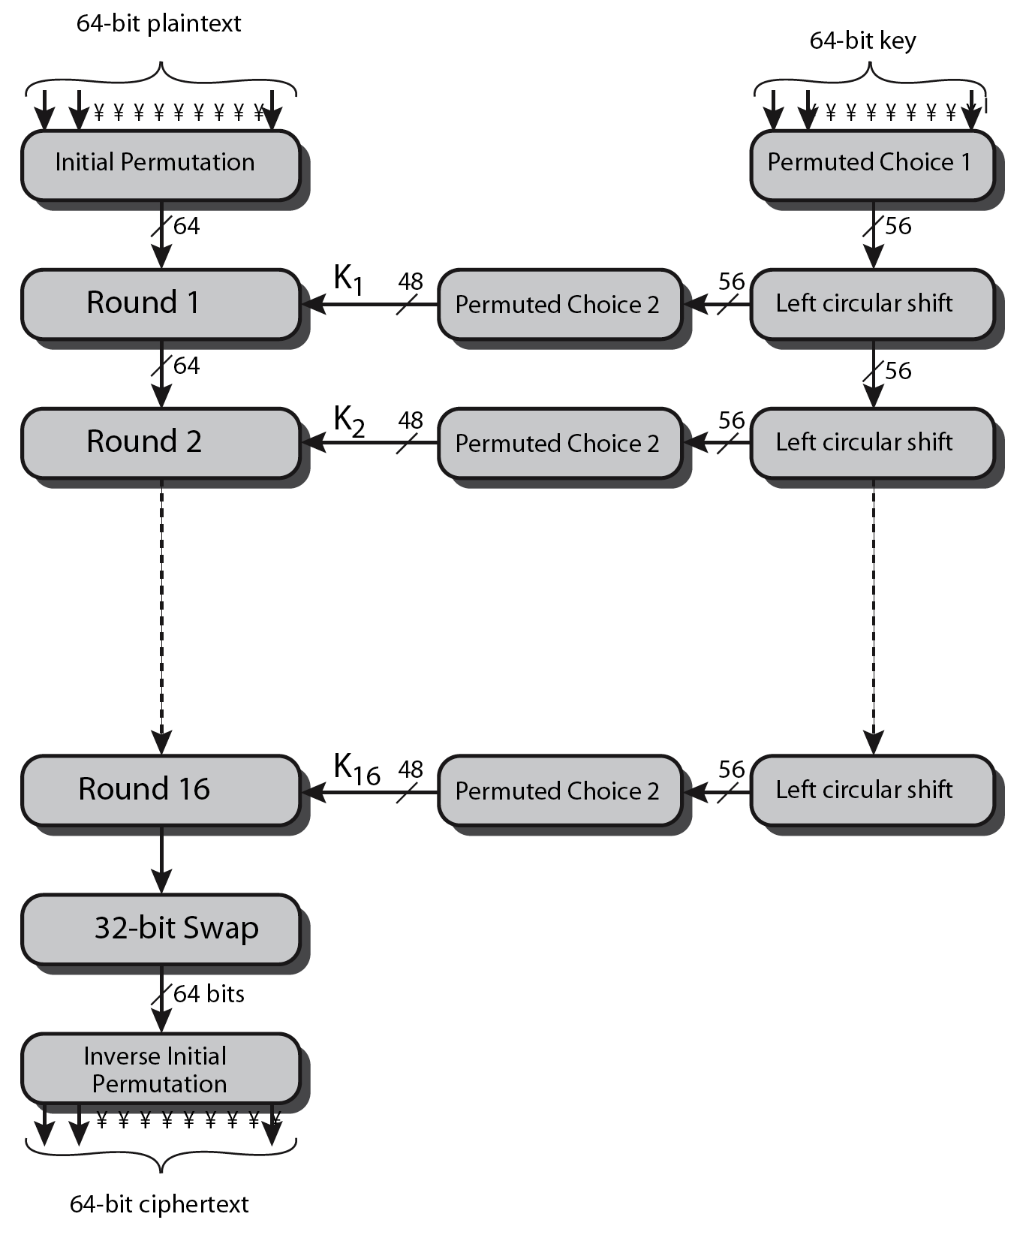
DES encryption overview

Slide 37
Avalanche effect
Key desirable property of an encryption algorithm
Changing one input or key bit results in changing approx. half output bits
Making attempts to “home-in” by guessing keys impossible
DES exhibits strong avalanche

Slide 38
DES contraversies
Design process was not made public
  Any hidden trapdoors?
56-bit keys too short
  Is it so that NSA can break it?
Designed for hardware and slow in software
  Independently developed, fast-in-software cipher needed (in late 1980s)

Slide 39
Strength of DES – Key size
56-bit keys have 2⁵⁶ = 7.2 x 10¹⁶ values
First, brute force search looked hard
Later on, advances have shown that it is possible
  In 1997 on Internet in a few months
  In 1998 on dedicated h/w (EFF) in a few days
  In 1999 above combined in 22hrs!
Still must be able to recognize plaintext
Must now consider alternatives to DES

Slide 40
Multiple Encryption & DES
Clear a replacement for DES was needed
  Theoretical attacks that can break it
  Demonstrated exhaustive key search attacks
AES is a new cipher alternative
Prior to AES, the alternative was to use multiple encryption with DES implementations
Triple-DES is the chosen form

Slide 41
Double-DES?
Could use 2-DES encrypts on each block
  C = E_{K2}(E_{K1}(P))
Can have “meet-in-the-middle” attack
  Since X = E_{K1}(P) = D_{K2}(C)
  Attack by encrypting P with all keys and store
  Then decrypt C with keys and match X value
  Can show takes O(2⁵⁶) steps
    A similar attack on DES takes 2⁵⁵ steps only

Slide 42
Triple-DES with two-keys
Hence must use 3 encryptions
  Would seem to need 3 distinct keys
But can use 2 keys with E-D-E sequence
  C = E_{K1}(D_{K2}(E_{K1}(P)))
  Number of encrypt & decrypt equivalent in security
  Three times slower than DES
Standardized in ANSI X9.17 & ISO8732
No current known practical attacks

Slide 43
Triple-DES with three-keys
Although there are no practical attacks on two-key Triple-DES, there are some indications
Can use Triple-DES with 3 keys to avoid even these
  C = E_{K3}(D_{K2}(E_{K1}(P)))
Has been adopted by some Internet applications, e.g., PGP, S/MIME

Slide 44
AES (Advanced Encryption Standard)
Clear a replacement for DES was needed
  Have theoretical attacks that can break it
  Have demonstrated exhaustive key search attacks
Triple-DES – but slow, has small blocks
US NIST issued call for ciphers in 1997
  15 candidates accepted in Jun 98
  5 were shortlisted in Aug-99
  Rijndael was selected as the AES in Oct-2000
  Issued as FIPS PUB 197 standard in Nov-2001

Slide 45
AES requirements
Secret key symmetric block cipher
128-bit data, 128/192/256-bit keys
Stronger & faster than Triple-DES
Provide full specification & design details
Both C & Java implementations
NIST have released all submissions & unclassified analyses

Slide 46
The AES cipher - Rijndael
Designed by Rijmen-Daemen in Belgium
Has a variety of block and key sizes
  128/160/192/224/256 bit keys and data
An iterative rather than feistel cipher
  Processes data as block of 4 columns of 4 bytes
  Operates on entire data block in every round
Designed to be:
  Resistant against known attacks
  Speed and code compactness on many CPUs
  Design simplicity

Slide 47
Modes of Operation

Slide 48
Modes of Operation
How to encrypt messages larger than 64-bits?
Block ciphers encrypt fixed size blocks
  E.g., DES encrypts 64-bit blocks with 56-bit key
Need some way to en/decrypt arbitrary amounts of data in practise
ANSI X3.106-1983 Modes of Use (now FIPS 81) defines 4 possible modes
Subsequently 5 defined for AES & DES
Have block and stream modes

Slide 49
Electronic Codebook Book (ECB)
Message is broken into independent blocks which are encrypted
Each block is a value which is substituted, like a codebook, hence the name
Each block is encoded independently of the other blocks
  C_{i} = DES_{K1}(P_{i})
Uses: secure transmission of single values

Slide 50
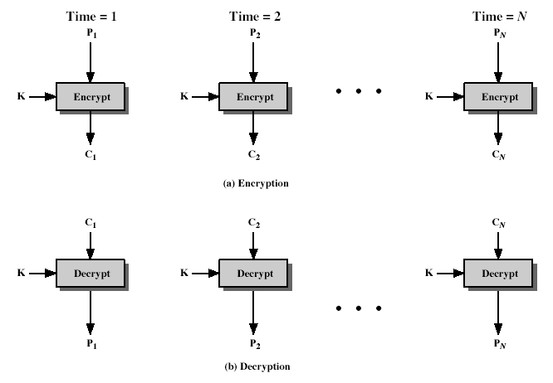
Electronic Codebook Book (ECB)

Slide 51
Advantages and Limitations of ECB
Propagation error in a ciphertext block does not affect the other ciphertext blocks
Can modify a block of ciphertext stored in a disk without needing to modify all other blocks
Message repetitions may show in ciphertext
  If aligned with message block
  Particularly with data such as graphics
  Or with messages that change very little, which become a code-book analysis problem
Weakness is due to the encrypted message blocks being independent
Main use is sending a few blocks of data

Slide 52
Cipher Block Chaining (CBC)
Message is broken into blocks
Linked together in encryption operation
Each previous cipher block is chained with current plaintext block, hence the name
Use Initial Vector (IV) to start process
  C_{i} = DES_{K1}(P_{i} XOR C_{i-1})
  C₋₁ = IV
Uses: bulk data encryption, authentication

Slide 53
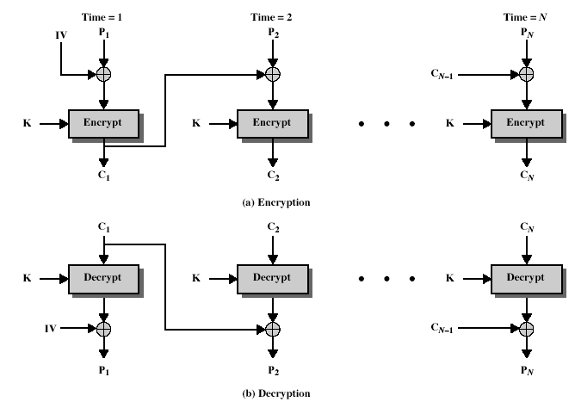
Cipher Block Chaining (CBC)

Slide 54
Advantages and Limitations of CBC
A ciphertext block depends on all blocks before it
  If you modify a plaintext block, you need to re-do CBC on the rest as it causes change to all following
Any change to a ciphertext during the transit affects the corresponding plaintext and the next one at the receiver
Need Initialization Vector (IV)
  Which must be known to sender & receiver
  If sent in clear, attacker can change bits of first block, and change IV to compensate
  Hence IV must either be a fixed value
  OR must be sent encrypted in ECB mode before rest of message

Slide 55
An attack on CBC: Modify ciphertext
Changing a ciphertext block C_{i} to C’_{i} would cause a change in P_{i+1} which may be desired by the attacker
  But would also cause P_{i} to map to a random 64-bit string where attacker have no control over – D{C’_{i}} XOR C_{i-1} may be anything
Append a 64-bit CRC to the message to detect modify attacks
  Decrypted message should pass CRC check to verify tamper proof message content

Slide 56
Output FeedBack (OFB) – stream cipher
Message is treated as a stream of bits
Output of cipher is added/XORed to message
Output is then feed back (hence name)
Feedback is independent of message
Can be computed in advance
  C_{i} = P_{i} XOR O_{i}
  O_{i} = DES_{K1}(O_{i-1})
  O₋₁ = IV
Uses: stream encryption on noisy channels

Slide 57
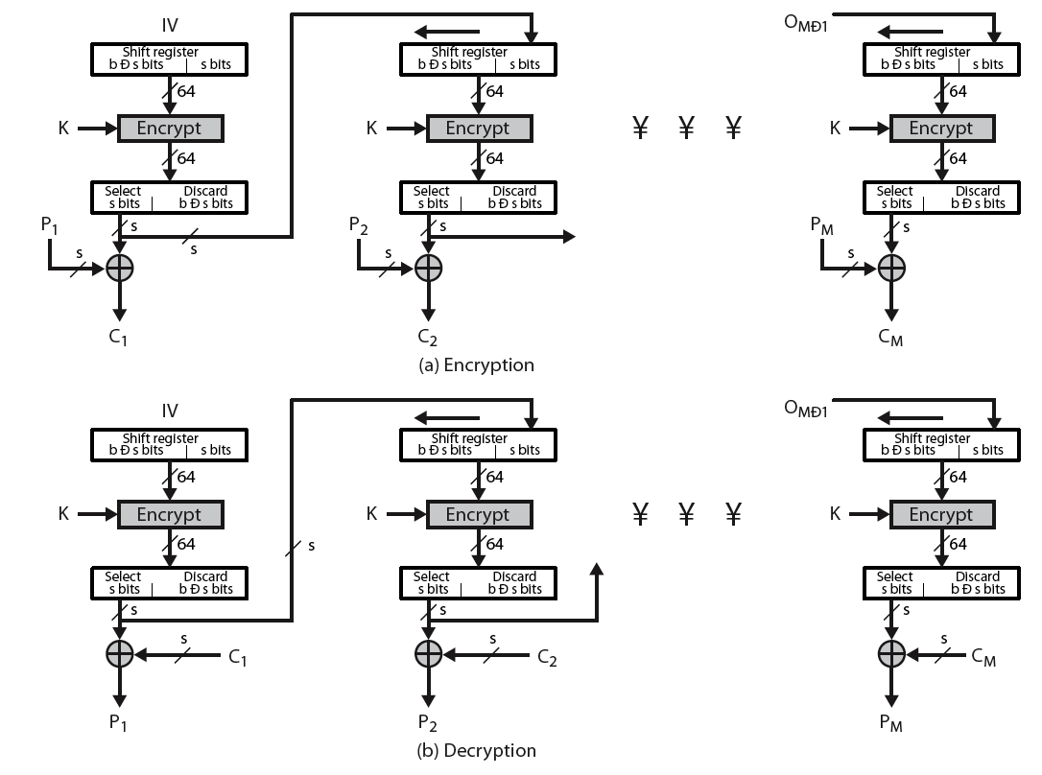
Output FeedBack (OFB)

Slide 58
Advantages and limitations of OFB
Advantages
  One-time pad can be generated in advance
  Bit errors do not propagate
Disadvantages
  More vulnerable to message stream modification
    If attacker knows both P and C, can change message to anything
  Sender & receiver must remain in sync
    If a message is lost, rest is garbled

Slide 59
Cipher FeedBack (CFB)
Message is treated as a stream of bits
Added to the output of the block cipher
Result is feed back for next stage (hence name)
Standard allows any number of bit (1,8, 64 or 128 etc) to be feed back
  Denoted CFB-1, CFB-8, CFB-64, CFB-128 etc
Most efficient to use all bits in block (64 or 128)
  C_{i} = P_{i} XOR DES_{K1}(C_{i-1})
  C₋₁ = IV
Uses: stream data encryption, authentication

Slide 60
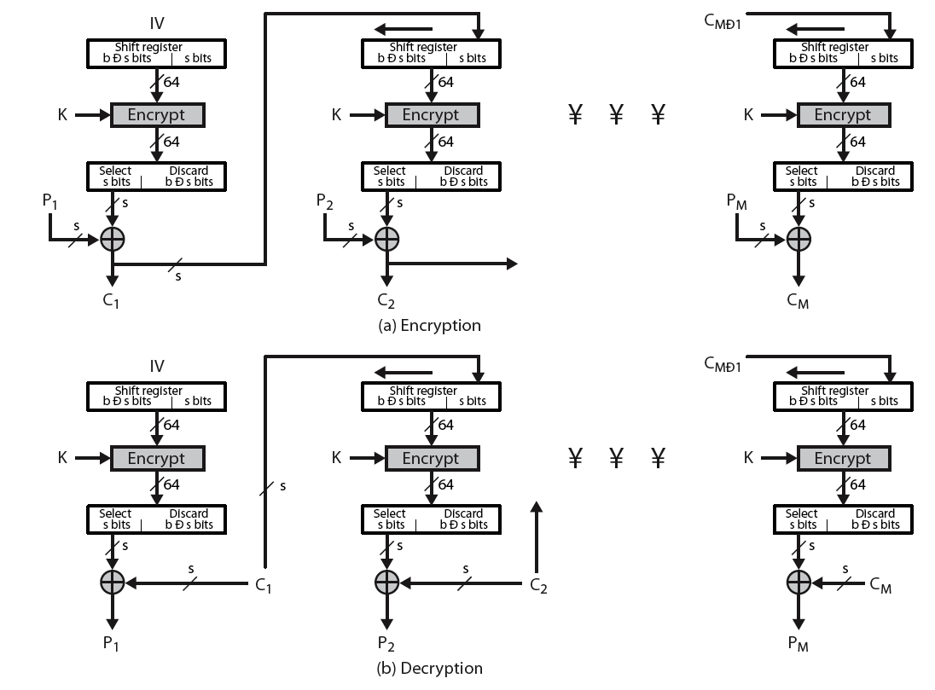
Cipher FeedBack (CFB)

Slide 61
Advantages and Limitations of CFB
Appropriate when data arrives in bits/bytes
Most common stream mode
Limitation is – need to stall while do block encryption after every n-bits
Note that the block cipher is used in encryption mode at both ends
What if ciphertext gets corrupted?
  Errors propagate for several blocks after the error
  Work on an example to observe this…
  Compare to CBC and OFB
What if ciphertext gets loss?
  Compare to CBC and OFB

Slide 62
Counter (CTR)
Similar to OFB but encrypts counter value rather than any feedback value
Must have a different key & counter value for every plaintext block (never reused)
  C_{i} = P_{i} XOR O_{i}
  O_{i} = DES_{K1}(i)
Uses: high-speed network encryptions

Slide 63
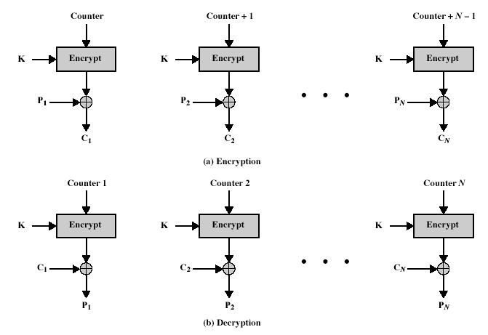
Counter (CTR)

Slide 64
Advantages and limitations of CTR
Efficiency
  Can do parallel encryptions in h/w or s/w
  Can preprocess in advance of need
  Good for bursty high speed links
Random access to encrypted data blocks
Provable security (good as other modes)
But must ensure never reuse key/counter values, otherwise could break (cf OFB)

Slide 65
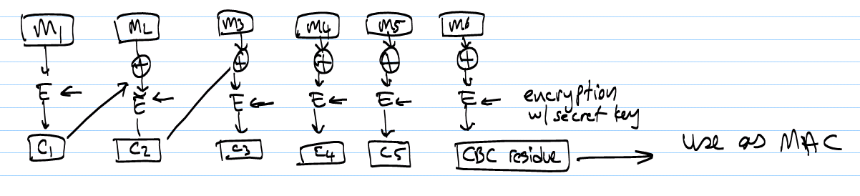
Generating Message Auth. Codes (MACs)
Message authentication codes (MACs) help protect integrity of a message
If we need integrity only and no privacy, can use CBC as follows
Send CBC residue along with plaintext

Slide 66
Ensuring Both Privacy & Integrity
Encryption by itself cannot provide integrity
  If the receiver side is a computer writing the content into a disk, tampered ciphertext would go undetected
CBC residue with ciphertext msg would not work
  You could tamper w/ ciphertext msg and send the modified last cipher block as residue (next slide)
E_{CBC}{Plaintext | CRC} would almost work but short CRC is a problem
Encrypt plaintext
  w/K₁ for CBC for privacy
  w/K₂ for CBC residue for integrity
  Double the work but it is the best we have

Slide 67
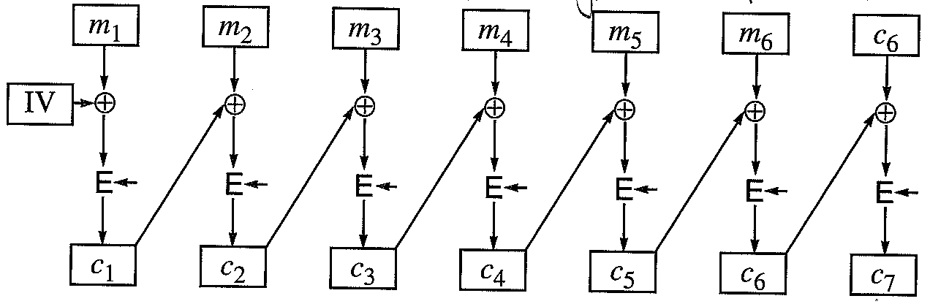
Ensuring Both Privacy & Integrity
The approach of using last cipher and encrypting it again would not work as it gives a zero input to the encryption algorithm no matter what the ciphertext (c₆) is

Slide 68
Stream Ciphers

Slide 69
Stream Ciphers
Process input one bit/byte at a time instead of in blocks
  Good for streaming applications
Have a pseudo random keystream
  Combined (XOR) with plaintext bit by bit
Randomness of stream key completely destroys statistical properties in message
  C_{i} = M_{i} XOR StreamKey_{i}
But must never reuse stream key
  Otherwise, can recover messages

Slide 70

Stream Cipher Structure

Slide 71
Stream Cipher Properties
Some design considerations are
  Long period with no repetitions
  Statistically random
  Depends on large enough key
  Large linear complexity
Faster than block cipher and use far less code
Requires that keys not be repeated as otherwise cryptanalysis would be easy
RC4 – a simple byte oriented and fast (in s/w) cipher
  Used in SSL/TLS, WEP, WPA

Slide 72
Hashes and Message Digests

Slide 73
Uses of hash functions
Basic use in message integrity verification
Can be used for signature verification for authentication
  Can it provide non-repudiation ?
Can be used to produce pseudo-random key stream for encryption for privacy
All of the above uses require a keyed hash function

Slide 74
Hashes and message digests
Requirements for hash functions
  Can be applied to any sized message M
  Produces fixed-length output h (h << M)
  Is easy to compute h=H(M) for any message M
  Given h, is infeasible to find x s.t. H(x)=h
    One-way property
  Given x, is infeasible to find y s.t. H(y)=H(x)
    Weak collision resistance
  Is infeasible to find any x,y s.t. H(y)=H(x)
    Strong collision resistance
Desirable properties
  Given inputs M₁,…, M₁₀₀₀, outputs h₁,…, h₁₀₀₀ look all random
  For consecutive M₁,M₂, outputs h₁,h₂ look random

Slide 75
Hashes and message digests
Given a msg M₁ with m-bit digest, it takes 2^{m}/2 randomly chosen msgs to find M₂ such that H(M₂)=H(M₁) w/ 50% probability
Given m-bit msg digests, it takes 2^{m/2} randomly chosen msgs to find two msgs with the same digest
  m=128 requires 2⁶⁴ randomly chosen msgs → difficult
Birthday Problem
  Given n inputs and k possible outputs
    How many input sample needed s.t. any two input sample maps to the same output w/ a probability of 50%?
    With n input, we have n(n-1)/2 tuples
    Prob. that both input values in a tuple map to the same o/p is 1/k
    For 50% chance, need k/2 pairs (n(n-1)/2 > k/2)
      Hence, n should be no less than sqrt(k)

Slide 76
Birthday Attacks
Might think a 64-bit hash is secure
  but by Birthday Paradox, it is not
Birthday attack works thus:
  Opponent generates 2^{m/2} variations of a valid message all with essentially the same meaning
  Opponent also generates 2^{m/2} variations of a desired fraudulent message
  Two sets of messages are compared to find pair with same hash (probability > 0.5 by birthday paradox)
  Have user sign the valid message hash, then substitute the forgery which will have a valid signature
Conclusion is that need to use longer MAC/hash
  Note that this does not apply if use keyed hashes

Slide 77
Use of crypto hash functions
Integrity verification
  MD: message digest or a hash
  Given a msg m, MD(m) → a MAC ???
    No security value in MD(m) as a MAC! Why?
  Would MD(K_{AB} || m) work ?
    Alice creates m, uses K_{AB} to create MD(K_{AB}||m) and sends m,MD(K_{AB}||m) to Bob
    Carol takes m,MD(K_{AB}||m), changes m→m||m’ and computes MD(K_{AB}|m|m’) starting MD with MD(K_{AB}|m)
  MD(m||K_{AB}) works
  MD(K_{AB}||m||K_{AB}) works too
  HMAC: MD_{K}(m)=H(K₁||H(m||K₂))

Slide 78
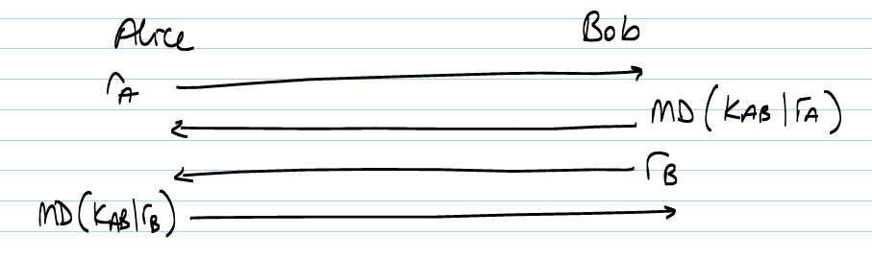
Use of crypto hash functions
Typically used with a secret key
  How are they different from secret key crypto algrs?
    Reversible vs irreversible
Authentication

Slide 79
Use of crypto hash functions
Encryption w/ a msg digest
  Generate and use one-time pass to XOR with data
  Start with MD(K_{AB}||IV) → b₁: first block of bit stream
    MD(K_{AB}||b₁) → b₂
    MD(K_{AB}||b_{i-1}) → b_{i}
    XOR plaintext with b bit string
  Problem: If you correctly guess plaintext p, you can get the entire one-time pass string s=p XOR c
    Then can use s to send any message

Slide 80
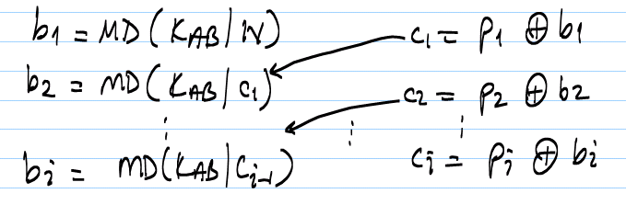
Use of crypto hash functions
Mixing in with plaintext
  Tie one time pass string to individual msgs
    Break msg p into MD-length chunks p₁, p₂, …
    corr. ciphertext blocks will be c₁, c₂, …
    each MD will use one-time pass block b₁, b₂, …
    compute cipherblock as
  Even if you can guess the entire plaintext, one-time pass cannot be used to send new msgs as it is computed for this particular msg only.

Slide 81
Popular hash functions
MD2, MD4, and MD5 used to be popular
SHA-1 taking over, HMAC also popular
All produce 128-bit digests (SHA is 160-bits)
MD2, MD4 broken, MD5 has vulnerabilities
SHA-1 proposed by US government
  produces 160, 256, 384, or 512 bit digests

Slide 82
Public Key Crypto

Slide 83
Public-Key Cryptography
Probably most significant advance in the 3000 year history of cryptography
Uses two keys – a public & a private key
Asymmetric since parties are not equal
Uses clever application of number theoretic concepts to function
Complements rather than replaces private key crypto

Slide 84
Why Public-Key Cryptography?
Developed to address two main issues:
  Key distribution – how to have secure communications in general without having to trust a KDC with your key
  Digital signatures – how to verify a message comes intact from the claimed sender
Public invention by Whitfield Diffie & Martin Hellman at Stanford Univ. in 1976
  Known earlier in classified community

Slide 85
Secret-Key Cryptography
Traditional symmetric/secret/single key cryptography uses one key
Shared by both sender and receiver
If this key is disclosed communications are compromised
Also is symmetric, parties are equal
  Hence does not protect sender from receiver forging a message & claiming is sent by sender

Slide 86
Public-Key Cryptography
Public-key/two-key/asymmetric cryptography involves the use of two keys:
  A public-key, which may be known by anybody, and can be used to encrypt messages, and verify signatures
  A private-key, known only to the recipient, used to decrypt messages, and sign (generate) signatures
Is asymmetric because
  Those who encrypt messages or verify signatures cannot decrypt messages or create signatures

Slide 87
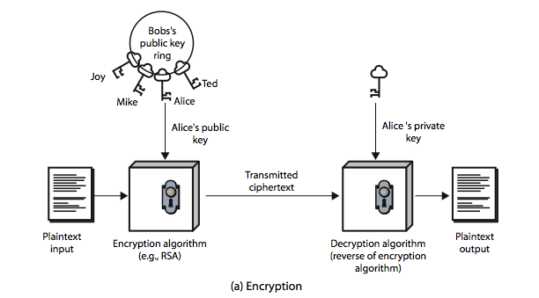
Public-Key Cryptography

Slide 88
Public-Key Characteristics
Public-key algorithms rely on two keys where:
  It is computationally infeasible to find decryption key knowing only algorithm & encryption key
  It is computationally easy to en/decrypt messages when the relevant (en/decrypt) key is known
  Either of the two related keys can be used for encryption, with the other used for decryption (for some algorithms)

Slide 89

Public-Key Cryptosystems
for encryption for privacy
for signature

Slide 90
Public-Key Applications
Can classify uses into 3 categories:
  Encryption/decryption (provide secrecy)
  Digital signatures (provide authentication)
  Key exchange (of session keys)
Some algorithms are suitable for all uses, others are specific to one

Slide 91
Security of Public Key Schemes
Brute force exhaustive search attack is always theoretically possible
  But keys used are too large (>512 bits)
Security relies on a large enough difference in difficulty between easy (en/decrypt) and hard (cryptanalysis) problems
  More generally the hard problem is known, but is made hard enough to be impractical to break
Requires the use of very large numbers
  Slow compared to symmetric key schemes

Slide 92
RSA
By Rivest, Shamir & Adleman of MIT in 1977
Best known & widely used public-key scheme
Based on exponentiation in a finite (Galois) field over integers modulo a prime
  Number exponentiation takes O((log n)³) operations (easy)
Uses large integers (eg. 1024 bits)
Security due to cost of factoring large numbers
  Number factorization takes O(e ^{log n log log n}) operations (hard)

Slide 93
RSA Key Setup
Each user generates a public/private key pair
  Select two large primes at random – p,q
  Compute their system modulus n=p.q
    Define ø(n)=(p-1)(q-1) – called Totient function
    ø(n): # of numbers < n and relatively prime to n
  Select at random the encryption key e
    where 1<e<ø(n), gcd(e,ø(n))=1
  Solve following equation to find decryption key d
    e.d=1 mod ø(n) and 0≤d≤n
Publish their public encryption key: PU={e,n}
Keep secret private decryption key: PR={d,n}

Slide 94
RSA Use
To encrypt a message M the sender:
  Obtains public key of recipient PU={e,n}
  Computes: C = Me mod n, where 0≤M<n
To decrypt the ciphertext C, the owner:
  Uses his/her private key PR={d,n}
  Computes: M = C^{d} mod n
Note that the message M must be smaller than n (block if needed)

Slide 95
Why RSA Works
Arithmetic is mod n; n=p.q, p,q are prime
For any x, x^{y} mod n=x^{(y mod ø(n))}mod n, where
  n is prime or product of two primes
Thus, for any x, x^{d.e} mod n = x mod n
where de=1 mod ø(n)
In RSA, we have:
  n=p.q
  ø(n)=(p-1)(q-1)
  Carefully chose e & d to be inverses mod ø(n)
  Then, e.d=1+k.ø(n) for some k
Hence :
C^{d} = M^{e.d} = M^{1+k.ø(n)} = M¹.(M^{ø(n)})^{k}
= M¹.(1)^{k} = M¹ = M ...(all in mod n)

Slide 96
RSA Example - Key Setup
Select primes: p=17 & q=11
Compute n = pq =17 x 11=187
Compute ø(n)=(p–1)(q-1)=16 x 10=160
Select e: gcd(e,160)=1; choose e=7
Determine d: de=1 mod 160 and d < 160 Value is d=23 since 23x7=161= 1x160+1
Publish public key PU={7,187}
Keep secret private key PR={23,187}

Slide 97
RSA Example - En/Decryption
Sample RSA encryption/decryption is:
  Given message M = 88 (nb. 88<187)
  encryption:
  C = 88⁷ mod 187 = 11
  decryption:
  M = 11²³ mod 187 = 88

Slide 98
RSA Key Generation
Users of RSA must:
  Determine two primes at random – p,q
  Select either e or d and compute the other
Primes p,q must not be easily derived from modulus n=p.q
  Means must be sufficiently large
  Typically guess and use primality test
Exponents e, d are inverses, so use Euclid’s inverse algorithm to compute the other
  Finding multiplicative inverse is easy via Euclid’s algr
  Finding exponential inverse is difficult

Slide 99
Generating RSA keys
Finding big primes – p,q
  No practical way to determine absolutely that a given large number is prime (until recently)
  But can test if the number is probably prime
  Euler’s Theorem: For any a relatively prime to n
  a^{ø(n)}mod n = 1
  Note that if n is prime, ø(n)=(n-1).
  Fermat’s Theorem: If n is prime and 0<a<n,
  a^{n-1} = 1 mod n.
Given n a randomly generated 100-digit number, probability that n is not prime but a^{n-1}mod n=1 is 1/10¹³ for 0<a<n.

Slide 100
RSA Security
Possible approaches to attacking RSA are
  Brute force key search (infeasible given size of numbers)
  Mathematical attacks (based on difficulty of computing ø(n), by factoring modulus n)
    Knowing n not easy to find p and q (n = p.q)
    Not knowing p and q, difficult to find ø(n)
    Not knowing ø(n), difficult to find d such that
    d.e mod ø(n) = 1
  Timing attacks (on running of decryption)
  Chosen ciphertext attacks (given properties of RSA)

Slide 101
Diffie-Hellman key exchange
Allows two individuals to agree on a secret key even though they can only communicate in public
  Alice chooses a private number and from that calculates a public number
  Bob does the same
  Each can use the other’s public number and their own private number to compute the same secret
An eavesdropper cannot reproduce it

Slide 102
Diffie-Hellman key exchange
A public-key distribution scheme
  Cannot be used to exchange an arbitrary message
  Rather it can establish a common key
  Known only to the two participants
Value of key depends on the participants (and their private and public key information)
Based on exponentiation in a finite (Galois) field (modulo a prime or a polynomial) – easy
Security relies on the difficulty of computing discrete logarithms (similar to factoring) – hard

Slide 103
Diffie-Hellman Setup
All users agree on global parameters p and g:
  Large prime integer or polynomial p
  g being a primitive root mod p
Each user (eg. A) generates their key
  Chooses a secret key (number): s_{A} < p
  Compute their public key: T_{A} = g^{sA} mod p
Each user makes public that key T_{A}

Slide 104
Diffie-Hellman Key Exchange
Shared session key for users A & B is K_{AB}:
  K_{AB} = g^{sA.sB} mod p
  = T_{A}^{sB} mod p (which B can compute)
  = T_{B}^{sA} mod p (which A can compute)
K_{AB} is used as session key in symmetric-key encryption scheme between Alice and Bob
If Alice and Bob subsequently communicate, they will have the same key as before, unless they choose new public-keys

Slide 105


Diffie-Hellman
Alice and Bob agree on a prime p and a random number g
Alice picks s_{A} at random, Bob s_{B} at random
Alice computes T_{B}^{SA} mod p, Bob T_{A}^{SB} mod p
Knowing g, p, g^{x} mod p (i.e., T_{A} or T_{B}),
difficult to compute X(i.e., X=s_{A}.s_{B})
  Attacker needs an X, must solve discrete log

Slide 106
Diffie-Hellman Example
Users Alice & Bob who wish to swap keys:
Agree on prime p=353 and g=3
Select random secret keys:
  A chooses s_{A}=97, B chooses s_{B}=233
Compute respective public keys:
  T_{A}=3⁹⁷ mod 353 = 40 (Alice)
  T_{B}=3²³³ mod 353 = 248 (Bob)
Compute shared session key as:
  K_{AB}= T_{B}^{xA} mod 353 = 248⁹⁷ = 160 (Alice)
  K_{AB}= T_{A}^{xB} mod 353 = 40²³³ = 160 (Bob)

Slide 107
D-H Key Exchange Protocols
Users could create random private/public D-H keys each time they communicate
Users could create a private/public D-H keys; publish the public key (in a directory) to be used to securely communicate with them
Both of these are vulnerable to a meet-in-the-middle attack
  Authentication of the keys is needed

Slide 108
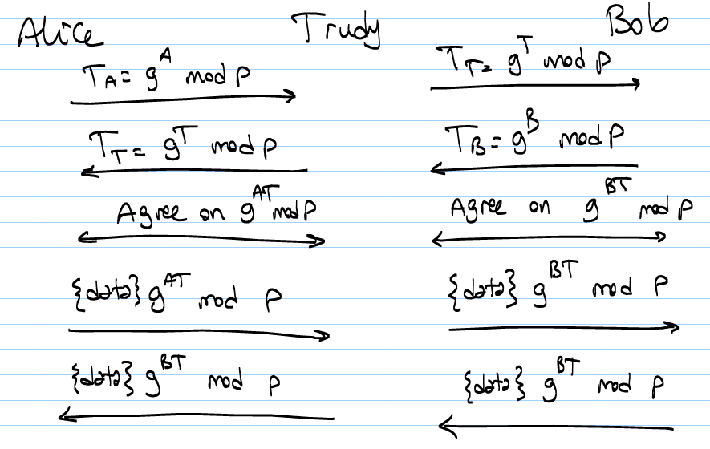
Man in the middle attack on D-H

Slide 109
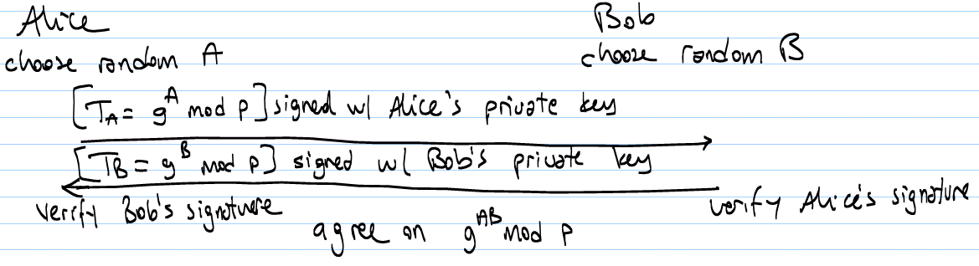
Defending against man in the middle attack
Published D-H
  Everyone agrees on p and g
  Use PKI to reliable collect other party’s public number T_{x}
Authenticated D-H
  Assume pre-established secret key or each others public key

Slide 110
Authenticated DH
If we need RSA signatures to authenticate DH key exchange, why not just use RSA?
RSA based key exchange example:
  Pick a random number k
  Encrypt w/ Bob’s public key
  Send it to Bob
  Use k as the session key
Why not use this instead of Authenticated-DH?

Slide 111
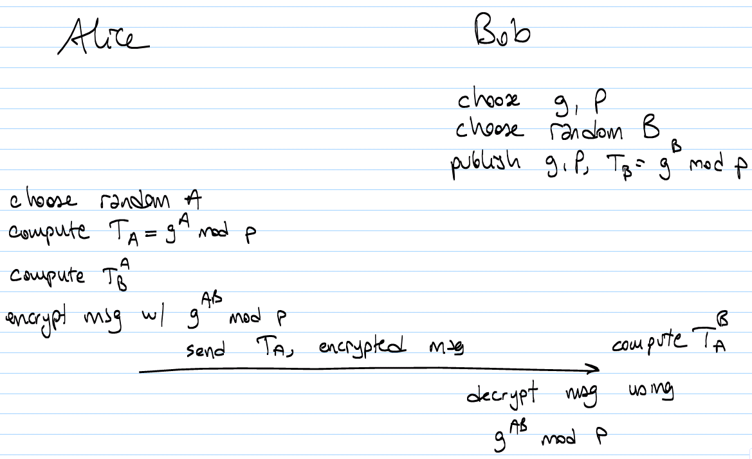
Diffie-Hellman for encryption

