Slide 1
Cylindrical coordinate = (25.5,31.5,theta)
31.5cm
38.99 degrees
Rotation axis
z
25.5cm
y
Paper
x

Slide 2
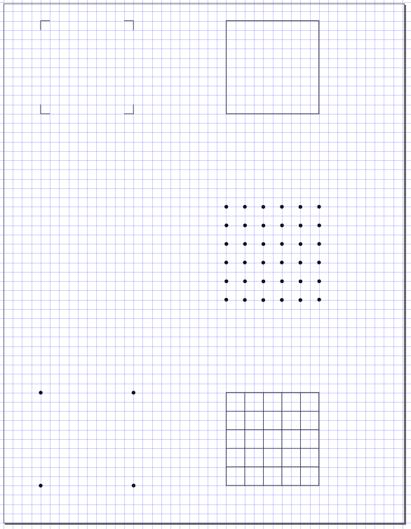
(10,10)
(-5,10)
5cm
5cm
(0,5)
(5,5)
Rotation axis intersection
(0,0)
(5,0)
y
1cm
(10,-5)
x
(0,-10)
(5,-10)
5cm
(-5,-15)
1cm
(10,-15)

