Slide 1

Tower of Hanoi Implementation in Python
By Joey Ji

Slide 2
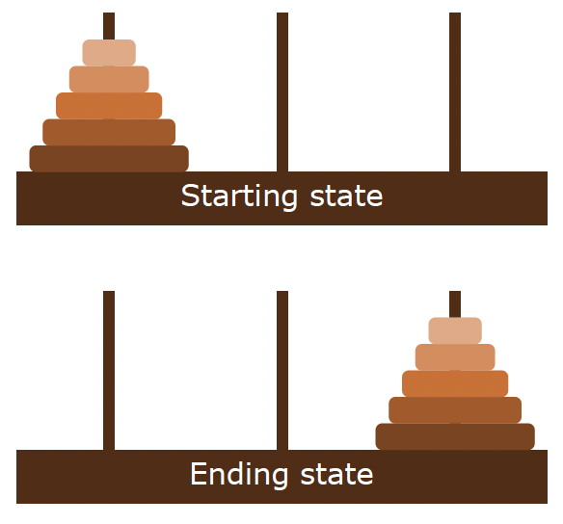
Tower of Hanoi Problem
Game consists of three poles and varying number of disks
No two disks are the same size
Disks are stacked together from smallest on the top and largest on the bottom
Game starts with all disks on the first pole
Goal: move all disks from the first to the third pole
Rules:
Moving one disk at a time
Larger disk can’t be on top of a smaller disk

Slide 3
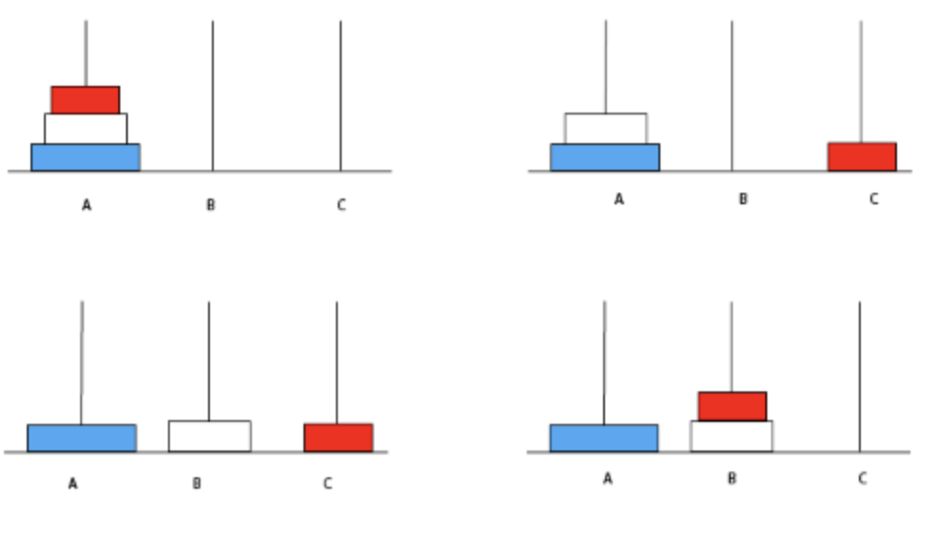
Representation of Stacks at Each State
At each step, the status of the stacks will be represented in terms of a tuple of size n
N is the number of stacks
Tuple indices are organized from smallest to the largest layer
Each index has a possible entry of {1, 2, 3}, correlates to the specific tower
i.e. For the four states on the left:
Top left: (1, 1, 1)
Top right: (3, 1, 1)
Bottom left: (3, 2, 1)
Bottom right: (2, 2, 1)

Slide 4
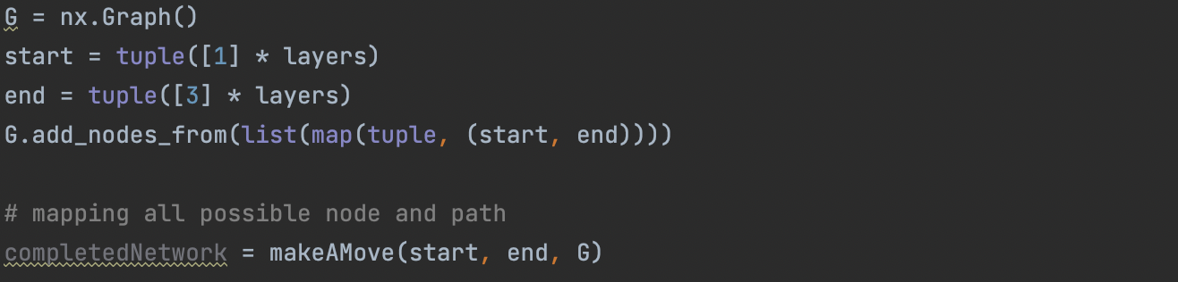
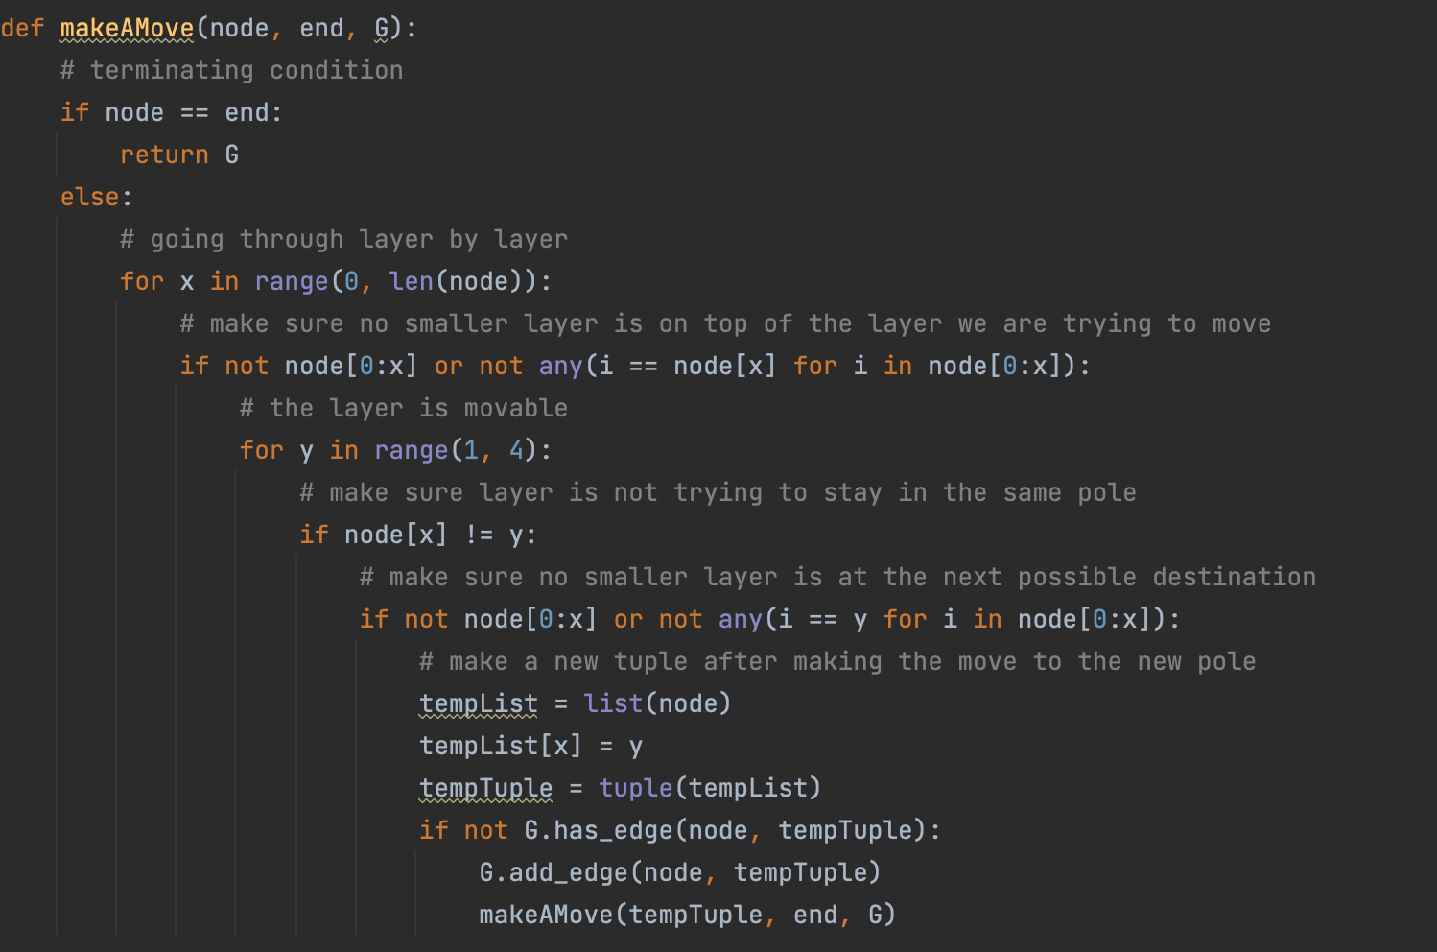
Graph Generation
A recursive function makeAMove(node, end, G) is created
Three inputs: the node to make extensions from, end node for program termination, and the graph G using Python package Networkx
makeAMove(node, end, G) is called within the function TowersOfHanoi(layers), where layers is the number of layers for the game

Slide 5
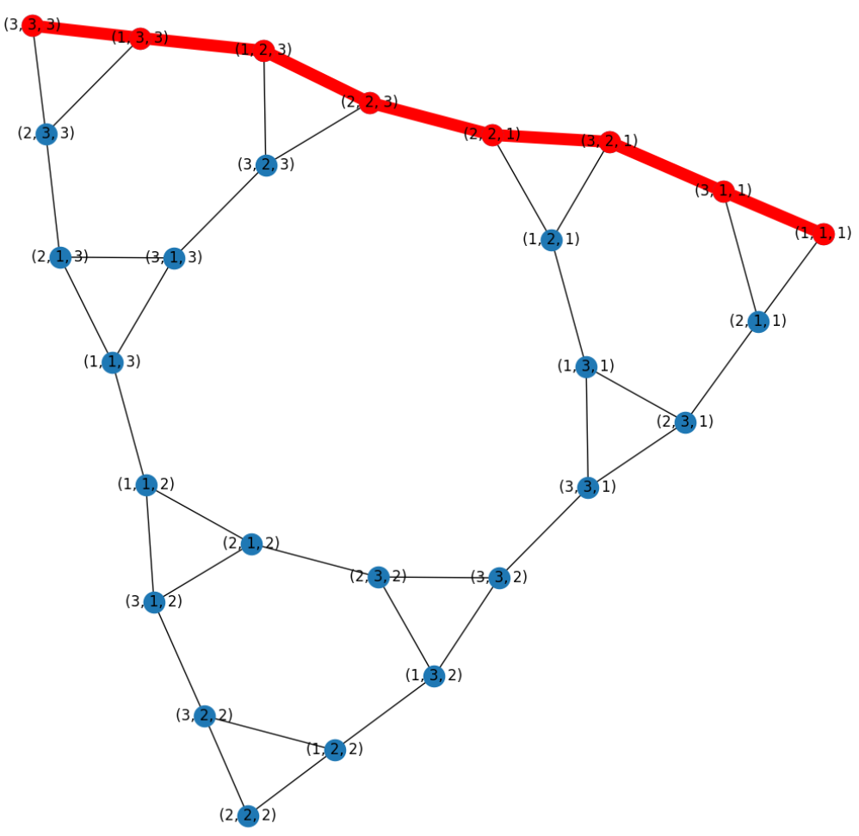
Original Game with Three Disks
Call Function TowersOfHanoi(3), generated the following diagram in Kamada-Kawai force-directed layout:
Red trail represent the shortest path
Each node is labeled with the state of the stack
Starting node: (1, 1, 1)
End node: (3, 3, 3)
Shortest Path: [(1, 1, 1), (3, 1, 1), (3, 2, 1), (2, 2, 1), (2, 2, 3), (1, 2, 3), (1, 3, 3), (3, 3, 3)]

Slide 6
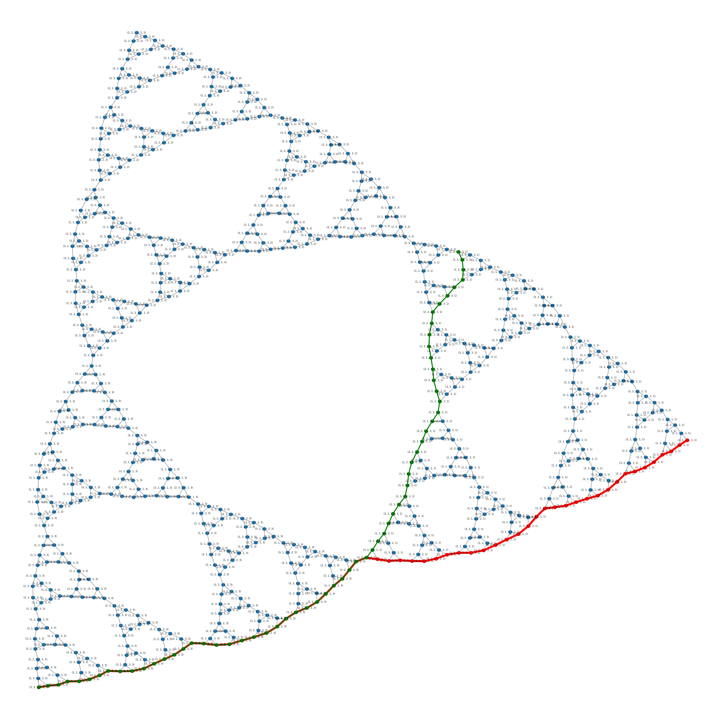
Six Disks Original Game
Call Function TowersOfHanoi(6), generated the following diagram in Kamada-Kawai force-directed layout:
Red trail represent the shortest path
Each node is labeled with the state of the stack
Starting node: (1, 1, 1, 1, 1, 1)
End node: (3, 3, 3, 3, 3, 3)

Slide 7
Six Disks Modified Game
Call Function TowersOfHanoi(6), generated the following diagram in Kamada-Kawai force-directed layout:
Green trail represent the shortest path
Each node is labeled with the state of the stack
Starting node: (2, 2, 1, 3, 3, 1)
End node: (3, 3, 3, 3, 3, 3)

Slide 8
Adjacency Matrix
 | 111 | 333 | 211 | 311 | 321 | 121 | 221 | 223 | 123 | 323 | 313 | 113 | 213 | 233 | 133 | 112 | 212 | 312 | 322 | 122 | 222 | 132 | 232 | 332 | 331 | 131 | 231
111 | 0 | 0 | 1 | 1 | 0 | 0 | 0 | 0 | 0 | 0 | 0 | 0 | 0 | 0 | 0 | 0 | 0 | 0 | 0 | 0 | 0 | 0 | 0 | 0 | 0 | 0 | 0
333 | 0 | 0 | 0 | 0 | 0 | 0 | 0 | 0 | 0 | 0 | 0 | 0 | 0 | 1 | 1 | 0 | 0 | 0 | 0 | 0 | 0 | 0 | 0 | 0 | 0 | 0 | 0
211 | 1 | 0 | 0 | 1 | 0 | 0 | 0 | 0 | 0 | 0 | 0 | 0 | 0 | 0 | 0 | 0 | 0 | 0 | 0 | 0 | 0 | 0 | 0 | 0 | 0 | 0 | 1
311 | 1 | 0 | 1 | 0 | 1 | 0 | 0 | 0 | 0 | 0 | 0 | 0 | 0 | 0 | 0 | 0 | 0 | 0 | 0 | 0 | 0 | 0 | 0 | 0 | 0 | 0 | 0
321 | 0 | 0 | 0 | 1 | 0 | 1 | 1 | 0 | 0 | 0 | 0 | 0 | 0 | 0 | 0 | 0 | 0 | 0 | 0 | 0 | 0 | 0 | 0 | 0 | 0 | 0 | 0
121 | 0 | 0 | 0 | 0 | 1 | 0 | 1 | 0 | 0 | 0 | 0 | 0 | 0 | 0 | 0 | 0 | 0 | 0 | 0 | 0 | 0 | 0 | 0 | 0 | 0 | 1 | 0
221 | 0 | 0 | 0 | 0 | 1 | 1 | 0 | 1 | 0 | 0 | 0 | 0 | 0 | 0 | 0 | 0 | 0 | 0 | 0 | 0 | 0 | 0 | 0 | 0 | 0 | 0 | 0
223 | 0 | 0 | 0 | 0 | 0 | 0 | 1 | 0 | 1 | 1 | 0 | 0 | 0 | 0 | 0 | 0 | 0 | 0 | 0 | 0 | 0 | 0 | 0 | 0 | 0 | 0 | 0
123 | 0 | 0 | 0 | 0 | 0 | 0 | 0 | 1 | 0 | 1 | 0 | 0 | 0 | 0 | 1 | 0 | 0 | 0 | 0 | 0 | 0 | 0 | 0 | 0 | 0 | 0 | 0
323 | 0 | 0 | 0 | 0 | 0 | 0 | 0 | 1 | 1 | 0 | 1 | 0 | 0 | 0 | 0 | 0 | 0 | 0 | 0 | 0 | 0 | 0 | 0 | 0 | 0 | 0 | 0
313 | 0 | 0 | 0 | 0 | 0 | 0 | 0 | 0 | 0 | 1 | 0 | 1 | 1 | 0 | 0 | 0 | 0 | 0 | 0 | 0 | 0 | 0 | 0 | 0 | 0 | 0 | 0
113 | 0 | 0 | 0 | 0 | 0 | 0 | 0 | 0 | 0 | 0 | 1 | 0 | 1 | 0 | 0 | 1 | 0 | 0 | 0 | 0 | 0 | 0 | 0 | 0 | 0 | 0 | 0
213 | 0 | 0 | 0 | 0 | 0 | 0 | 0 | 0 | 0 | 0 | 1 | 1 | 0 | 1 | 0 | 0 | 0 | 0 | 0 | 0 | 0 | 0 | 0 | 0 | 0 | 0 | 0
233 | 0 | 1 | 0 | 0 | 0 | 0 | 0 | 0 | 0 | 0 | 0 | 0 | 1 | 0 | 1 | 0 | 0 | 0 | 0 | 0 | 0 | 0 | 0 | 0 | 0 | 0 | 0
133 | 0 | 1 | 0 | 0 | 0 | 0 | 0 | 0 | 1 | 0 | 0 | 0 | 0 | 1 | 0 | 0 | 0 | 0 | 0 | 0 | 0 | 0 | 0 | 0 | 0 | 0 | 0
112 | 0 | 0 | 0 | 0 | 0 | 0 | 0 | 0 | 0 | 0 | 0 | 1 | 0 | 0 | 0 | 0 | 1 | 1 | 0 | 0 | 0 | 0 | 0 | 0 | 0 | 0 | 0
212 | 0 | 0 | 0 | 0 | 0 | 0 | 0 | 0 | 0 | 0 | 0 | 0 | 0 | 0 | 0 | 1 | 0 | 1 | 0 | 0 | 0 | 0 | 1 | 0 | 0 | 0 | 0
312 | 0 | 0 | 0 | 0 | 0 | 0 | 0 | 0 | 0 | 0 | 0 | 0 | 0 | 0 | 0 | 1 | 1 | 0 | 1 | 0 | 0 | 0 | 0 | 0 | 0 | 0 | 0
322 | 0 | 0 | 0 | 0 | 0 | 0 | 0 | 0 | 0 | 0 | 0 | 0 | 0 | 0 | 0 | 0 | 0 | 1 | 0 | 1 | 1 | 0 | 0 | 0 | 0 | 0 | 0
122 | 0 | 0 | 0 | 0 | 0 | 0 | 0 | 0 | 0 | 0 | 0 | 0 | 0 | 0 | 0 | 0 | 0 | 0 | 1 | 0 | 1 | 1 | 0 | 0 | 0 | 0 | 0
222 | 0 | 0 | 0 | 0 | 0 | 0 | 0 | 0 | 0 | 0 | 0 | 0 | 0 | 0 | 0 | 0 | 0 | 0 | 1 | 1 | 0 | 0 | 0 | 0 | 0 | 0 | 0
132 | 0 | 0 | 0 | 0 | 0 | 0 | 0 | 0 | 0 | 0 | 0 | 0 | 0 | 0 | 0 | 0 | 0 | 0 | 0 | 1 | 0 | 0 | 1 | 1 | 0 | 0 | 0
232 | 0 | 0 | 0 | 0 | 0 | 0 | 0 | 0 | 0 | 0 | 0 | 0 | 0 | 0 | 0 | 0 | 1 | 0 | 0 | 0 | 0 | 1 | 0 | 1 | 0 | 0 | 0
332 | 0 | 0 | 0 | 0 | 0 | 0 | 0 | 0 | 0 | 0 | 0 | 0 | 0 | 0 | 0 | 0 | 0 | 0 | 0 | 0 | 0 | 1 | 1 | 0 | 1 | 0 | 0
331 | 0 | 0 | 0 | 0 | 0 | 0 | 0 | 0 | 0 | 0 | 0 | 0 | 0 | 0 | 0 | 0 | 0 | 0 | 0 | 0 | 0 | 0 | 0 | 1 | 0 | 1 | 1
131 | 0 | 0 | 0 | 0 | 0 | 1 | 0 | 0 | 0 | 0 | 0 | 0 | 0 | 0 | 0 | 0 | 0 | 0 | 0 | 0 | 0 | 0 | 0 | 0 | 1 | 0 | 1
231 | 0 | 0 | 1 | 0 | 0 | 0 | 0 | 0 | 0 | 0 | 0 | 0 | 0 | 0 | 0 | 0 | 0 | 0 | 0 | 0 | 0 | 0 | 0 | 0 | 1 | 1 | 0

Slide 9
Incidence Matrix
 | 111<->211 | 111<->311 | 333<->133 | 333<->233 | 211<->311 | 211<->231 | 311<->321 | 321<->121 | 321<->221 | 121<->221 | 121<->131 | 221<->223 | 223<->123 | 223<->323 | 123<->323 | 123<->133 | 323<->313 | 313<->113 | 313<->213 | 113<->213 | 113<->112 | 213<->233 | 233<->133 | 112<->212 | 112<->312 | 212<->312 | 212<->232 | 312<->322 | 322<->122 | 322<->222 | 122<->222 | 122<->132 | 132<->232 | 132<->332 | 232<->332 | 332<->331 | 331<->131 | 331<->231 | 131<->231
111 | 1 | 1 | 0 | 0 | 0 | 0 | 0 | 0 | 0 | 0 | 0 | 0 | 0 | 0 | 0 | 0 | 0 | 0 | 0 | 0 | 0 | 0 | 0 | 0 | 0 | 0 | 0 | 0 | 0 | 0 | 0 | 0 | 0 | 0 | 0 | 0 | 0 | 0 | 0
333 | 0 | 0 | 1 | 1 | 0 | 0 | 0 | 0 | 0 | 0 | 0 | 0 | 0 | 0 | 0 | 0 | 0 | 0 | 0 | 0 | 0 | 0 | 0 | 0 | 0 | 0 | 0 | 0 | 0 | 0 | 0 | 0 | 0 | 0 | 0 | 0 | 0 | 0 | 0
211 | 1 | 0 | 0 | 0 | 1 | 1 | 0 | 0 | 0 | 0 | 0 | 0 | 0 | 0 | 0 | 0 | 0 | 0 | 0 | 0 | 0 | 0 | 0 | 0 | 0 | 0 | 0 | 0 | 0 | 0 | 0 | 0 | 0 | 0 | 0 | 0 | 0 | 0 | 0
311 | 0 | 1 | 0 | 0 | 1 | 0 | 1 | 0 | 0 | 0 | 0 | 0 | 0 | 0 | 0 | 0 | 0 | 0 | 0 | 0 | 0 | 0 | 0 | 0 | 0 | 0 | 0 | 0 | 0 | 0 | 0 | 0 | 0 | 0 | 0 | 0 | 0 | 0 | 0
321 | 0 | 0 | 0 | 0 | 0 | 0 | 1 | 1 | 1 | 0 | 0 | 0 | 0 | 0 | 0 | 0 | 0 | 0 | 0 | 0 | 0 | 0 | 0 | 0 | 0 | 0 | 0 | 0 | 0 | 0 | 0 | 0 | 0 | 0 | 0 | 0 | 0 | 0 | 0
121 | 0 | 0 | 0 | 0 | 0 | 0 | 0 | 1 | 0 | 1 | 1 | 0 | 0 | 0 | 0 | 0 | 0 | 0 | 0 | 0 | 0 | 0 | 0 | 0 | 0 | 0 | 0 | 0 | 0 | 0 | 0 | 0 | 0 | 0 | 0 | 0 | 0 | 0 | 0
221 | 0 | 0 | 0 | 0 | 0 | 0 | 0 | 0 | 1 | 1 | 0 | 1 | 0 | 0 | 0 | 0 | 0 | 0 | 0 | 0 | 0 | 0 | 0 | 0 | 0 | 0 | 0 | 0 | 0 | 0 | 0 | 0 | 0 | 0 | 0 | 0 | 0 | 0 | 0
223 | 0 | 0 | 0 | 0 | 0 | 0 | 0 | 0 | 0 | 0 | 0 | 1 | 1 | 1 | 0 | 0 | 0 | 0 | 0 | 0 | 0 | 0 | 0 | 0 | 0 | 0 | 0 | 0 | 0 | 0 | 0 | 0 | 0 | 0 | 0 | 0 | 0 | 0 | 0
123 | 0 | 0 | 0 | 0 | 0 | 0 | 0 | 0 | 0 | 0 | 0 | 0 | 1 | 0 | 1 | 1 | 0 | 0 | 0 | 0 | 0 | 0 | 0 | 0 | 0 | 0 | 0 | 0 | 0 | 0 | 0 | 0 | 0 | 0 | 0 | 0 | 0 | 0 | 0
323 | 0 | 0 | 0 | 0 | 0 | 0 | 0 | 0 | 0 | 0 | 0 | 0 | 0 | 1 | 1 | 0 | 1 | 0 | 0 | 0 | 0 | 0 | 0 | 0 | 0 | 0 | 0 | 0 | 0 | 0 | 0 | 0 | 0 | 0 | 0 | 0 | 0 | 0 | 0
313 | 0 | 0 | 0 | 0 | 0 | 0 | 0 | 0 | 0 | 0 | 0 | 0 | 0 | 0 | 0 | 0 | 1 | 1 | 1 | 0 | 0 | 0 | 0 | 0 | 0 | 0 | 0 | 0 | 0 | 0 | 0 | 0 | 0 | 0 | 0 | 0 | 0 | 0 | 0
113 | 0 | 0 | 0 | 0 | 0 | 0 | 0 | 0 | 0 | 0 | 0 | 0 | 0 | 0 | 0 | 0 | 0 | 1 | 0 | 1 | 1 | 0 | 0 | 0 | 0 | 0 | 0 | 0 | 0 | 0 | 0 | 0 | 0 | 0 | 0 | 0 | 0 | 0 | 0
213 | 0 | 0 | 0 | 0 | 0 | 0 | 0 | 0 | 0 | 0 | 0 | 0 | 0 | 0 | 0 | 0 | 0 | 0 | 1 | 1 | 0 | 1 | 0 | 0 | 0 | 0 | 0 | 0 | 0 | 0 | 0 | 0 | 0 | 0 | 0 | 0 | 0 | 0 | 0
233 | 0 | 0 | 0 | 1 | 0 | 0 | 0 | 0 | 0 | 0 | 0 | 0 | 0 | 0 | 0 | 0 | 0 | 0 | 0 | 0 | 0 | 1 | 1 | 0 | 0 | 0 | 0 | 0 | 0 | 0 | 0 | 0 | 0 | 0 | 0 | 0 | 0 | 0 | 0
133 | 0 | 0 | 1 | 0 | 0 | 0 | 0 | 0 | 0 | 0 | 0 | 0 | 0 | 0 | 0 | 1 | 0 | 0 | 0 | 0 | 0 | 0 | 1 | 0 | 0 | 0 | 0 | 0 | 0 | 0 | 0 | 0 | 0 | 0 | 0 | 0 | 0 | 0 | 0
112 | 0 | 0 | 0 | 0 | 0 | 0 | 0 | 0 | 0 | 0 | 0 | 0 | 0 | 0 | 0 | 0 | 0 | 0 | 0 | 0 | 1 | 0 | 0 | 1 | 1 | 0 | 0 | 0 | 0 | 0 | 0 | 0 | 0 | 0 | 0 | 0 | 0 | 0 | 0
212 | 0 | 0 | 0 | 0 | 0 | 0 | 0 | 0 | 0 | 0 | 0 | 0 | 0 | 0 | 0 | 0 | 0 | 0 | 0 | 0 | 0 | 0 | 0 | 1 | 0 | 1 | 1 | 0 | 0 | 0 | 0 | 0 | 0 | 0 | 0 | 0 | 0 | 0 | 0
312 | 0 | 0 | 0 | 0 | 0 | 0 | 0 | 0 | 0 | 0 | 0 | 0 | 0 | 0 | 0 | 0 | 0 | 0 | 0 | 0 | 0 | 0 | 0 | 0 | 1 | 1 | 0 | 1 | 0 | 0 | 0 | 0 | 0 | 0 | 0 | 0 | 0 | 0 | 0
322 | 0 | 0 | 0 | 0 | 0 | 0 | 0 | 0 | 0 | 0 | 0 | 0 | 0 | 0 | 0 | 0 | 0 | 0 | 0 | 0 | 0 | 0 | 0 | 0 | 0 | 0 | 0 | 1 | 1 | 1 | 0 | 0 | 0 | 0 | 0 | 0 | 0 | 0 | 0
122 | 0 | 0 | 0 | 0 | 0 | 0 | 0 | 0 | 0 | 0 | 0 | 0 | 0 | 0 | 0 | 0 | 0 | 0 | 0 | 0 | 0 | 0 | 0 | 0 | 0 | 0 | 0 | 0 | 1 | 0 | 1 | 1 | 0 | 0 | 0 | 0 | 0 | 0 | 0
222 | 0 | 0 | 0 | 0 | 0 | 0 | 0 | 0 | 0 | 0 | 0 | 0 | 0 | 0 | 0 | 0 | 0 | 0 | 0 | 0 | 0 | 0 | 0 | 0 | 0 | 0 | 0 | 0 | 0 | 1 | 1 | 0 | 0 | 0 | 0 | 0 | 0 | 0 | 0
132 | 0 | 0 | 0 | 0 | 0 | 0 | 0 | 0 | 0 | 0 | 0 | 0 | 0 | 0 | 0 | 0 | 0 | 0 | 0 | 0 | 0 | 0 | 0 | 0 | 0 | 0 | 0 | 0 | 0 | 0 | 0 | 1 | 1 | 1 | 0 | 0 | 0 | 0 | 0
232 | 0 | 0 | 0 | 0 | 0 | 0 | 0 | 0 | 0 | 0 | 0 | 0 | 0 | 0 | 0 | 0 | 0 | 0 | 0 | 0 | 0 | 0 | 0 | 0 | 0 | 0 | 1 | 0 | 0 | 0 | 0 | 0 | 1 | 0 | 1 | 0 | 0 | 0 | 0
332 | 0 | 0 | 0 | 0 | 0 | 0 | 0 | 0 | 0 | 0 | 0 | 0 | 0 | 0 | 0 | 0 | 0 | 0 | 0 | 0 | 0 | 0 | 0 | 0 | 0 | 0 | 0 | 0 | 0 | 0 | 0 | 0 | 0 | 1 | 1 | 1 | 0 | 0 | 0
331 | 0 | 0 | 0 | 0 | 0 | 0 | 0 | 0 | 0 | 0 | 0 | 0 | 0 | 0 | 0 | 0 | 0 | 0 | 0 | 0 | 0 | 0 | 0 | 0 | 0 | 0 | 0 | 0 | 0 | 0 | 0 | 0 | 0 | 0 | 0 | 1 | 1 | 1 | 0
131 | 0 | 0 | 0 | 0 | 0 | 0 | 0 | 0 | 0 | 0 | 1 | 0 | 0 | 0 | 0 | 0 | 0 | 0 | 0 | 0 | 0 | 0 | 0 | 0 | 0 | 0 | 0 | 0 | 0 | 0 | 0 | 0 | 0 | 0 | 0 | 0 | 1 | 0 | 1
231 | 0 | 0 | 0 | 0 | 0 | 1 | 0 | 0 | 0 | 0 | 0 | 0 | 0 | 0 | 0 | 0 | 0 | 0 | 0 | 0 | 0 | 0 | 0 | 0 | 0 | 0 | 0 | 0 | 0 | 0 | 0 | 0 | 0 | 0 | 0 | 0 | 0 | 1 | 1

Slide 10
Descending Order Eigenvector Centrality

Slide 11
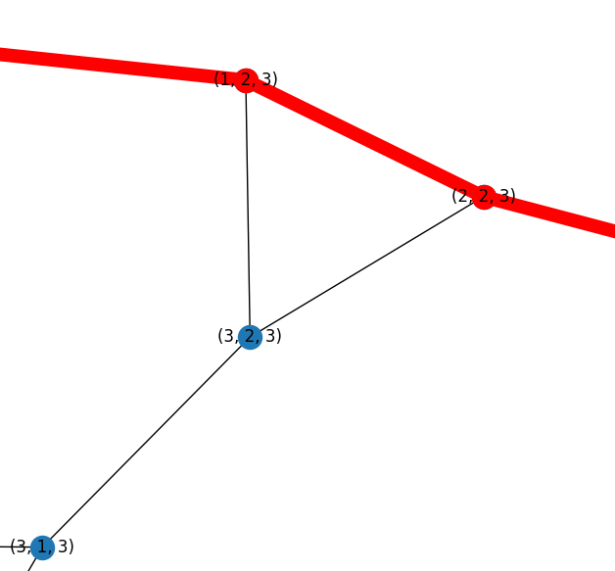
Graph is not Eulerian because not all nodes have even degrees, i.e. node (3, 2, 3)

